Slide 1
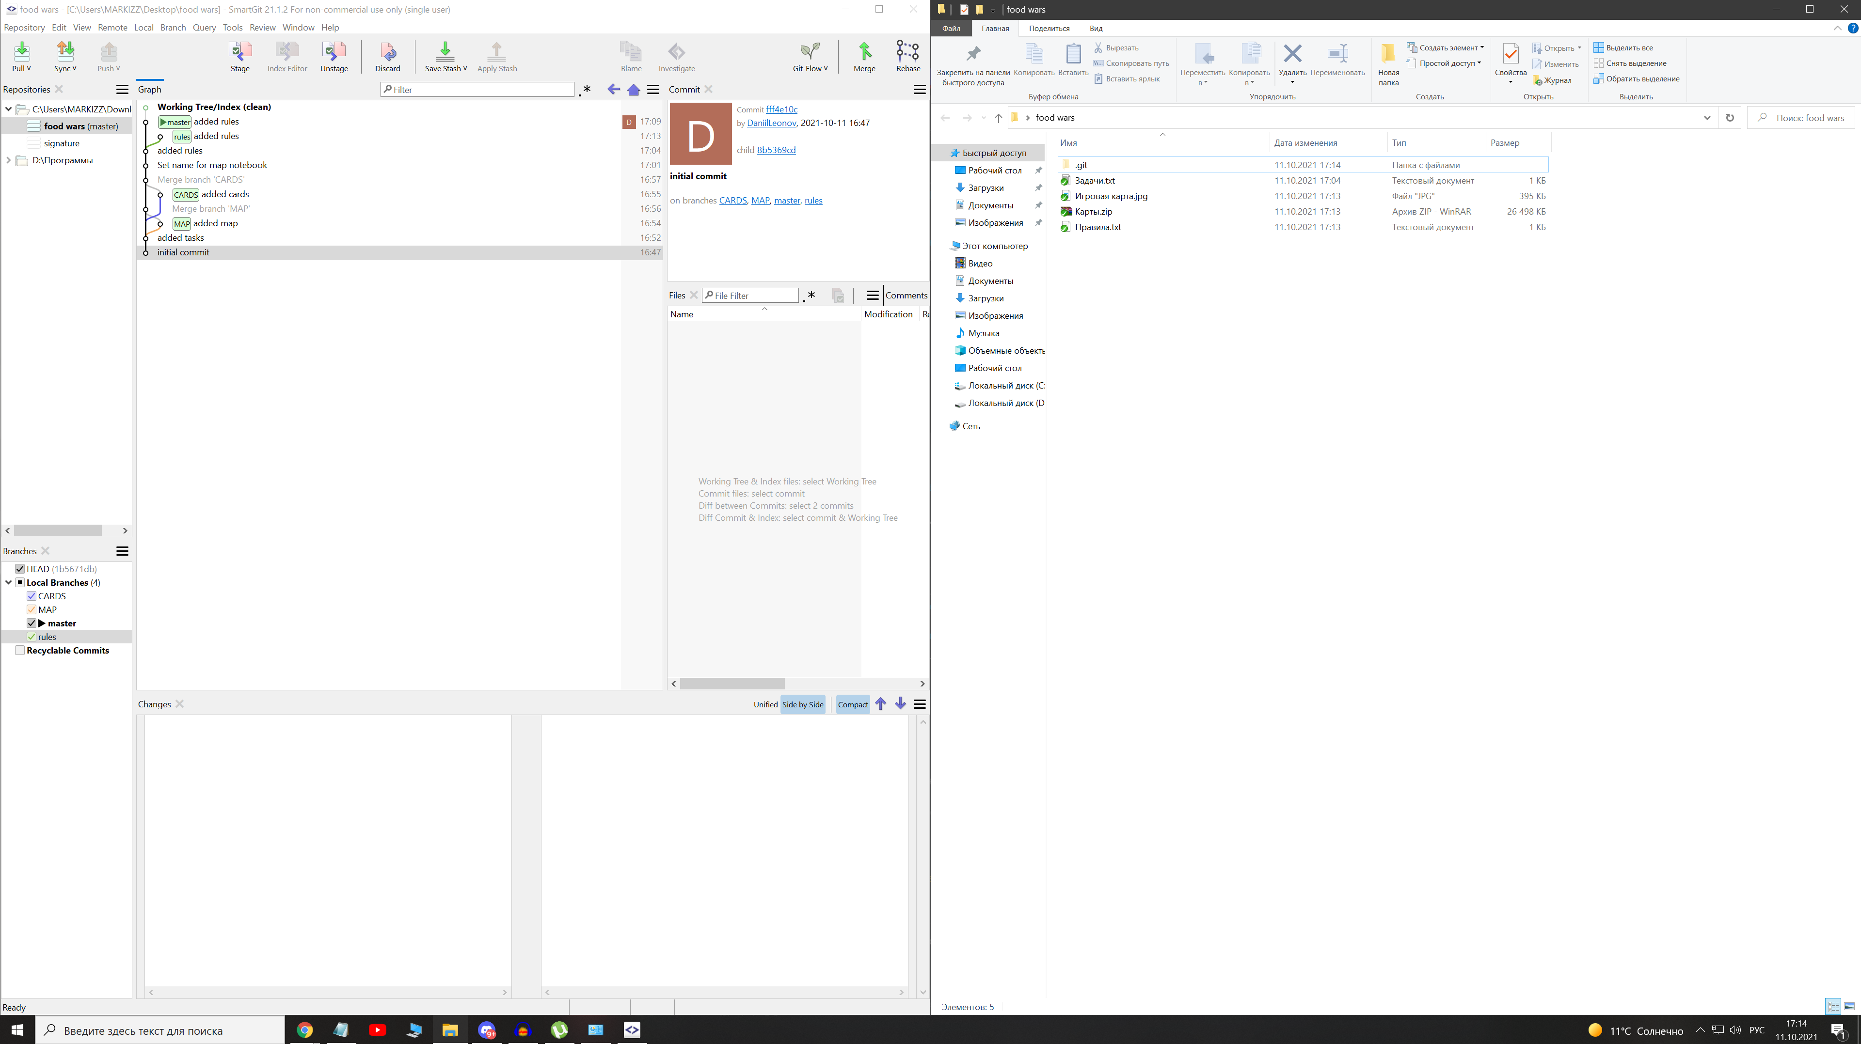
asdadsads
sdasdasd

