Slide 1
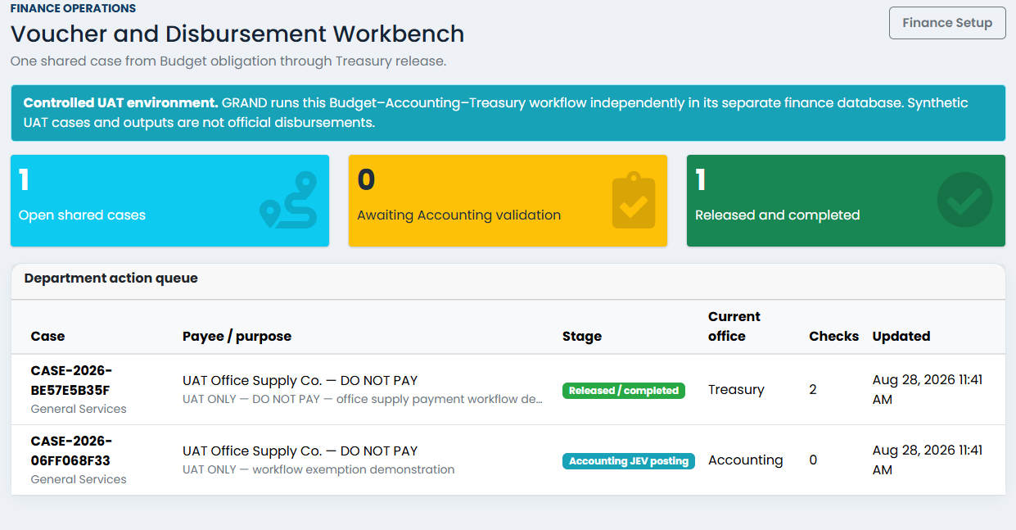
GRAND FINANCE
End-to-End UAT
Stakeholder Walkthrough
A standalone Budget–Accounting–Treasury cycle with controlled Excel templates, non-financial amendments, audit evidence, and configurable maker-checker controls.
11 PHASES · PASS
NO eGAPS RUNTIME
Synthetic UAT · 28 August 2026
Notes:
[Sources]
- C:/Users/Administrator/Desktop/GH/grand-finance-complete-cycle/output/uat/grand-finance-uat-20260828-113001/screenshots/phase-10-standalone-workbench.png
- C:/Users/Administrator/Desktop/GH/grand-finance-complete-cycle/output/uat/grand-finance-uat-20260828-113001/evidence/uat-results.json
[/Sources]

Slide 2
SAFETY BOUNDARY
Standalone by design
GRAND completes the workflow using only its local application services and a separately routed finance database.
GRAND web application
Separate finance database
Evidence
Role-aware work queues
Governed setup releases
Controlled voucher workflow
Append-only event history
Periods, funds, accounts
Balanced JEVs and ledger
Voucher posting snapshots
No cross-system credentials
XLSX
Screenshots
PPTX
Manifest
ROUTED
FILES
Isolation verified
Only the branch-local db.sqlite3 and grand_finance.sqlite3 were mutated. The primary GRAND checkout and eGAPS were not touched.
GRAND Finance · Synthetic UAT evidence
02
Notes:
[Sources]
- C:/Users/Administrator/Desktop/GH/grand-finance-complete-cycle/output/uat/grand-finance-uat-20260828-113001/evidence/uat-results.json
- C:/Users/Administrator/Desktop/GH/grand-finance-complete-cycle/output/uat/grand-finance-uat-20260828-113001/../
[/Sources]

Slide 3
ACTORS
Four named users, explicit departments
Budget Officer
Accounting Preparer
Accounting Reviewer
Treasury Officer
budget.officer
Budget
Opens and certifies the OBR
accounting.preparer
Accounting
Builds setup, DV, and JEV draft
accounting.reviewer
Accounting
Approves, validates, and posts
treasury.officer
Treasury
Issues, replaces, and releases checks
Department means assigned department
Permissions are explicit and department-scoped; superuser status does not automatically replace finance-office assignment or maker-checker rules.
GRAND Finance · Synthetic UAT evidence
03
Notes:
[Sources]
- C:/Users/Administrator/Desktop/GH/grand-finance-complete-cycle/output/uat/grand-finance-uat-20260828-113001/evidence/uat-results.json
[/Sources]

Slide 4
METHOD
The eleven-phase UAT cycle
1 Baseline
2 Users & roles
3 Excel authoring
4 Finance governance
5 Accounting setup
6 Budget & OBR
PASS
PASS
PASS
PASS
PASS
PASS
7 DV & signatures
8 Validation & posting
9 Signatory amendment
10 Treasury cycle
11 Scoped exemption
PASS
PASS
PASS
PASS
PASS
GRAND Finance · Synthetic UAT evidence
04
Notes:
[Sources]
- C:/Users/Administrator/Desktop/GH/grand-finance-complete-cycle/output/uat/grand-finance-uat-20260828-113001/evidence/uat-results.json
[/Sources]

Slide 5
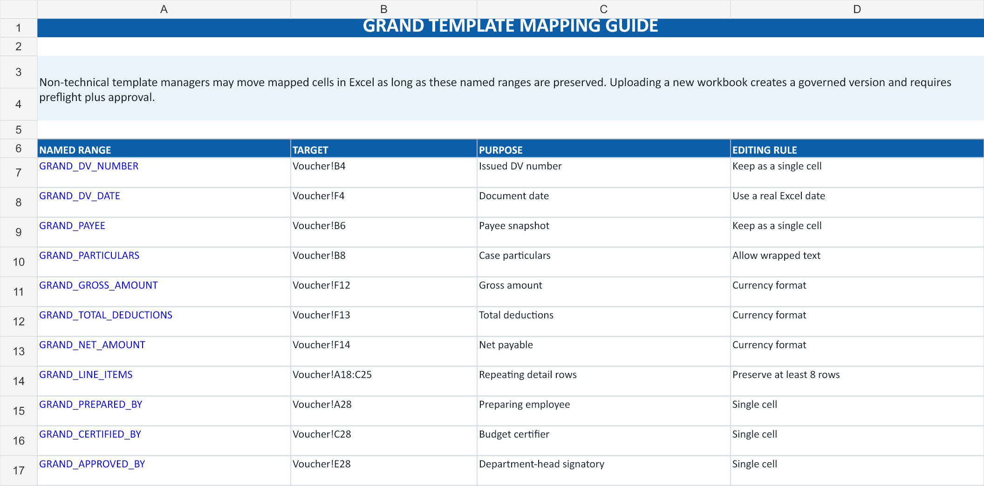
EXCEL TEMPLATE
Non-technical changes, controlled mappings
Eleven required named mappings
DV number · DV date · Payee · Particulars
Gross · Deductions · Net · Line items
Prepared by · Certified by · Approved by
Safe for ordinary Excel users
Edit labels, spacing, branding, and mapped cell placement. GRAND preflight rejects missing mappings, macros, external links, risky formulas, or unusable print areas before approval.
GRAND Finance · Synthetic UAT evidence
05
Notes:
[Sources]
- C:/Users/Administrator/Desktop/GH/grand-finance-complete-cycle/output/uat/grand-finance-uat-20260828-113001/workbooks/GRAND_UAT_DV_v1.xlsx
- C:/Users/Administrator/Desktop/GH/grand-finance-complete-cycle/output/uat/grand-finance-uat-20260828-113001/workbooks/GRAND_UAT_DV_v1-guide.png
[/Sources]

Slide 6
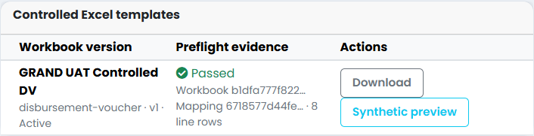
EXCEL TEMPLATE
Office 2016+ and Microsoft 365 compatibility
16.0
51
Real Excel engine
Standard .xlsx format
0
0
VBA projects
External links
Read-only verification
The authored template and both generated outputs opened successfully in Microsoft Excel 16 with macros forced off and link updates disabled; none was saved or altered.
GRAND Finance · Synthetic UAT evidence
06
Notes:
[Sources]
- C:/Users/Administrator/Desktop/GH/grand-finance-complete-cycle/output/uat/grand-finance-uat-20260828-113001/screenshots/phase-03-template-preflight.png
- C:/Users/Administrator/Desktop/GH/grand-finance-complete-cycle/output/uat/grand-finance-uat-20260828-113001/workbooks/GRAND_UAT_DV_v1.xlsx
- C:/Users/Administrator/Desktop/GH/grand-finance-complete-cycle/output/uat/grand-finance-uat-20260828-113001/workbooks/GRAND_UAT_DV_generated_v1.xlsx
- C:/Users/Administrator/Desktop/GH/grand-finance-complete-cycle/output/uat/grand-finance-uat-20260828-113001/workbooks/GRAND_UAT_DV_generated_v2_amended.xlsx
[/Sources]

Slide 7
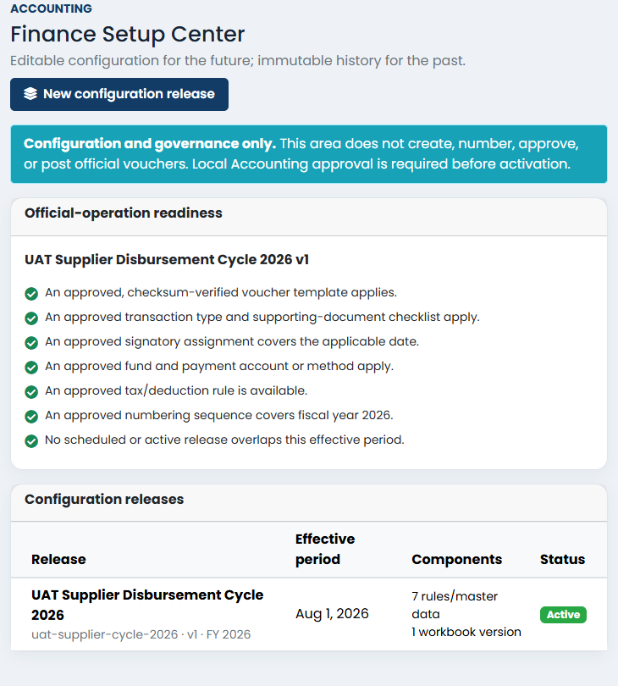
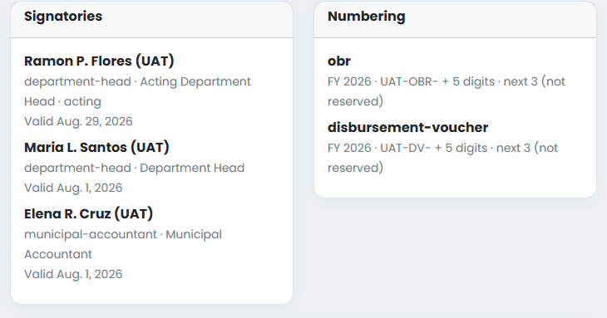
FINANCE GOVERNANCE
Approved release, ready before use
Release lifecycle
Accounting Preparer: preflight and submit
Accounting Reviewer: approve and activate
Result: Active, checksum-backed, immutable
GRAND Finance · Synthetic UAT evidence
07
Notes:
[Sources]
- C:/Users/Administrator/Desktop/GH/grand-finance-complete-cycle/output/uat/grand-finance-uat-20260828-113001/screenshots/phase-04-finance-readiness.png
- C:/Users/Administrator/Desktop/GH/grand-finance-complete-cycle/output/uat/grand-finance-uat-20260828-113001/screenshots/phase-04-signatories-numbering.png
[/Sources]

Slide 8
ACCOUNTING READINESS
Posting rules resolve before Treasury
Period
Fund
Center
August 2026 · Open
general-fund
gso
Expense
Payable
Withholding
5-02-03
2-01-01
2-02-EWT
Mapping contract
ordinary-supplier-claim → Accounts payable; ewt → Withholding payable. The voucher snapshot materializes into an independently submitted and posted GRAND JEV.
GRAND Finance · Synthetic UAT evidence
08
Notes:
[Sources]
- C:/Users/Administrator/Desktop/GH/grand-finance-complete-cycle/output/uat/grand-finance-uat-20260828-113001/evidence/uat-results.json
[/Sources]

Slide 9
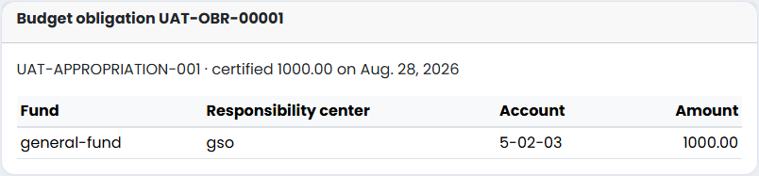
BUDGET
Stable OBR identity and allocation trace
OBR
UAT-OBR-00001
₱1,000.00 certified
Source
UAT-APPROPRIATION-001
General Fund · GSO · 5-02-03
One case continues forward—users do not re-enter the same obligation in separate modules.
GRAND Finance · Synthetic UAT evidence
09
Notes:
[Sources]
- C:/Users/Administrator/Desktop/GH/grand-finance-complete-cycle/output/uat/grand-finance-uat-20260828-113001/screenshots/phase-06-budget-obr.png
[/Sources]

Slide 10
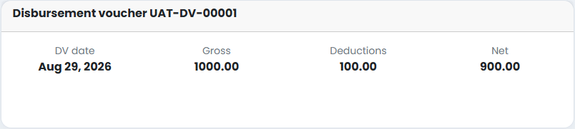
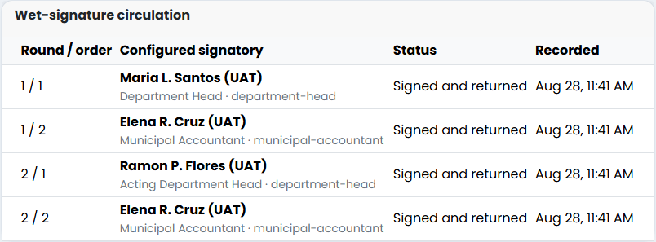
DISBURSEMENT VOUCHER
Amounts and wet signatures stay visible
DV UAT-DV-00001
Gross ₱1,000.00
EWT ₱100.00
Net ₱900.00
Synthetic signatories
Round 1
Maria L. Santos (UAT)
Elena R. Cruz (UAT)
Round 2
Ramon P. Flores (UAT)
Elena R. Cruz (UAT)
GRAND Finance · Synthetic UAT evidence
10
Notes:
[Sources]
- C:/Users/Administrator/Desktop/GH/grand-finance-complete-cycle/output/uat/grand-finance-uat-20260828-113001/screenshots/phase-07-dv-amounts.png
- C:/Users/Administrator/Desktop/GH/grand-finance-complete-cycle/output/uat/grand-finance-uat-20260828-113001/screenshots/phase-07-wet-signatures.png
[/Sources]

Slide 11
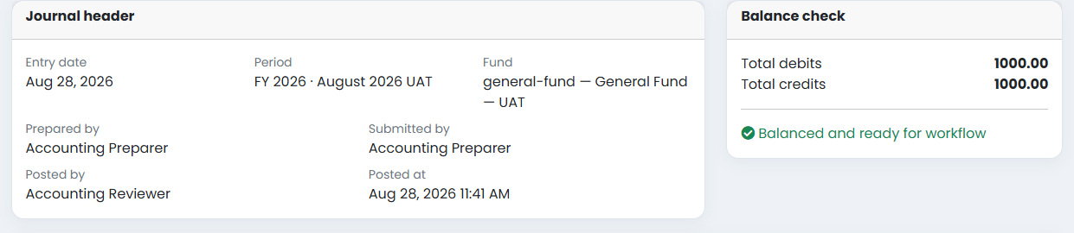
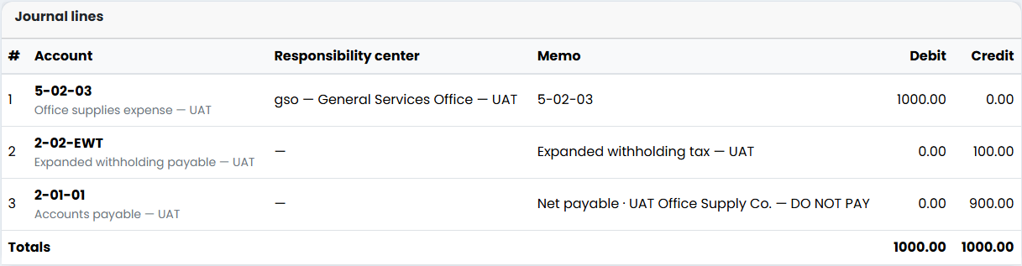
ACCOUNTING
Independent validation and balanced posting
GRAND Finance · Synthetic UAT evidence
11
Notes:
[Sources]
- C:/Users/Administrator/Desktop/GH/grand-finance-complete-cycle/output/uat/grand-finance-uat-20260828-113001/screenshots/phase-08-jev-header-balance.png
- C:/Users/Administrator/Desktop/GH/grand-finance-complete-cycle/output/uat/grand-finance-uat-20260828-113001/screenshots/phase-08-jev-lines.png
[/Sources]

Slide 12
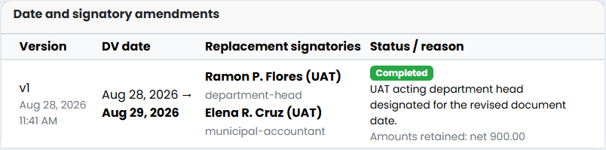
CONTROLLED CORRECTION
Change dates and signatories without re-entry
Before
After
DV NUMBER PRESERVED
DV date: Aug 28, 2026
Approved by: Maria L. Santos (UAT)
Net: ₱900.00
AMEND
DV date: Aug 29, 2026
Approved by: Ramon P. Flores (UAT)
Net: ₱900.00
POSTED JEV PRESERVED
GRAND Finance · Synthetic UAT evidence
12
Notes:
[Sources]
- C:/Users/Administrator/Desktop/GH/grand-finance-complete-cycle/output/uat/grand-finance-uat-20260828-113001/screenshots/phase-09-signatory-amendment.png
- C:/Users/Administrator/Desktop/GH/grand-finance-complete-cycle/output/uat/grand-finance-uat-20260828-113001/evidence/uat-results.json
[/Sources]

Slide 13
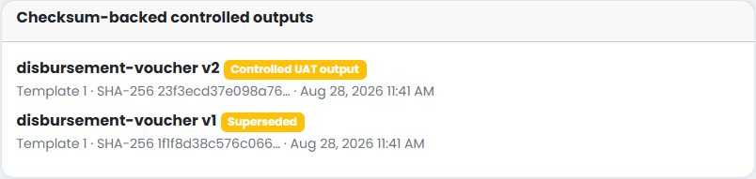
CONTROLLED OUTPUT
Original retained, revised workbook becomes current
v1 · Superseded
Original workbook remains downloadable evidence with its own SHA-256 checksum.
v2 · Controlled UAT output
Revised date and signatories; same DV number, same amounts, same posted JEV.
Why this matters
Users can correct common non-financial fields before check issuance while preserving a clear before/after trail instead of cancelling and re-entering the whole transaction.
GRAND Finance · Synthetic UAT evidence
13
Notes:
[Sources]
- C:/Users/Administrator/Desktop/GH/grand-finance-complete-cycle/output/uat/grand-finance-uat-20260828-113001/screenshots/phase-09-versioned-outputs.png
- C:/Users/Administrator/Desktop/GH/grand-finance-complete-cycle/output/uat/grand-finance-uat-20260828-113001/workbooks/GRAND_UAT_DV_generated_v1.xlsx
- C:/Users/Administrator/Desktop/GH/grand-finance-complete-cycle/output/uat/grand-finance-uat-20260828-113001/workbooks/GRAND_UAT_DV_generated_v2_amended.xlsx
[/Sources]

Slide 14
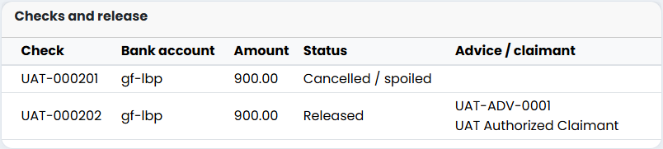
TREASURY
Cancelled numbers remain consumed
Control results
Post-check date/signatory amendment: BLOCKED
Cancelled check reuse: BLOCKED
Replacement lineage: RETAINED
Release amount: ₱900.00
UAT-000201 · CANCELLED
UAT-000202 · RELEASED
UAT-ADV-0001
UAT-RECEIPT-0001
GRAND Finance · Synthetic UAT evidence
14
Notes:
[Sources]
- C:/Users/Administrator/Desktop/GH/grand-finance-complete-cycle/output/uat/grand-finance-uat-20260828-113001/screenshots/phase-10-check-lineage.png
- C:/Users/Administrator/Desktop/GH/grand-finance-complete-cycle/output/uat/grand-finance-uat-20260828-113001/evidence/uat-results.json
[/Sources]

Slide 15
END-TO-END STATUS
One shared case reaches Completed
GRAND Finance · Synthetic UAT evidence
15
Notes:
[Sources]
- C:/Users/Administrator/Desktop/GH/grand-finance-complete-cycle/output/uat/grand-finance-uat-20260828-113001/screenshots/phase-10-standalone-workbench.png
[/Sources]

Slide 16
CONFIGURABLE CONTROL
Exception is explicit, scoped, and temporary
1 · Strict default
2 · Authorized exception
3 · Restore
Accounting Preparer attempts to validate their own DV.
Result: BLOCKED by maker-checker control.
Group: UAT Combined Accounting Exception
Control: dv-preparer-self-validation
Department: Accounting
Audit snapshot retained.
Policy deactivated
Membership removed
Control returns to strict default
SCOPE
CLOSE
User-friendly without becoming invisible
Exceptions are named, department-scoped, time-bound, and copied into immutable workflow evidence—not hidden in code or granted as blanket superuser power.
GRAND Finance · Synthetic UAT evidence
16
Notes:
[Sources]
- C:/Users/Administrator/Desktop/GH/grand-finance-complete-cycle/output/uat/grand-finance-uat-20260828-113001/evidence/uat-results.json
[/Sources]

Slide 17
ASSESSMENT
What GRAND improves over the legacy approach
Architecture
Standalone database and runtime
No dependency on the legacy application
Navigation
Role-aware queues and one shared case
Less duplicate encoding and status hunting
Templates
Named Excel mappings + governed releases
Non-technical layout changes with preflight
Corrections
Pre-check non-financial amendment
No cancel/re-entry for dates or signatories
Controls
Maker-checker + scoped exemption
Strict by default, configurable with evidence
Audit
Checksums, versions, events, JEV trace
Clear before/after and source lineage
GRAND Finance · Synthetic UAT evidence
17
Notes:
[Sources]
- C:/Users/Administrator/Desktop/GH/grand-finance-complete-cycle/output/uat/grand-finance-uat-20260828-113001/evidence/uat-results.json
- C:/Users/Administrator/Desktop/GH/grand-finance-complete-cycle/output/uat/grand-finance-uat-20260828-113001/screenshots/phase-10-standalone-workbench.png
[/Sources]

Slide 18
UAT CONCLUSION
The complete cycle works
inside GRAND.
Ready for guided manual UAT
The branch retains complete synthetic records and leaves room for repair work before any official-use decision.
Still intentionally limited
Passed: governed Excel template, OBR, DV, wet signatures, balanced JEV, non-financial amendment, check replacement, bank advice, release, and scoped exemption.
Synthetic data only; no real payment, official check printing, bank transmission, production cutover, or Records filing.
11 / 11 PHASES PASSED
42 FINANCE TESTS PASSED
EXCEL 16 VERIFIED
Next: stakeholder review → repair backlog → guided full-cycle manual UAT.
Notes:
[Sources]
- C:/Users/Administrator/Desktop/GH/grand-finance-complete-cycle/output/uat/grand-finance-uat-20260828-113001/evidence/uat-results.json
- C:/Users/Administrator/Desktop/GH/grand-finance-complete-cycle/output/uat/grand-finance-uat-20260828-113001/evidence/UAT_Evidence_Manifest.md
[/Sources]

