Slide 1
Brian decoding of emotional reactivity and regulation
Jinxiao Zhang
PSYCH 253

Slide 2
Sample
162 adult woman
40 healthy controls
121 breast cancer (BC) patients
Today
1 subject: BC patient, 37 yrs
Data: 115 trials

Slide 3
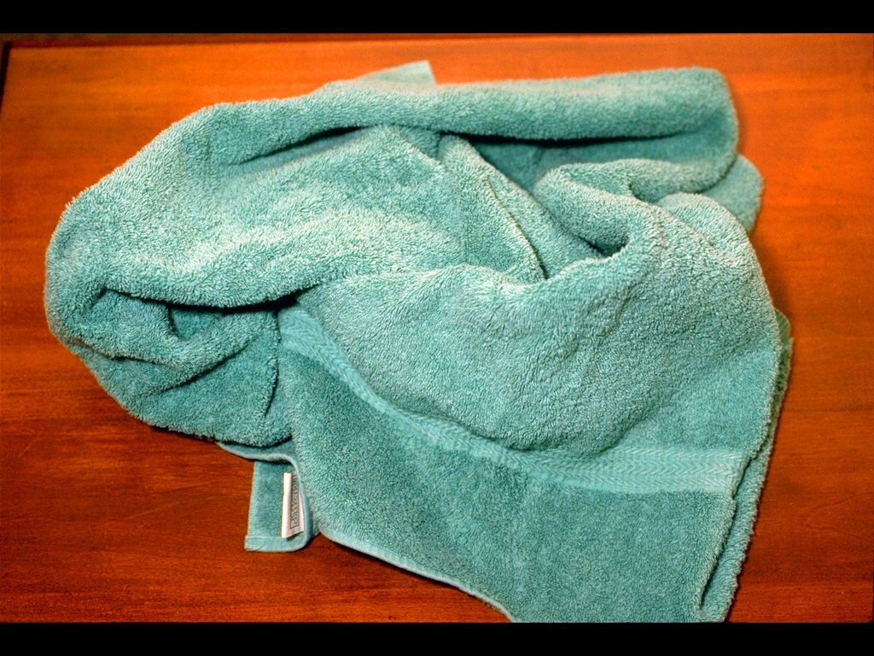

fMRI Experiment
neutral
+
cue word
negativity rating
(1-7)
Negative-react
2-8 s
2 s
4 s
Negative-regulate
6 s
5 runs of 23 trials = 115 trials

Slide 4
Goal
To predict trial-type (neutral, negative-react, negative-regulate) from BOLD signal
Compare the performance of different brain regions
Candidate brain regions:
Amygdala (reactivity)
Anterior cingulate cortex (regulation)
Lateral PFC (regulation)

Slide 5
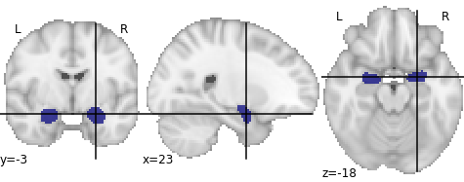
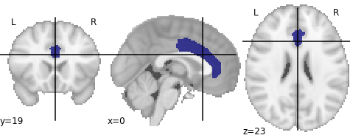
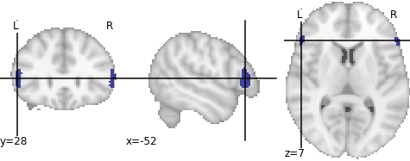
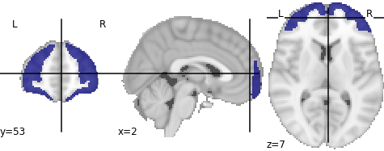
Data
fMRI data preprocessed by fmriprep
Normalized feature-wise
No further denoise or filter
Amygdala: 494 voxels
ACC: 1496 voxels
lPFC: 241 voxels
Frontal pole: 9691 voxels

Slide 6
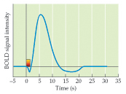
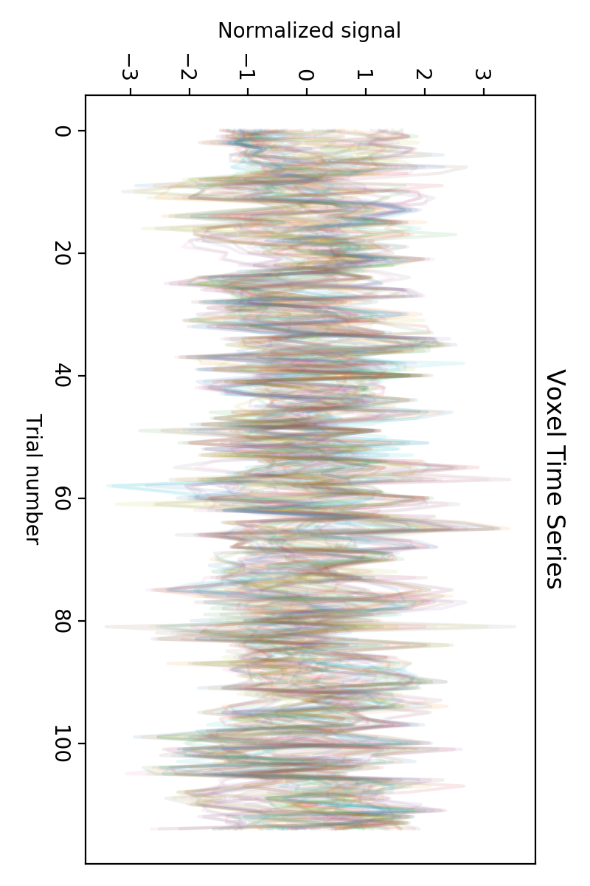
Data
2-14s after stimulus onset

Slide 7
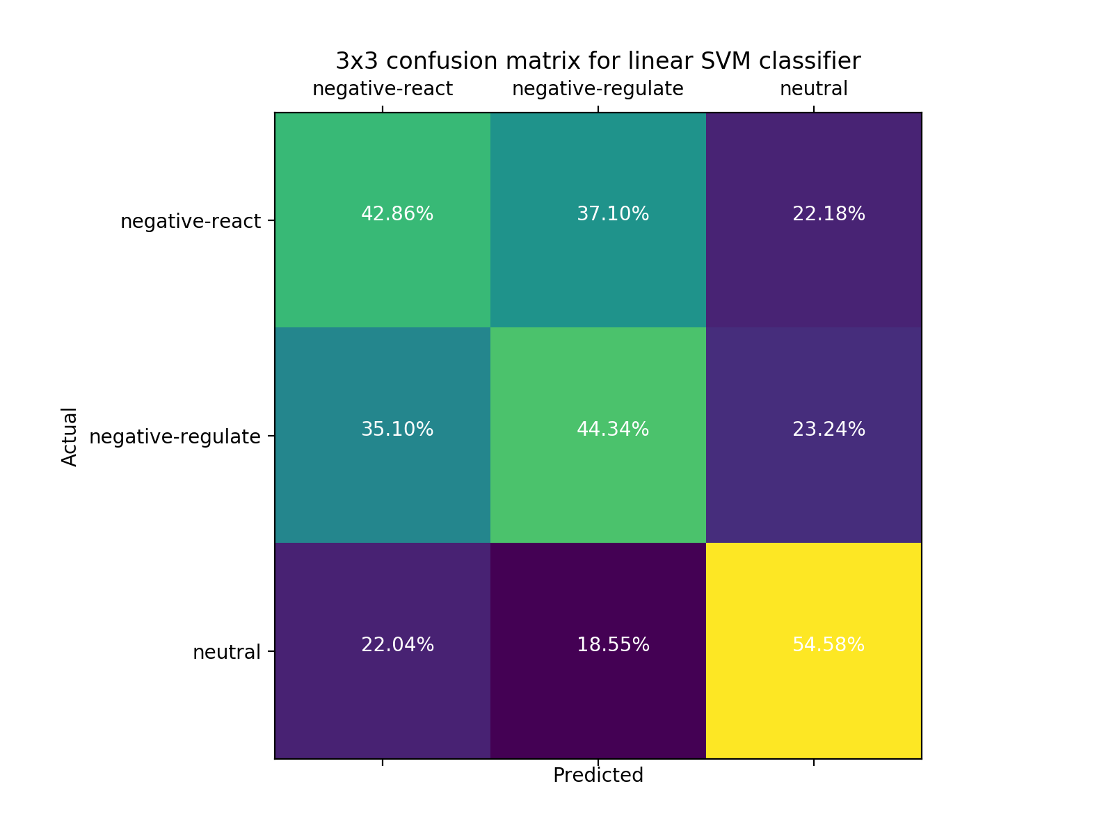
SVM results
Amygdala: 494 voxels
test accuracy: 47.5%
Notes:
# amygdala
# train accuracy: 0.802
# test accuracy: 0.47733333333333333
# test d-prime: [0.38094803 0.41302117 0.95500438]

Slide 8
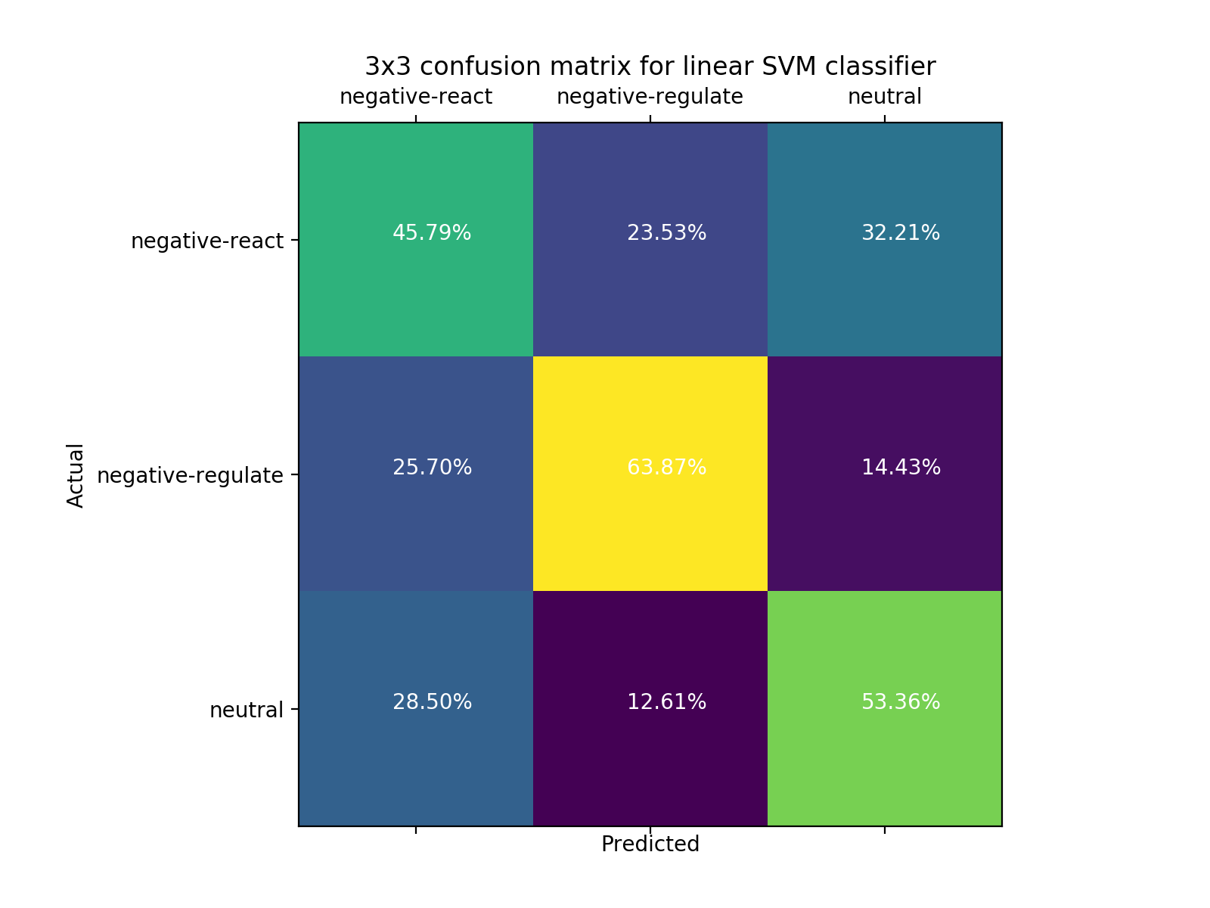
SVM results
ACC: 1496 voxels
test accuracy: 54.5%
Notes:
# ACC
# train accuracy: 0.9748888888888888
# test accuracy: 0.5453333333333333
# test d-prime: [0.45816609 1.22040147 0.93658042]

Slide 9
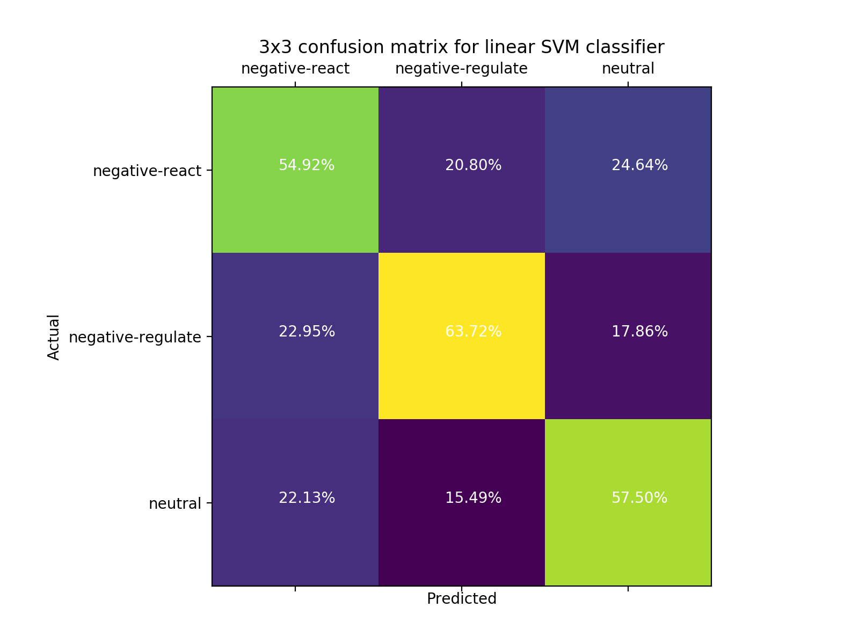
SVM results
lPFC: 241 voxels
test accuracy: 58.5%
Notes:
# IFG
# train accuracy: 0.9273333333333335
# test accuracy: 0.5853333333333334
# test d-prime: [0.86255465 1.16982119 1.08192212]

Slide 10
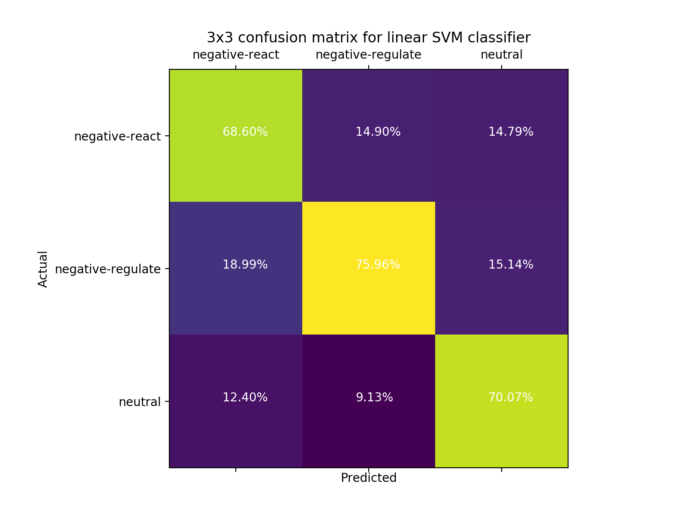
SVM results
Frontal pole: 9691 voxels
test accuracy: 71.2%
Notes:
# frontal pole
# train accuracy: 1.0
# test accuracy: 0.7119999999999999
# test d-prime: [1.53382265 1.61870664 1.78158357]

Slide 11
Questions
Voxel/feature selection? Dimension deduction?
Interpret/visualize SVM parameters?
Recommendation for PFC atlas?
Denoise to improve performance?
Notes:
Dan and Russ:
-Broadly widen the regularization range
-instead of 3-way classification, try 2 2-way classification to understand the reactivity and regulation questions better
-for feature selection, try L1 regularization to see if the performance is very different from L2 regularization (if yes, feature selection is likely to make a difference)
-in terms of HRF, 2-14s is kinda wide. Try different time windows and maybe weigh time points differently. Different brain regions could have very different HRF

Slide 12
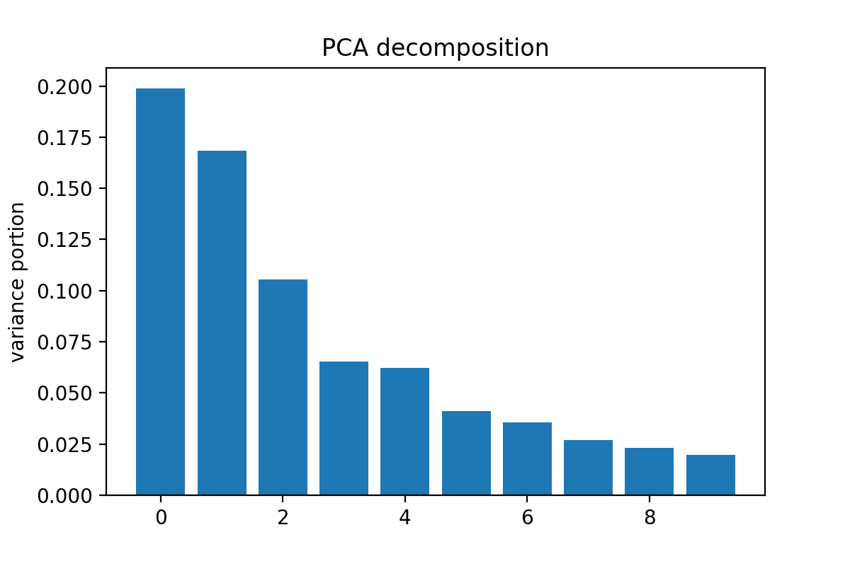
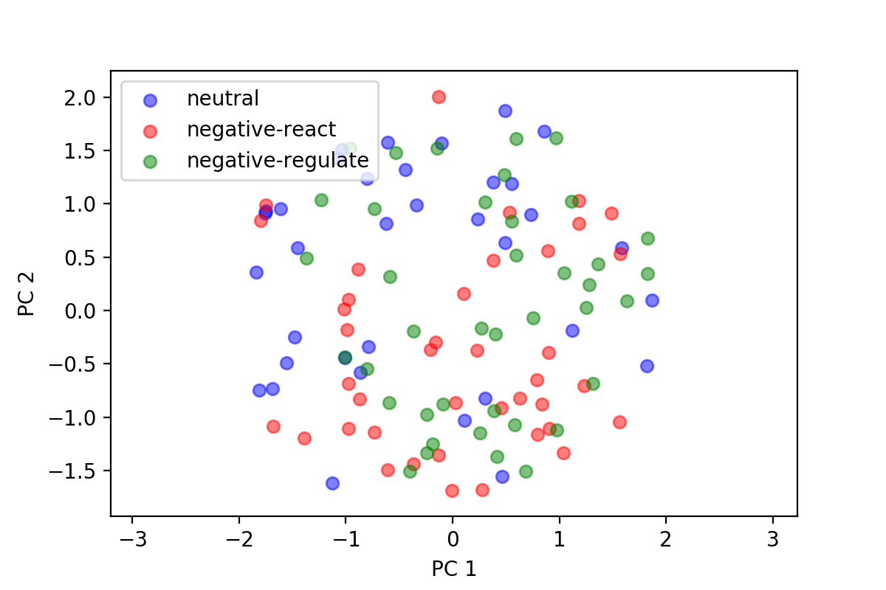
PCA decomposition
Amygdala: 494 voxels

Slide 13
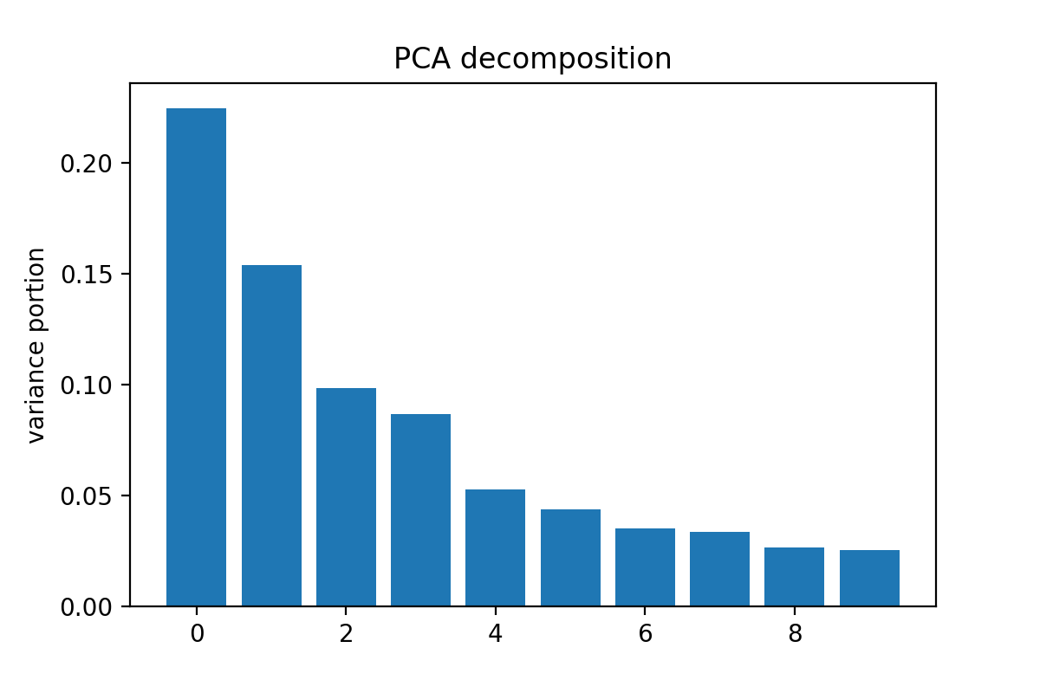
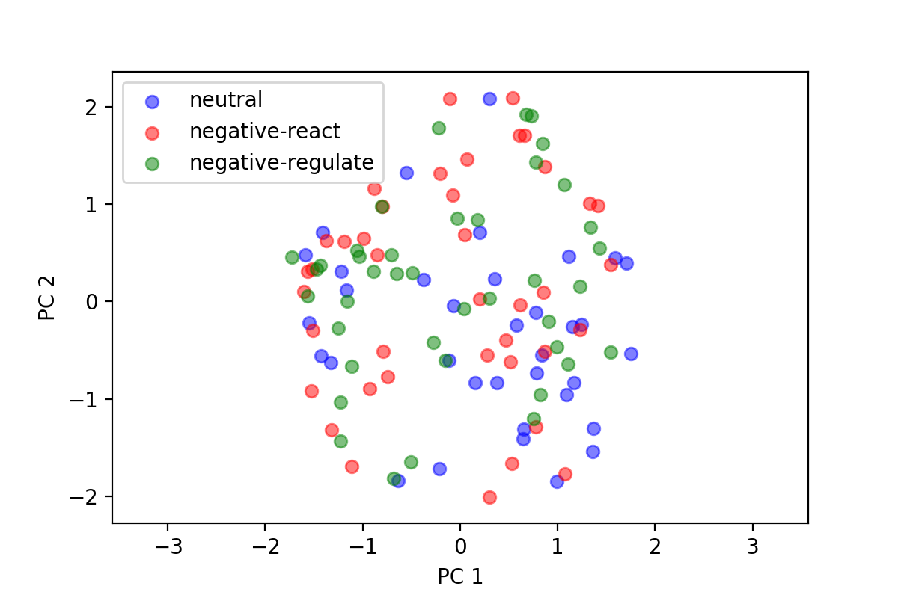
PCA decomposition
lPFC: 241 voxels

