Slide 1

♪ play
TEQGRID · HANDS-ON SEMINAR
Meet TEQGRID
ResumeFit · match a resume to a job with a real AI API
React Native + Google Gemini · live on a phone

Slide 2
TODAY
♪ play
How we will run this room
01
My intro
Who is teaching today
02
TEQGRID intro
Why we are here
03
Project intro
What ResumeFit does
04
React Native structure
How a phone app is wired
05
Google API key
Create your own Gemini key
06
How the app works
PDF + JD → score
07
Student Q&A
Your questions
08
10-question quiz
Scan the QR · top 3 win
09
Thank you
♪ music on title, quiz, winners
Meet TEQGRID · ResumeFit seminar
2 / 24

Slide 3
01 · SPEAKER
Hi — I am Aishwarya Rastogi
Who I am
How I will teach
Aishwarya Rastogi
React Native developer
I ship small phone apps with real APIs
No mock screens for this seminar
Today I will teach from a live app
on a real iPhone — ResumeFit.
One idea → one file → one question
We will not open 20 files
You will see: input, API, result
Ask anytime. Wrong answers are useful.
The quiz at the end uses this talk.
Meet TEQGRID · ResumeFit seminar
3 / 24

Slide 4
02 · TEQGRID
Why TEQGRID brought you here
• TEQGRID trains builders — not slide readers.
• Line we use in production: frontend → backend → AI.
• Today you learn the AI middle: a phone calls Gemini and shows JSON.
• A backend would hide the key. We skip it so you can see the full feature.
• Goal: leave able to clone, paste your key, and change one prompt line.
• Participation is the point. The quiz is how we pick the top 3.
Meet TEQGRID · ResumeFit seminar
4 / 24

Slide 5
03 · PROJECT
ResumeFit — a junior recruiter on a phone
The product
What comes back
Upload a PDF resume
Paste a job description
Tap Analyze match
Gemini reads both
You get a score you can argue with
Match score 0–100
Matching skills (green chips)
Missing skills (red chips)
Experience alignment
3 concrete resume edits
React Native CLI — not Expo
Meet TEQGRID · ResumeFit seminar
5 / 24

Slide 6
03 · PROJECT
This is a feature, not ChatGPT in a browser
• User gives input → our app calls an API → user sees a usable result.
• We are not training a model. We are calling one.
• Weather API returns temperature. Gemini returns text. We force JSON.
• Two inputs only: resume PDF + job description.
• No fake analysis. If the key or the model fails, you see the real error.
Ask: what two inputs does this feature need? Wait for: PDF + JD.
Meet TEQGRID · ResumeFit seminar
6 / 24

Slide 7
APPLICATION WORKING STRUCTURE
04
How a React Native app is structured
Meet TEQGRID · ResumeFit seminar
7 / 24

Slide 8
04 · REACT NATIVE
One JavaScript/TypeScript app → two phones
1
2
3
JS / TS layer
Screens, state, fetch(). HomeScreen and ResultScreen live here. Same code for iOS and Android.
Native layer
iOS (Swift + Xcode) and Android (Kotlin + Gradle) host the JS. Camera, files, splash, icon.
Metro
Dev server on your Mac. The phone loads index.js from 8081. Change JS → Fast Refresh.
Meet TEQGRID · ResumeFit seminar
8 / 24

Slide 9
04 · REACT NATIVE
Folders you will actually open today
• App.tsx + src/navigation — which screen is showing
• src/screens/HomeScreen.tsx — pick PDF, paste JD, tap Analyze
• src/screens/ResultScreen.tsx — dumb UI. It only draws JSON.
• src/api/pickResume.ts — system file picker, PDF only
• src/api/gemini.ts — URL, key, prompt, fetch, parse
• .env — GEMINI_API_KEY. Never commit this file.
• ios/ and android/ — splash, icons, signing. Rebuild after native changes.
Stay in 3 files for the live walk: pickResume.ts, gemini.ts, HomeScreen.tsx.
Meet TEQGRID · ResumeFit seminar
9 / 24

Slide 10
04 · THIS CODE
React Native app cycle — ResumeFit as it is wired today
1 Native boot
iOS / Android looks up app.json name ResumeFit
2 index.js
AppRegistry.registerComponent → App
3 App.tsx
GestureHandler + SafeArea + navigator
4 navigation
Stack: Home first, then Result
8 ResultScreen
Draws the JSON only. Does not re-score.
7 gemini.ts
POST generateContent · Flash Lite JSON
6 pick + base64
pickResume.ts then uriToBase64(pdf)
5 HomeScreen
onPickResume + paste JD + onAnalyze
Live path in this repo
HomeScreen.onAnalyze → uriToBase64 + analyzeResumeMatch (src/api/gemini.ts) → navigation.navigate('Result', { analysis }).
Key files: index.js · App.tsx · src/navigation/index.tsx · HomeScreen.tsx · pickResume.ts · gemini.ts · ResultScreen.tsx · .env
Meet TEQGRID · ResumeFit seminar
10 / 24

Slide 11
FREE KEY · 4 MINUTES
05
Generate a Google Gemini API key
Meet TEQGRID · ResumeFit seminar
11 / 24

Slide 12
05 · GOOGLE AI STUDIO
Create your own key — do not share one room key
1. Open https://aistudio.google.com/apikey (Google account).
2. Click Create API key. Pick or create a Google Cloud project if asked.
3. Copy the key once. Treat it like a password.
4. In the project: cp .env.example .env
5. Paste: GEMINI_API_KEY=your_key (no quotes, no extra space).
6. Restart Metro. The app reads .env only at start.
7. If 40 people hammer one key you get 429 / quota. Each student = one key.
This classroom key lives on the phone. Play Store? Put the key on YOUR server.
Meet TEQGRID · ResumeFit seminar
12 / 24

Slide 13
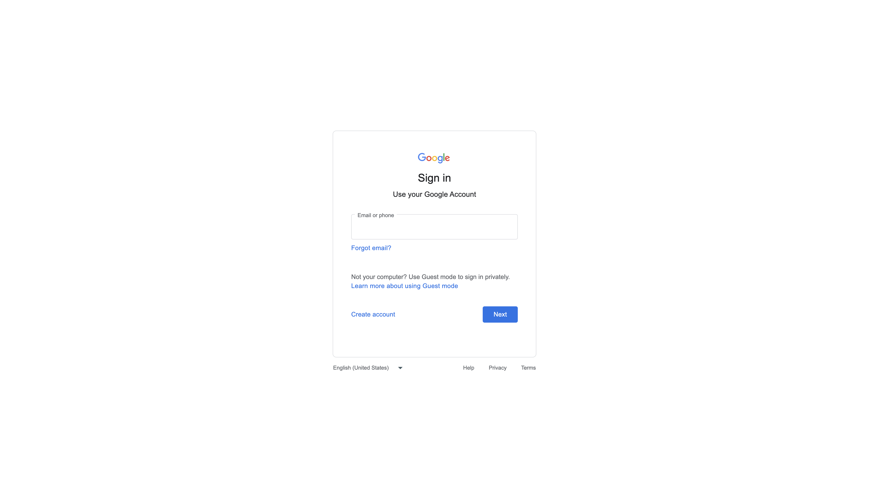
05 · GOOGLE AI STUDIO
Gemini key — official steps (click the blue chips)
1
Sign in with a Google account
2
Open aistudio.google.com/apikey
3
Create API key · pick / create a Cloud project
4
Copy the key once · treat it like a password
5
cp .env.example .env then GEMINI_API_KEY=…
6
Restart Metro · never commit .env
Official docs screenshot · ai.google.dev
Create key → aistudio.google.com/apikey
API key docs
Quickstart
Never paste the key in Slack, GitHub, or this deck. Classroom demo keeps it in .env on the phone. Play Store → put the key on YOUR server.
Meet TEQGRID · ResumeFit seminar
13 / 24

Slide 14
THE LIVE PATH
06
How ResumeFit actually works
Meet TEQGRID · ResumeFit seminar
14 / 24

Slide 15
06 · FLOW
What happens when they tap Analyze
1. Phone has a PDF + a job description
2. App converts the PDF to base64 (JSON cannot carry a raw file)
3. POST to Gemini generateContent (gemini-3.1-flash-lite)
4. Prompt says: recruiter, be honest, do not invent skills, return this JSON
5. Gemini reads PDF + JD and returns score, chips, 3 edits
6. Result screen only displays that JSON — it does not re-score
There is no backend today. The phone talks to Google.
Meet TEQGRID · ResumeFit seminar
15 / 24

Slide 16
06 · THREE FILES
The working path — do not rewrite the app
The letter
The files
Address = URL (generateContent)
Stamp / ID = API key
Body = prompt + PDF
Reply = JSON
text = instructions + job
inline_data = PDF as base64
pickResume.ts — picker, cancel = null
gemini.ts — key, parts, fetch, parse
HomeScreen.tsx — validate, load, navigate
setLoading(true) before the network.
finally { setLoading(false) } always.
Meet TEQGRID · ResumeFit seminar
16 / 24

Slide 17
06 · PROMPT
The model follows the prompt, not a magic HR API
• Role: you are a recruiter.
• Task: compare this resume PDF to this job description.
• Constraints: be honest; if not a resume, score 0; do not invent skills.
• Output contract: exact JSON keys the Result screen already uses.
• temperature 0.2 — scoring wants boring and repeatable.
• If green chips show skills that are not on the PDF, fix the prompt, not the CSS.
Live tweak: change “recruiter” to “strict hiring manager.” Same API, different score.
Meet TEQGRID · ResumeFit seminar
17 / 24

Slide 18
♪ play
YOUR TURN
07
Student Q&A
Meet TEQGRID · ResumeFit seminar
18 / 24

Slide 19
07 · Q&A
♪ play
Ask anything. If the room is quiet, start here.
• Why PDF, not Word? — one path; Gemini document understanding likes PDF.
• Why base64, not Drive? — Drive needs login. Base64 = one POST.
• Shared key for 40 students? — quota dies. Each person uses their own key.
• Is the score “true”? — no. Model opinion under our prompt.
• Match 3 jobs? — loop the same function three times.
• Scanned photo resume? — often yes. Prefer a real text PDF for the demo.
Write one question on a slip if you do not want to speak.
Meet TEQGRID · ResumeFit seminar
19 / 24

Slide 20

♪ play
08 · QUIZ
Meet TEQGRID
Scan the QR and take the 10-question quiz
Phones up · one scan each · top 3 win
Scan to start the quiz
Meet TEQGRID · ResumeFit seminar
20 / 24

Slide 21
♪ play
QUIZ WINNERS
Top 3 students take the quiz
1st
2nd
3rd
Gold
Silver
Bronze
Meet TEQGRID · ResumeFit seminar
23 / 24

Slide 22
♪ play
THANK YOU
Clone. Paste your key. Change one prompt line.
aistudio.google.com/apikey
github.com/teqgrid/resume-fit
npm start then npm run ios / npm run android
questions anytime · TEQGRID
Meet TEQGRID · ResumeFit seminar
24 / 24

