Slide 1

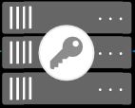



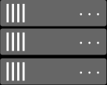





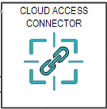



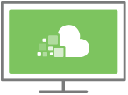






TestRG9NSG
TestRG9
RESOURCE GROUP
AZRG10
VIRTUAL NETWORK
TestRG9VNet
trg9winag3
LICENSE SERVER (Optional)
trg9ub
TestRG9CentosLicenseS
trg9centag
SUBNETS
(SUBNET-CONNECTOR, SUBNET-WORKSTATIONS, GATEWAYSUBNET)
TCP 60443
TestRG9VNGWtoAZRG10VNGW
LOCAL NETWORK GATEWAY
TestRG9VNGW
AZRG10LNGW
REMOTE WORKSTATIONS
PCOIP AGENT(S)
Site-to-Site VPN Connection
TCP 443
PCoIP CONNECTION
TCP 60443, TCP 443
TCP 4172, UDP 4172
TestRG9UbuntuCACv2
TCP 443/636
VIRTUAL NETWORK GATEWAY
AZRG10VNGWtoTestRG9VNGW
AZRG10VNGW
TCP 443/80
TestRG9LNGW
PCoIP CLIENTS
NETWORK SECURITY GROUP
AZRG10NSG
AZRG10VNet
SUBNETS
(SUBNET-CONNECTOR, SUBNET-WORKSTATIONS, GATEWAYSUBNET)
CLOUD ACCESS MANAGER
TestRG9WinDC

