Slide 1
The Development of Agile Culture in Full-Service Agencies
Munich, June 23th 2017

Slide 2
ABOUT mE
Dan Fitzpatrick @terafitz | Technical Director, Triplesense Reply

Slide 3
AgIle: TSR vs. Classic
Differences
Analysis
Measures
Roles & Responsibilities
Methodology of Estimation
Feedback & Discussion

Slide 4
Agile methods, while offering solutions to many common problems in software development projects, often require adaptation.

Slide 5
TSR vs. Classic: the differences
During the transition from waterfall to agile project management, we discovered that
AGILE METHODS ARE OFTEN TOO INFLEXIBLE, DUE TO…
The project landscape
Project duration and variety
Project demographics
Issue-tracking and priorisation
Notes:
Pitch Projects!
Disruptions are often too large-scale to be compensated with the usuall agile mechanisms
It is difficultto complete the same sprint started

Slide 6
TSR vs. Classic: analysis
TSR PROJECTS GENERALLY INVOLVE FOUR+ PROFESSIONS
The level of interdependancy is much higher
Avoiding the agile waterfall horror
Deficits in co-ordination have an immediate impact during the sprint cycle

Slide 7
TSR vs. Classic: analysis
THERE IS A PREDICTABLE, DISRUPTIVE PATTERN IN VELOCITY
Sprint 1: ramp-up
Sprint 2: co-ordination and communication
Sprint n: safely including the customer
Oh! We have to talk to one another!
Client feedback plays an increasing role
Opening the toolbox
Notes:
Start up is a repetitve process. It can be done independantly

Slide 8
TSR vs. Classic: Methodology
Challenge: how to integrate creative experts into the agile workflow.
AGILE METHODOLOGY OFFERS FOUR POSSIBILITIES
Big Upfront Design
Just in Time
Sprint Pairs
Design Spikes
Notes:
Upfront Design’
Design resources operate in advance of development resources before a release
Designs may be used for estimating and reducing risk
Works well for prototyping / proof-of-concept work
‘Just in Time’
Design done within a sprint
Typically requires predefined and commonly used chunks of design
Requires a lot of collaboration
Iterative with parallel efforts and predicted throw-away work
Easier to track
‘Design Spikes’
Not developing a shippable product increment
Interrupt a normal Sprint
Typically used by architects to address technical exploration
‘Sprint Pairs’
Design works a sprint ahead of development
Scope is traded off for designing within time box
Respects functional dependencies

Slide 9
TSR vs. Classic: Methodology
Challenge: how to integrate creative experts into the agile workflow.
WE PREFER TWO, BUT USE ALL
Big Upfront Design
Just in Time
Sprint Pairs
Design Spikes
Notes:
Upfront Design’
Design resources operate in advance of development resources before a release
Designs may be used for estimating and reducing risk
Works well for prototyping / proof-of-concept work
‘Just in Time’
Design done within a sprint
Typically requires predefined and commonly used chunks of design
Requires a lot of collaboration
Iterative with parallel efforts and predicted throw-away work
Easier to track
‘Design Spikes’
Not developing a shippable product increment
Interrupt a normal Sprint
Typically used by architects to address technical exploration
‘Sprint Pairs’
Design works a sprint ahead of development
Scope is traded off for designing within time box
Respects functional dependencies

Slide 10
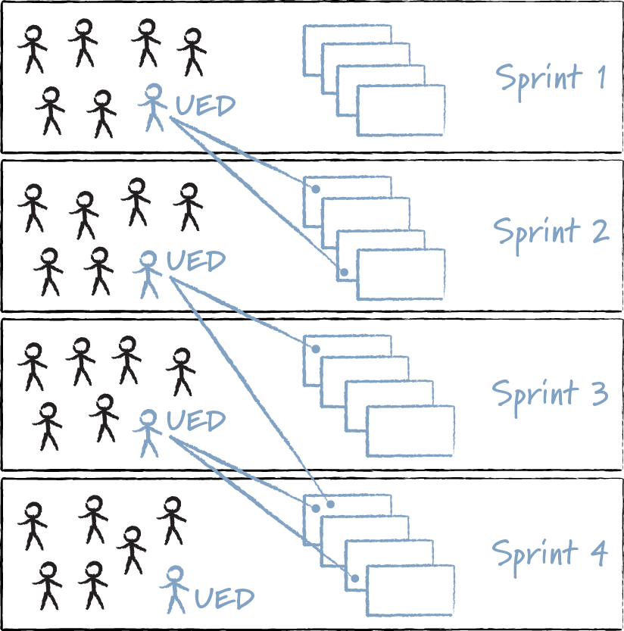
TSR vs. Classic: Methodology
Solution: Plan ahead for interdependancies
TSR HAS INVENTED TIME TRAVEL
FE / BE can start production earlier, in a more synchronised manner
Heightens the customer‘s sensitivity towards their project role and responsibilities
Well adapted to release cycles
Notes:
Upfront Design’
Design resources operate in advance of development resources before a release
Designs may be used for estimating and reducing risk
Works well for prototyping / proof-of-concept work
‘Just in Time’
Design done within a sprint
Typically requires predefined and commonly used chunks of design
Requires a lot of collaboration
Iterative with parallel efforts and predicted throw-away work
Easier to track
‘Design Spikes’
Not developing a shippable product increment
Interrupt a normal Sprint
Typically used by architects to address technical exploration
‘Sprint Pairs’
Design works a sprint ahead of development
Scope is traded off for designing within time box
Respects functional dependencies

Slide 11
TSR vs. Classic: ROLES & RESPONSIBILITIES
Product Owner
Differs from project to project
TSR project manager, customer team member or a third „neutral“ party
Scrum Master
@TSR, Scrum Master is not necessarily a dedicated roll
Has more responsibility for team planning
Supervises the processes
Programmers, Designers and UX-Architects
Have to take more responsibility for interdisciplinary communication
Notes:
With team members working on multiple projects (and with multiple product owners), co-ordinated team planning is critical
The Scrum product owner is typically a project's key stakeholder. Part of the product owner responsibilities is to have a vision of what he or she wishes to build, and convey that vision to the scrum team. This is key to successfully starting any agile software development project. The agile product owner does this in part through the product backlog, which is a prioritized features list for the product.
The product owner is commonly a lead user of the system or someone from marketing, product management or anyone with a solid understanding of users, the market place, the competition and of future trends for the domain or type of system being developed.

Slide 12
Classic AGILE: ESTIMATIONS
Challenge: Higher learning curve for scrum and planning poker
DESIGNERS AND UX-ARCHITECTS ARE OFTEN HESITANT
Better adapted for homogenic teams
Team members are more confident in their estimates
Programmers often have an instinctive understanding of complexity
Estimation discrepancies can be resolved more quickly

Slide 13
TSR AGILE: ESTIMATIONS
Reward: There are advantages to mastering the learning curve
TEAM MEMBERS LEARN ENORMOUSLY FROM EACH OTHER
+ Osmosis of technical and creative competence
+ Supports the cohesion of team members
+ Team members can predict challenges in the entire production chain
– Difficulties in understanding across technical boundaries
– Core question: can I / should I abstain from estimating story points?

Slide 14
Thank you
www.reply.com

