Slide 1
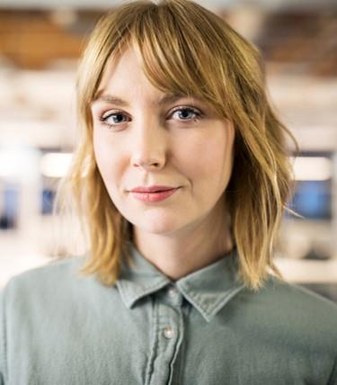
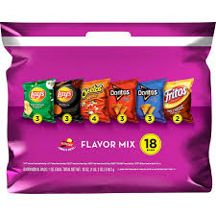
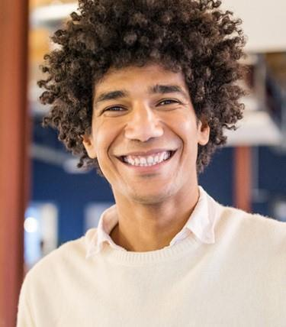



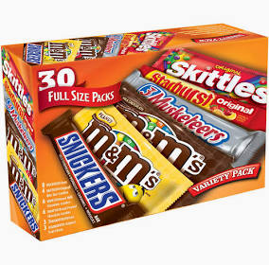
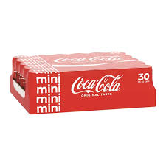

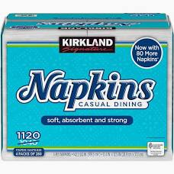

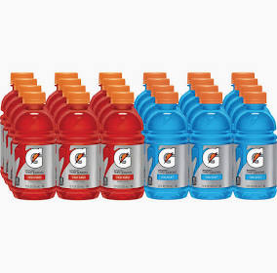

5th & 6th Grade Volleyball OLG vs St . Marys
$78.94
Shopping | List
 | $9.99
 | $11.00
 | $8.99
 | $13.99
 | $8.99
 | $12.99
 | $12.99
Serena Willams
Contributions
$20.99
Michael Jackson
$56.64
Only This Much to go!
Ello Govna
Who Dat
Can’t wait to see you there @ Michael Jackson
Subtotal
$78.94
Don’t forget your umbrellas. It’s going to be raining!!! Go Tigers!
Checkout

