Slide 1
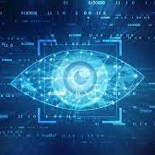
Repair assistance using Computer vision
By Raghava Reddy Tera
Mentor – Pruthvi Anumandla
Computer vision is a field of artificial intelligence that trains computers to interpret and understand the visual world. Using digital images from cameras and videos and deep learning models, machines can accurately identify and classify objects

Slide 2
Use Case
When a vehicle Owner uploads an Image of the car bennet into the API , The feature of API should reflect the output with the number of the yellow wires on the top 180 degrees of the image, which gives the Automobile Service man the basic idea of the vehicle with the Air bags and its condition through Machine learning Model

Slide 3
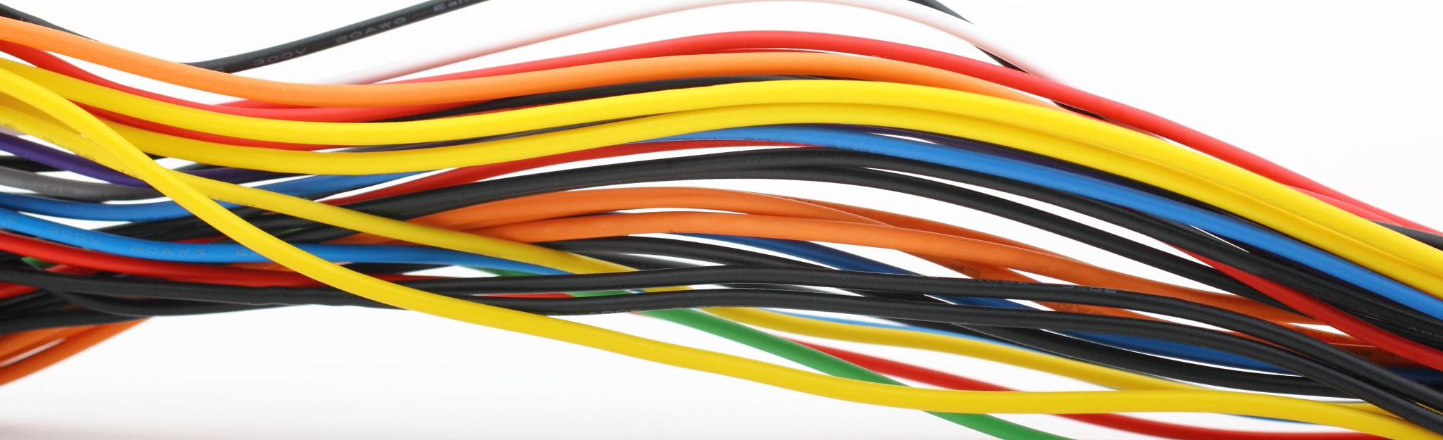
objective
The main objective of this project is to identify the number of yellow wires on top 180 degrees ,which are connected to Airbags using the Machine Learning Models

Slide 4
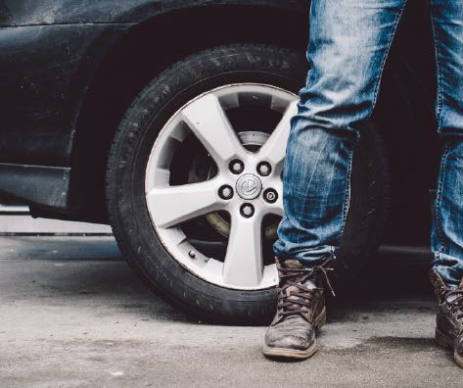


What it Solves ?
It helps the service man whether to carry or Order the New air Bag kit while going to Repair the Vehicle
This gives the prediction of number of yellow Wires on the top 180 Degrees

Slide 5
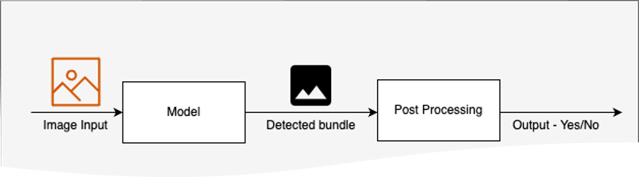
Solution Architecture
We have a trained model, which performs instance segmentation and detects the wire harness. The image is then cropped to include only the harness bounding box and image is processed by using the custom functions we created to extract the number of yellow wires.

Slide 6
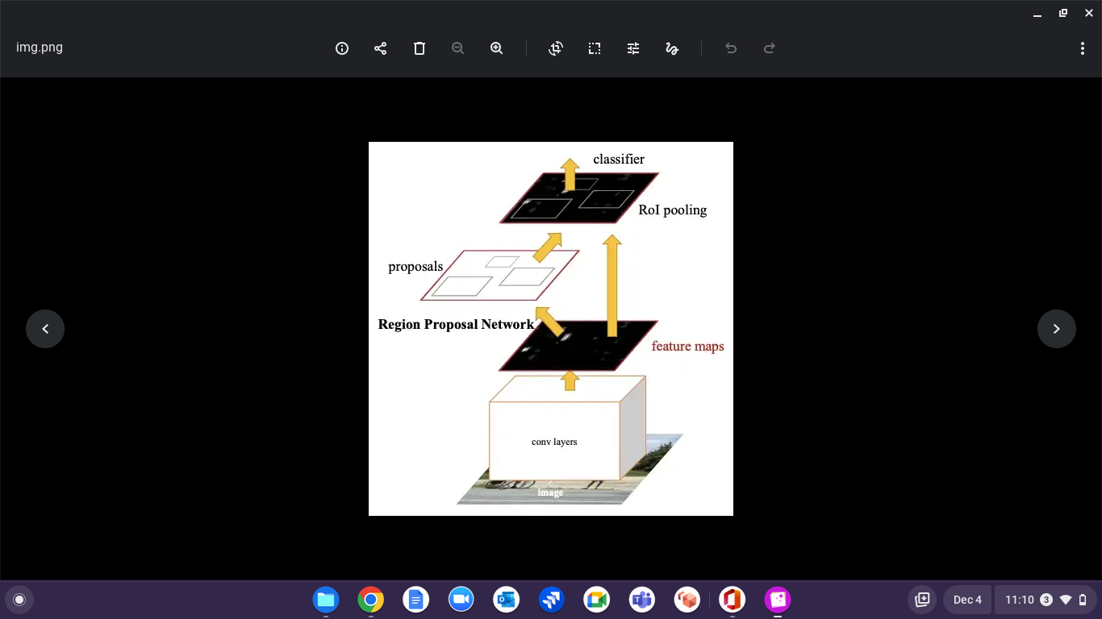
Fast R-CNN model
Region proposal network (RPN): after passing the input image in the CNN as before, the RPN is a deep network used to generate region proposals;
Fast R-CNN detector: it will use the proposed region and output the bounding boxes and class labels.

Slide 7
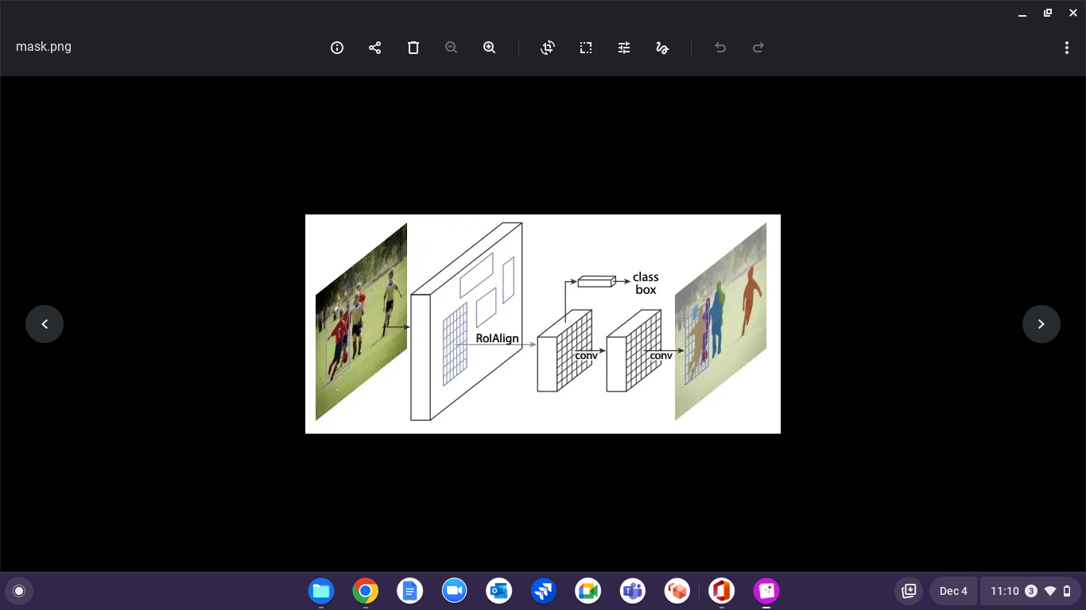
Mask R-CNN Model
Implementation of Mask R-CNN using Detectron2
Detectron2 is a framework built by Facebook AI Research and implemented in Pytroch. It includes implementation for some object detection models namely Fast R-CNN, Faster R-CNN, Mask R-CNN, etc.
Here we use Mask R-CNN (R-101) with ResNet as the backbone architecture. This backbone architecture was pre-trained on COCO dataset.

Slide 8
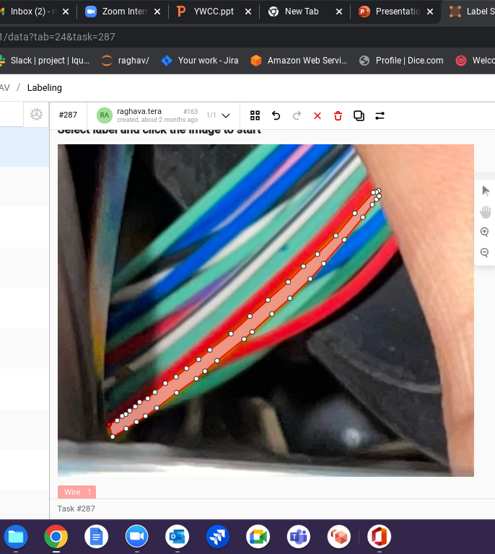
Label studio
Here I Iabeled the contures with the instance segmentation tools in the open source patterns
Download the Json file with the conture coordinnates to train the Model from label studio

Slide 9
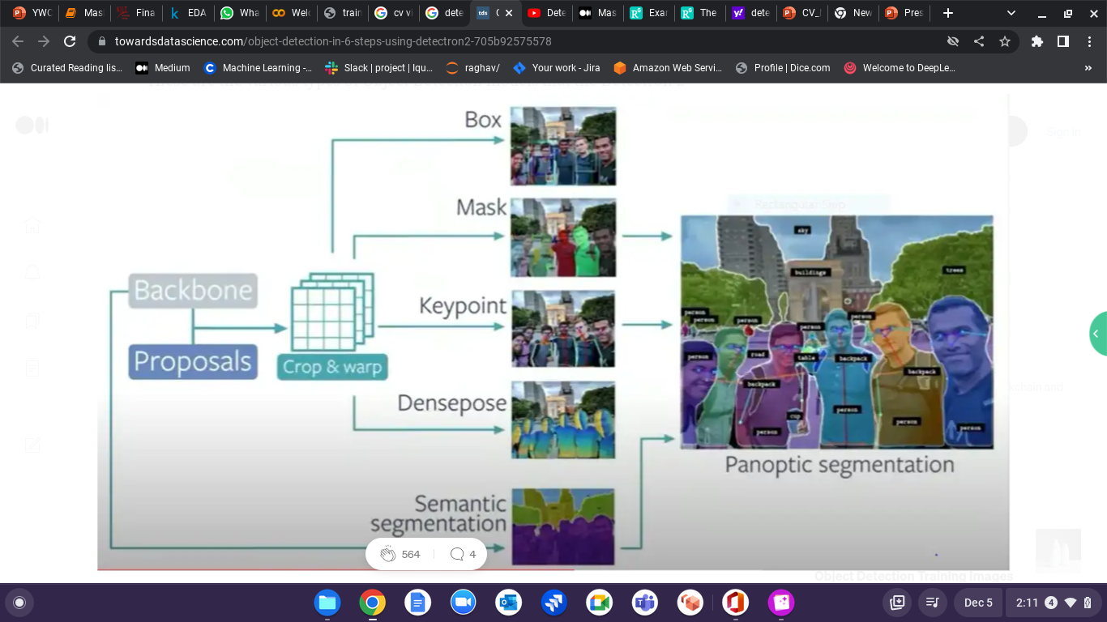
What happens to the input ?

Slide 10
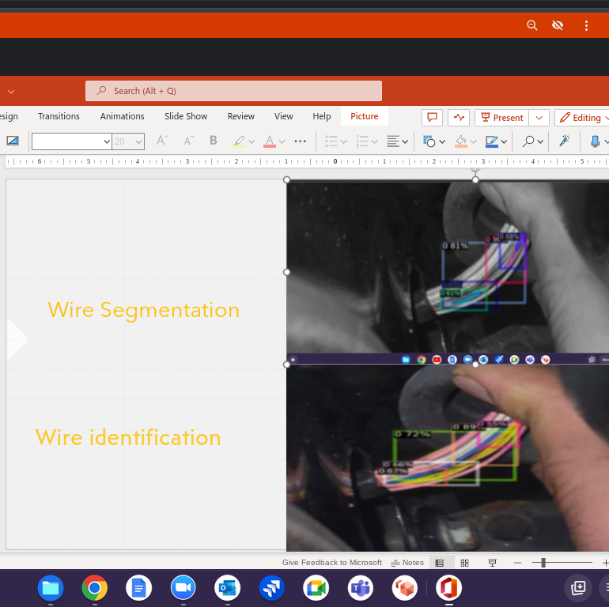
Direct detection of yellow wire
Testing with the diffrent images and ploting the bounding boxes in the image

Slide 11
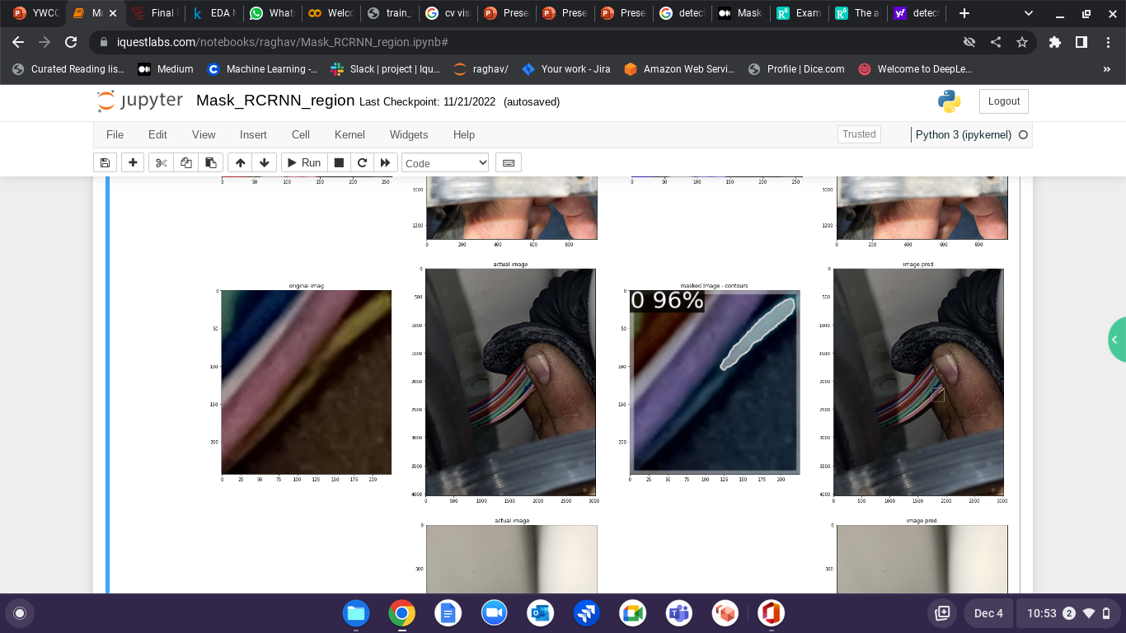
Prediction
ROI Prediction praposal
Orginal Img
ROI Pred Mask
Prediction Box

