Slide 1

LongLoRA: Efficient Fine-tuning of Long-Context Large Language Models
March 28, 2024
UNIST Language & Intelligence Lab
Chanbin Lee

Slide 2

Contents
Introduction
Related Work
LongLoRA
Experiment
LongAlpaca
Conclusion

Slide 3
Introduction
Pretrained LLMs are trained with pre-defined context size e.g., Llama (2048), Llama2 (4096)
Need longer context size for various tasks (summarizing, long QA, …)
→Recent studies focus on context length extension
But needs additional fine-tuning on long texts
32x A100 GPU needed for context size extension of Llama (2k → 8k), 128x TPU(LongLLaMA)
Very expensive, need more efficient and effective way

Slide 4
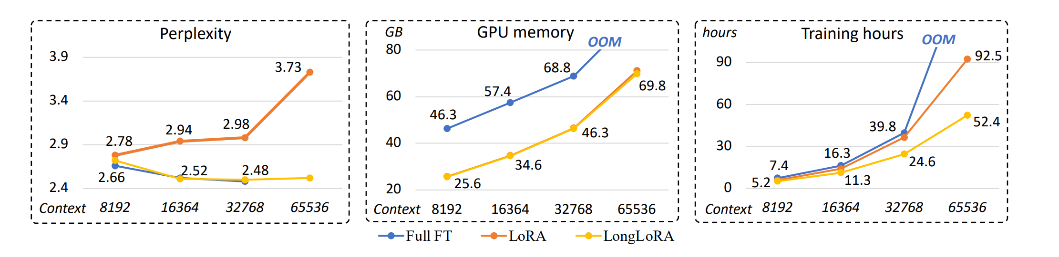
Introduction
Using LoRA(low-rank adaptation) for efficient long text fine-tuning?
Not enough for context extension
Proposed LongLoRA can solve this problem

Slide 5
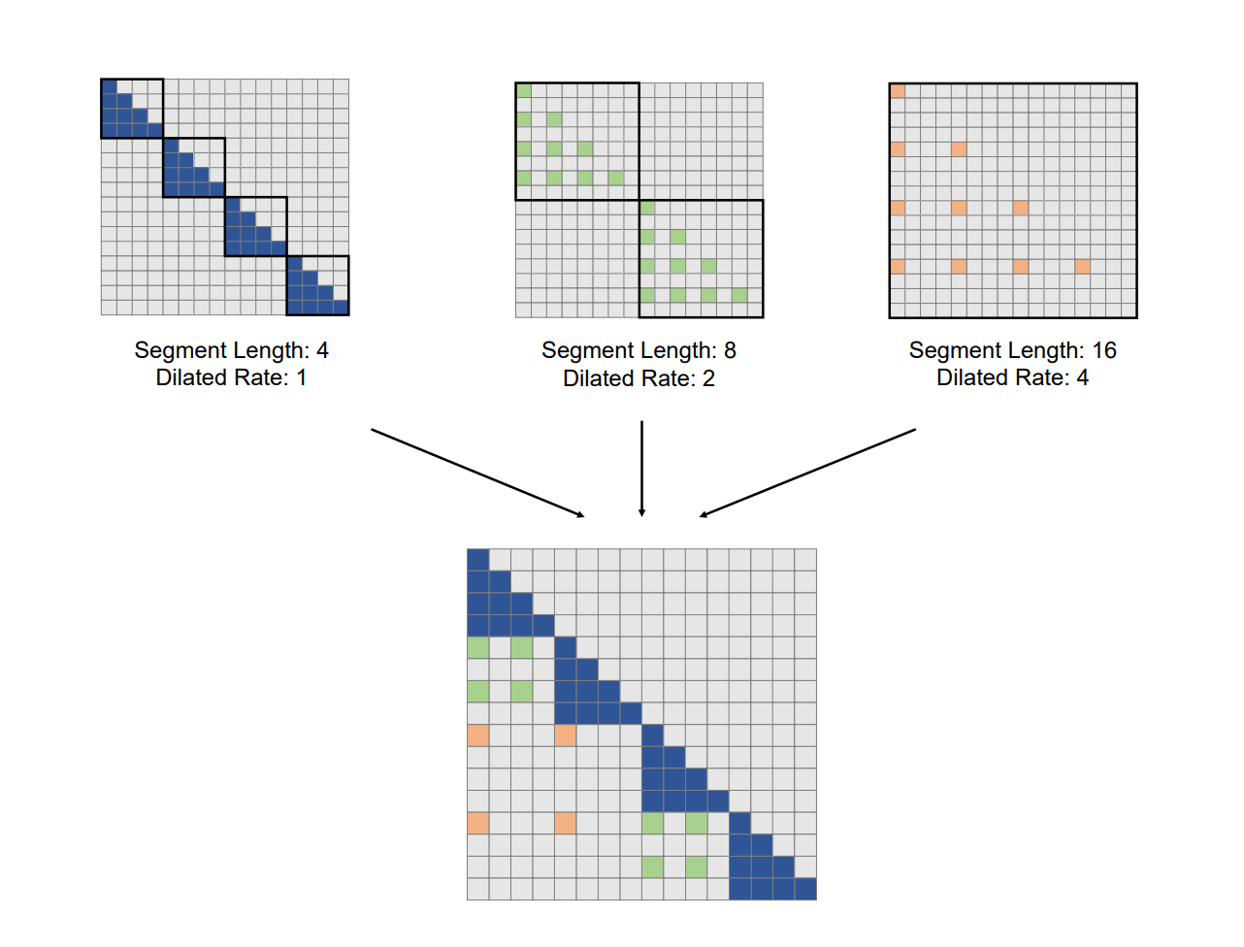
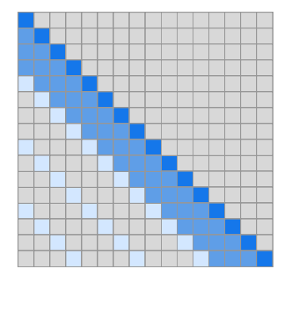
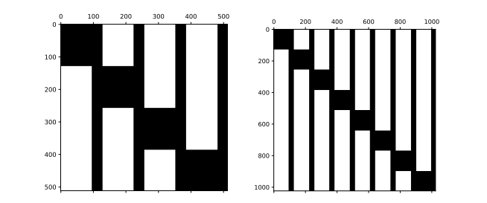
Related Work – Approximating Attention
BlockBERT(Qiu et al., 2020)
Sparse Transformers(Child et al., 2019)
Dilated Attention(Ding et al., 2023)

Slide 6
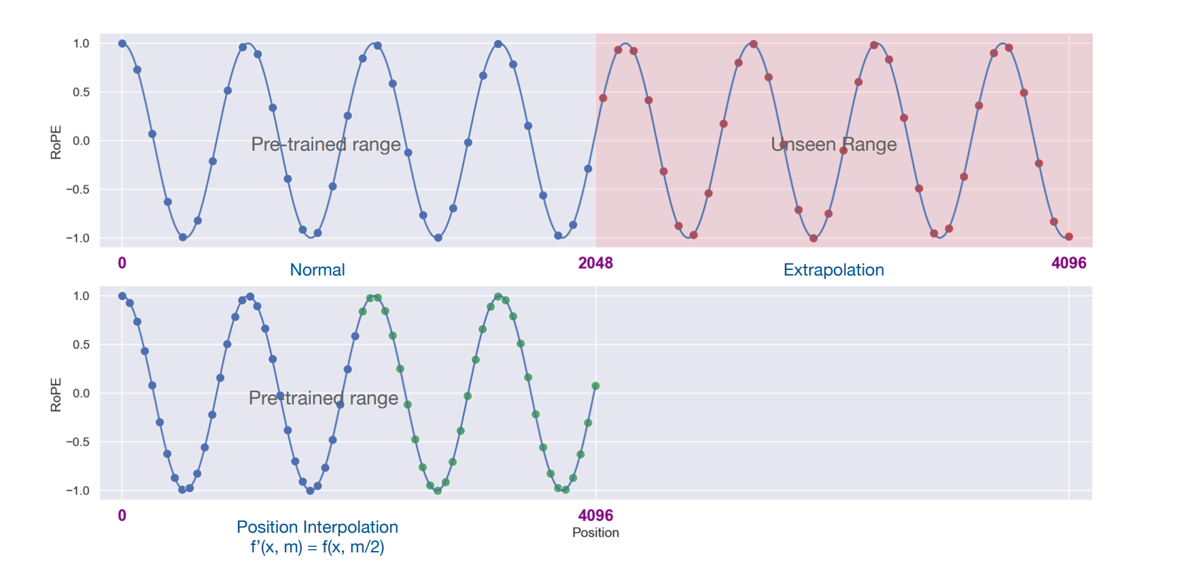
Related Work - Long Context LLMs
Full Finetuning on long texts
Context compression
Position embedding modification
Position Interpolation(PI)
Chen et al., 2023

Slide 7
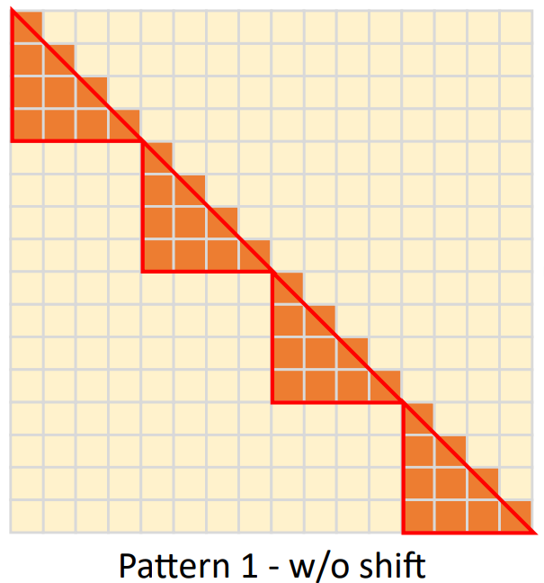
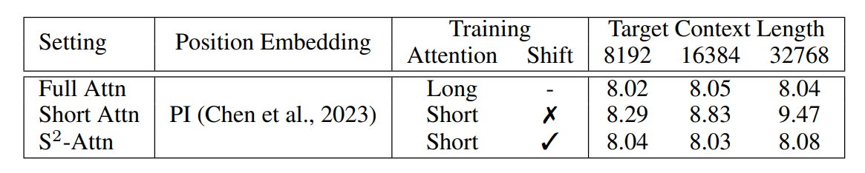
LongLoRA – Shifted Sparse Attention (S²-Attn)
Short Attention – split into groups
→No information exchange between groups
➔degrading performance

Slide 8
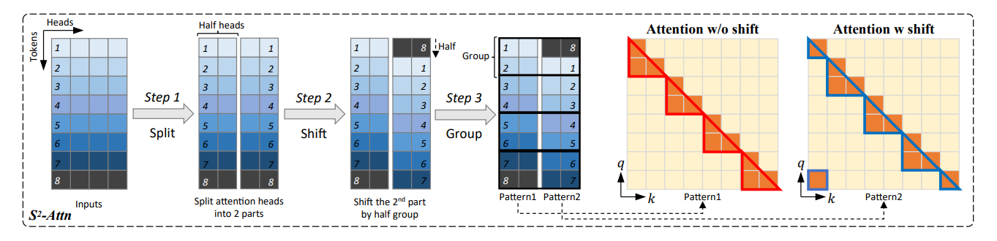
LongLoRA – Shifted Sparse Attention (S²-Attn)
Shifted Sparse Attention – split into groups + shift the half
Shift amount = group size / 2
Groups into batches

Slide 9
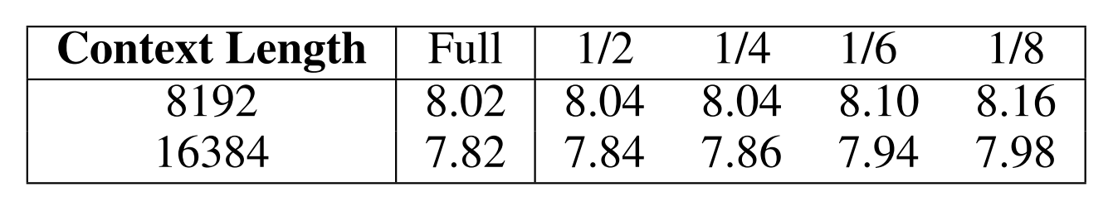
Group Size
How to set Group size / Context length ?
¼ is tested to be optimal

Slide 10
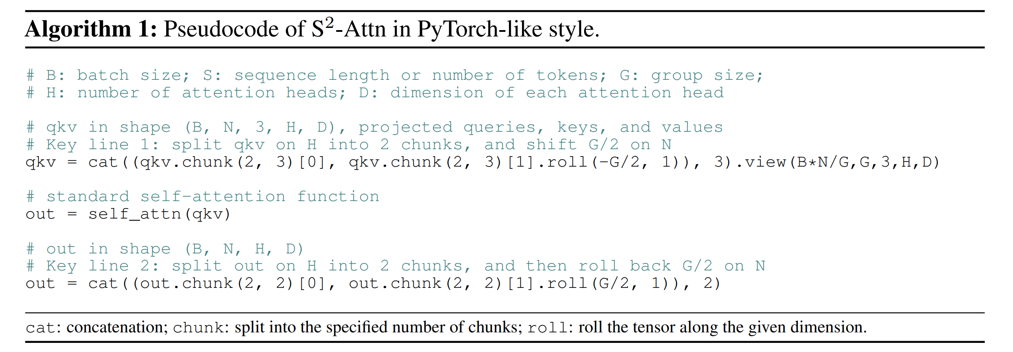
LongLoRA – Shifted Sparse Attention (S²-Attn)
Easy implementation — two lines of additional code

Slide 11
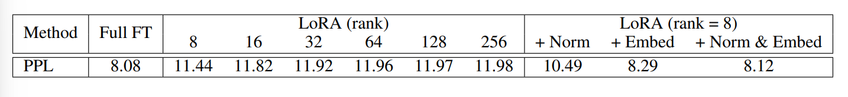
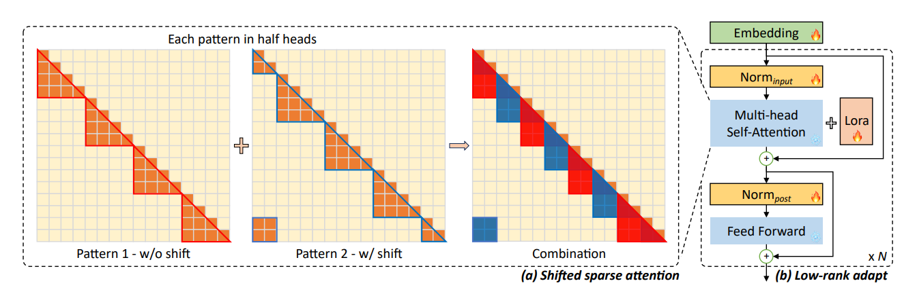
LongLoRA – LoRA⁺
LoRA typically adapts attention weights only
Simply increasing LoRA rank cannot close performance gap on long context adaptation
LoRA⁺ —Train Normalization and Embedding layers together
Llama2 (4K →32K)

Slide 12
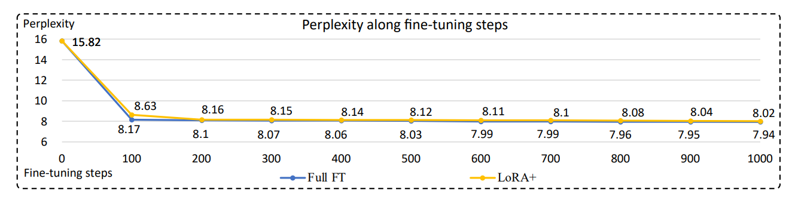
Experiment — Language Modeling
Setting
-Llama2
-Modify Position Embedding with PI(Chen et al., 2023)
-Fine-tuning on RedPajama (Computer, 2023)
-Testing on proof-pile(Azerbayev et al., 2022) / PG19(Rae et al., 2020)

Slide 13
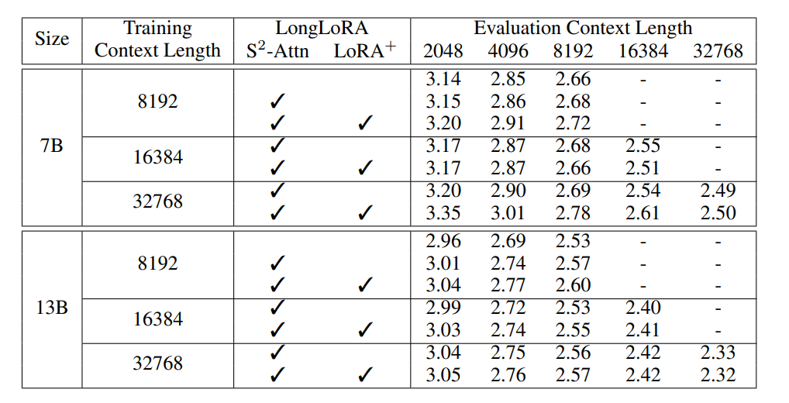
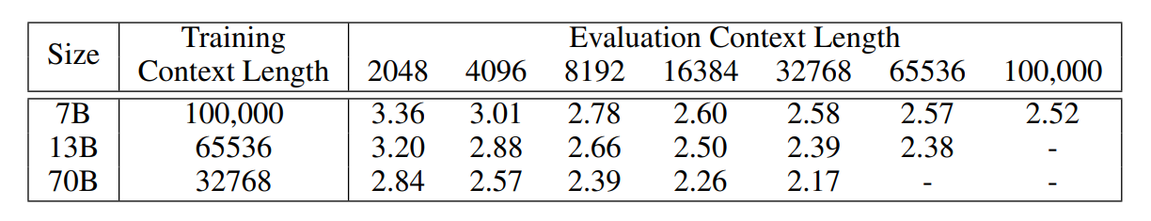
Experiment — Language Modeling
Maximum Context length on 8x A100

Slide 14
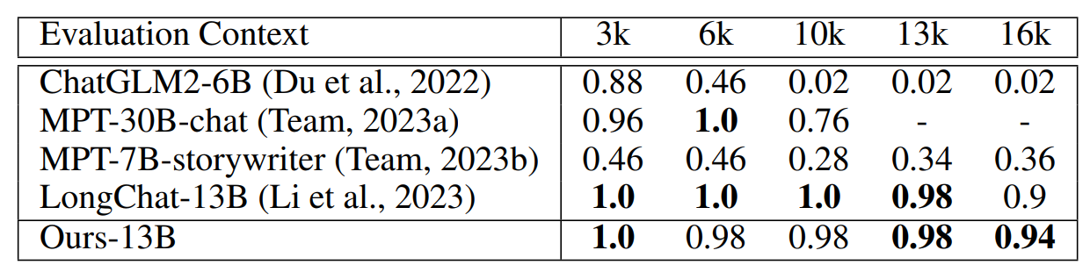
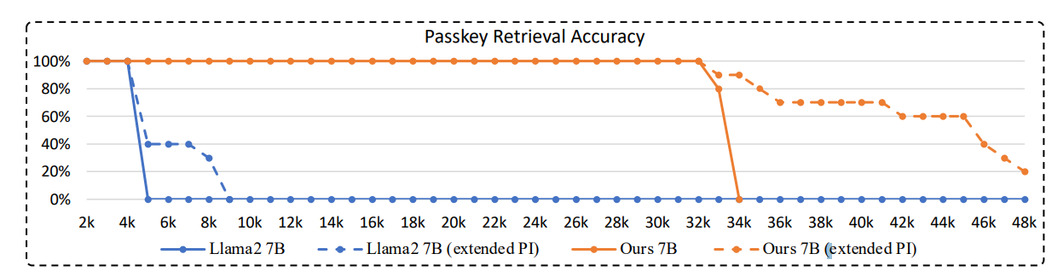
Experiment — Retrieval-based Evaluation
LongChat(Topic Retrieval)
Passkey Retrieval

Slide 15
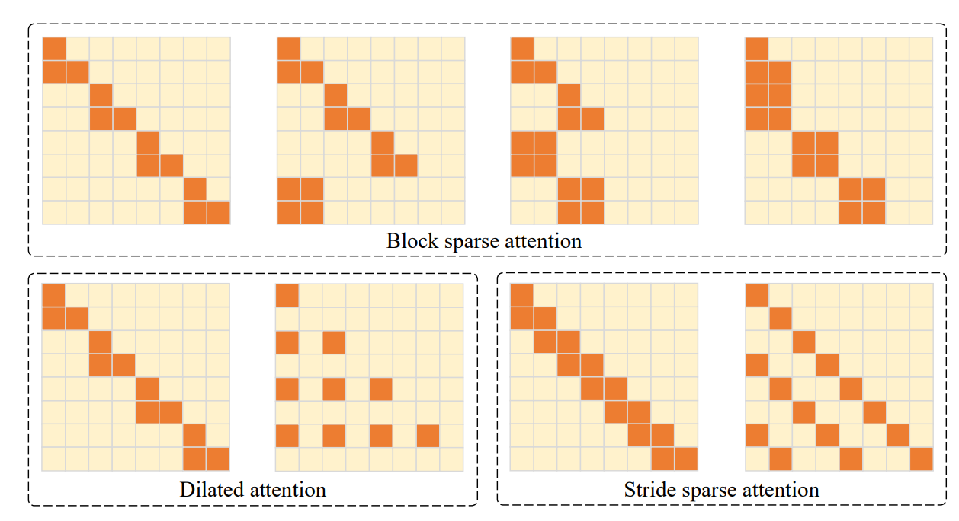
Ablation Study
Test on alternative sparse attention patterns

Slide 16
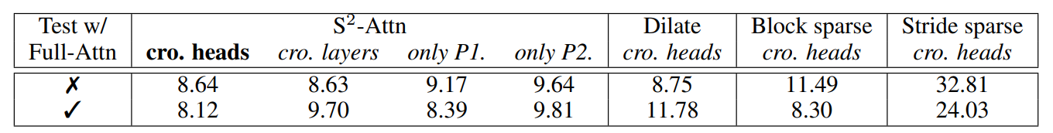
Ablation Study
Trained using LoRA⁺, patterns split across attention heads
S²-Attn across heads gives best results
S²-Attn has consistent performance in full attention testing

Slide 17
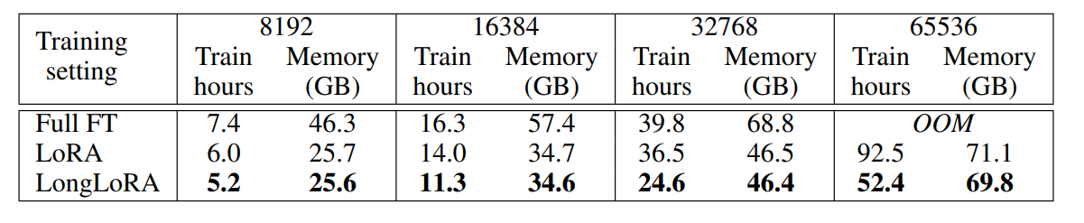
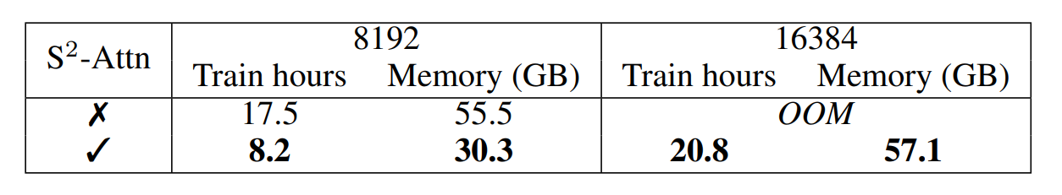
Ablation Study
With Flash-Attention2
Without Flash-Attention2 (LoRA⁺)

Slide 18
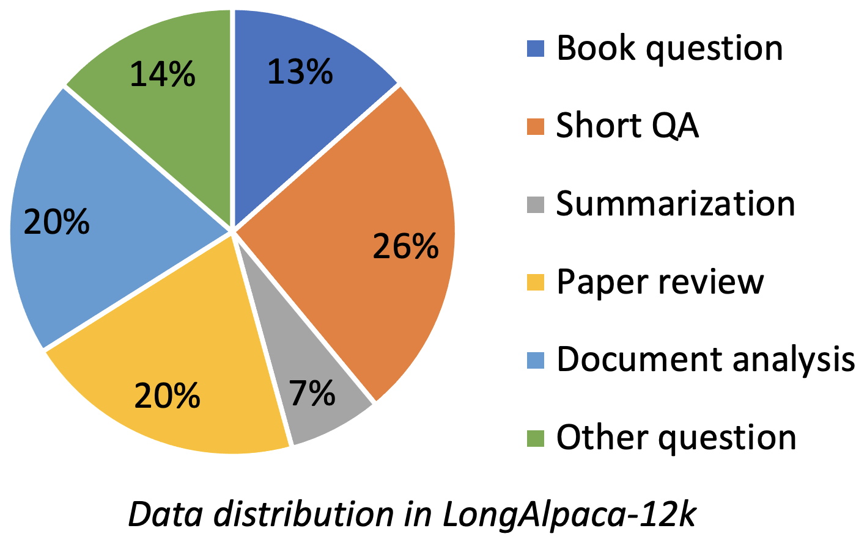
LongAlpaca
Instruction-following dataset

Slide 19
Conclusion
LongLoRA efficiently extends the context length of LLMs
S²-Attn: Less GPU cost and training time, but comparable results with full fine-tuning
LoRA⁺: Bridges gap between LoRA and full finetuning

Slide 20
THANK YOU

