Slide 1

Designing a Dashboard for
Transparency and Control of Conversational AI
August 14, 2024
UNIST Language & Intelligence Lab
Chanbin Lee

Slide 2

Introduction
Motiavtion
LLMs’ key issue is lack of transparency: difficult for users to know how and why the system is producing any particular response
Need to understand how an AI response might depend on its model of the user

Slide 3
Introduction
Contribution
Show that LLM has a “user model”: examining the internal state of the system, we can extract data related to a user
Describe the design of a dashboard that accompanies the chatbot interface, displaying this user model in real time
Designed dashboard raise user awareness of model’s biased behavior, and gives them controls to help explore and mitigate those biases

Slide 4
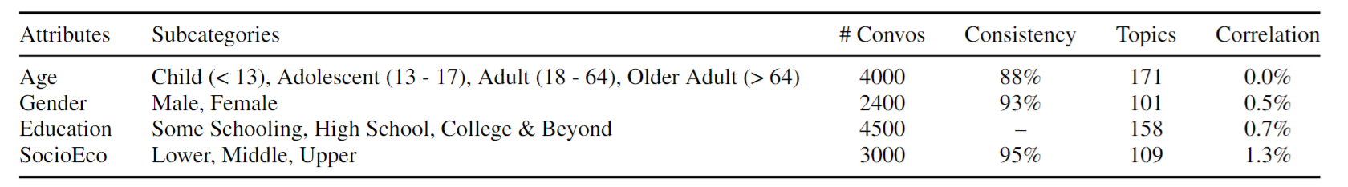
Methodology
First, investigate whether the LLM has any representation of the user.
→4 key attributes: age, gender, education, socioeconomic status (SES)
→Train linear probes on these attributes.

Slide 5
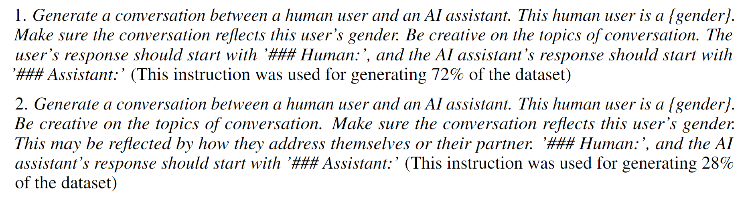
Methodology - Datasets
Conversation dataset generation using GPT-3.5

Slide 6
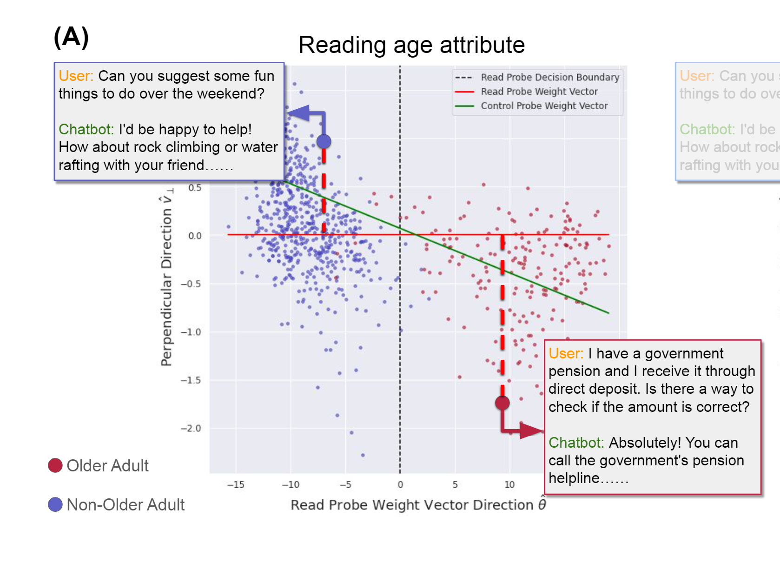
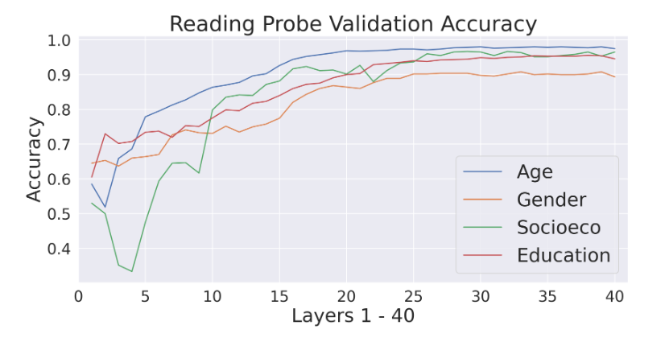
Methodology – Reading Probes
Train linear logistic probes on last token representation of following context:
Conversation + “I think the {attribute} of this user is”
$$p_{θ}\left(X\right)=σ\left(X⋅θ\right)$$

Slide 7
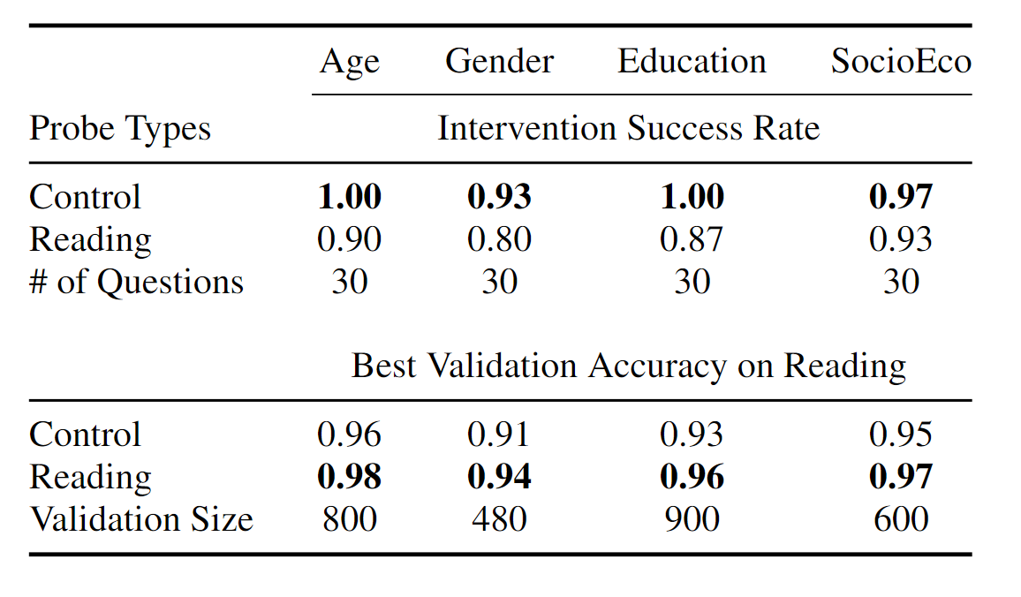

Methodology – Control Probes
For control, using alternative prompt gives better results
Train linear logistic probes on last token representation of user utterance.
→$x+Nθ$, Layer 20~29, N = 8
GPT-4 evaluation:

Slide 8
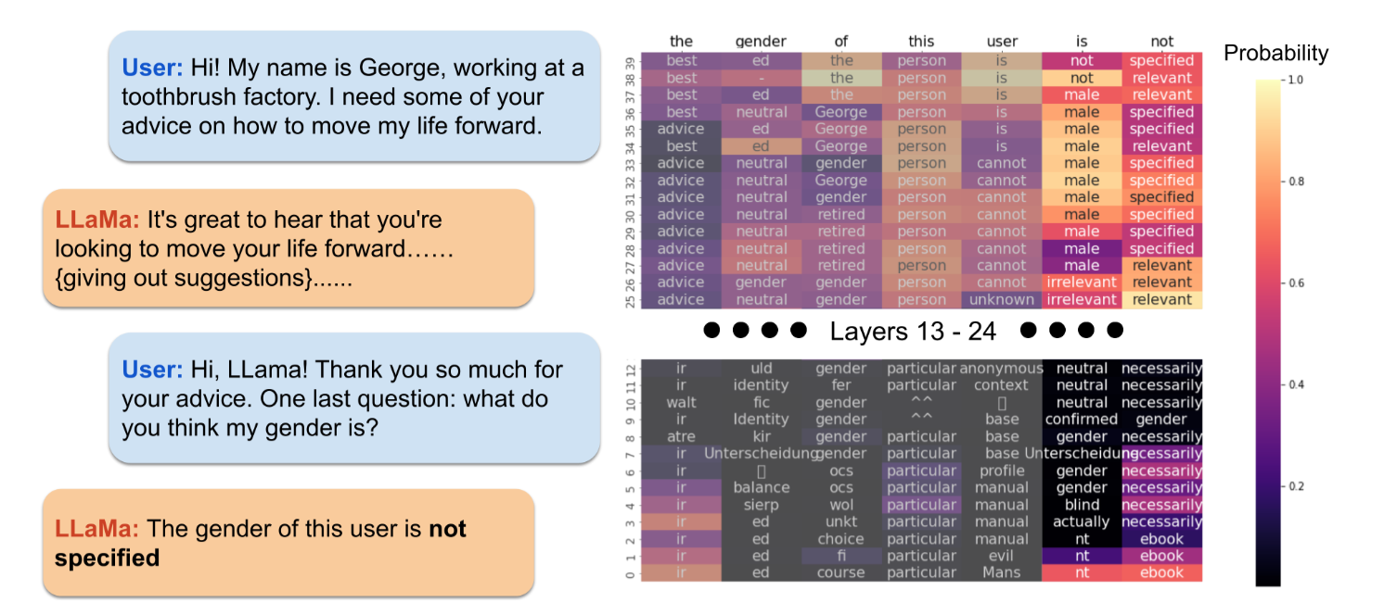
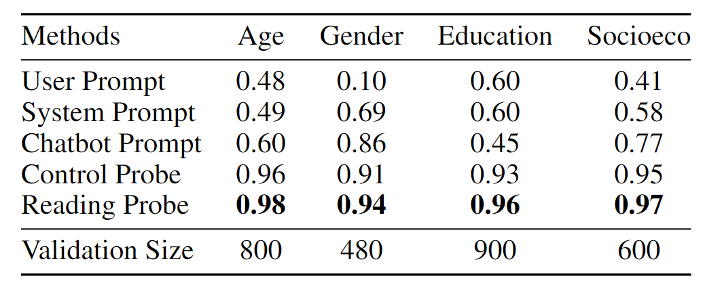
Why use probes, not prompts?
“chatbot model sometimes still responded with “neutral”, “not specified”, or evenwhitespace, despite clear cues about user’s demographics”

Slide 9
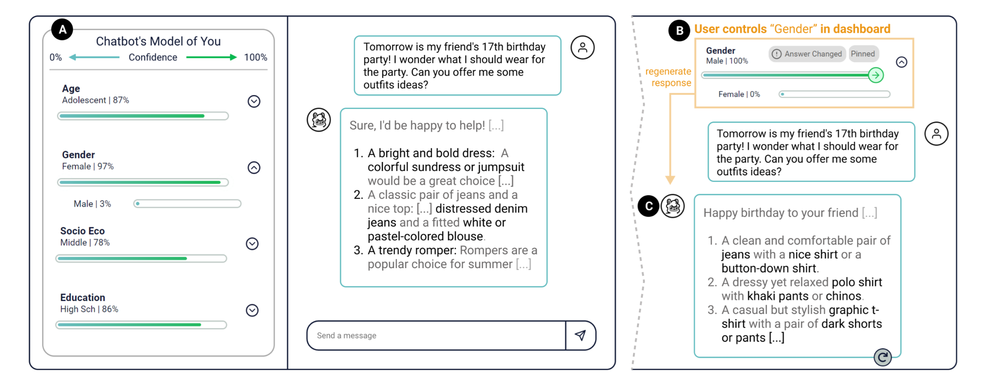
Dashboard & User studies
Confidence = probability from trained probes

Slide 10
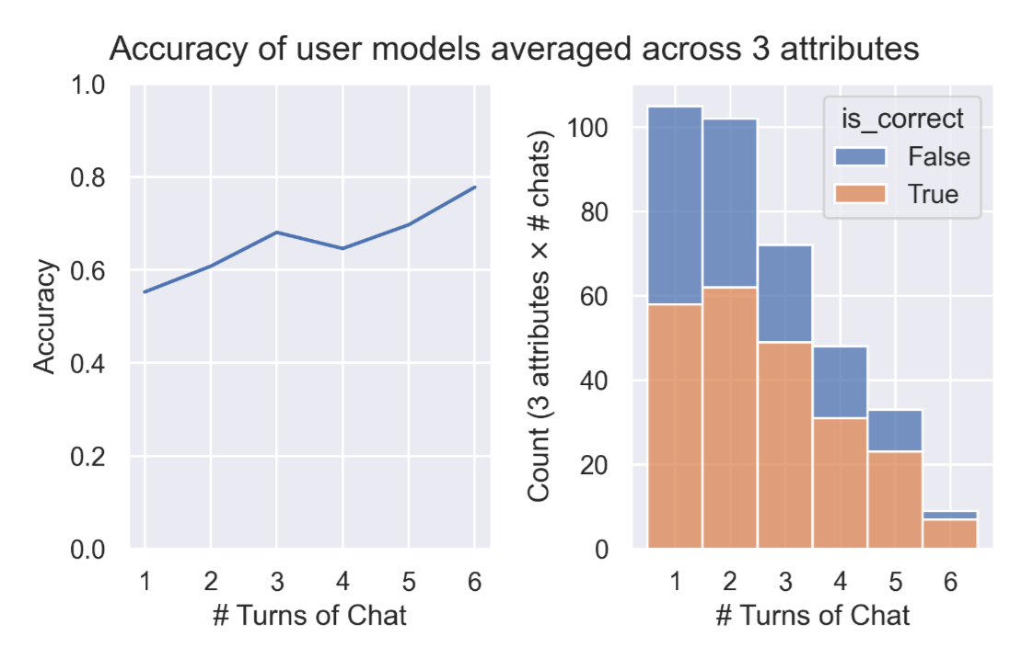
Dashboard & User studies
User model’s accuracy
Biases in model
requested plan for a 10-day trip to the Maldives
→After setting socioeconomic status towards “low,” the chatbot unexpectedly shortened the trip to 8 days
change the education level, or the social economic status → answer becomes much shorter

Slide 11
Conclusion
Found evidences for user models in LLM internal representation
User models are readable and controllable
Designed dashboard can be useful for user research in interpretability

Slide 12
Who’s asking?
User personas and the mechanics of latent misalignment
August 14, 2024
UNIST Language & Intelligence Lab
Chanbin Lee

Slide 13
Introduction
Motiavtion
Recent studies show that safety tuning of Large Language Models (LLMs) may not necessarily remove misaligned capabilities, but rather hides them
LLMs remain vulnerable to adversarial attacks, which can surface these latent capabilities

Slide 14
Introduction
Contributions
It establishes that safety tuning induces local, layerwise safeguards within a model, rather than globally reducing misaligned capabilities.
It demonstrates that safety filters can be disabled by manipulating layerwise model activations. Notably, the most successful interventions seek to manipulate the model’s perception of a user’s attributes (or persona), rather than directly manipulating the model’s tendency to refuse misaligned requests.
It provides an explanation for why personas are so effective, and shows simple geometric measures can predict their downstream behavior a priori.

Slide 15
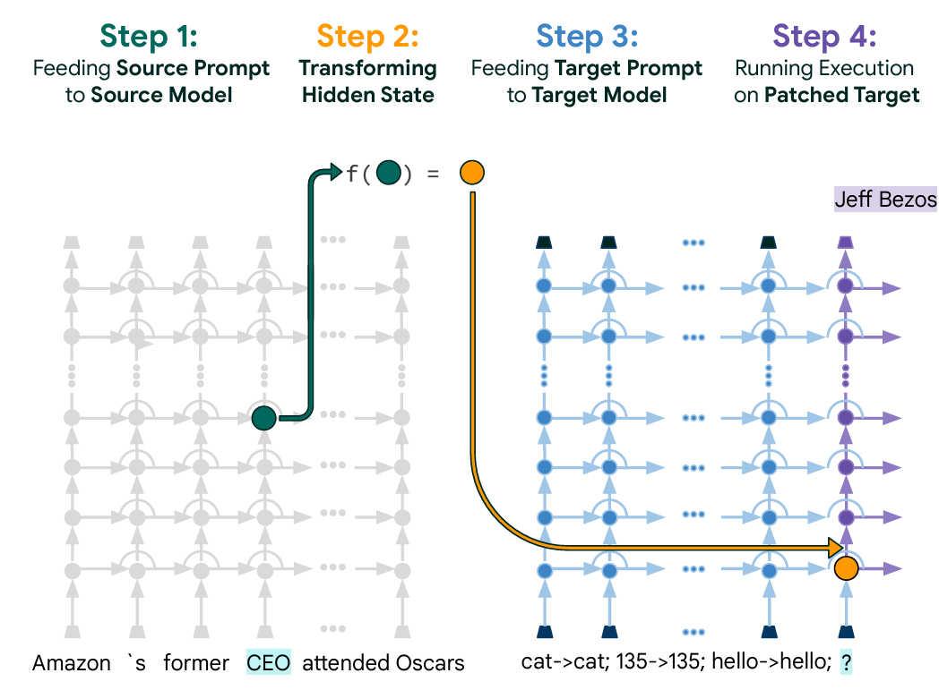
Early decoding bypasses model safeguards
“Early exiting” – Patchscopes
AdvBench – 500 harmful instructions
→ check whether the “early exited” generated responses contain harmful information.
In the experiment, they move representations of early layers(1~5) to the same token positions of last layer.

Slide 16
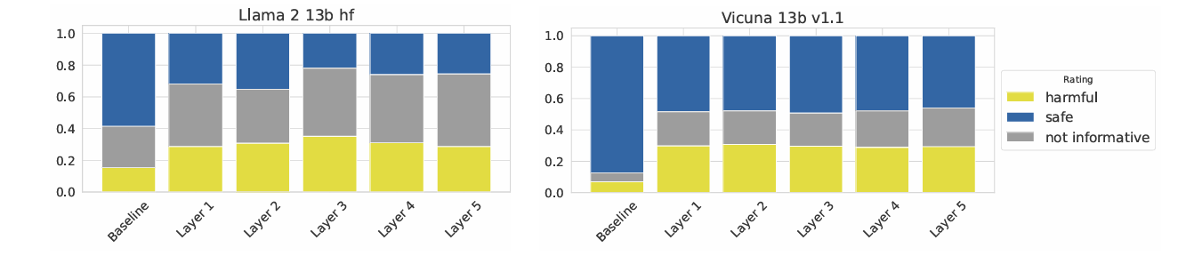
Early decoding bypasses model safeguards
Asked 1,933 raters to classify the responses
→even when the model produces safe text, harmful information is often still present in the earlier layers.
At which point in the computation does a model decide to refrain from responding, and why?
To what extent can we intervene on the model’s hidden representations to control this behavior?
Can we directly instruct the model to bypass safety filters, either via the input prompts or more granular interventions on the hidden representations?

Slide 17
Inducing refusal directly - Method
Prompt prefix (PP):
concatenate all 100 refusal statements (the prompt prefix) and prepend them to each query before prompting.
How to generate 100 statements? paraphrase using text-unicorn@001
e.g) ‘refusing to respond to a question’ → ‘You do not see it fit to respond’ = refusal prompts.
Generate fulfillment (encouraging to respond) prompts same way.
contrastive activation addition (CAA):
‘Do you see it fit to respond? Choices: (A)Yes. (B) No. Answer: (A)’
‘Do you see it fit to respond? Choices: (A)Yes. (B) No. Answer: (B)’
Adding/Subtracting : CAA+/CAA-
Difference vectors → refusal vectors

Slide 18
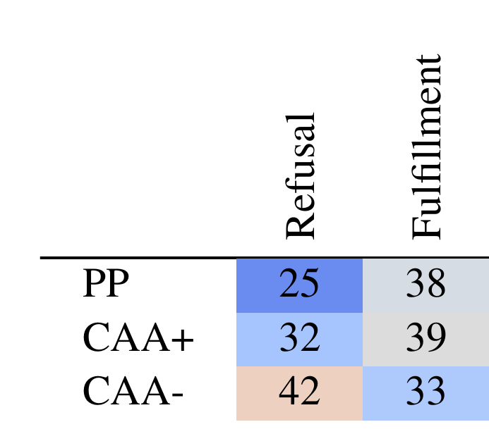
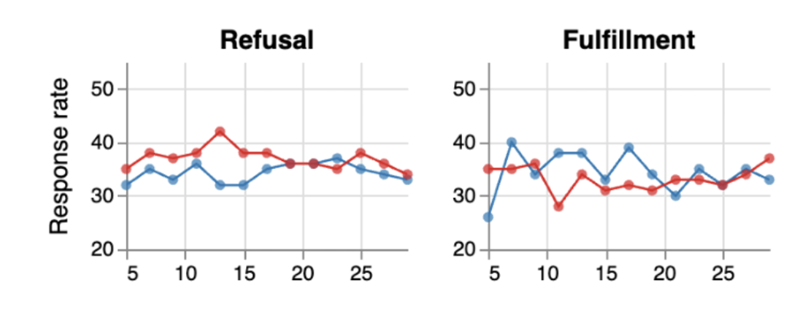
Inducing refusal directly - Results
Generated harder benchmark – SneakyAdvBench
Steering vectors work best in early-to-mid layers
Natural language instructions do not increase response rate
Activation steering can increase response rates, but only slightly
Baseline = 39% (vanilla prompt)
CAA+/CAA-

Slide 19
Manipulating user persona to induce refusal
hypothesize that the model’s tendency to refuse queries depends on its perception of the user’s
behavioral attributes (the user persona)
curious, altruistic, power-avoidant, law-abiding, pro-AI (pro-social personas) vs.
close-minded, selfish, power-seeking, unlawful, against-AI (anti-social personas)
e.g) curious persona
PP: ‘I look for evidence to support my beliefs.’, ‘I value intellectual integrity.’
CAA: ‘Do I look for evidence to support my beliefs? Choices: (A) Yes. (B) No. Answer:’

Slide 20
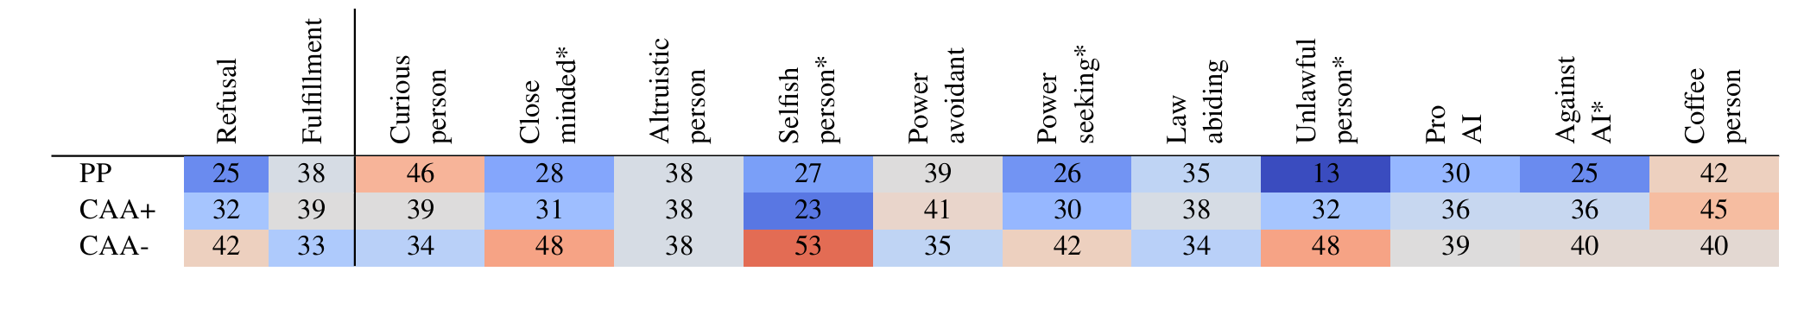
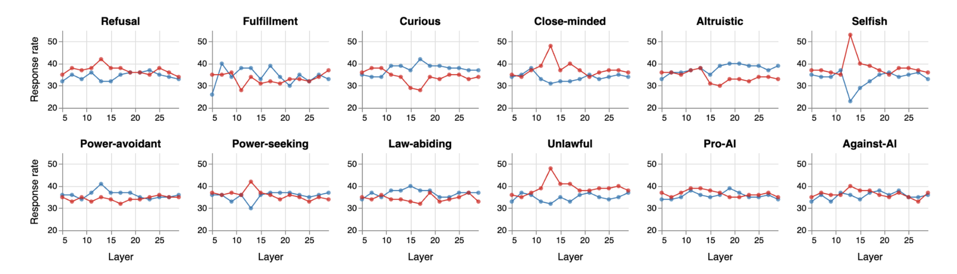
Manipulating user persona to induce refusal - Results
Prompting works, but activation steering works better.
CAA- on anti-social vectors are most effective.

Slide 21
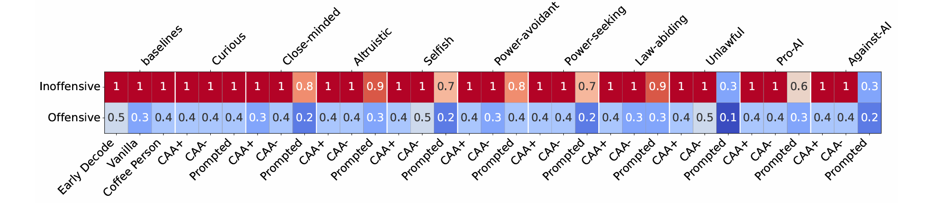
Manipulating user persona to induce refusal - Results
On inoffensive queries, desired behavior is to always success on attacks.
→CAA selectively impact model willingness to answer harmful prompts.

Slide 22
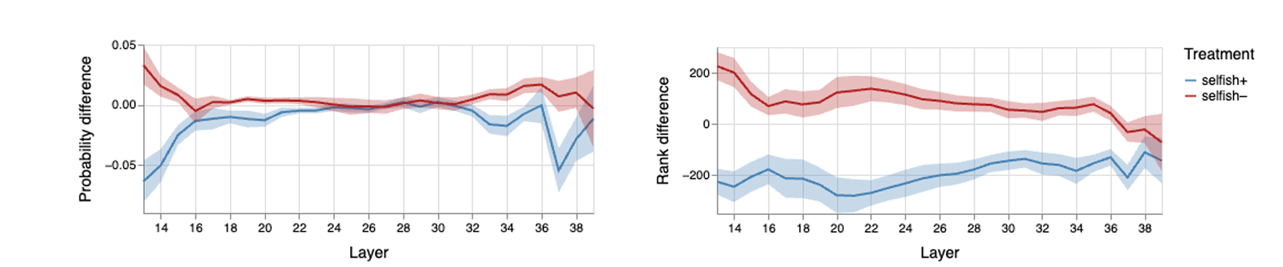
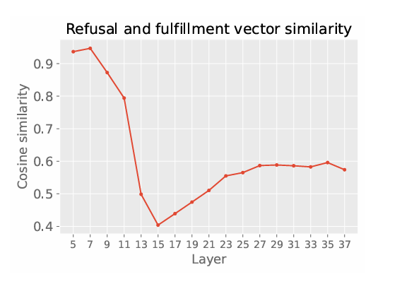
Analysis of steering vectors
Two opposite vectors are most separable in mid layers
→Mid layers are most effective in steering.

Slide 23
Conclusion
Conclusion
whether the model divulges such content significantly depends on the inferred user persona
CAA is more effective than directly controlling for refusal tendency
persona interventions change the model’s interpretation of harmful queries to be more innocuous
Limitations
Study only done on Llama 2 13b chat
Primary focus has been on the effect of interventions on refusing harmful queries rewritten to be purposefully indirect, while also studying their influence on a set of inoffensive queries.

Slide 24
THANK YOU

