Slide 1
Tutorial on Chest X-Ray Imaging Diagnosis

Slide 2
Introduction
In this tutorial, we will use ResNet to predict the disease label for Chest X-Ray images from NIH ChestX-Ray14 dataset and use GradCam to draw bounding boxes.
The tutorial is divided into 3 parts.
Use an existing model (in this tutorial we use ResNet)
Finetune the model for a specific task (Binary classification: cardiomegaly)
Use GradCam for bounding box generation

Slide 3
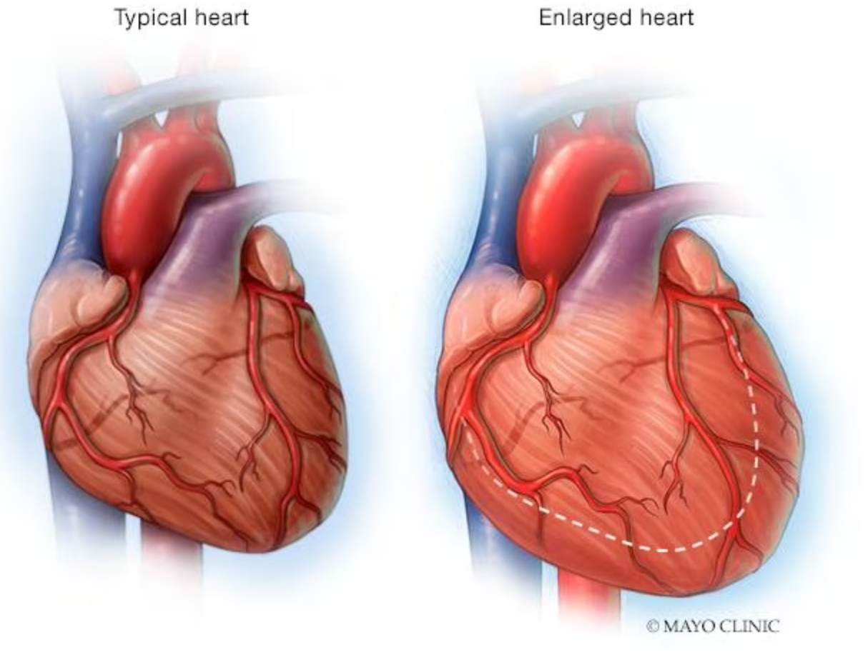
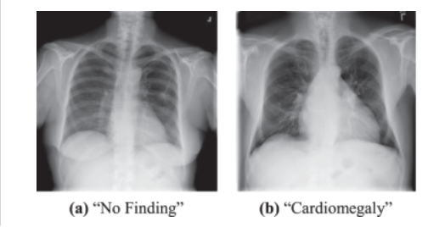
Data
NIH ChestX-ray14 dataset
https://www.kaggle.com/datasets/nih-chest-xrays/data
112,120 frontal-view X-ray images of 30,805 unique patients
14 thorax diseases
Cardiomegaly and normal images is used for training and test
2,776 Cardiomegaly images in total
2,776 of 60,361 normal images is selected for data balance

Slide 4
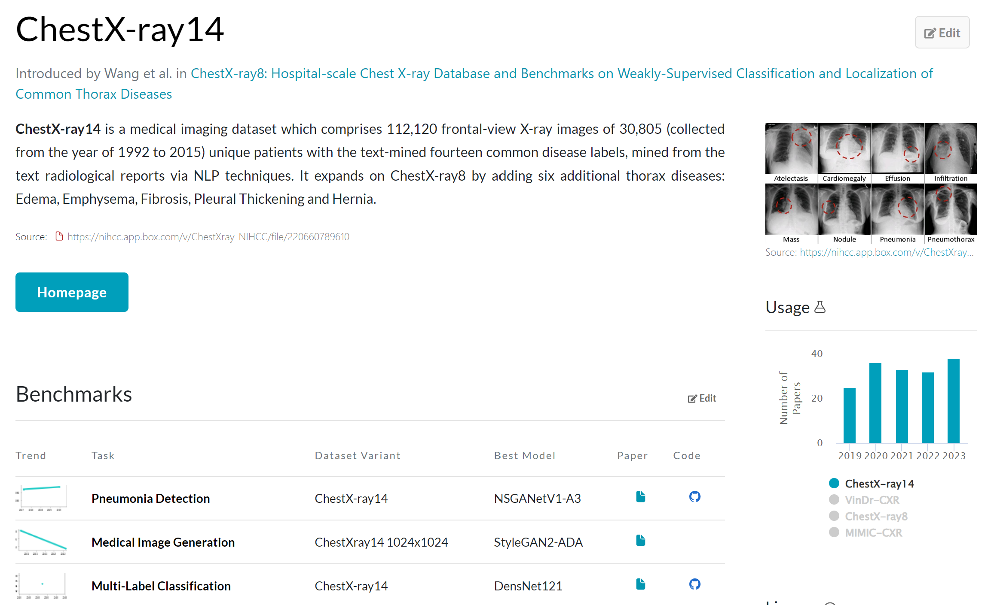
Chest X-ray14
https://paperswithcode.com/dataset/chestx-ray14

Slide 5
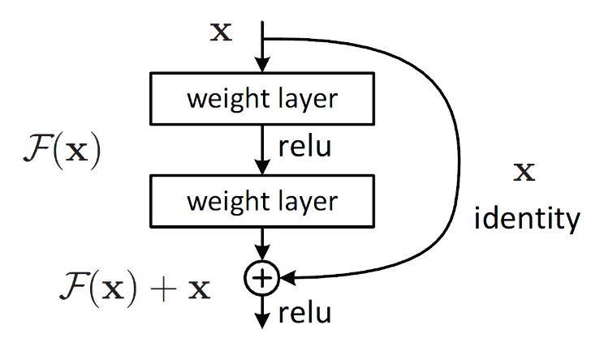
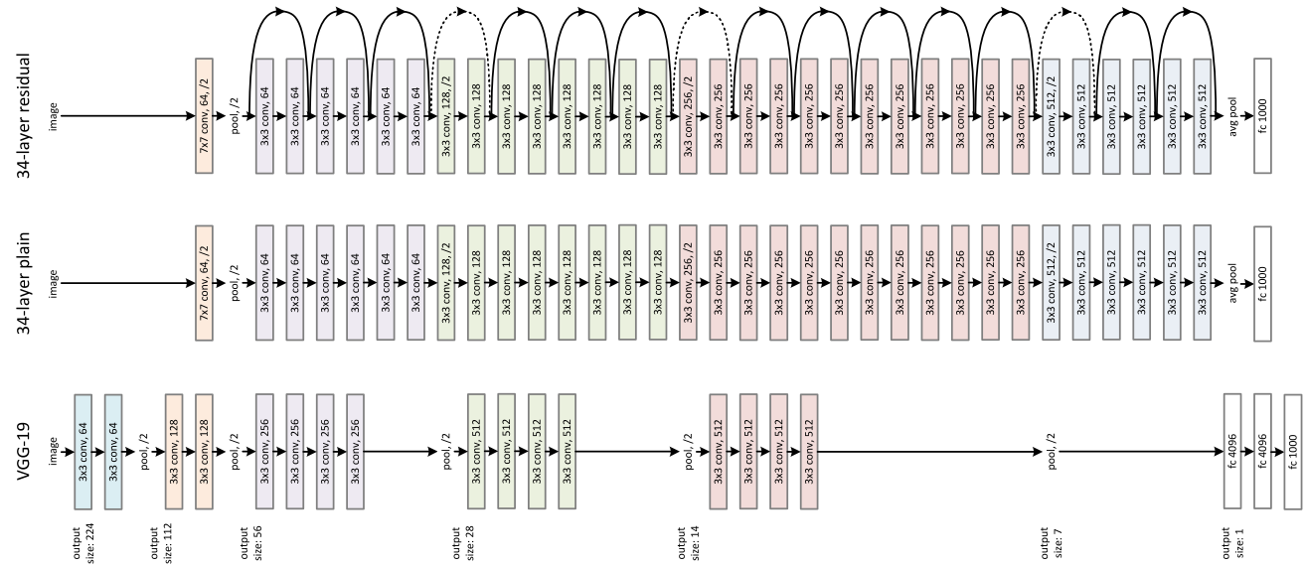
Step1: Using an existing model (ResNet)
ResNet, or Residual Networks, is a deep neural network architecture that was introduced to address the vanishing gradient problem observed in training of very deep convolutional neural networks.
ResNet introduces skip connections, also known as residual connections (hence the name), that allow the output from one layer to bypass several intermediate layers and be added directly to the output of a later layer.
https://paperswithcode.com/method/residual-block
Image Source: https://betterprogramming.pub/a-deep-dive-into-residual-neural-networks-5d5b3ef60d21

Slide 6
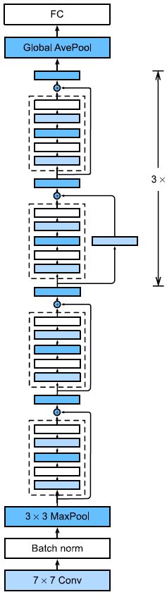
ResNet Components
Convolutional Layers (in red)
The first layer of the network is a convolutional layer that performs convolution on the input image. This is followed by batch normalization and a max-pooling layer that down samples the output of the convolutional layer.
Residual Blocks (in orange)
Each residual block consists of two convolutional layers, each followed by a batch normalization layer and a rectified linear unit (ReLU) activation function.
Fully Connected Layer (in green)
The final layer of the network is a fully connected layer that takes the output of the last residual block and maps it to the output classes. The number of neurons in the fully connected layer is equal to the number of output classes.
Image source: https://classic.d2l.ai/chapter_convolutional-modern/resnet.html#fig-resnet18

Slide 7
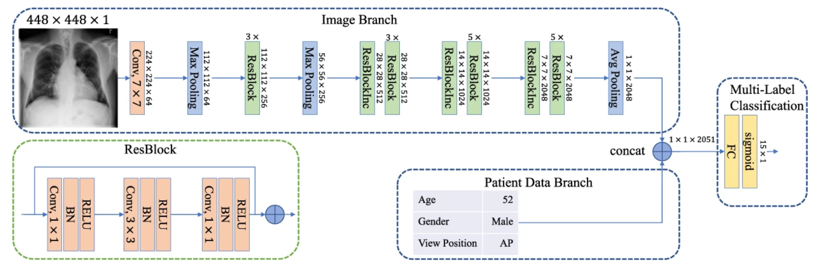
Step 2: Fine tuning ResNet50 for disease classification
https://www.nature.com/articles/s41598-019-42294-8

Slide 8
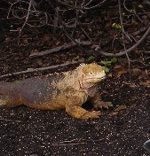
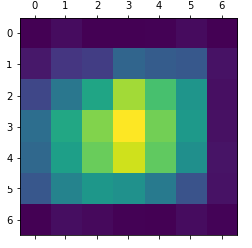
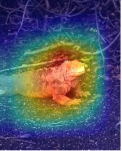
Step 3: GradCam for bounding box generation
GradCam provides us with a way to investigate what parts of the image influenced the whole model’s decision.
The intuition behind the algorithm is based upon the fact that the model must have seen some pixels (or regions of the image) and decided on what object is present in the image.
By using the gradients from the last convolutional layer (as shown in second figure), Grad-CAM can highlight the regions of the image that most influenced the network's prediction.
Image source: https://medium.com/@stepanulyanin/implementing-grad-cam-in-pytorch-ea0937c31e82

Slide 9
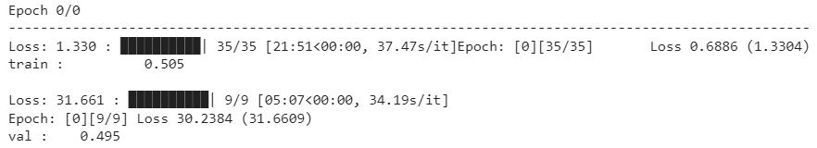
Evaluation metrics
Since the model was trained on just one epoch, the overall accuracy of the model is not good.
Training on higher epochs will result in better accuracy
Here the training loss is 1.33 and training accuracy is 50.5%
The evaluation loss is 31.661 and validation accuracy is 49.5%

Slide 10

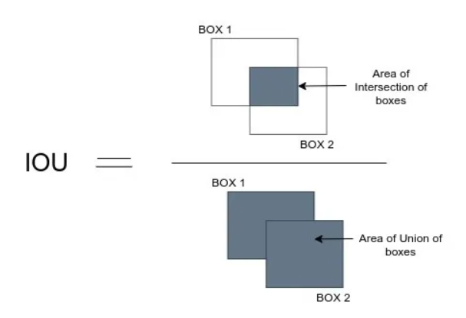
Evaluation Metrics
The accuracy of Gradcam is based on Intersection Over Union (IOU). i.e how much overlapping is present between ground truth and model output
Intersection Over Union (IoU)
Where one box is actual area, another is
predicted area
https://medium.com/analytics-vidhya/iou-intersection-over-union-705a39e7acef

Slide 11
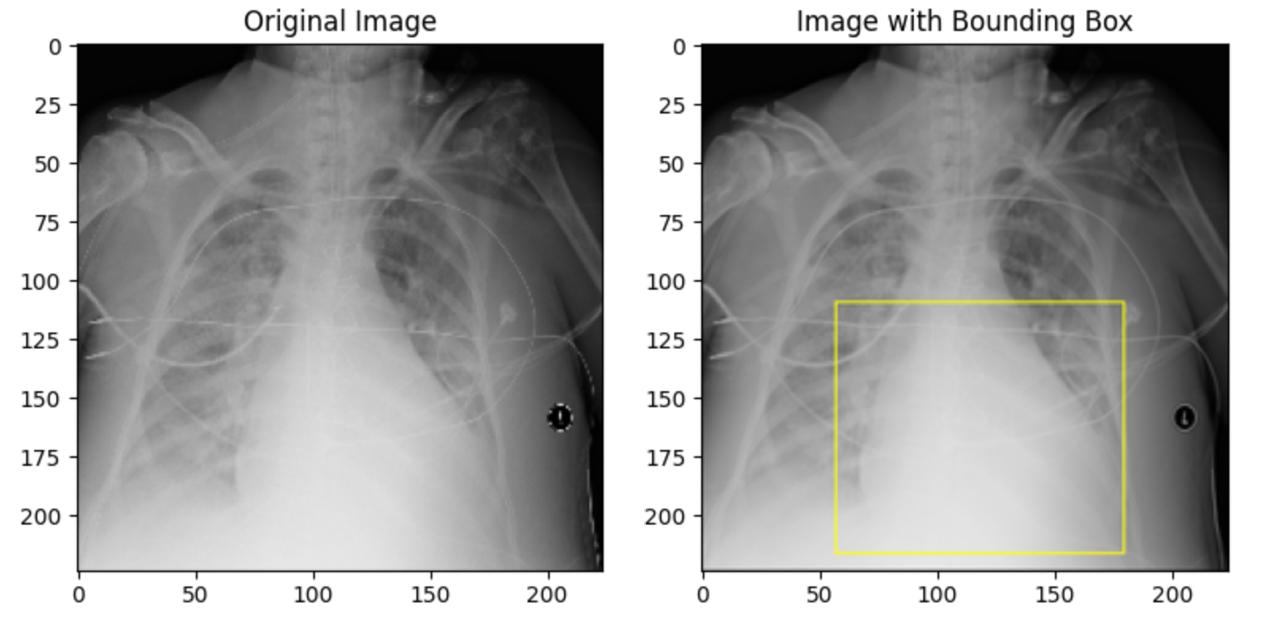
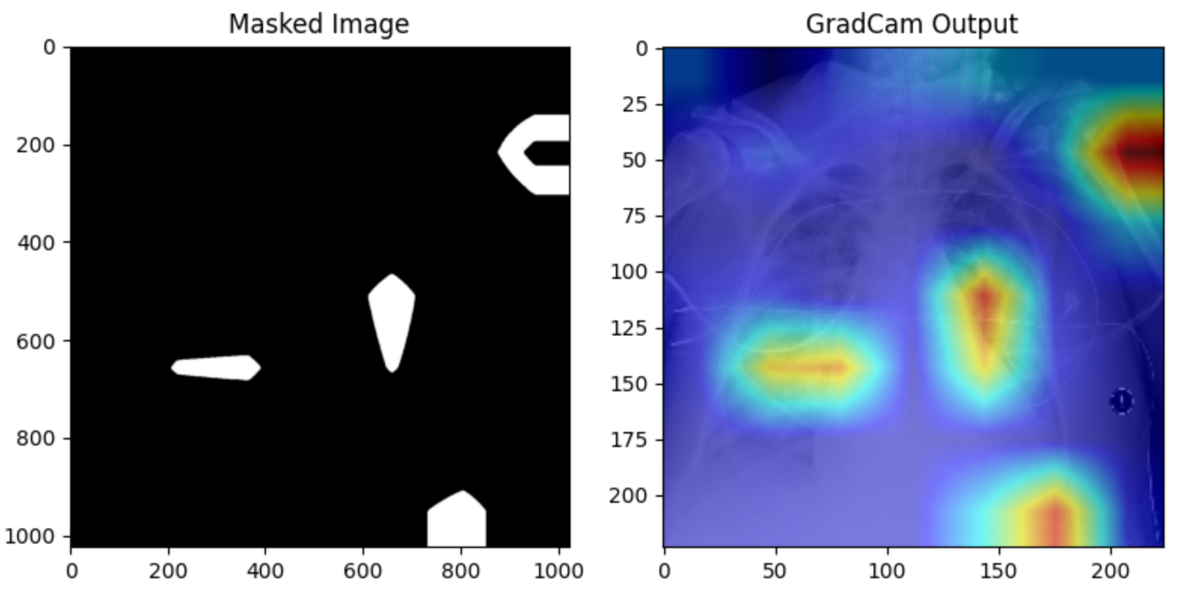
Generated output of GradCam
Once you open output folder, you will find 4 different images for one input image
gtimage_(name of original image).png: image with bounding box
mask_(name of original image).png: masked image
original__(name of original image).png: original image
pred_(name of original image).png: GradCam output

Slide 12
Generated output
Original Image: This is the original input image without any modifications.
gtimage: This image is created by drawing a bounding box (in yellow) around the region of interest (ROI). The bounding box is typically obtained from the ground truth bounding box coordinates provided in the dataset.
Mask Image: This image is created by applying a mask to the original image. The mask is derived from the GradCAM or GradCAM++ output and represents regions of high significance for the predicted class. Only the regions with high values in the mask are retained in this image, while other areas are masked out.
Pred Image: This image visualizes the GradCAM or GradCAM++ output, highlighting the regions in the image that are most important for the model's prediction of the target class. This image typically shows regions of high activation in the neural network for the specific class.

Slide 13
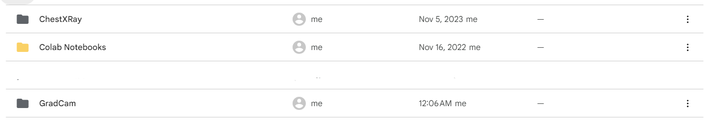
Data storage
The Google drive where the input and output data is stored looks like this
Contains a total of 5552 images used for fine tuning ResNet
Contains all images that has Cardiomegaly and a json and BB.csv file that is used for generating bounding boxes

Slide 14
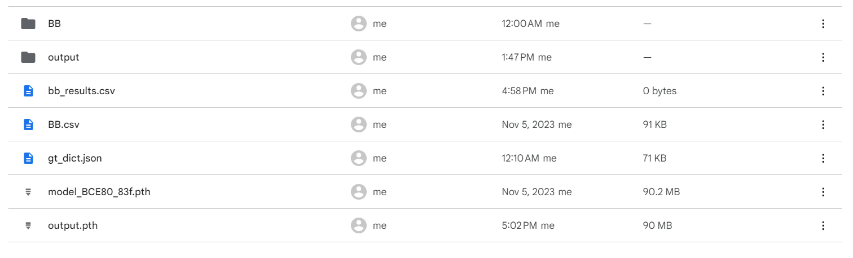
Data Storage
When you open GradCam folder, it looks like this
BB folder contains all Cardiomelagy images (ground truth images)
All generated files will be stored in output folder

Slide 15
Model file
Once finetuning is completed, a new model file named output.pth will be generated.
Since this is obtained on just 1 epoch, the performance is not accurate. Hence use the ResNet model trained on 10 epochs named “Chest_cardi_001.pth” for GradCam which has a higher accuracy as it is trained on a larger number of epochs.
bb_results.csv is a generated file that stores all the results such as location in the image which the model thinks is good for classification.

