Slide 1
BERT and ClinicalBERT

Slide 2
2018 Oct
2019 Jan
2019 Mar
2019 April
BERT
BioBERT
SciBERT
ClinicalBERT

Slide 3
2018 Oct
2019 Jan
2019 Mar
2019 April
BERT
BioBERT
SciBERT
ClinicalBERT
BERT = Bidirectional Encoder Representation from Transformers
BERT is published by Google in 2018. It obtained the best accuracy in 11 different NLP tasks.
Notes:
At the end of 2018 researchers at Google AI Language open-sourced a new technique for Natural Language Processing (NLP) called BERT (Bidirectional Encoder Representations from Transformers) — a major breakthrough which took the Deep Learning community by storm because of its incredible performance.

Slide 4
Why was BERT needed?
The lack of training data was a big challenge in NLP, as deep learning models require large amounts of annotated data to perform well.
To address this, researchers have developed pre-training techniques such as BERT to utilize unannotated text data.
These kind of pre-trained models (e.g., BERT) can be fine-tuned on smaller task-specific datasets (e.g., MIMIC notes) to get fine-tuned models (e.g., BioBERT, SciBERT, ClinicalBERT) to achieve better accuracy in specific domain.
Read more: https://towardsml.wordpress.com/2019/09/17/bert-explained-a-complete-guide-with-theory-and-tutorial/

Slide 5
What is the core idea behind BERT?
BERT takes advantages of multiple models
(1) BERT predicts word from given context - Word2Vec CBOW
(2) 2-layer bidirectional model –ELMO (a word embedding method for representing a sequence of words as a corresponding sequence of vectors)
(3) Transformer instead of RNN –GPT (Generative Pre-training)
Use Transformer proposed in Attention is All you need in 2017 to replace RNN
Notes:
It has two phases: pre-training and fine-tuning.

Slide 6
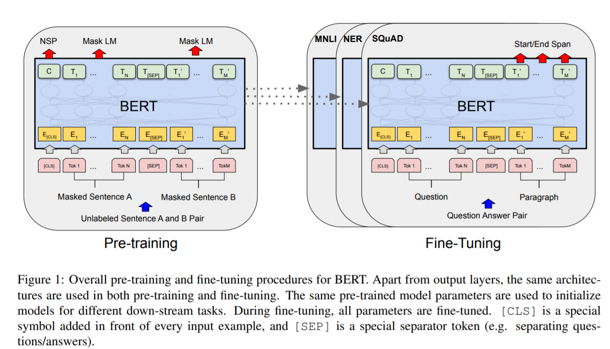
Bert：Pretraining and fine-tuning
The corpus BERT uses for pre-training is BooksCorpus and English Wikipedia.
https://arxiv.org/pdf/1810.04805.pdf
https://huggingface.co/blog/bert-101
Notes:
It has two phases: pre-training and fine-tuning.

Slide 7
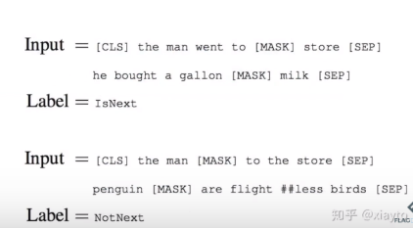
Bert-Pretraining task
Uses Masked Language Model to train model.
It masks 15% words of doc:
80% use “[mask]”
10% use original word
10% use a random word
e.g., To be or [mask] to be, that is the question
2. Continuous sentence or not
To be or not to be, that is the question VS To be or not to be, or to take arms against a sea of troubles
Notes:
For pre-training, there are two tasks for BERT. The first one masked language model to train model, inspired by the cloze task. It masks 15% words randomly to let the model to predict the masked words. In this way, they force the model to memory the context. 80% of masked words are replaced with “[mask]”, 10% use original word and 10% use random word. The second task is to pre-train the model to predict whether the two sentences input are continuous or not. For example, “To be or not to be, that is the question” is a classic saying from Hamlet. Then the first pre-training task will randomly mask some words in the sentence, just like “to be or [mask] to be, that is the question”. The second task will extract continuous sentence from documents, and also generate same negative samples: discontinuous sentences like “To be or not to be, or to take arms against a sea of troubles”.

Slide 8
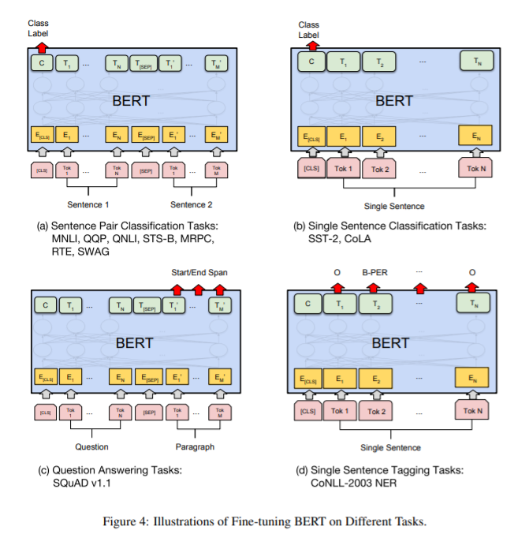
Fine tuning tasks
https://arxiv.org/pdf/1810.04805.pdf

Slide 9
Why ClinicalBERT?
Directly applying BERT to biomedical NLP tasks is not promising because of a word distribution shift from general domain corpus to biomedical domain corpus.
Thus, other models e.g, BioBERT [2] and BlueBERT [3], SciBERT, ClinicalBERT pretrained on biomedical domain corpus are proposed.

Slide 10
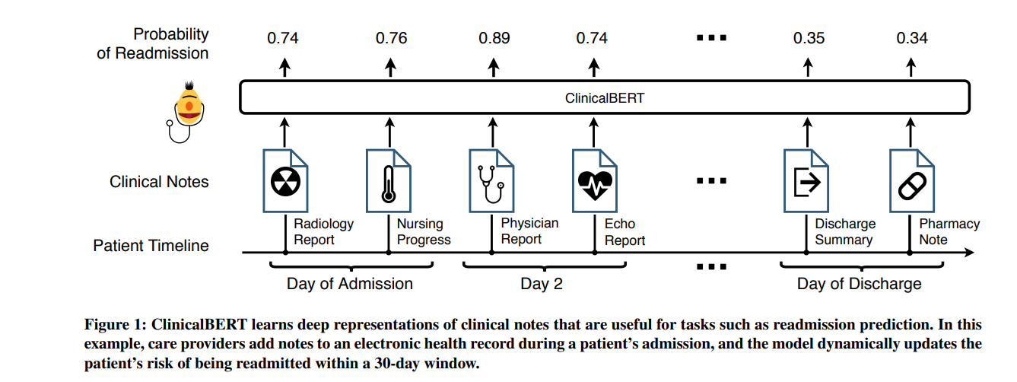
ClinicalBERT finetuning
https://arxiv.org/pdf/1904.05342.pdf
Notes:
The text corpora used for pre-training of BioBERT are listed in Table 1, and the tested combinations of text corpora are listed in Table 2.

Slide 11
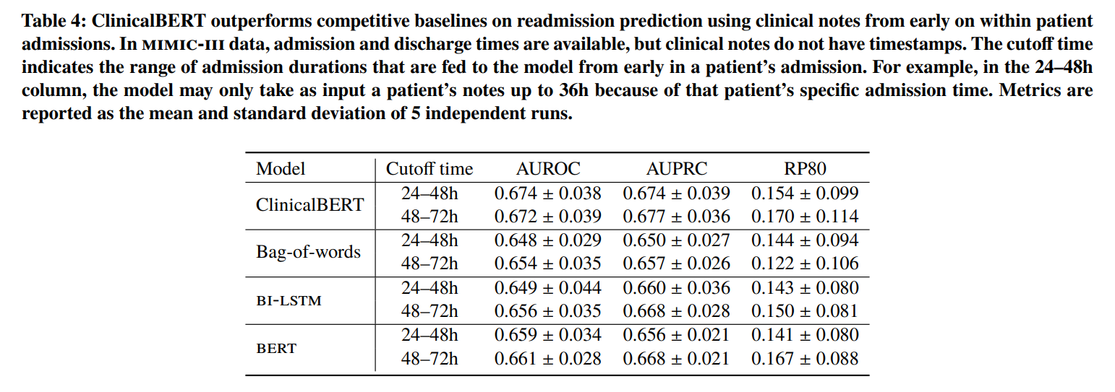
Finetuning task: Readmission prediction
RP80: Recall at Precision 80%, which is used to control false positive.
https://arxiv.org/pdf/1904.05342.pdf

Slide 12
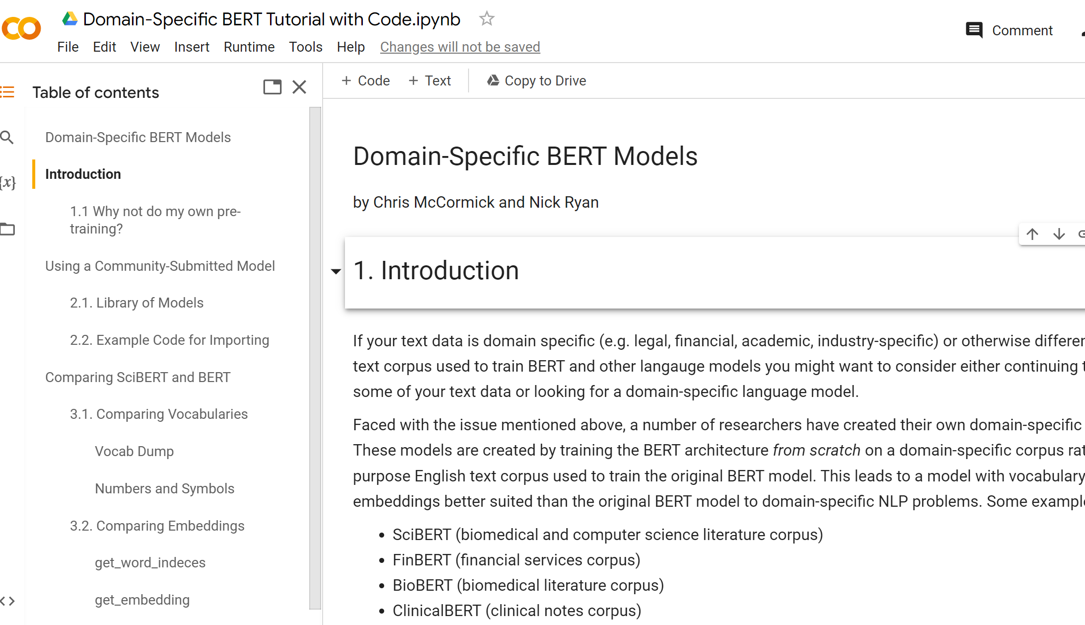
ClinicalBert Tutorial
Modified from Chris McCormick and Nick Ryan's SciBERT Tutorial
https://colab.research.google.com/drive/19loLGUDjxGKy4ulZJ1m3hALq2ozNyEGe#scrollTo=uXKyKe3NZONV

Slide 13
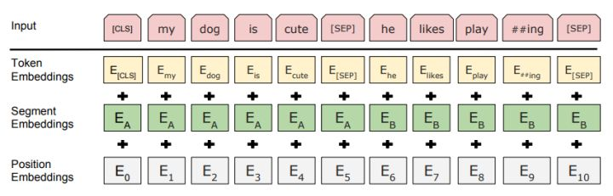
BERT_base has 13 hidden layers: the first layer = sub-word embedding layer = “input embeddings”= Token embeddings+ Segment Emb+ Position Emb) The last layer = Contextual representations = final output of BERT = we usually use this as embeddings for other tasks .
Bert/ClinicalBERT Architecture
https://arxiv.org/abs/1810.04805

Slide 14
BERT (clinical bert)’s first layer: Input embeddings
Token embeddings: A [CLS] token is added to the input word tokens at the beginning of the first sentence and a [SEP] token is inserted at the end of each sentence.
Segment embeddings: A marker indicating Sentence A or Sentence B is added to each token. This allows the encoder to distinguish between sentences.
Positional embeddings: A positional embedding is added to each token to indicate its position in the sentence.

Slide 15
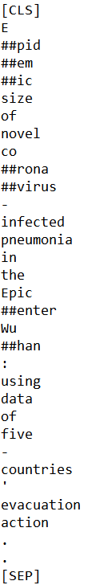
Tokenizer
The token embeddings are obtained from WordPiece. An example of the tokenized word is “coronaviruses” => “Co##rona##virus##es”.
For the named entity recognition task, [CLS] is added at the beginning of each sentence and [SEP] is added at the end of each sentence.
https://arxiv.org/pdf/1609.08144v2.pdf

Slide 16
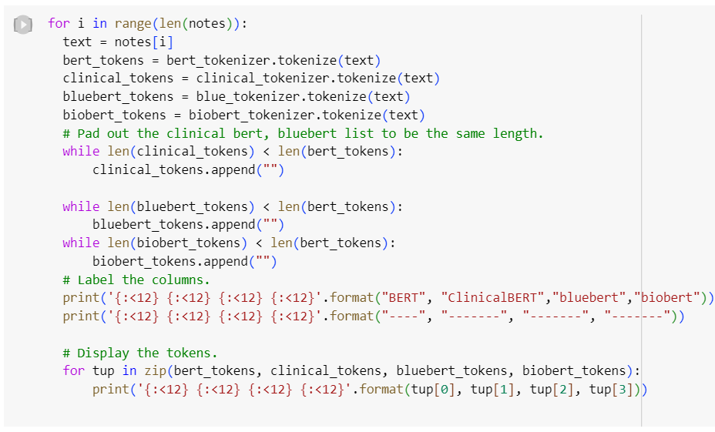
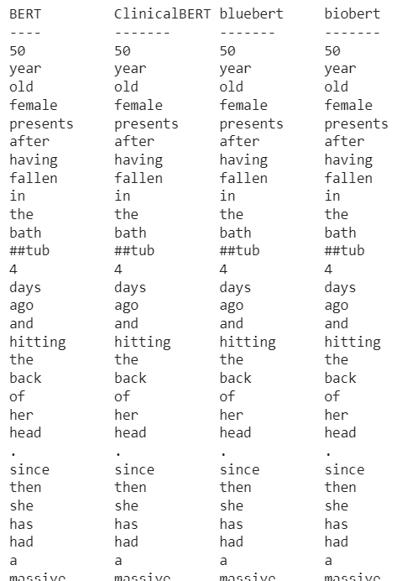
Compare all BERT and its variant Tokenizer

Slide 17
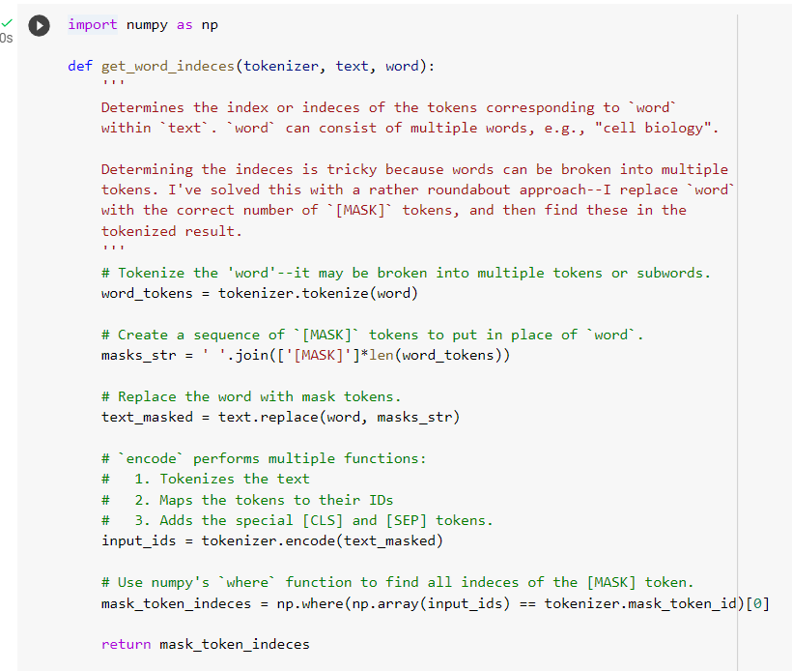
Get word embedding and sentence embedding

Slide 18
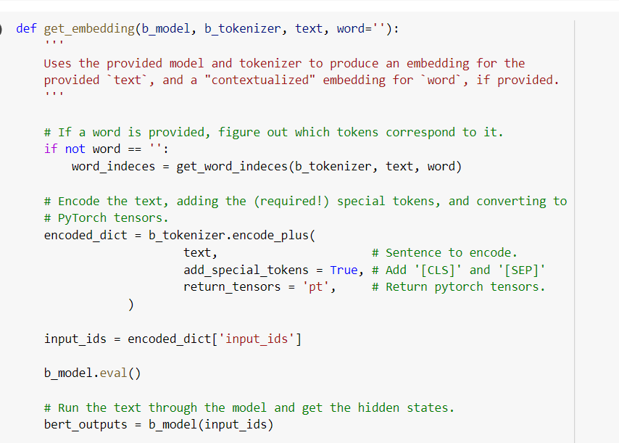
Get word embedding and sentence embedding

Slide 19
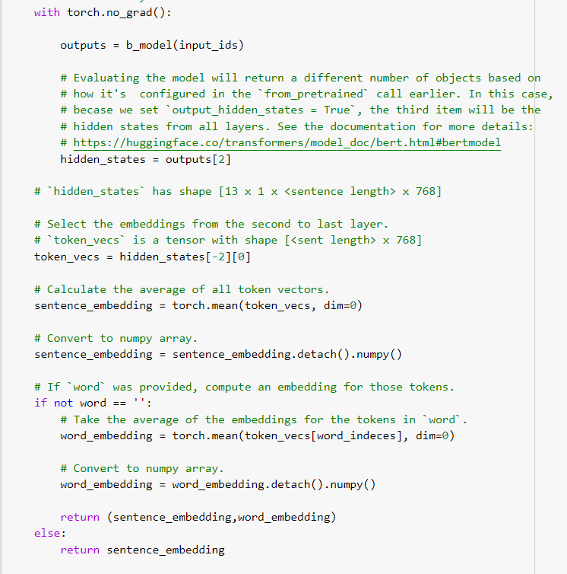
Get word embedding and sentence embedding

Slide 20
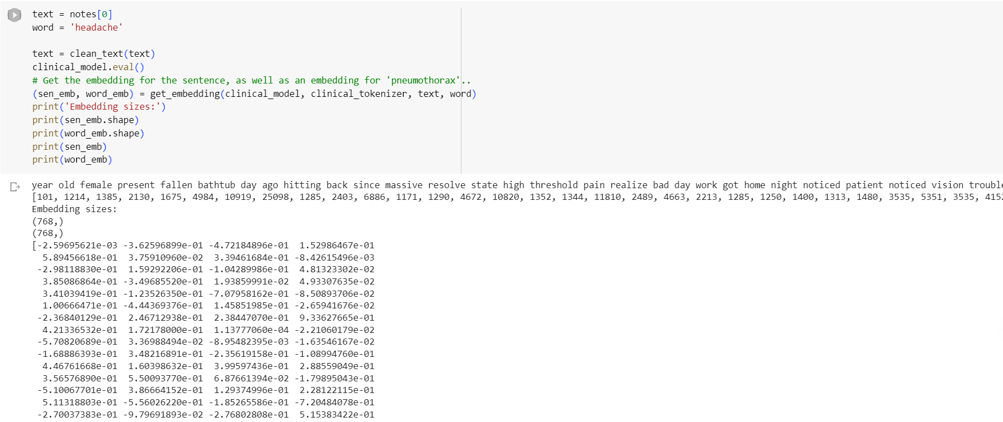
Embeddings of Clinical Bert

Slide 21
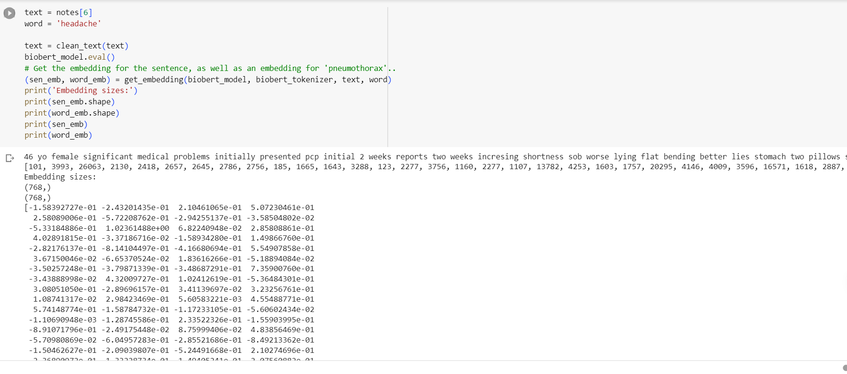
Embeddings of Bio Bert

Slide 22
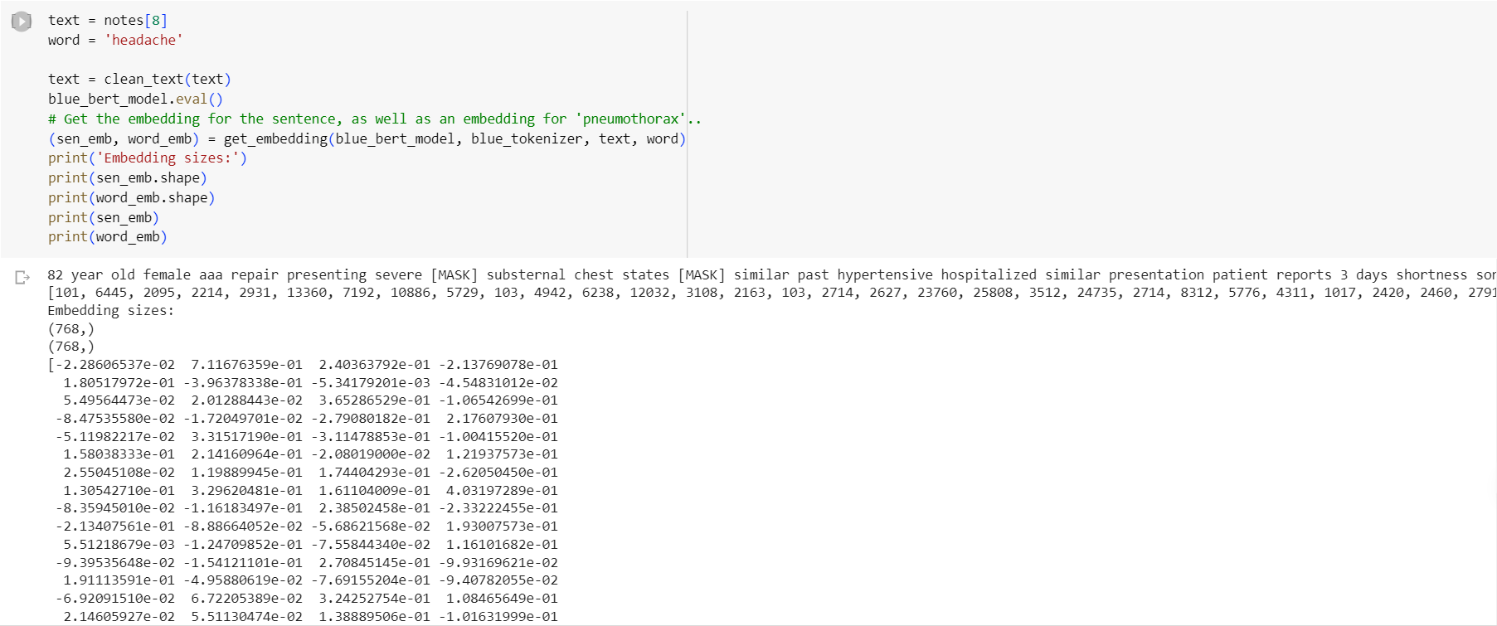
Embeddings of Blue Bert

Slide 23
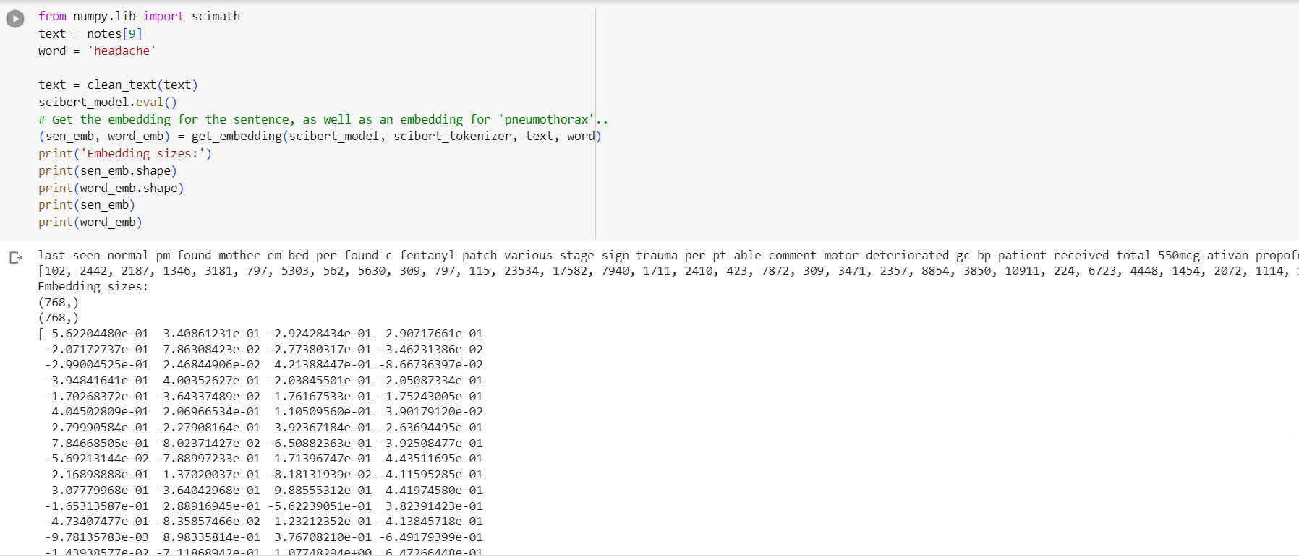
Embeddings of Sci Bert

Slide 24
References:
1. Bert: https://github.com/google-research/bert
Devlin, J., Chang, M. W., Lee, K., & Toutanova, K. (2018). Bert: Pre-training of deep bidirectional transformers for language understanding. arXiv preprint arXiv:1810.04805.
2. BioBert: https://github.com/dmis-lab/biobert
Lee, J., Yoon, W., Kim, S., Kim, D., Kim, S., So, C. H., & Kang, J. (2019). BioBERT: pre-trained biomedical language representation model for biomedical text mining. arXiv preprint arXiv:1901.08746.
Notes:
Here are the references: I mainly read the original paper of BERT, BioBERT, Transformer, a blog explaining Bert’s embedding, and a 1 hour long video about latest NLP models. Thank you for watching

Slide 25
Notes: this tutorial is built based on these reference:
1. https://towardsml.wordpress.com/2019/09/17/bert-explained-a-complete-guide-with-theory-and-tutorial/
2. Transformer:
Vaswani, A., Shazeer, N., Parmar, N., Uszkoreit, J., Jones, L., Gomez, A. N., ... & Polosukhin, I. (2017). Attention is all you need. In Advances in neural information processing systems (pp. 5998-6008).
3. https://www.youtube.com/watch?v=Po38Dl-XDd4
4. https://medium.com/@_init_/why-bert-has-3-embedding-layers-and-their-implementation-details-9c261108e28a

