Slide 1
MIMIC III & IV
AI in Health
UT Austin

Slide 2
MIMIC III ICU Data
MIMIC (Medical Information Mart for Intensive Care) is an openly available dataset developed by the MIT Lab for Computational Physiology, comprising deidentified health data associated with ~60,000 intensive care unit admissions. It includes demographics, vital signs, laboratory tests, medications, and more.
The latest version of MIMIC is MIMIC-III v1.4, which comprises 61,532 intensive care unit stays at Beth Israel Deaconess Medical Center in Boston, Massachusetts: 53,432 stays for adult patients and 8,100 for neonatal patients. The data spans June 2001 - October 2012.

Slide 3
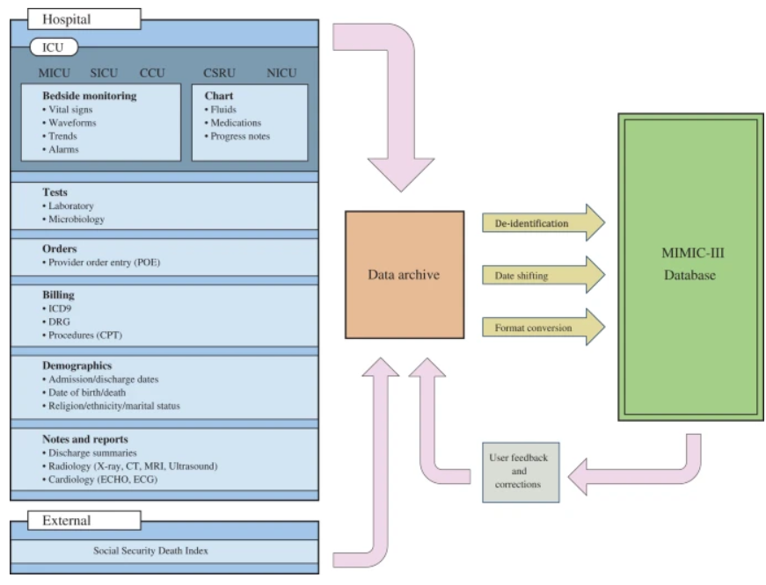
Overview of MIMIC III ICU data

Slide 4
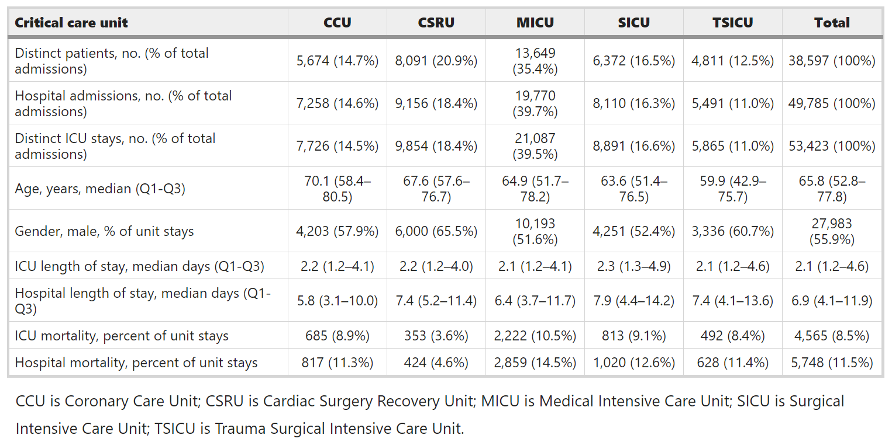
Data statistics

Slide 5
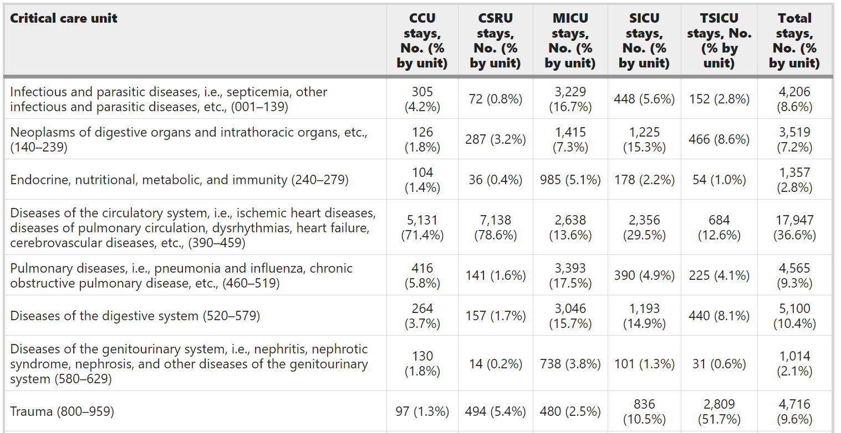
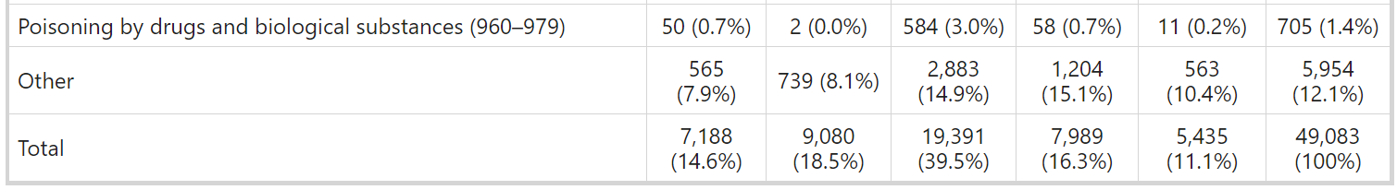
ICD9 code coverage by patients 16 years older

Slide 6
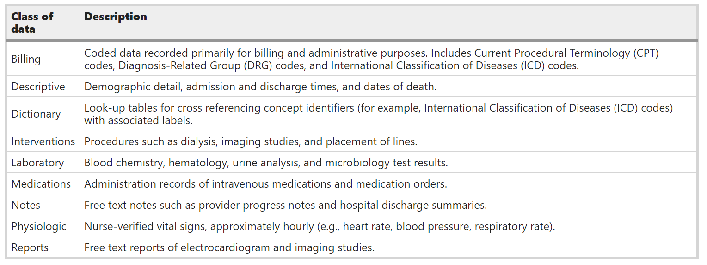
Kinds of data available at MIMIC III

Slide 7
MIMIC data source
Data was downloaded from several sources, including:
archives from critical care information systems.
time-stamped nurse-verified physiological measurements (for example, hourly documentation of heart rate, arterial blood pressure, or respiratory rate);
documented progress notes by care providers;
continuous intravenous drip medications and fluid balances.
hospital electronic health record databases.
patient demographics and in-hospital mortality.
laboratory test results (for example, hematology, chemistry, and microbiology results).
discharge summaries and reports of electrocardiogram and imaging studies.
billing-related information such as International Classification of Disease, 9th Edition (ICD-9) codes, Diagnosis Related Group (DRG) codes, and Current Procedural Terminology (CPT) codes.
Social Security Administration Death Master File.
Out-of-hospital mortality dates

Slide 8
Related Projects
Several projects are ongoing to map concepts within the MIMIC database to standardized dictionaries:
Researchers at the National Library of Medicine National Institutes of Health have mapped laboratory tests and medications in MIMIC-II to LOINC and RxNorm, respectively.
Efforts are also underway to transform MIMIC to common data models, such as the Observational Medical Outcomes Partnership (OMOP) Common Data Model, to support the application of standardized tools and methods.

Slide 9
MIMIC Data
MIMIC-III is a relational database consisting of 26 tables.
Tables are linked by identifiers which usually have the suffix ‘ID’. For example, SUBJECT_ID refers to a unique patient, HADM_ID refers to a unique admission to the hospital, and ICUSTAY_ID refers to a unique admission to an intensive care unit.

Slide 10
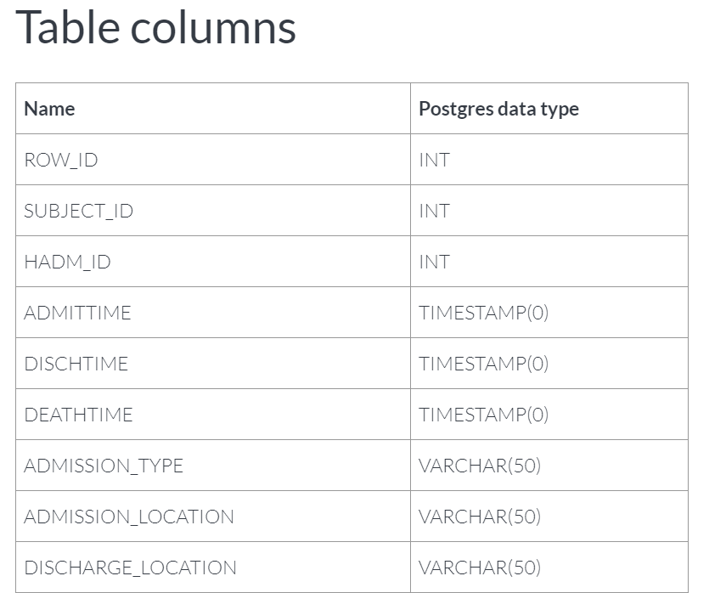
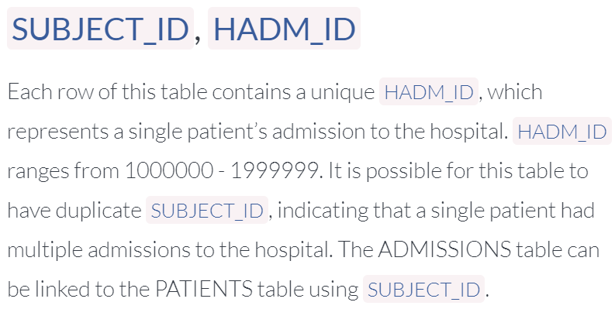
Each table details
https://mimic.mit.edu/docs/iii/tables/admissions/

Slide 11
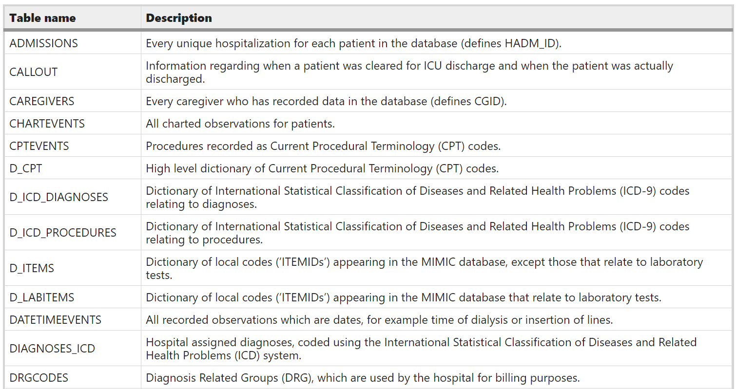
MIMC III Tables

Slide 12
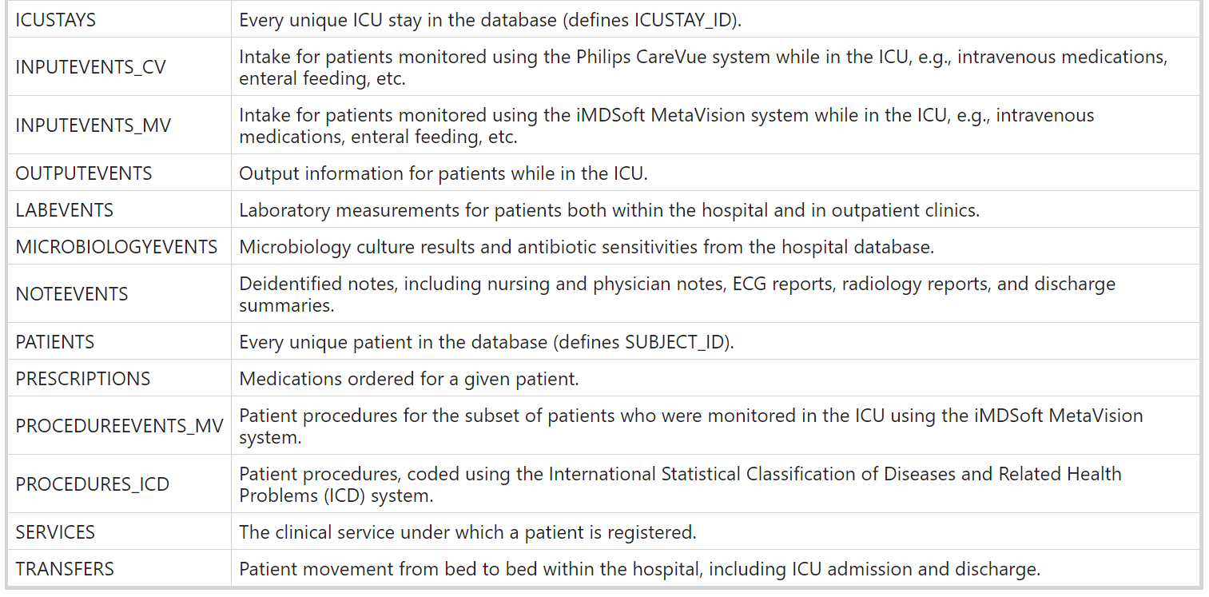
MIMC III Tables

Slide 13
Common Tables
Define and track patient stays:
ADMISSIONS; PATIENTS; ICUSTAYS; SERVICES; and TRANSFERS.
Cross-referencing codes against their respective definitions:
D_CPT; D_ICD_DIAGNOSES; D_ICD_PROCEDURES; D_ITEMS; and D_LABITEMS.
The remaining tables contain data associated with patient care, such as physiological measurements, caregiver observations, and billing information.

Slide 14
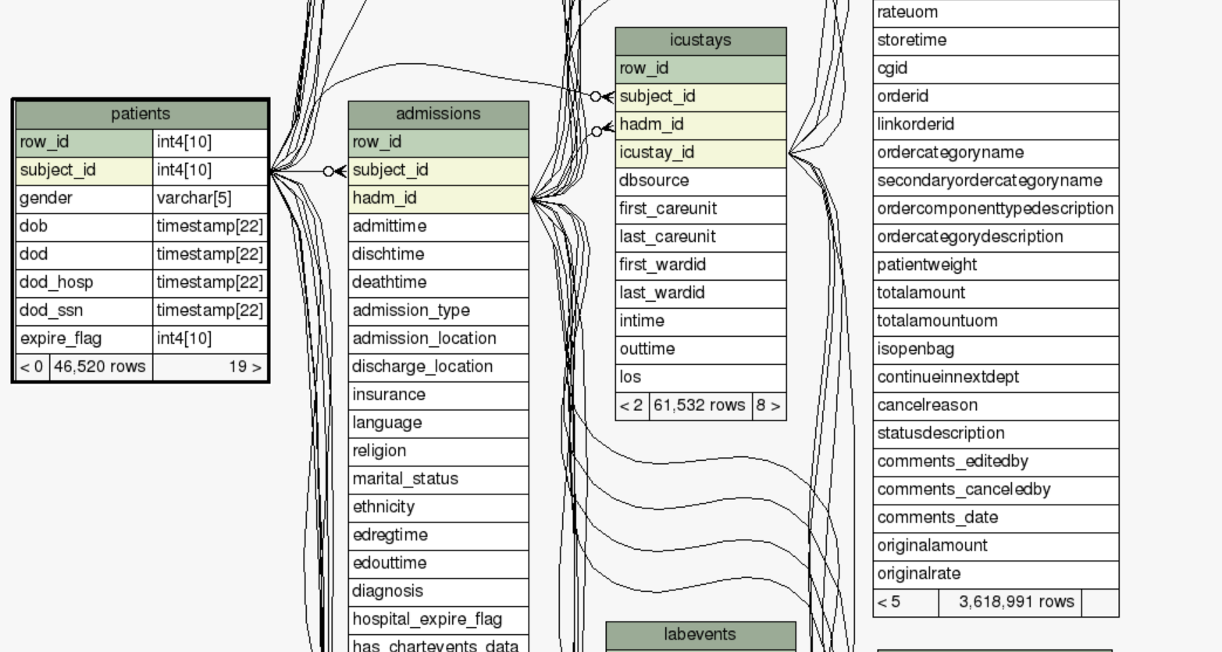
MIMIC III Data Schema
Data Schema: https://mit-lcp.github.io/mimic-schema-spy/

Slide 15
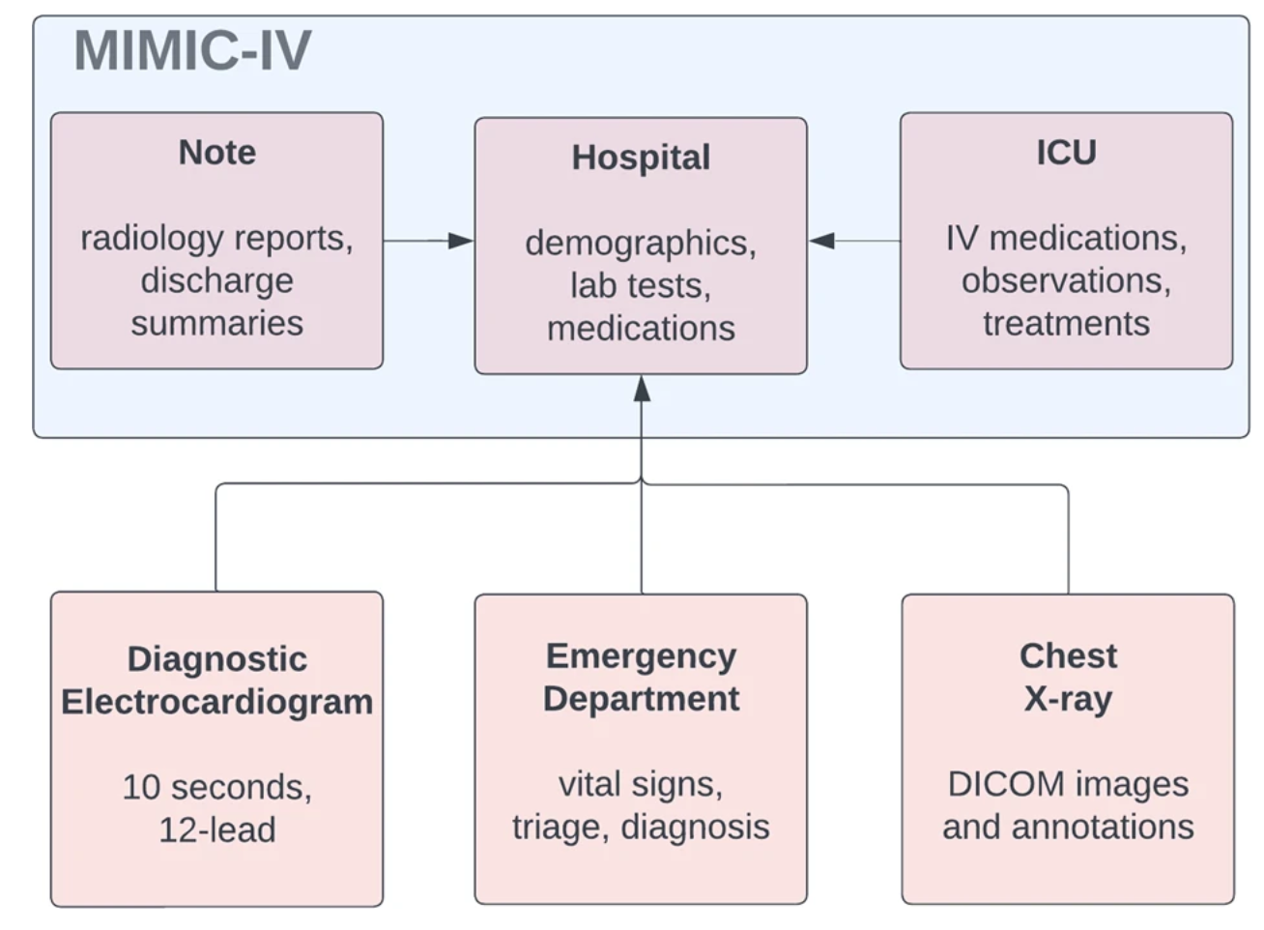
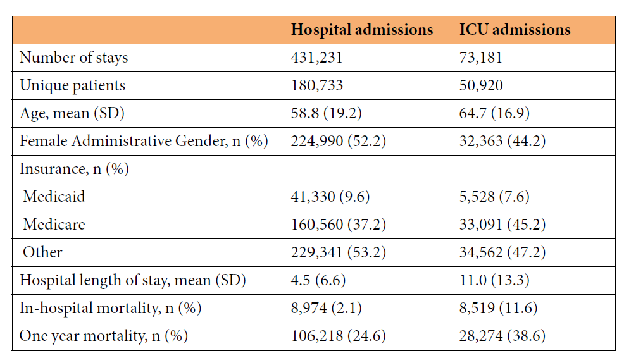
MIMIC IV
MIMIC-IV
2008–2019
ICD 9 and ICD 10
three modules: hosp, icu, and note
https://www.nature.com/articles/s41597-022-01899-x

Slide 16
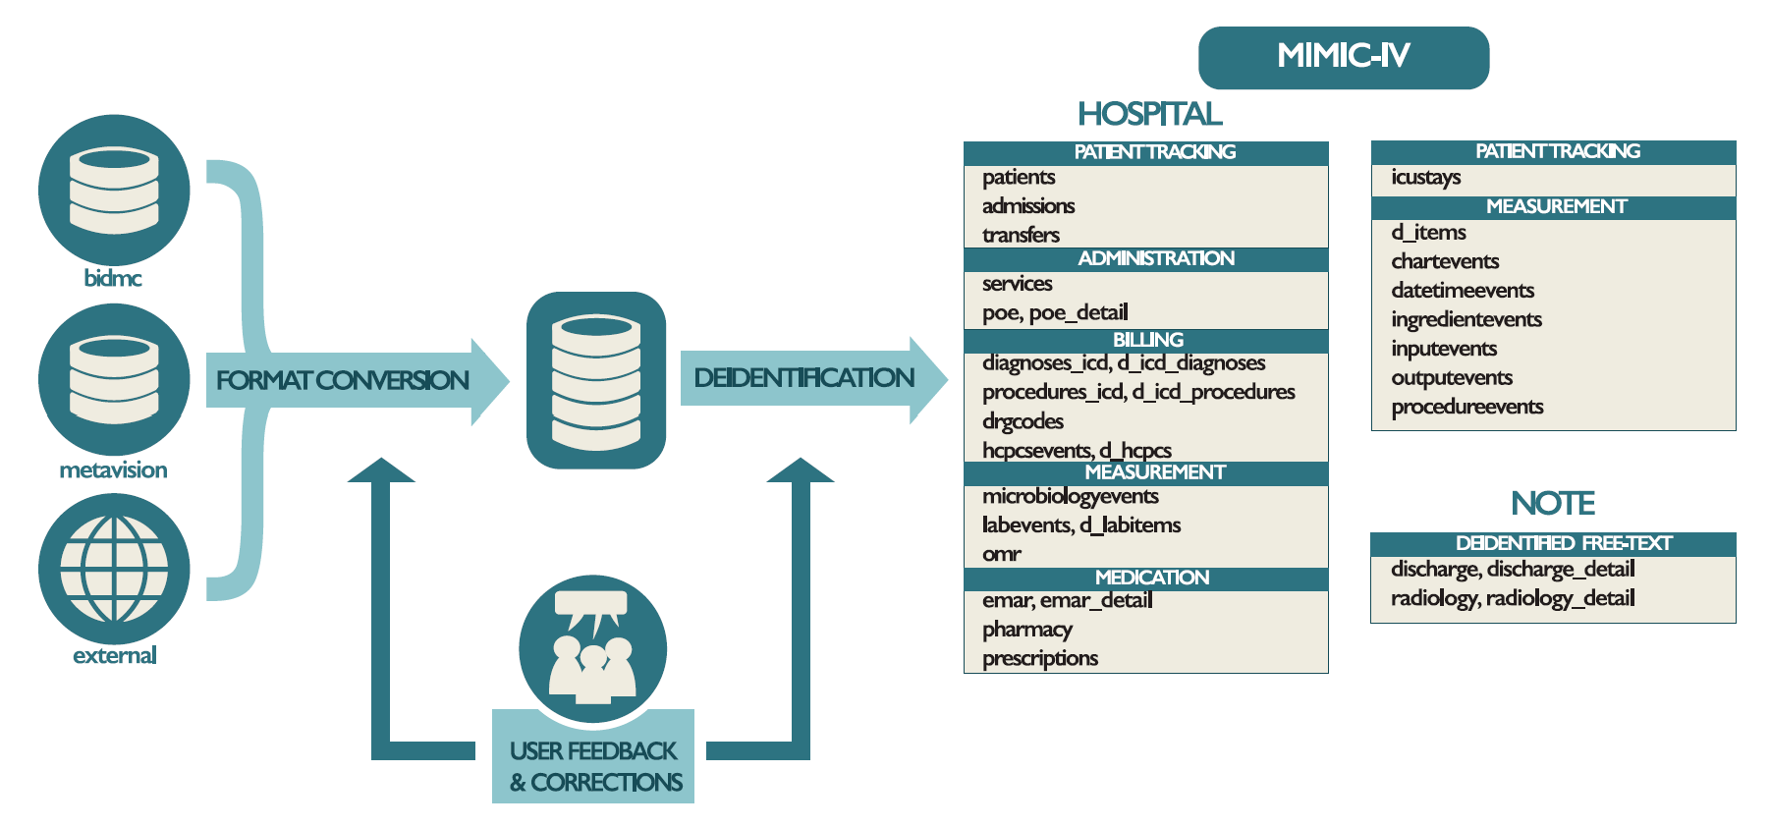
MIMIC IV

Slide 17
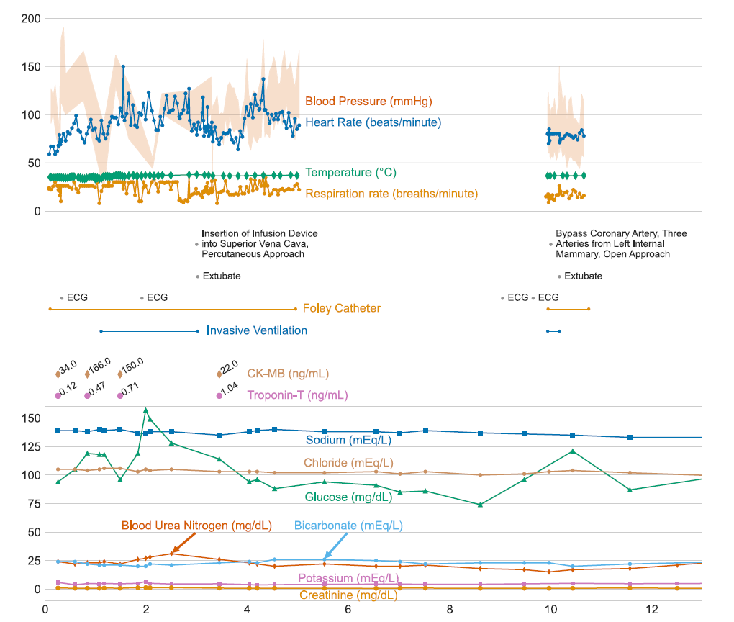
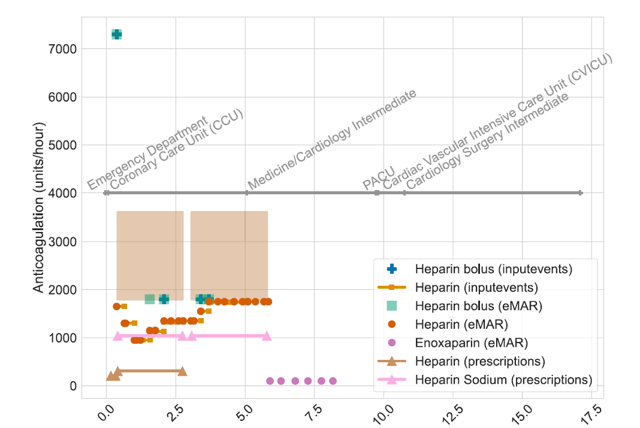
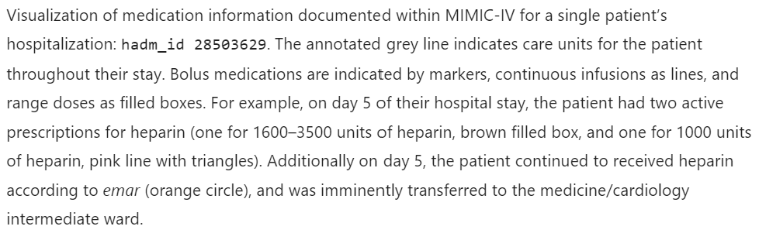
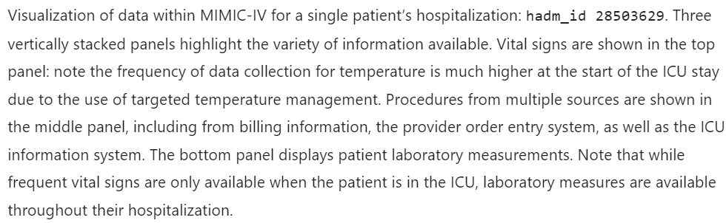
MIMIC IV Examples

Slide 18
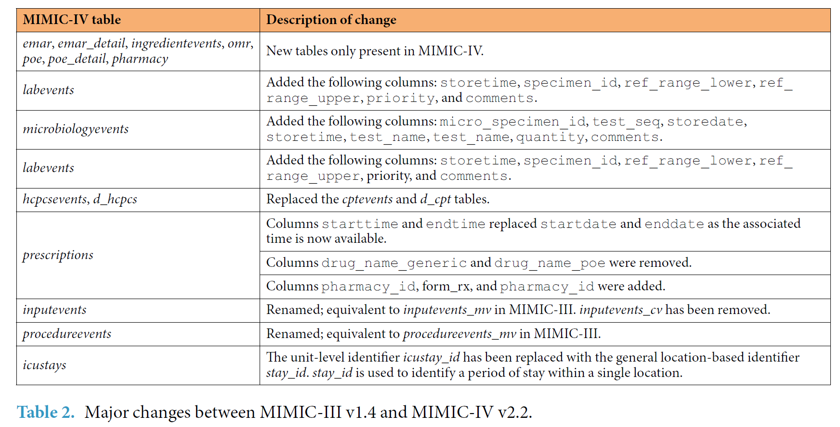
electronic Medicine Administration Record (eMAR)
Online Medical Record (OMR)
the provider order entry (POE) system

Slide 19
Other data at MIMIC
https://physionet.org/content/
For example
Chest X-ray data: https://physionet.org/content/mimic-cxr/2.0.0/:
The MIMIC Chest X-ray (MIMIC-CXR) Database v2.0.0 is a large publicly available dataset of chest radiographs in DICOM format with free-text radiology reports. The dataset contains 377,110 images corresponding to 227,835 radiographic studies performed at the Beth Israel Deaconess Medical Center in Boston, MA. The dataset is de-identified to satisfy the US Health Insurance Portability and Accountability Act of 1996 (HIPAA) Safe Harbor requirements. Protected health information (PHI) has been removed. The dataset is intended to support a wide body of research in medicine including image understanding, natural language processing, and decision support

Slide 20
Other Datasets
The eICU Collaborative Research Database (eICU-CRD) v2.0 comprises of 200,859 stays at ICUs and step-down units across 208 hospitals in the continental United States - https://www.nature.com/articles/sdata2018178
The HiRID database contains high-resolution data for almost 34,000 admissions between 2008–2016 at Bern University Hospital in Switzerland - https://physionet.org/content/hirid/1.1.1/
The Pediatric Intensive Care (PIC) database is sourced from The Children’s Hospital at Zhejiang University School of Medicine with 12,881 patients and 13,941 ICU stays admitted from 2010–2018 - http://pic.nbscn.org/

Slide 21
MIMIC III data access
https://mimic.physionet.org/gettingstarted/access/
Start now, it will take 1-2 weeks
When you submit the project description, say you are attending this course and will work on MIMIC on course assignments and group projects
MIMIC Demo Data
https://physionet.org/content/mimiciii-demo/1.4/

Slide 22
References
https://www.nature.com/articles/sdata201635
https://mimic.physionet.org/
https://mimic.mit.edu/docs/iii/tables/
https://physionet.org/content/mimiciv/2.2/
https://www.nature.com/articles/s41597-022-01899-x

