Slide 1
MIMIC Tutorial
SQL Search

Slide 2
MIMIC III
MIMIC-III (Medical Information Mart for Intensive Care III) is a large, freely-available database comprising de-identified health-related data associated with over forty thousand patients who stayed in critical care units of the Beth Israel Deaconess Medical Center between 2001 and 2012.
The database includes information such as demographics, vital sign measurements made at the bedside (~1 data point per hour), laboratory test results, procedures, medications, caregiver notes, imaging reports, and mortality (both in and out of hospital).

Slide 3
MIMIC III
MIMIC supports a diverse range of analytic studies spanning epidemiology, clinical decision-rule improvement, and electronic tool development. It is notable for three factors:
it is freely available to researchers worldwide
it encompasses a diverse and very large population of ICU patients
it contains high temporal resolution data including lab results, electronic documentation, and bedside monitor trends and waveforms.

Slide 4
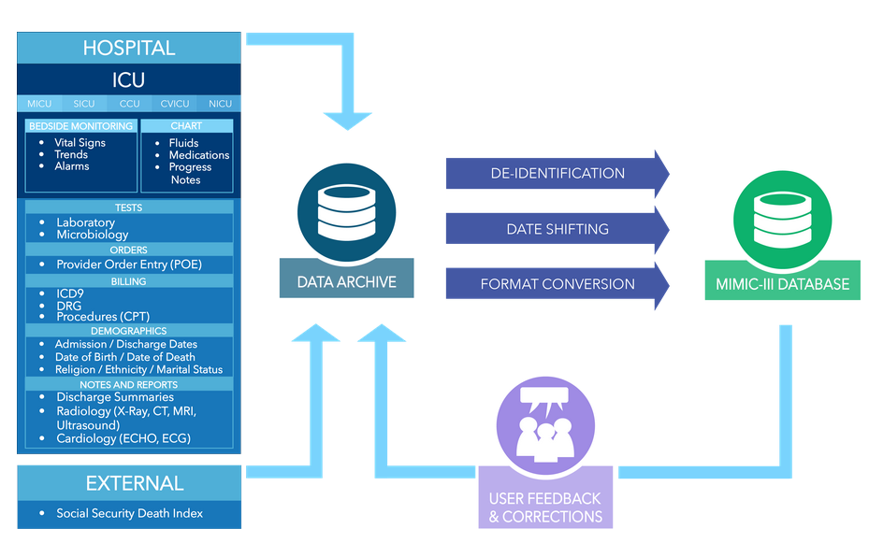
Overall

Slide 5
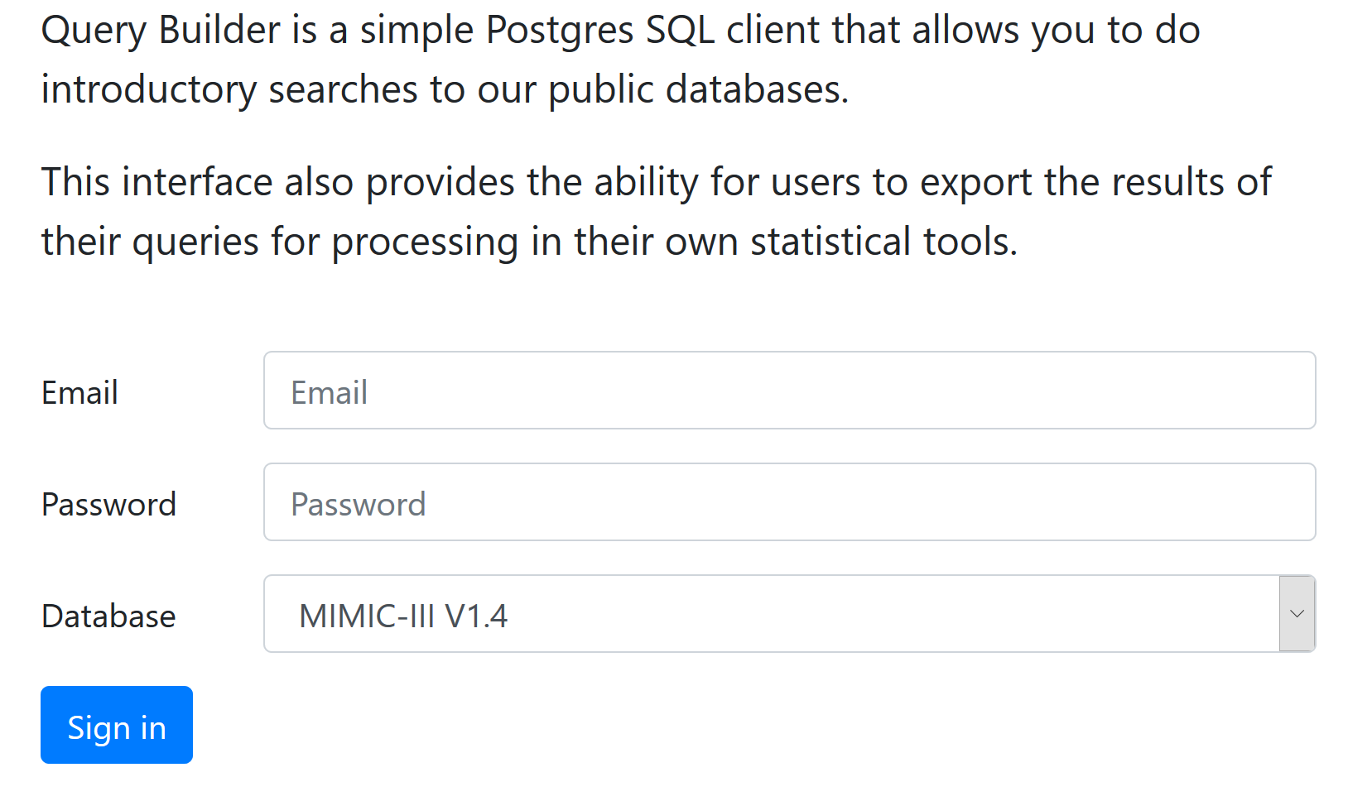
SQL Query Builder
https://querybuilder-lcp.mit.edu/

Slide 6
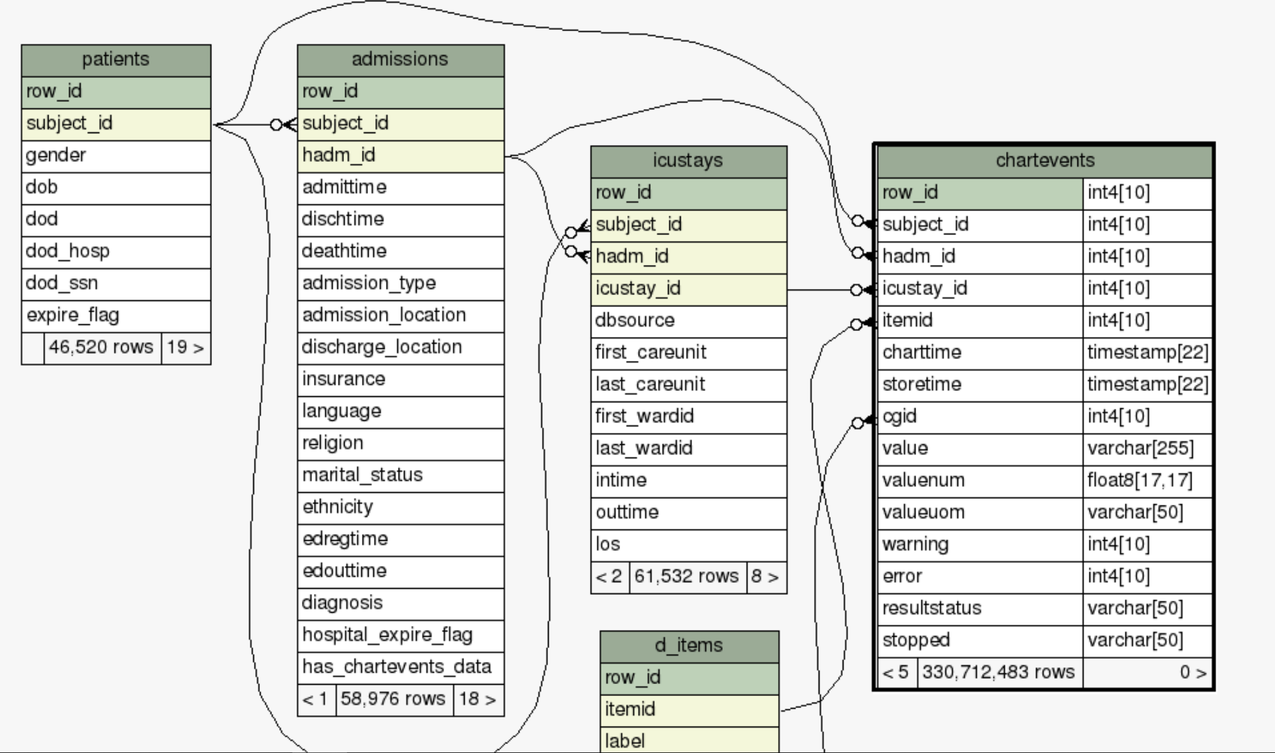
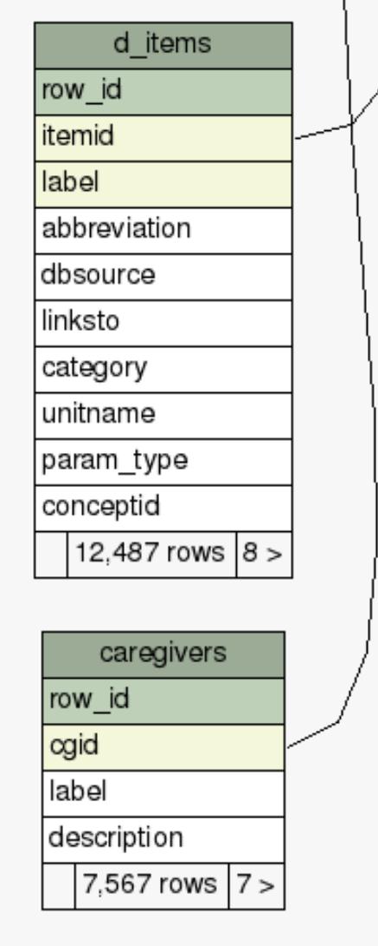
MIMIC III Tables
https://mimic.mit.edu/docs/gettingstarted/

Slide 7
MIMIC III
Tables and relationships
https://mit-lcp.github.io/mimic-schema-spy/tables/patients.html
Table Schema
https://mimic.mit.edu/docs/iii/tables
MIMIC III full dataset download:
https://physionet.org/content/mimiciii/1.4/

Slide 8
SQL Queries: Search patients
SELECT *
FROM patients
WHERE subject_id BETWEEN 109 AND 127;
SELECT *
FROM patients;
SELECT subject_id, dob, gender
FROM patients;
SELECT subject_id, dob
FROM patients
ORDER BY dob;
SELECT count(*)
FROM patients;
SELECT *
FROM patients
WHERE subject_id = 109
OR subject_id = 117
OR subject_id = 127;
SELECT subject_id, dob, round( ( (cast(dod as date) - cast(dob as date)) / (365) ) )as age
FROM patients
Where EXPIRE_FLAG = 1
order by age DESC;
SELECT count(*)
FROM patients
WHERE gender = 'F';
SELECT *
FROM patients
WHERE subject_id IN (109, 117, 127);
SELECT count(*)
FROM patients
Where EXPIRE_FLAG = 1
SELECT count(subject_id), round( ( (cast(dod as date) - cast(dob as date)) / (365) ) )as age
FROM patients
Where EXPIRE_FLAG = 1
group by age
order by age DESC;
SELECT *
FROM patients
WHERE subject_id >= 109
AND subject_id <= 127;
SELECT count(*)
FROM patients
Where EXPIRE_FLAG = 1 and gender = 'F';

Slide 9
Search admissions table
SELECT admission_type, count(HADM_ID)
FROM admissions
where insurance LIKE 'Self Pay'
group by admission_type
SELECT admission_type, count(HADM_ID)
FROM admissions
group by admission_type
SELECT
admission_type, diagnosis, ethnicity
FROM admissions
WHERE insurance LIKE 'Self Pay';
SELECT ETHNICITY, count(HADM_ID)
FROM admissions
where insurance LIKE 'Self Pay'
group by ETHNICITY
SELECT diagnosis, insurance
FROM admissions
WHERE ethnicity LIKE 'HISPANIC OR LATINO';
SELECT distinct(insurance), count(HADM_ID)
FROM admissions
WHERE ethnicity LIKE 'HISPANIC OR LATINO'
group by insurance
SELECT ethnicity, count(subject_id) as count
FROM admissions
WHERE insurance LIKE 'Self Pay'
Group by ethnicity
Order by count DESC;
SELECT insurance, count(subject_id)
FROM admissions
WHERE ethnicity LIKE 'HISPANIC OR LATINO'
group by insurance
-- find patients who died at ICU
SELECT subject_id,admittime,deathtime, deathtime - admittime AS length_of_stay
FROM admissions
WHERE deathtime IS NOT NULL;
SELECT insurance, count(SUBJECT_ID)
FROM admissions
WHERE ethnicity LIKE '%WHITE%'
group by insurance

Slide 10
SQL Queries: Search patients and admissions
SELECT admission_type, count (admissions.subject_id)
FROM patients INNER JOIN admissions ON patients.subject_id = admissions.subject_id WHERE gender = 'F' and ethnicity LIKE 'HISPANIC OR LATINO'
group by admission_type;
SELECT *
FROM patients
INNER JOIN admissions
ON patients.subject_id = admissions.subject_id
WHERE gender = 'F';
SELECT patients.*
FROM patients
INNER JOIN admissions
ON patients.subject_id = admissions.subject_id
WHERE gender = 'F'
AND patients.subject_id = 40080;
SELECT count(patients.SUBJECT_ID)
FROM patients
INNER JOIN admissions
ON patients.subject_id = admissions.subject_id
WHERE gender = 'F';
SELECT admission_type, count(hadm_id)
FROM patients INNER JOIN admissions ON patients.subject_id = admissions.subject_id
WHERE gender = 'F' and insurance LIKE 'Self Pay'
group by admission_type
SELECT p.subject_id, p.dob, a.hadm_id, a.admittime, p.gender
FROM patients p
INNER JOIN admissions a
ON p.subject_id = a.subject_id
ORDER BY a.subject_id, a.hadm_id;

Slide 11
SQL Queries: patients and admissions
DROP MATERIALIZED VIEW IF EXISTS patient_dates_view;
CREATE MATERIALIZED VIEW patient_dates_view AS
SELECT count(p.subject_id), round(((cast(a.admittime as date) - cast(p.dob as date)) / (365))) as age
FROM patients p
INNER JOIN admissions a
ON p.subject_id = a.subject_id
Where p.gender = 'F'
Group by age
ORDER BY age DESC
--find female patients who died of head bleed
SELECT count(patients.subject_id)
FROM patients INNER JOIN admissions ON patients.subject_id = admissions.subject_id
WHERE gender = 'F' AND admissions.deathtime is NOT NULL and diagnosis = 'HEAD BLEED';
SELECT subject_id, gender,
CASE WHEN gender = 'M' then 1
WHEN gender = 'F' then 0
ELSE NULL END
as gender_binary
FROM patients;

Slide 12
SQL Queries: patients and admissions
-- When combining columns in an operation, it is sometimes necessary to convert ('cast') them to the same data type
SELECT subject_id, admittime, deathtime
, deathtime - admittime AS length_of_stay
FROM admissions
WHERE deathtime IS NOT NULL;
SELECT p.subject_id, p.dob, a.hadm_id, a.admittime, ( (cast(a.admittime as date) - cast(p.dob as date)) / (365) ) as age
FROM patients p
INNER JOIN admissions a
ON p.subject_id = a.subject_id
ORDER BY subject_id, hadm_id
-- find dead ICU patients’ first admit time
SELECT p.subject_id, p.gender, MIN(a.admittime)
FROM admissions a INNER JOIN patients p ON p.subject_id = a.subject_id
where p.expire_flag=1
group by p.subject_id, p.gender

Slide 13
SQL Queries: Search icustays
SELECT Distinct (last_careunit)
FROM icustays
SELECT count(*)
FROM icustays;
-- use `LIKE` to match text. The `%` is a wildcard that will match all characters
SELECT *
FROM icustays
WHERE first_careunit LIKE '%ICU%';
SELECT subject_id, max(round(los)) as maxlos
FROM icustays
group by subject_id
order by maxlos DESC;
SELECT *
FROM icustays
LIMIT 5;
SELECT MAX(los)
FROM icustays;
SELECT icustay_id, round(los)
FROM icustays;
-- Use if/else logic to categorize length of stay into 'short', 'medium', and 'long'
SELECT subject_id, hadm_id, icustay_id, los,
CASE WHEN los < 2 THEN 'short'
WHEN los >=2 AND los < 7 THEN 'medium'
WHEN los >=7 THEN 'long'
ELSE NULL END AS los_group
FROM icustays;
SELECT count(*)
FROM icustays
where FIRST_WARDID != LAST_WARDID
SELECT SUBJECT_ID, count(HADM_ID) as visit
FROM icustays
group by SUBJECT_ID
order by visit DESC;
SELECT *
FROM icustays
where FIRST_careunit != LAST_CAREUNIT
SELECT icustay_id, round(los) AS los_integer_days
FROM icustays
Order by los DESC;
SELECT *
FROM icustays
WHERE first_careunit LIKE 'ICU%';

Slide 14
SQL Queries: Search icustays
SELECT count (hadm_id),
CASE WHEN los < 2 THEN 'short'
WHEN los >=2 AND los < 7 THEN 'medium'
WHEN los >=7 THEN 'long'
ELSE NULL END AS los_group
FROM icustays
Group by los_group
-- find the maximum length of stay in the ICU for each patient where the maximum length of stay is < 10 days
SELECT subject_id, MAX(los)
FROM icustays
GROUP BY subject_id
HAVING MAX(los) <= 10;
-- find ICU patients who are 18 years older
SELECT p.subject_id, i.intime, p.dob
FROM icustays i, patients p
WHERE i.subject_id = p.subject_id AND (i.intime - interval '18' YEAR) > p.dob;
-- find ICU patients age when they were admitted to ICU
SELECT ie.subject_id,
ROUND((cast(ie.intime as date) -
cast(pat.dob as date))/(365)) AS age
FROM icustays ie INNER JOIN patients pat
ON ie.subject_id = pat.subject_id;

Slide 15
SQL Queries: Search patients, admissions, and ICUstays
SELECT *
FROM admissions
INNER JOIN icustays ON admissions.hadm_id = icustays.hadm_id
WHERE icustays.los>30
WITH AgeCalculations AS (
SELECT
p.subject_id,
p.gender,
MIN(a.admittime) AS first_admit_time,
p.dob
FROM
admissions a
INNER JOIN
patients p ON p.subject_id = a.subject_id
GROUP BY
p.subject_id, p.gender, p.dob)
SELECT
ac.subject_id,
ac.gender,
EXTRACT(YEAR FROM AGE(ac.first_admit_time, ac.dob)) AS age_at_first_admit
FROM
AgeCalculations ac;
SELECT * FROM icustays icu
INNER JOIN admissions adm
ON icu.hadm_id = adm.hadm_id
INNER JOIN patients pat
on icu.subject_id = pat.subject_id
SELECT ethnicity, count(icu.hadm_id), avg(round(icu.los))
FROM icustays icu
INNER JOIN admissions adm
ON icu.hadm_id = adm.hadm_id
INNER JOIN patients pat
on icu.subject_id = pat.subject_id
WHERE gender = 'F' and insurance LIKE 'Self Pay'
group by ethnicity

Slide 16
SQL Queries: Chartevent
SELECT *
FROM chartevents
WHERE subject_id = 40080;
SELECT ce.*
FROM chartevents ce
WHERE subject_id = 40080;
SELECT ce.*, di.label
FROM chartevents ce
INNER JOIN d_items di
ON ce.itemid = di.itemid
WHERE subject_id = 40080;
1457=CPAP
SELECT icustay_id, max(valuenum) as HeartRate_Max
FROM chartevents
WHERE itemid = 1457
GROUP BY icustay_id;
SELECT icustay_id, max(valuenum) as HeartRate_Max
FROM chartevents
WHERE itemid = 211
GROUP BY icustay_id
HAVING max(valuenum) <= 140;
SELECT icustay_id, di.itemid, di.label
FROM chartevents c, d_items di
where c.itemid=di.itemid
211=Heart Rate
SELECT itemid, label
FROM d_items
where itemid=211

Slide 17
SQL Queries: other tables
SELECT subject_id, hadm_id, count(*) as num_of_transfers
FROM transfers
GROUP BY subject_id, hadm_id
HAVING count(*)>4
ORDER BY num_of_transfers desc;
SELECT COUNT(itemid), category
FROM d_labitems
GROUP BY category;
SELECT *
FROM noteevents
WHERE text LIKE 'cough%';
-- find patients with sepsis
SELECT COUNT(subject_id)
FROM diagnoses_icd
WHERE icd9_code
IN('99591','99592','78552');
SELECT itemid, label
FROM d_items
WHERE label LIKE ‘%Temperature%';
SELECT *
FROM prescriptions
WHERE drug LIKE '%citrate%';
SELECT itemid, label
FROM d_items
WHERE label LIKE '%Systolic%';
-- patients that had temperatures of over 102F, or systolic blood pressures <90, or white blood cell counts of >12000. These are signs of severe infection
SELECT COUNT(subject_id)
FROM chartevents
WHERE (itemid IN (678, 223761) AND valuenum>102) OR (itemid=220179 AND valuenum<90) OR (itemid IN (1542, 220546) AND valuenum>12000);
SELECT itemid, label
FROM d_items
WHERE label LIKE '%WBC%';

Slide 18
SQL Queries: other tables
SELECT submit_careunit, curr_careunit, callout_service, outcometime -
createtime AS length
FROM callout
ORDER BY length DESC, callout_service
SELECT *
FROM d_icd_diagnoses
WHERE short_title LIKE '%TB%'
SELECT ab_name, dilution_text, interpretation
FROM patients, microbiologyevents
WHERE patients.subject_id = microbiologyevents.subject_id
AND dilution_text IS NOT NULL

Slide 19
More queries
WITH caregivers AS (
SELECT n.cgid, c.cgid, c.description
FROM NOTEEVENTS n INNER JOIN
CAREGIVERS c
ON n.cgid = c.cgid )
SELECT description, count (*) FROM caregivers
GROUP BY description ORDER BY count DESC;
SELECT p.subject_id, p.gender, p.dob, icu.icustay_id, rx.*
FROM patients p INNER JOIN ICUSTAYS icu
ON icu.subject_id = p.subject_id
INNER JOIN PRESCRIPTIONS rx
ON rx.subject_id = p.subject_id
WHERE p.gender = ‘F’;
SELECT p.subject_id, p.gender, p.dob, icu.icustay_id, rx.*
FROM patients p INNER JOIN ICUSTAYS icu
ON icu.subject_id = p.subject_id
INNER JOIN PRESCRIPTIONS rx
ON rx.subject_id = p.subject_id
WHERE p.dod is NULL and icu.outtime is NOT NULL and rx.route = 'IV';

Slide 20
More queries
SELECT *
FROM icustays icu INNER JOIN admissions adm
ON icu.hadm_id = adm.hadm_id
INNER JOIN patients p on icu.subject_id = p.subject_id
WHERE p.gender = 'F';
select pat.subject_id, se.curr_service
from patients pat
join ( select p.subject_id from patients p
join services s on p.subject_id = s.subject_id
group by p.subject_id
having count(*) = 1
) as s on pat.subject_id = s.subject_id
join services se on pat.subject_id = se.subject_id
SELECT p.subject_id, p.gender, p.dob, icu.icustay_id, rx.*
FROM patients p INNER JOIN ICUSTAYS icu ON icu.subject_id = p.subject_id
INNER JOIN PRESCRIPTIONS rx ON rx.subject_id = p.subject_id
WHERE p.dod is NULL and icu.outtime is NOT NULL;

Slide 21
More queries
-- '46.{2}’: intestinal procedure**
select * from patients p
join procedures_icd pi
on p.subject_id = pi.subject_id
where p.dod is null and
pi.icd9_code ~* '46.{2}'
order by p.subject_id asc
select subject_id, gender, age from (
select p.*, ((cast(a.admittime as date) - cast(p.dob as date))/(365.2*24)) as age from patients p
join admissions a on a.subject_id = p.subject_id ) as pat
where dod is null and age <100
select p.subject_id, a.marital_status, i.los
from patients p
join icustays i on p.subject_id = i.subject_id
join admissions a on p.subject_id = a.subject_id
where a.marital_status = 'MARRIED'
select a.marital_status, avg(i.los)
from patients p
join icustays i on p.subject_id = i.subject_id
join admissions a on p.subject_id = a.subject_id
group by a.marital_status
select * from patients p
join ( select subject_id, count(hadm_id) as stays
from cptevents c
group by subject_id, hadm_id
) as s on p.subject_id = s.subject_id
where stays > 1

Slide 22
SQL Queries: more
WITH serv as (
SELECT subject_id, hadm_id, transfertime, prev_service, curr_service
FROM services
)
, icu as (
SELECT subject_id, hadm_id, icustay_id, intime, outtime
FROM icustays
)
SELECT icu.subject_id, icu.hadm_id, icu.icustay_id, icu.intime, icu.outtime
, serv.transfertime, serv.prev_service, serv.curr_service
FROM icu
INNER JOIN serv
ON icu.hadm_id = serv.hadm_id
SELECT icu.subject_id, icu.hadm_id, icu.icustay_id, icu.intime, icu.outtime, serv.transfertime, serv.prev_service, serv.curr_service
FROM ( SELECT subject_id, hadm_id, icustay_id, intime, outtime FROM icustays) as icu
INNER JOIN ( SELECT subject_id, hadm_id, transfertime, prev_service, curr_service FROM services) as serv
ON icu.hadm_id = serv.hadm_id

Slide 23
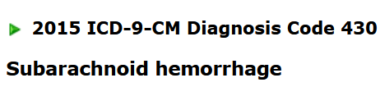
SQL Queries: more
SELECT dx.subject_id, dx.hadm_id, ne.chartdate, ne.charttime, ne.category, ne.description, ne.text
FROM diagnoses_icd dx
JOIN noteevents ne on dx.subject_id=ne.subject_id
WHERE dx.icd9_code like '430' AND ne.category like 'Discharge summary'
ORDER BY subject_id ASC

Slide 24
SQL Queries: more
SELECT AVG(hours) AS mean_hours,
percentile_cont(0.5) within group(order by hours) as
mid_hours, MAX(hours) AS max_hours,
MIN(hours) AS min_hours
FROM ( SELECT icustay_id,
ROUND(extract(day from duration)*24 + extract(hour from
duration) + extract(minute from duration)/60) as hours
FROM (SELECT icustay_id, (outtime - intime) AS duration
FROM icustays ) AS t
WHERE duration IS NOT NULL ) AS h;
SELECT description, AVG(days) AS mean_days, COUNT(*) AS num_group
FROM (SELECT subject_id, extract(day from duration) AS days, description
FROM (SELECT i.subject_id, (i.outtime - i.intime) AS duration, n.description
FROM icustays AS i
LEFT JOIN noteevents AS n
ON i.subject_id = n.subject_id) AS m) as d
WHERE description IS NOT NULL
GROUP BY description
ORDER BY mean_days DESC ;

Slide 25
SQL Queries: more
SELECT i.subject_id, (i.outtime - i.intime) AS duration,
n.description, n.text
FROM icustays AS i
INNER JOIN noteevents AS n
ON i.subject_id = n.subject_id
WHERE n.text LIKE '%lung%' AND (i.outtime - i.intime) IS NOT NULL;
WITH newtable as(
SELECT icu.subject_id, SUM(icu.los) AS los, round((cast(p.dod as date) -
cast(p.dob as date))/365.2) AS age
FROM icustays icu
INNER JOIN patients p ON icu.subject_id = p.subject_id
WHERE p.dod IS NOT NULL AND icu.los IS NOT NULL
GROUP BY icu.subject_id, p.dod, p.dob)
SELECT age, count(age) as numberOfPatients, round(AVG(los)) as meanLos
FROM newtable
WHERE age < 100
GROUP BY age
ORDER BY age DESC;

Slide 26
SQL Queries: more
WITH icustay as (
SELECT subject_id, COUNT ( icustay_id ) as icustays
FROM ICUSTAYS
GROUP BY subject_id)
, expire as (
SELECT subject_id, expire_flag FROM PATIENTS)
SELECT expire.expire_flag, AVG ( icustay.icustays ) as avg_icustays
FROM icustay
INNER JOIN expire ON icustay.subject_id = expire.subject_id
GROUP BY expire.expire_flag;
--?
SELECT row_id, substring(text,
POSITION('Service' IN text)+9, POSITION (' ' IN
substring(text, POSITION('Service' IN text)+9)) ) as
service
FROM NOTEEVENTS
WHERE row_id BETWEEN 175 and 190;
SELECT icustay_id,
ROUND(extract(day from duration)*24 + extract(hour from
duration) + extract(minute from duration)/60) as hours
FROM ( SELECT icustay_id, (outtime - intime) AS duration
FROM icustays ) AS t
WHERE duration IS NOT NULL
ORDER BY hours DESC;

Slide 27
SQL Queries: more
-- all patients who had ICD-9 diagnosis codes for dyspnea, shortness of breath, and cough.
WITH dx as (
SELECT subject_id, icd9_code
FROM diagnoses_icd
WHERE icd9_code IN ('786','78605','7862'))
, notes as (
SELECT subject_id, text
FROM noteevents
)
SELECT dx.subject_id, dx.icd9_code, notes.subject_id, notes.text
FROM notes
INNER JOIN dx
ON dx.subject_id=notes.subject_id;

Slide 28
SQL Queries: one big query (2 slides)
WITH first_admission_time AS
(
SELECT
p.subject_id, p.dob, p.gender
, MIN (a.admittime) AS first_admittime
, MIN( ROUND( (cast(admittime as date) - cast(dob as date)) / 365.242,2) )
AS first_admit_age
FROM patients p
INNER JOIN admissions a
ON p.subject_id = a.subject_id
GROUP BY p.subject_id, p.dob, p.gender
ORDER BY p.subject_id
)
, age as

Slide 29
(
SELECT
subject_id, dob, gender
, first_admittime, first_admit_age
, CASE
-- all ages > 89 in the database were replaced with 300
-- we check using > 100 as a conservative threshold to ensure we capture all these patients
WHEN first_admit_age > 100
then '>89'
WHEN first_admit_age >= 14
THEN 'adult'
WHEN first_admit_age <= 1
THEN 'neonate'
ELSE 'middle'
END AS age_group
FROM first_admission_time
)
select age_group, gender
, count(subject_id) as NumberOfPatients
from age
group by age_group, gender

Slide 30
SQL Queries: another one big query (2 slides)
SELECT ie.subject_id, ie.hadm_id, ie.icustay_id,
ie.intime, ie.outtime, adm.deathtime,
ROUND((cast(ie.intime as date) - cast(pat.dob as date))/365.242, 2) AS age,
ROUND((cast(ie.intime as date) - cast(adm.admittime as date))/365.242, 2) AS preiculos,
CASE
WHEN ROUND((cast(ie.intime as date) - cast(pat.dob as date))/365.242, 2) <= 1
THEN 'neonate'
WHEN ROUND((cast(ie.intime as date) - cast(pat.dob as date))/365.242, 2) <= 14
THEN 'middle'
-- all ages > 89 in the database were replaced with 300
WHEN ROUND((cast(ie.intime as date) - cast(pat.dob as date))/365.242, 2) > 100
THEN '>89'
ELSE 'adult'
END AS ICUSTAY_AGE_GROUP,
-- note that there is already a "hospital_expire_flag" field in the admissions table which you could use
CASE
WHEN adm.hospital_expire_flag = 1 then 'Y'
ELSE 'N'
END AS hospital_expire_flag,
-- note also that hospital_expire_flag is equivalent to "Is adm.deathtime not null?"

Slide 31
CASE
WHEN adm.deathtime BETWEEN ie.intime and ie.outtime
THEN 'Y'
-- sometimes there are typographical errors in the death date, so check before intime
WHEN adm.deathtime <= ie.intime
THEN 'Y'
WHEN adm.dischtime <= ie.outtime
AND adm.discharge_location = 'DEAD/EXPIRED'
THEN 'Y'
ELSE 'N'
END AS ICUSTAY_EXPIRE_FLAG
FROM icustays ie
INNER JOIN patients pat
ON ie.subject_id = pat.subject_id
INNER JOIN admissions adm
ON ie.hadm_id = adm.hadm_id;

Slide 32
Appendix
SELECT count(patients.subject_id)
FROM patients INNER JOIN admissions ON patients.subject_id = admissions.subject_id
WHERE gender = 'F' AND admissions.deathtime is NOT NULL and diagnosis = 'HEAD BLEED';
59
SELECT count(patients.subject_id)
FROM patients INNER JOIN admissions ON patients.subject_id = admissions.subject_id
WHERE gender = 'F' AND admissions.deathtime ='' and diagnosis = 'HEAD BLEED';
35
SELECT count(patients.subject_id)
FROM patients INNER JOIN admissions ON patients.subject_id = admissions.subject_id
WHERE gender = 'F' AND admissions.deathtime !='' and diagnosis = 'HEAD BLEED';
24
SELECT count(patients.subject_id)
FROM patients INNER JOIN admissions ON patients.subject_id = admissions.subject_id
WHERE gender = 'F' AND admissions.deathtime >0 and diagnosis = 'HEAD BLEED';
24

Slide 33
Additional Queries
-- Service Transitions in ICU Stays:
WITH serv AS (
SELECT subject_id, hadm_id, transfertime, prev_service, curr_service
FROM services
)
, icu AS (
SELECT subject_id, hadm_id, icustay_id, intime, outtime
FROM icustays
)
SELECT icu.subject_id, icu.hadm_id, icu.icustay_id, icu.intime, icu.outtime
, serv.transfertime, serv.prev_service, serv.curr_service
FROM icu
INNER JOIN serv
ON icu.hadm_id = serv.hadm_id;
-- Diagnoses and Discharge Notes for Stroke Patients:
SELECT dx.subject_id, dx.hadm_id, ne.chartdate, ne.charttime, ne.category, ne.description, ne.text
FROM diagnoses_icd dx
JOIN noteevents ne ON dx.subject_id = ne.subject_id
WHERE dx.icd9_code LIKE '430' AND ne.category LIKE 'Discharge summary'
ORDER BY subject_id ASC;

