Slide 1
Medical Imaging Diagnosis: Classification, Localization, and Interpretation

Slide 2
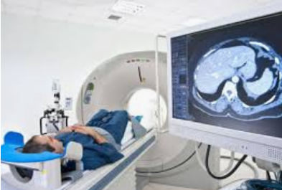
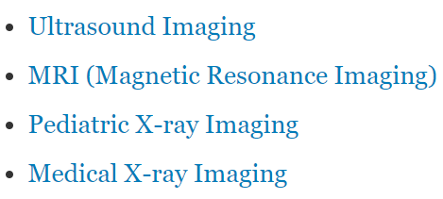
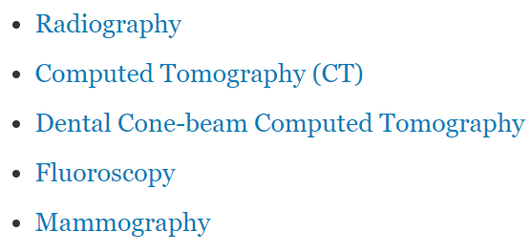
Medical Imaging
https://www.fda.gov/radiation-emitting-products/radiation-emitting-products-and-procedures/medical-imaging

Slide 3
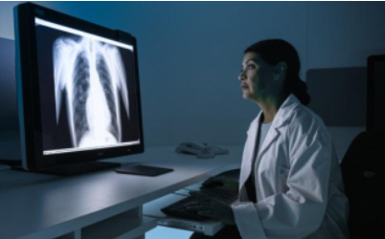
Radiologists
Radiologists are physicians who are specialized in diagnosing and treating diseases using a variety of medical imaging techniques such as x-rays, computed tomography (CT), magnetic resonance imaging (MRI), Positron emission tomography (PET), and ultrasound.
Expertise in radiology is defined by refined visual search patterns and diagnostic accuracy.
Expert radiologists not only perceive abnormalities that non-experts do not, but they also better understand what to attend to and what to ignore.
https://www.frontiersin.org/articles/10.3389/fnhum.2019.00213/full

Slide 4
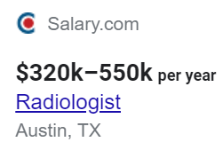
Radiologists and Images
2 billion chest x-rays are done each year worldwide.
In US, 800 million medical scans a year, which amounts to 600 billion images,
A radiologist reads about 20,000 images a year, roughly 50-100 per day, and the number is increasing
The U.S. has approximately 34,000 radiologists, or 100 per million according to the Journal of Nuclear Medicine (2015)
31% of American radiologists have experienced at least one malpractice claim, often missed diagnoses.
Eric Topol, Deep Medicine, 2019

Slide 5
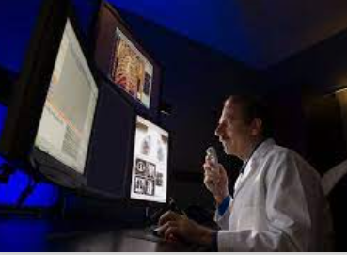
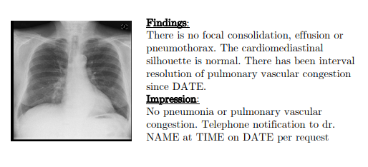
How radiologists work
Broadly, diagnostic radiology entails
(1) detection—noting a potentially significant finding is present that merits further analysis;
(2) recognition—deciding that the finding is pathologic;
(3) discrimination—characterizing the lesion as a specific type; and
(4) diagnosis -- The first task, detection, has primary importance, because all following steps leading to diagnosis rely on detection efficacy
The error rate of radiologists scanning images is around 33% and has not been changed for the past seven decades.
https://arxiv.org/pdf/1904.02633.pdf
https://www.ncbi.nlm.nih.gov/pmc/articles/PMC6603246/pdf/fnhum-13-00213.pdf

Slide 6
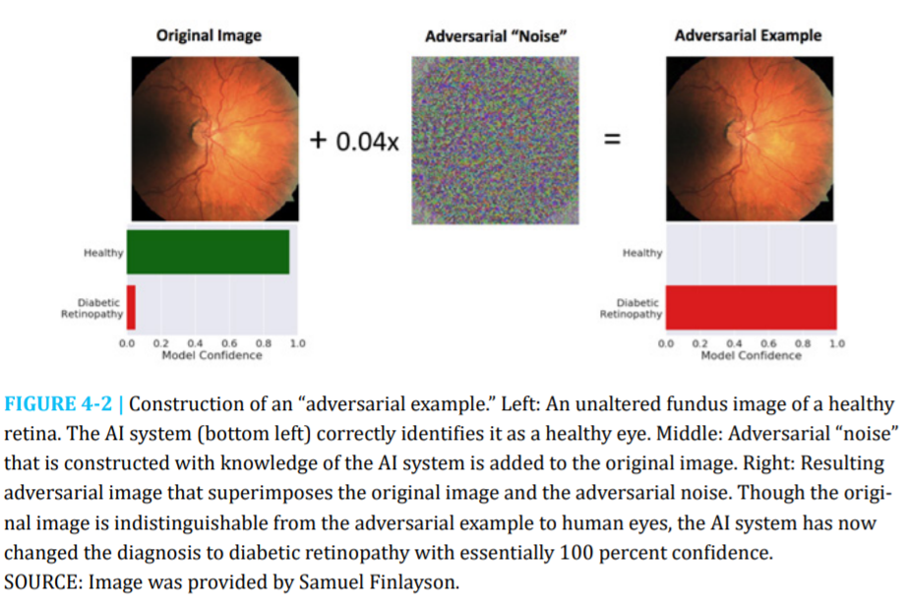
AI also makes mistake
https://nap.nationalacademies.org/read/27111/chapter/6#109

Slide 7
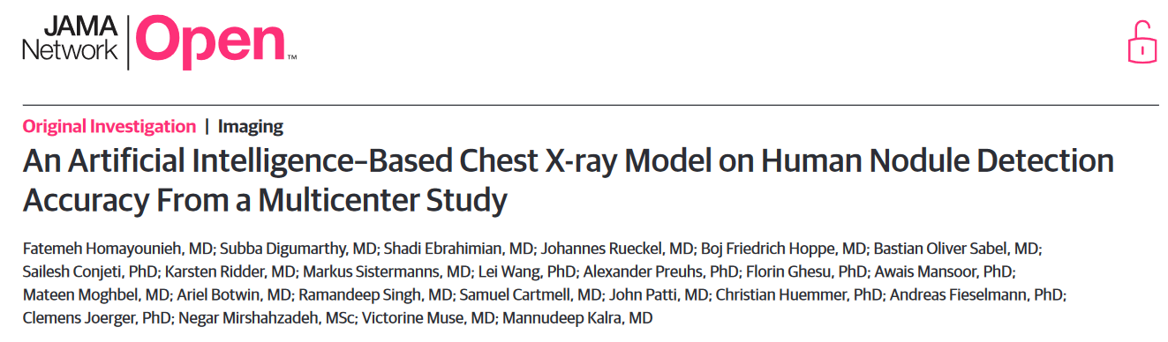


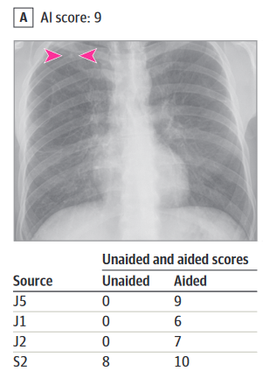
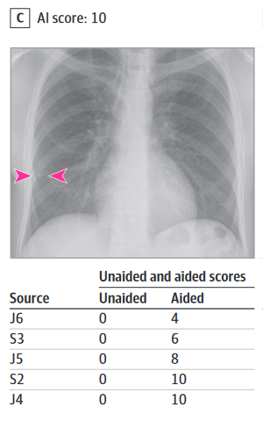
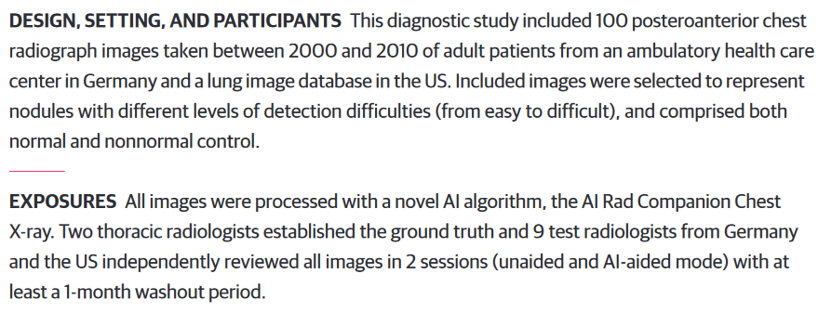
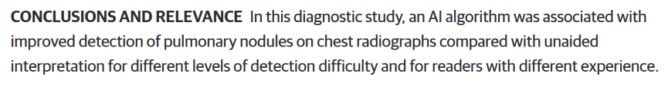

Slide 8
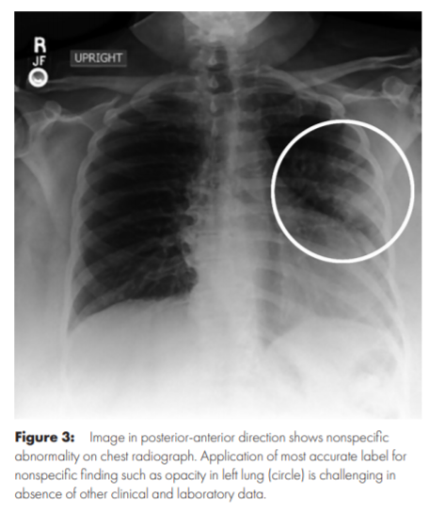
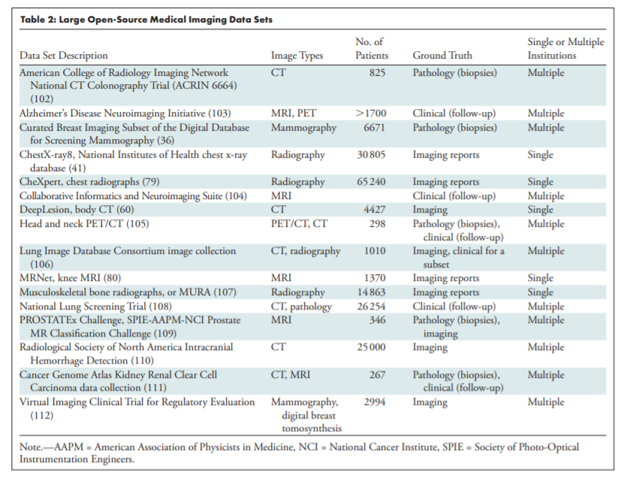
Labeled Medical Image Data
Willemink, M., Koszek, W.A., Hardell, C., Wu, J., Fleischmann, D., Harvey, H., Folio, L. R., Summers, R. M., Rubin, D. L., & Lungren, M P. (2020). Preparing medical imaging data for machine learning. Radiology, 295, 4-15.

Slide 9
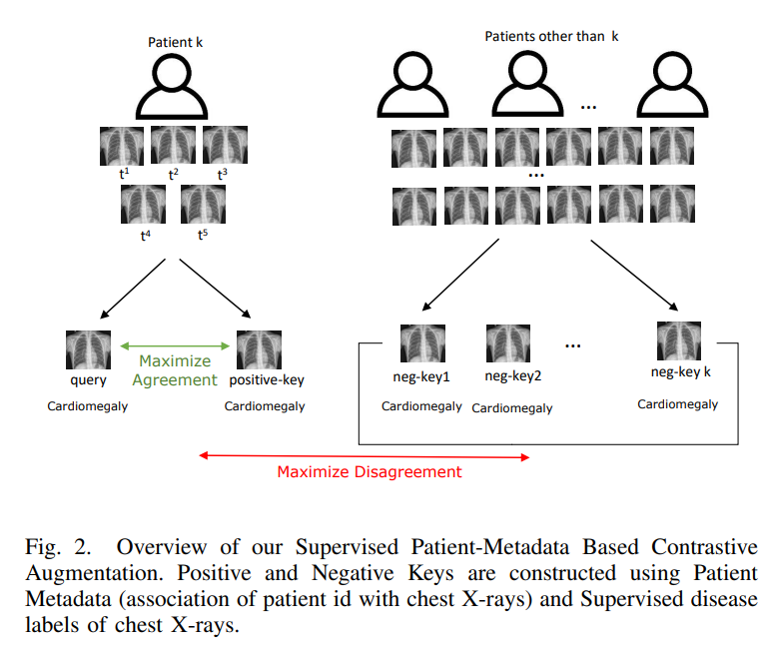
Better Data Augmentation for Contrastive Learning
Jaiswal, A., Li, H., Zander, C., Han, Y., Rousseau, J., Peng, Y., & Ding, Y. (2021). SCALP - Supervised Contrastive Learning for Cardiopulmonary Disease Classification and Localization in Chest X-rays using Patient Metadata. IEEE International Conference on Data Mining (ICDM 2021), Dec 7-10, 2021, Auckland, New Zealand.

Slide 10
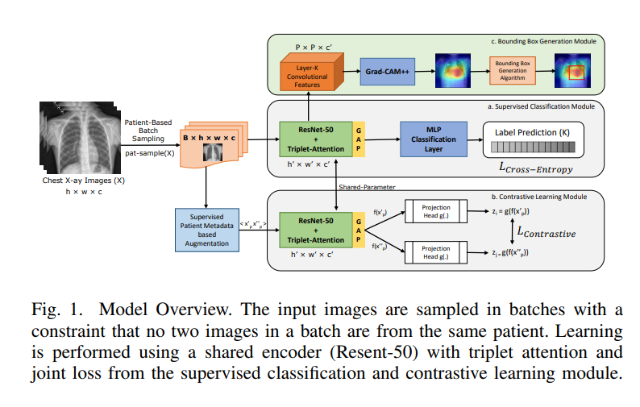
Better Data Augmentation for Contrastive Learning

Slide 11
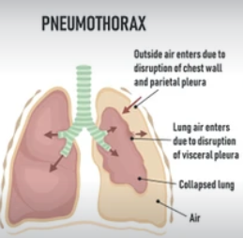
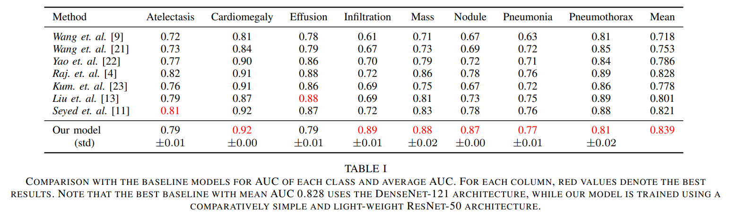
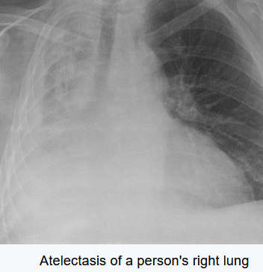
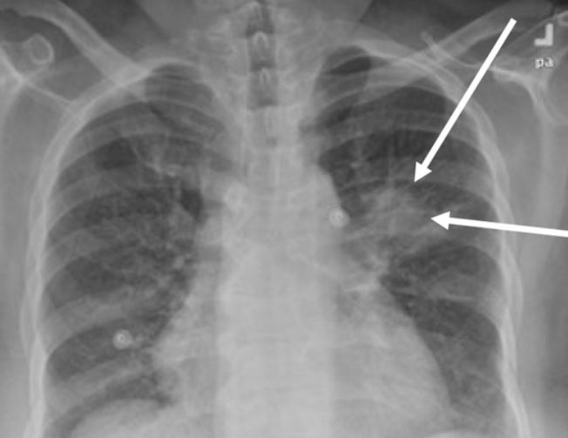
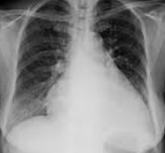
Disease Classification
Mass, Nodule = A lung nodule (or mass) is a small abnormal area
Pneumothorax = total lung collapse
Atelectasis = partial lung collapse
Cardiomegaly = an enlarged heart
Infiltration = fluid or some unusual substance in the lung tissue. Effusion = too much pleural fluid around the lungs.
Pneumonia = lung inflammation caused by bacterial or viral infection, in which the air sacs fill with pus, fluid, and may become solid

Slide 12
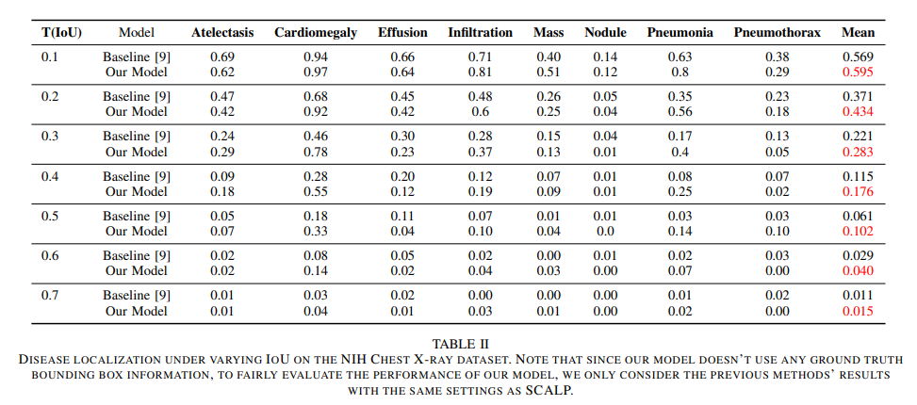

Slide 13
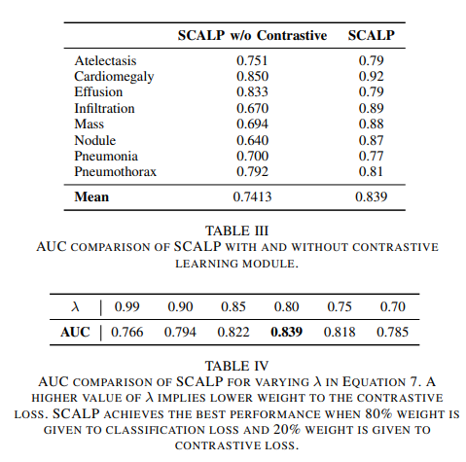
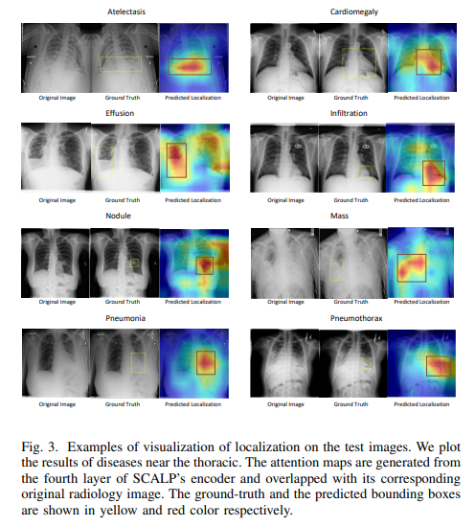

Slide 14
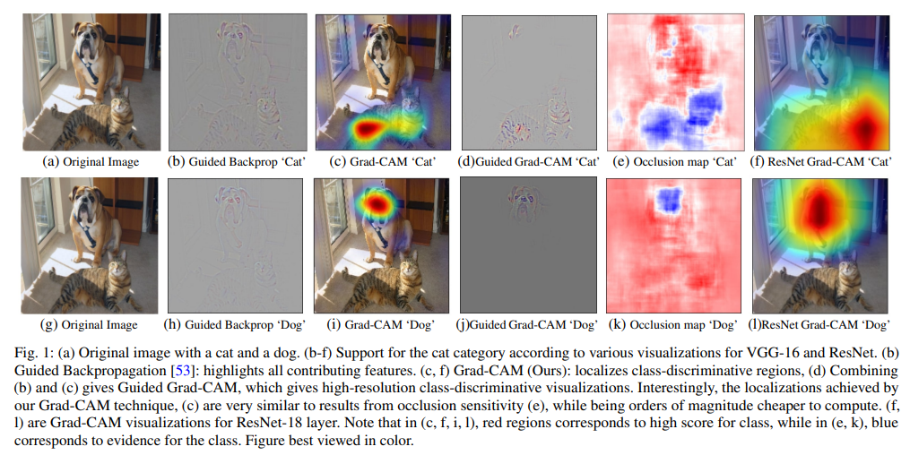
Explainability: Grad-CAM

Slide 15
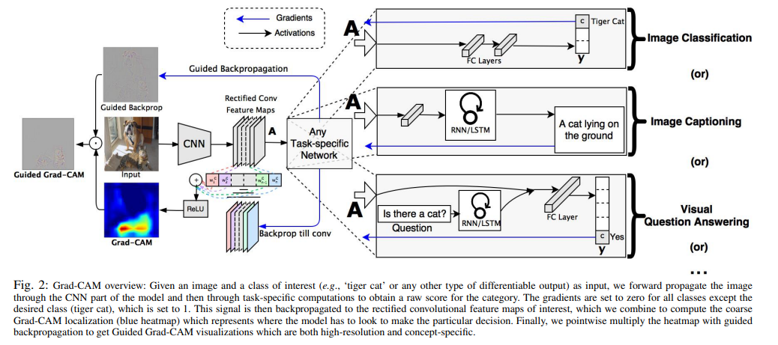
Grad-CAM
Grad-CAM lacks the ability to highlight fine grained details like pixel-space gradient visualization methods (Guided Backpropagation) by using the gradient information of the last convolutional layer of CNN
Guided Backpropagation visualizes gradients with respect to the image where negative gradients are suppressed when backpropagating through ReLU layers.
Guided Grad-CAM fuses Guided Backpropagation (pixel space) and Grad-CAM (class conditional property) via element-wise multiplication.
Input-level explanation
Output-level explanation
https://arxiv.org/pdf/1610.02391.pdf

Slide 16
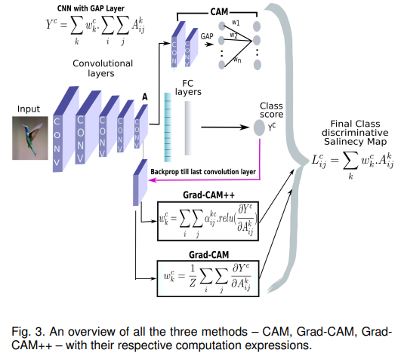
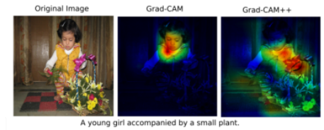
Grad-CAM ++
Grad-CAM: fails to properly localize objects in an image if the image contains multiple occurrences of the same class.
Grad-CAM: fails to locate the entire object, but bits and parts of it
Grad-CAM ++: using relu to only keep the positive gradients
Grad-CAM++: taking a weighted average of the pixel-wise gradients to store the pixel spatial information
https://arxiv.org/pdf/1710.11063.pdf

Slide 17
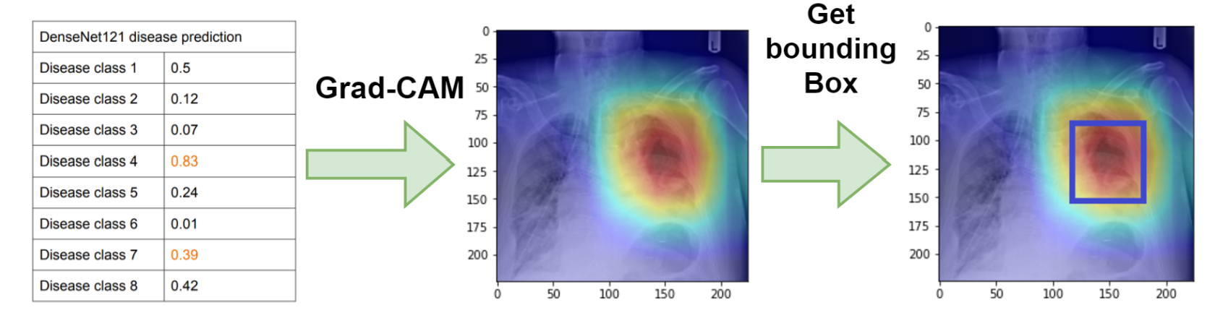
Generating Bounding Box for Chest X-Ray Images
https://github.com/thtang/CheXNet-with-localization

