Slide 1
RETAIN (REverse Time AttentioN)

Slide 2
Introduction
Accuracy and interpretability are vital in predictive models.
A common dilemma in predictive modeling is choosing between complex models like RNN for accuracy or more interpretable models like logistic regression.
Medicine faces this dilemma where both accuracy and interpretability are crucial.
Hence RETAIN, a Reverse Time Attention model for Electronic Health Records (EHR) data can be used to solve such problem.
In this tutorial RETAIN is used for mortality prediction.

Slide 3
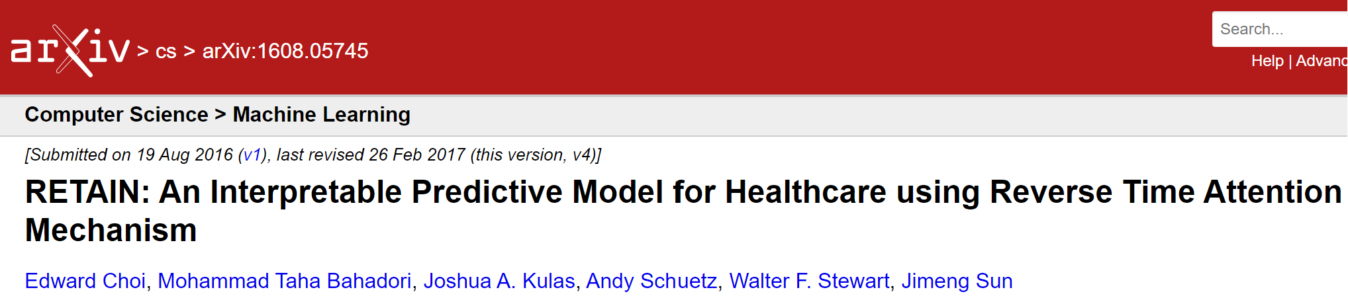
Why RETAIN?
https://arxiv.org/abs/1608.05745
RETAIN strikes a balance between predictive accuracy and interpretability, making it a valuable tool for healthcare applications.
It can deliver accurate predictions while providing clear insights into why specific predictions were made.
RETAIN processes data with the most recent clinical visits. This approach mimics how physicians often analyze patient records, giving more weight to recent visits.

Slide 4
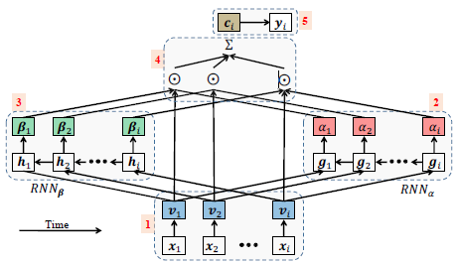
Architecture of RETAIN
A critical feature of RETAIN is its two-level neural attention mechanism.
This mechanism operates at both the visit-level (RNNα) and variable-level (RNNβ), allowing the model to focus on relevant visits and specific clinical variables.

Slide 5

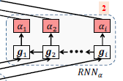
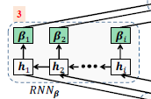
Working of RETAIN
Step 1: Visit embeddings ‘v’ are generated through a linear embedding.
Step 2: The model uses one RNN to generate visit-level attention weights. This RNN processes visit embeddings and determines the importance of each visit in the patient's history.
Step 3: A second RNN is employed to generate variable-level attention weights. This RNN operates in parallel with the visit-level RNN but focuses on individual clinical variables within each visit.

Slide 6


Working of RETAIN
Step 4: For each patient's sequence of visits, RETAIN calculates a context vector by combining the weighted information from the two RNNs and input vector.
o/p of RNNα + RNNβ + Input vector = Context vector
Step 5: Uses this context vector to make predictions (binary classification) regarding clinical outcomes. For example, it can predict whether a patient will be diagnosed with a particular disease based on their EHR data.

Slide 7
Interpreting RETAIN: Understanding Variable Contributions
Identifying Important Visits:
To find the visits that play a significant role in predictions, we focus on the attention weight α. This weight helps us identify visits that carry more weight in the model's predictions.
Identifying influential Variable:
A visit consists of multiple medical variables, each contributing differently to predictions. The exact contribution of each variable is determined by a combination of factors: v, α and β as understanding α by itself tells us which visit is important, but not why.

Slide 8
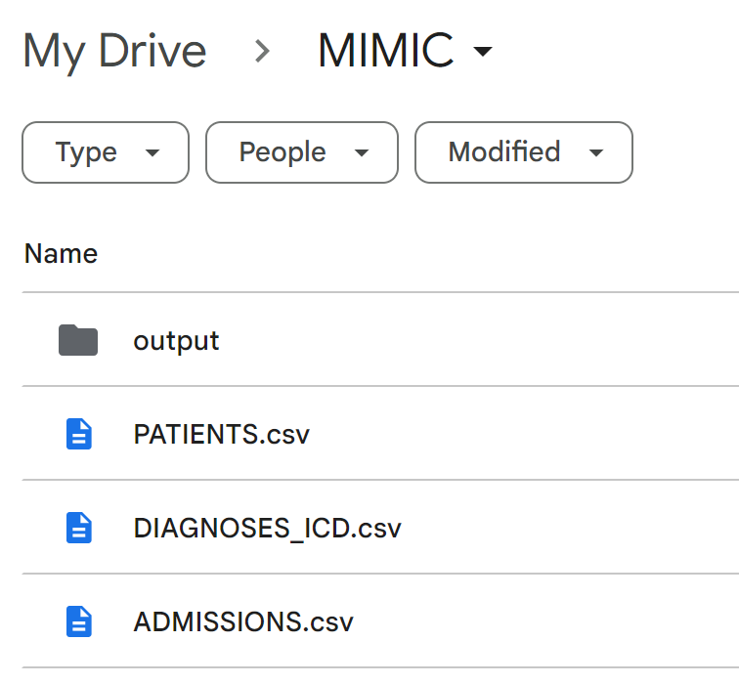
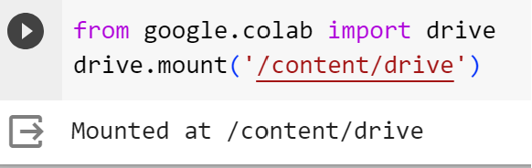
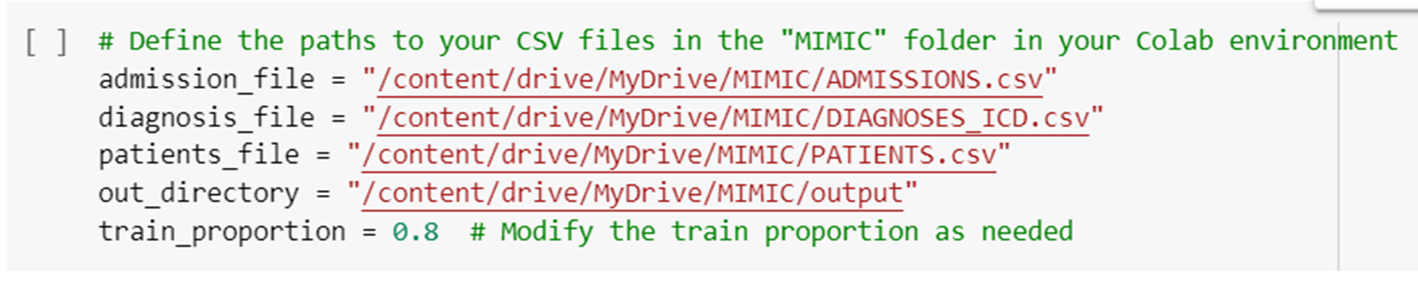
Retain Tutorial
Prepare Data:
Datasets we need
Admissions table
Diagnoses_ICD table
Patients table
Store them in your google drive (MyDrive/MIMIC)
Your output files will go to the out_directory which is in your google drive (MyDrive/MIMIC/output)
Tutorial: https://colab.research.google.com/drive/1pzSZriI0OUEfHh3MqgEybrspKIY-bw6a?authuser=1#scrollTo=HsIUPP8BCnlH

Slide 9
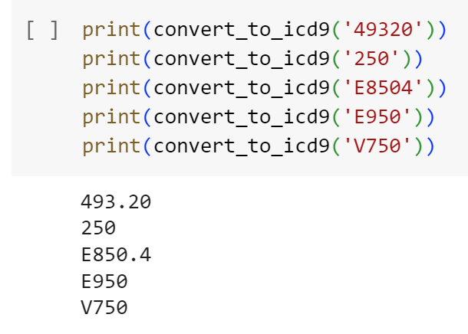
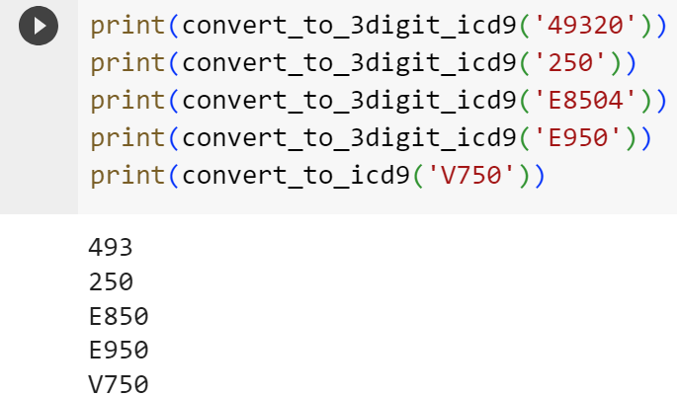
Data Formatting
The primary goal is to create longitudinal patient records.
It identifies patients with two or more encounters in the MIMIC-III dataset and organizes their data in a chronological order.
The code takes Admissions, Diagnosis_ICD and Patients table and output consists of pickled pandas dataframes, dictionary mappings, and target labels.
Some of the key functions include
convert_to_icd9(dx_str)
Maps an ICD diagnosis code to ICD9 format.
Handles both regular and "E" diagnosis codes.
convert_to_3digit_icd9(dx_str)
Rolls up a diagnosis code to 3 digits.
Accommodates both regular and "E" diagnosis codes.

Slide 10
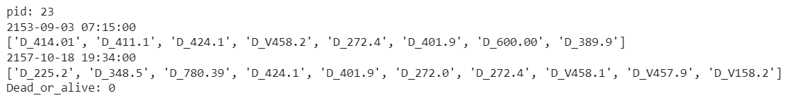
Data Structure
The data of one patient looks like this
Pid: is the patient id
Date of admission
Diagnosed ICD9 code for that visit
In this case patient id 23 visited 2 times and respective ICD9 codes for those visits are displayed
Last element is whether the patient is dead or alive

Slide 11
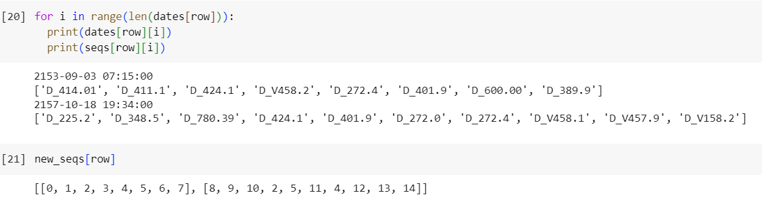
Data Structure
The diagnosis ICD9 codes which are in string format needs to be converted into embeddings
it starts with zero and if any code repeats than it is assigned the previous value.
example: D_424.1 (encoded as 2) appears in 3rd position and in 12th position. Hence 2 is repeated twice. Similarly, D_272.4 appears 2 times.

Slide 12
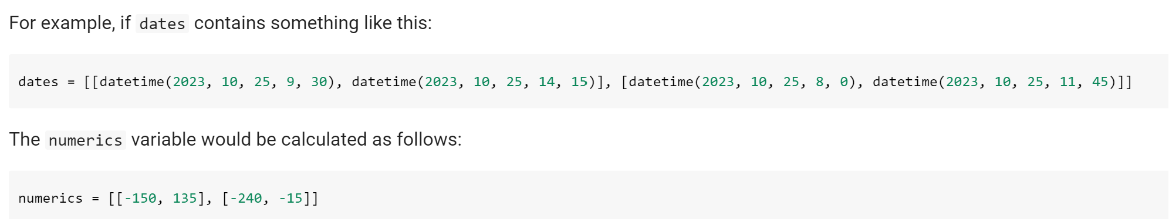
Date and time format
It calculates the time difference between a reference date (January 1, 2025) and a list of dates available. The result is stored in a variable called to_event and sort the data according to date.
For each date in a patient's record, it calculates a numeric value using the formula: date.hour * 60 + date.minute - 720. Then stores in ‘numerics’
date.hour returns the hour part of the date in minutes (e.g., 9 AM would be 540 minutes).
date.minute returns the minute part of the date.
Subtracting 720 represents the offset from noon (720 minutes) to obtain values that can be positive or negative.

Slide 13
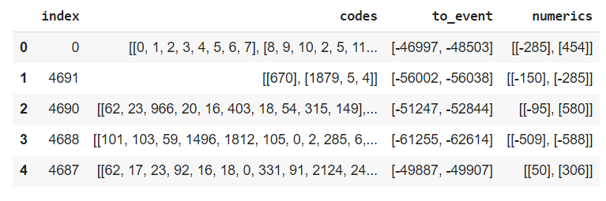
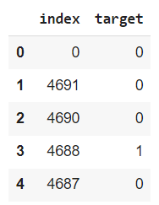
Input and Output data to model
The input data (features) and output data (labels) are given to model as shown below

Slide 14
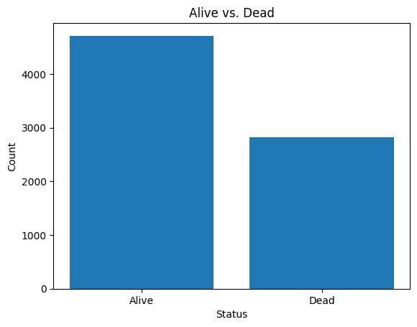
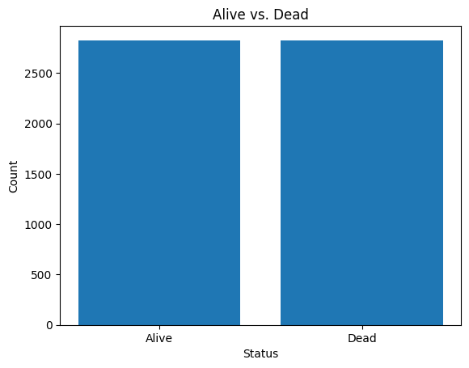
Data imbalance
There is a clear imbalance in class distribution
To balance the classes, random under sampling is used

Slide 15
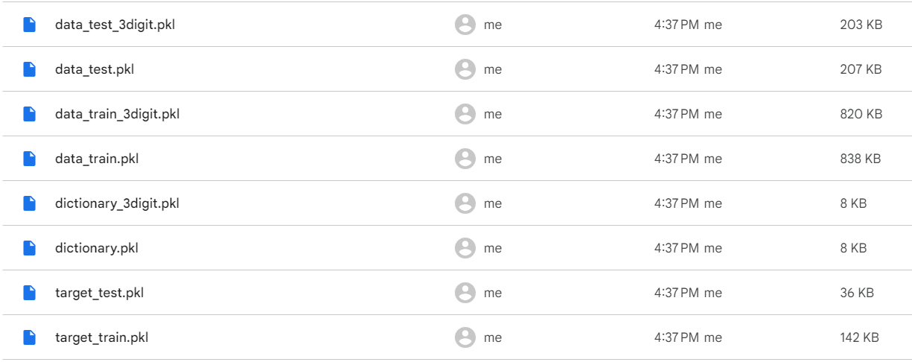
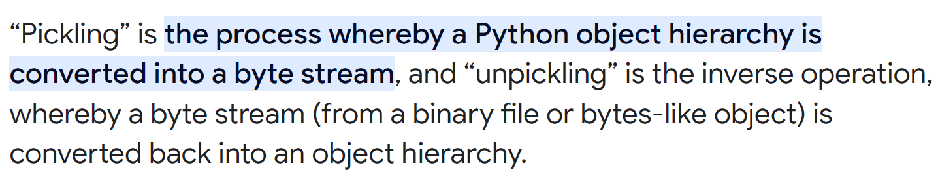
Training and test data files
data_train.pkl and data_test.pkl: Pickled dataframes for training and testing, containing patient codes and time-to-event sequences.
data_train_3digit.pkl and data_test_3digit.pkl: Pickled dataframes for training and testing, with 3-digit diagnosis codes.
target_train.pkl and target_test.pkl: Pickled dataframes containing target labels for training and testing.
https://docs.python.org/3/library/pickle.html#:~:text=%E2%80%9CPickling%E2%80%9D%20is%20the%20process%20whereby,back%20into%20an%20object%20hierarchy.

Slide 16
Training
Hyper parameters to consider while training
num_codes: Number of medical codes.
numeric_size: Size of numeric inputs (0 if none).
use_time: Flag to indicate the use of time input.
emb_size: Size of the embedding layer.
epochs: Number of training epochs.
n_steps: Maximum number of visits after which data is truncated.
recurrent_size: Size of the recurrent layers.
path_data_train: Path to the training data.
path_data_test: Path to the testing data.
path_target_train: Path to the training target.
path_target_test: Path to the testing target.
batch_size: Batch size for training.
dropout_input: Dropout rate for embedding.
dropout_context: Dropout rate for context vector.
l2: L2 regularization value.
directory: Directory to save the model and log files.
allow_negative: Flag to allow negative weights for embeddings/attentions.

Slide 17
Freeze padding during training
The FreezePadding class is a custom constraint used for weight constraints in neural network layers.
This constraint is applied to the last weight in the weight matrix of certain layers to ensure that this weight is "frozen" or set to specific values, typically near 0. This is required because:
The embeddings are learned during training and by using this constraint, the model ensures that the last weight in the embeddings layer remains near 0 preventong negative embeddings.
In some applications, especially in healthcare analytics, negative weights in embeddings or attention mechanisms might not make intuitive sense. By "freezing" the last weight to be near 0, the model effectively prevents negative weights from affecting the representation of medical codes or attention scores.

Slide 18
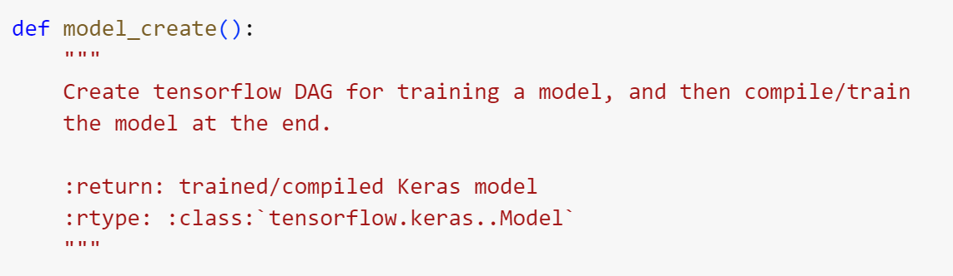
Creating Retain Model
The model_create function is responsible for creating a Keras model using the TensorFlow library. This model is designed to mimic the RETAIN architecture and is used for training and prediction.
The architecture of this model follows the RETAIN architecture and is suitable for binary classification tasks where the goal is to predict binary outcomes. The model uses attention mechanisms to weigh the importance of different elements in the input data. It can handle different types of input data, including codes, numerics, and time, and make predictions based on these inputs. The use of bidirectional LSTMs and attention mechanisms is a key characteristic of the RETAIN architecture, which aims to capture sequential dependencies in the data.

Slide 19
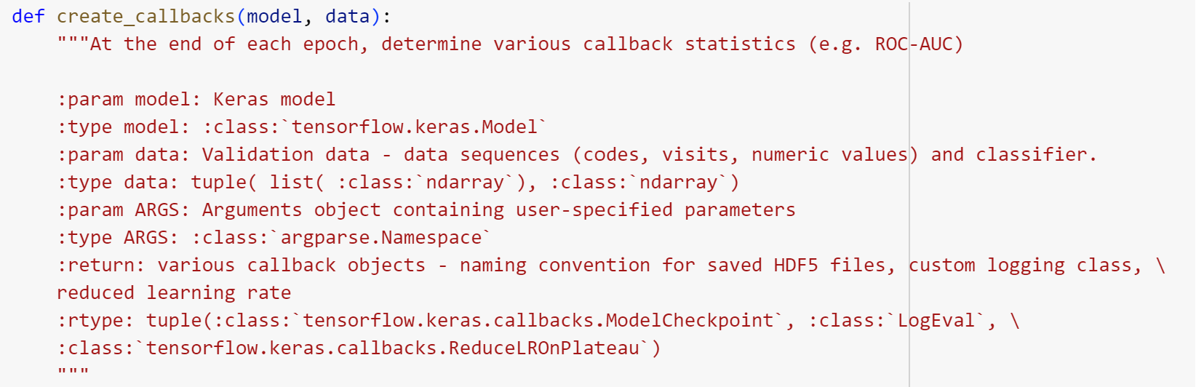
Creating Retain Model
The create_callbacks function is responsible for creating various callback objects that are used during the training of a Keras model. Callbacks are functions that can be applied at different stages during training to perform tasks such as saving model checkpoints, logging training progress, and adjusting the learning rate.
The LogEval callback focuses on logging metrics such as ROC-AUC and PR-AUC, which are common evaluation metrics for binary classification tasks.

Slide 20
Training Results
ROC-AUC (Receiver Operating Characteristic - Area Under the Curve): 0.808748
ROC-AUC measures the model's ability to distinguish between positive and negative samples. A higher value indicates better discrimination.
PR-AUC (Precision-Recall - Area Under the Curve): 0.719806
PR-AUC assesses the trade-off between precision and recall. A higher value signifies better balance between precision and recall.
Loss: 0.5691
The loss is a measure of how well the model's predictions match the true labels. Lower values indicate better model performance.
Accuracy: 0.7058
Accuracy represents the proportion of correctly predicted samples. In this case, the model has achieved an accuracy of 70.58% on the training data.

Slide 21
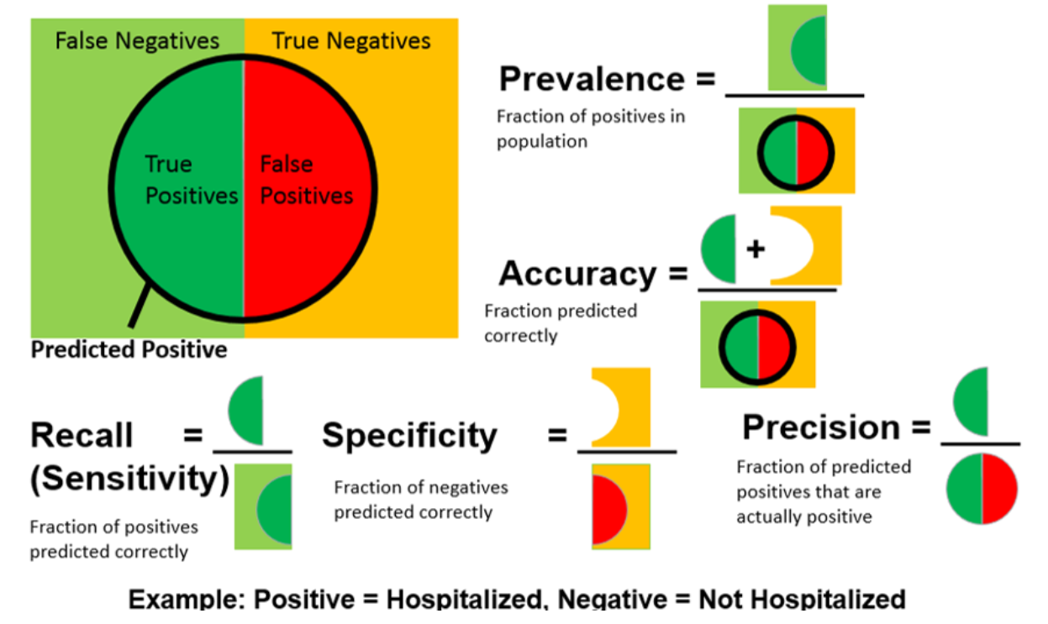
Evaluation

Slide 22
Precision Recall
The precision_recall function is a valuable tool for assessing the performance of binary classification models, especially in situations involving imbalanced datasets or where the trade-off between precision and recall is crucial.
It provides valuable insights into a model's ability to correctly classify positive instances while minimizing false positives, and the precision-recall curve helps visualize this trade-off.
The purpose of this function is to compute and visualize precision-recall statistics, which can help assess the model's performance, especially in binary classification tasks.

Slide 23
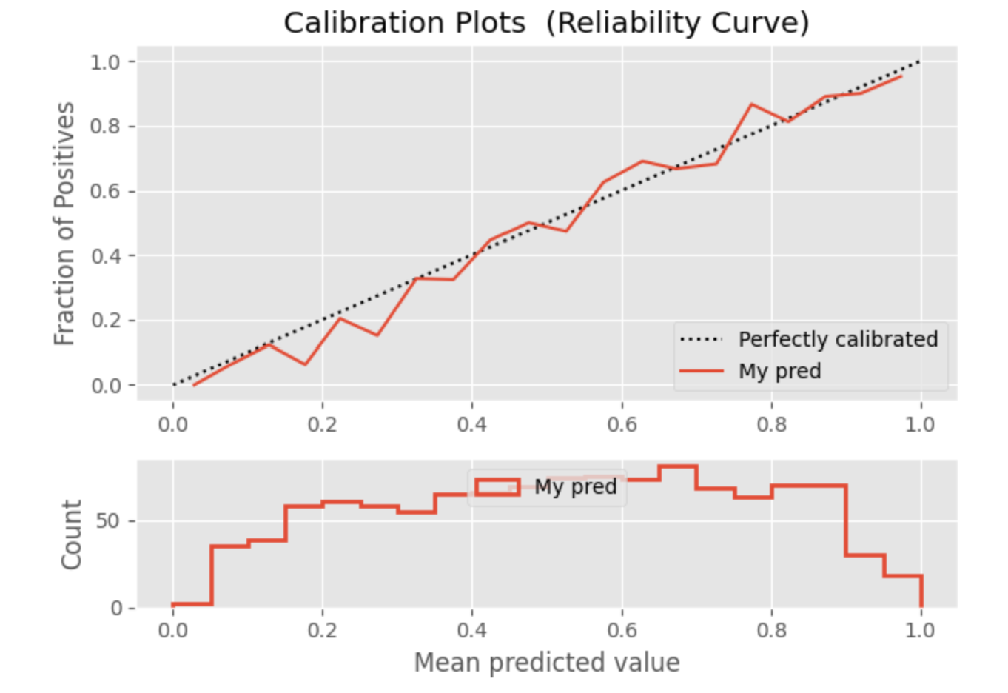
Test Results
Probability Calibration: In many classification tasks, especially those involving binary classification, models not only make predictions but also provide probability scores. These probability scores represent the model's confidence in its predictions.
However, these predicted probabilities are not always well-calibrated, meaning they may not accurately reflect the true likelihood of an event occurring. In other words, a model's probability score of 0.8 for "spam" may not mean that 80% of such emails are actually spam. Calibration is the process of ensuring that the predicted probabilities are in line with the actual event probabilities.
Plot 2 provides insight into the distribution of predicted probabilities.
In a well-calibrated model, you would typically expect the predicted probabilities to be spread evenly across the entire range of 0 to 1.

Slide 24
Why Probability Calibration is Important:
Confidence Estimation: Calibrated probabilities are useful for understanding how confident the model is in its predictions. This is important for applications where the reliability of predictions matters, such as medical diagnosis.
Threshold Selection: Many classification tasks require setting a probability threshold for making decisions. For example, in a medical diagnosis model, a threshold might be set to determine when a patient is at high risk. Calibrated probabilities help in selecting appropriate thresholds.
Comparing Models: Calibration makes it easier to compare the performance of different models. A well-calibrated model provides a more accurate indication of the likelihood of an event happening, making it easier to compare different models or algorithms.
Interpretability: Calibrated probabilities are more interpretable. Users or stakeholders can better understand the confidence level of the model's predictions, which is essential for transparency and trust.
Graphical Visualization: The probability calibration curve provides a visual representation of how well the model's predicted probabilities align with the true probabilities. This curve is useful for model evaluation and communication.

Slide 25
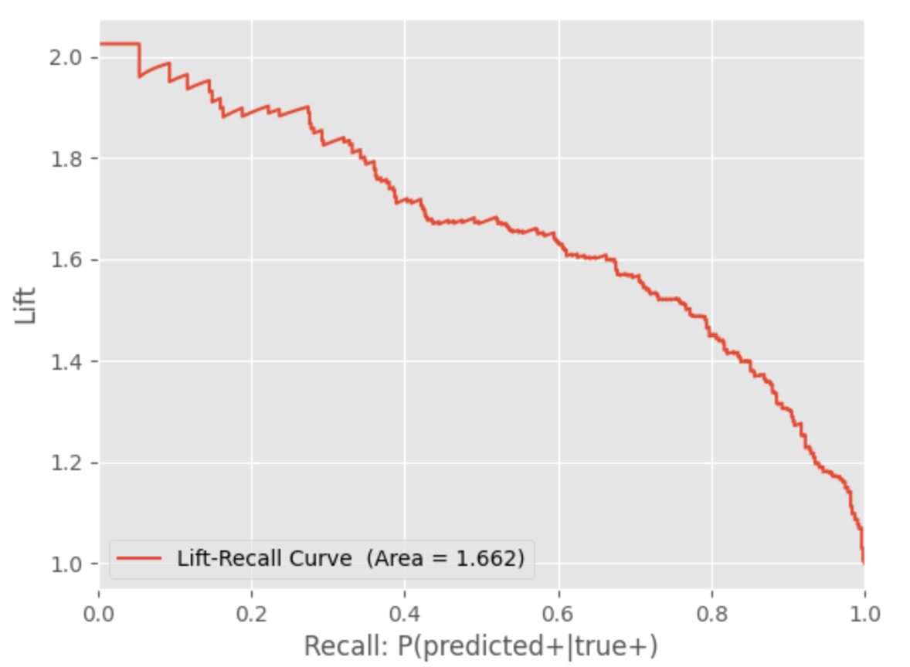
Test Results
Lift Recall Curve Area: 1.849
Lift Chart: A lift chart is a graphical representation of the performance of a binary classification model. It helps assess the model's effectiveness in targeting a specific group, such as patients who are likely to encounter death.
Why Lift Chart is Important: The lift chart provides insights into how much better the model is at identifying the target group compared to random selection. It is particularly valuable in scenarios where the cost of reaching out to a patient is high and you want to optimize the use of resources.

Slide 26
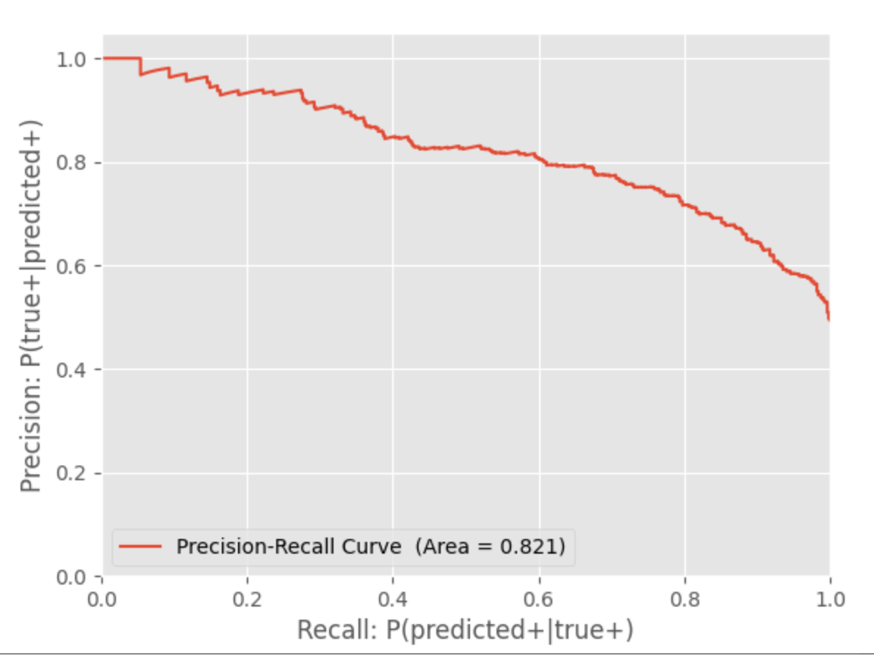
Test Results
Precision-Recall Curve Area: 0.704
The precision_recall function is a valuable tool for assessing the performance of binary classification models, especially in situations involving imbalanced datasets or where the trade-off between precision and recall is crucial.
It provides valuable insights into a model's ability to correctly classify positive instances while minimizing false positives, and the precision-recall curve helps visualize this trade-off.

Slide 27
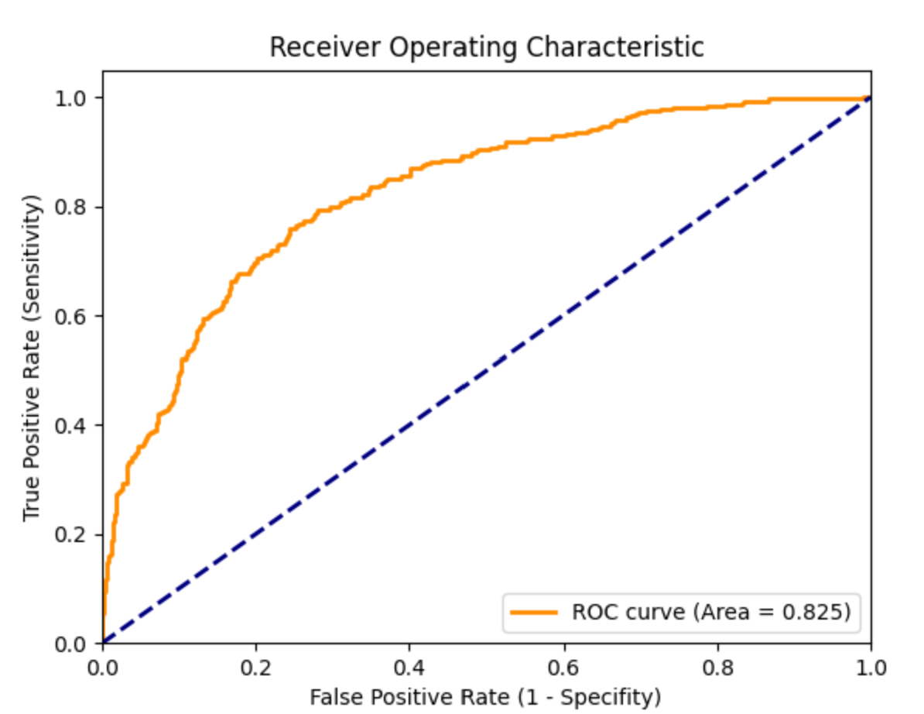
Test Results
ROC Analysis:
ROC analysis is a technique used to evaluate the performance of a binary classification model.
It is particularly valuable in situations where you want to assess a model's ability to distinguish between two classes (e.g., positive and negative cases) by varying the model's threshold for classification.
Why ROC Analysis is Important:
ROC analysis provides a comprehensive evaluation of a model's performance across various classification thresholds.
It helps you understand the trade-off between true positive rate (sensitivity) and false positive rate (1 - specificity) at different threshold settings.
ROC analysis is especially useful when dealing with imbalanced datasets or when the cost of false positives and false negatives differs.

Slide 28
Interpretation
The overall structure of the output looks like this:
Predicts the probability of death
The patient is diagnosed with a particular ICD code (feature) and this feature has influenced the above prediction by the given value in feature_importance column.
The patient was admitted some number of times given by to_events and each of these vistis importance in prediction is given by importance_visit column.

Slide 29
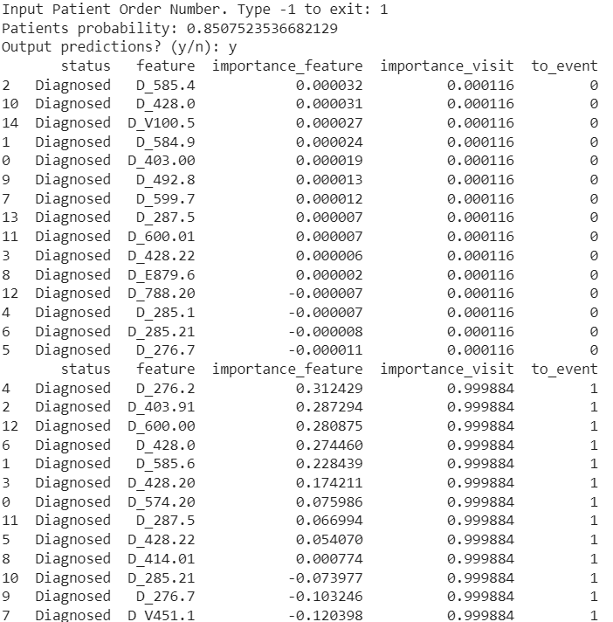
Inferencing on one patient (order: 1)

Slide 30
Inferencing on one patient (order: 1)
Patient Probability: The probability of the patient being diagnosed with the condition (in this case, death) is approximately 0.85.
Output Predictions: The following table presents the predictions and importance of features for this patient.
The "status" column indicates that the patient has been diagnosed with the condition.
The "feature" column lists specific encoded medical codes or diagnoses associated with the patient.
"Importance_feature" shows the importance of each feature in making the diagnosis prediction. Positive values suggest that the feature contributes positively to the prediction, while negative values have a negative impact.
"Importance_visit" indicates the importance of each visit in the patient's medical history. High values suggest that the visit has had a significant influence on the prediction.
"to_event" indicates the timing of the prediction relative to the patient's visits. "0" signifies that the prediction is made during first visit, while "1" suggests that the prediction was made on second visit and so on.
In this case, it appears that the patient has been dead or alive. Some features and visits had a positive influence on the diagnosis, while others had a negative impact.
The output includes feature-level and visit-level importance scores, highlighting the contribution of each element to the prediction.

Slide 31
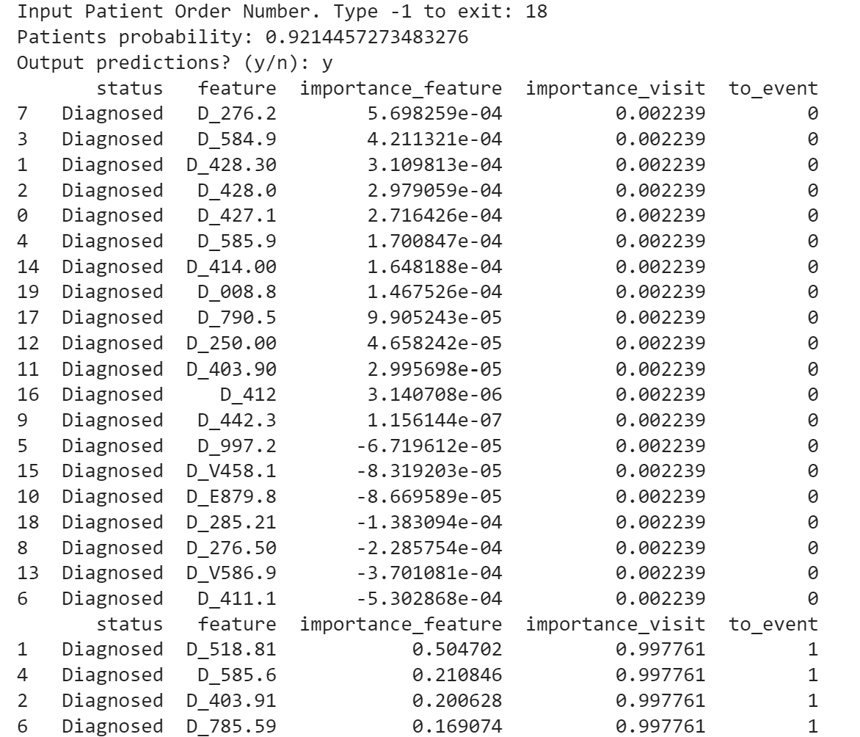
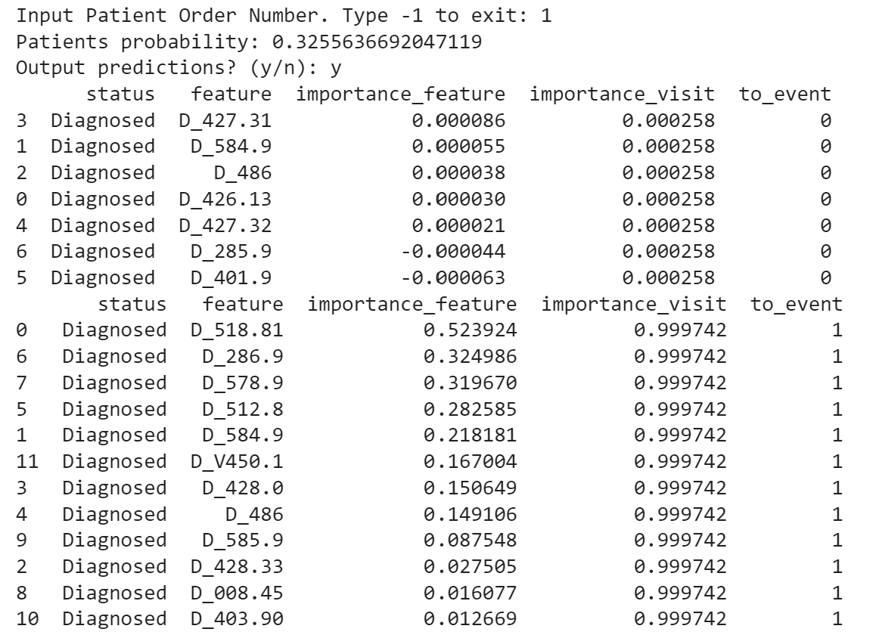
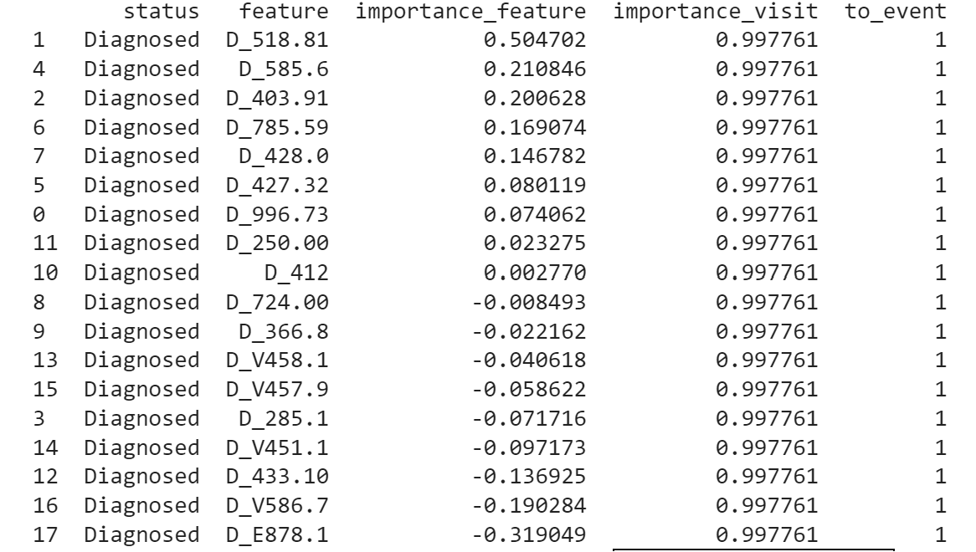
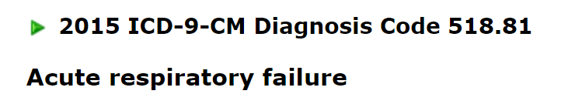
http://www.icd9data.com/

Slide 32
