Slide 2
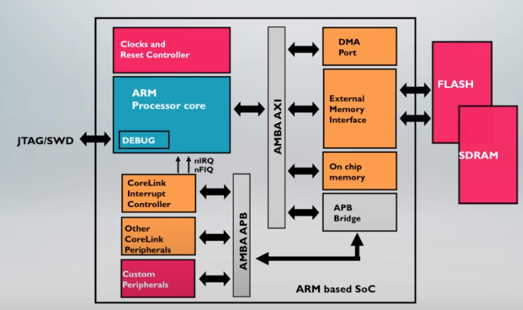

Slide 3
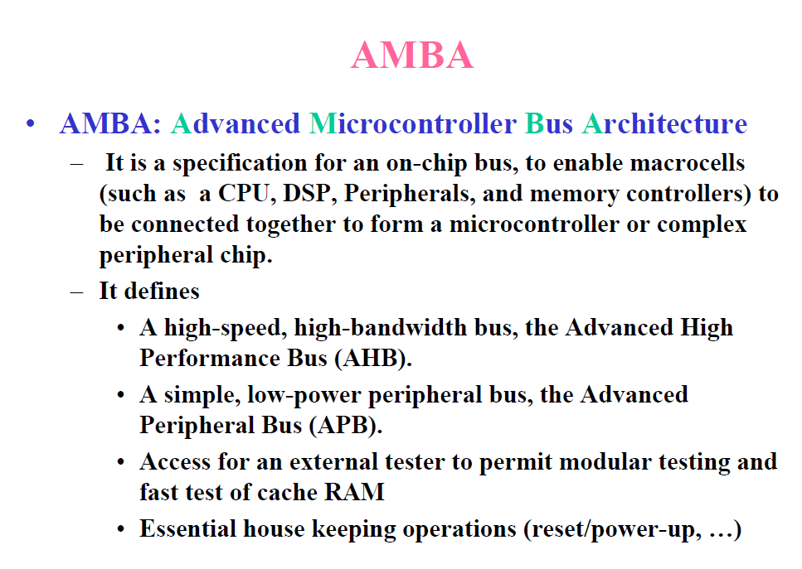

Slide 4
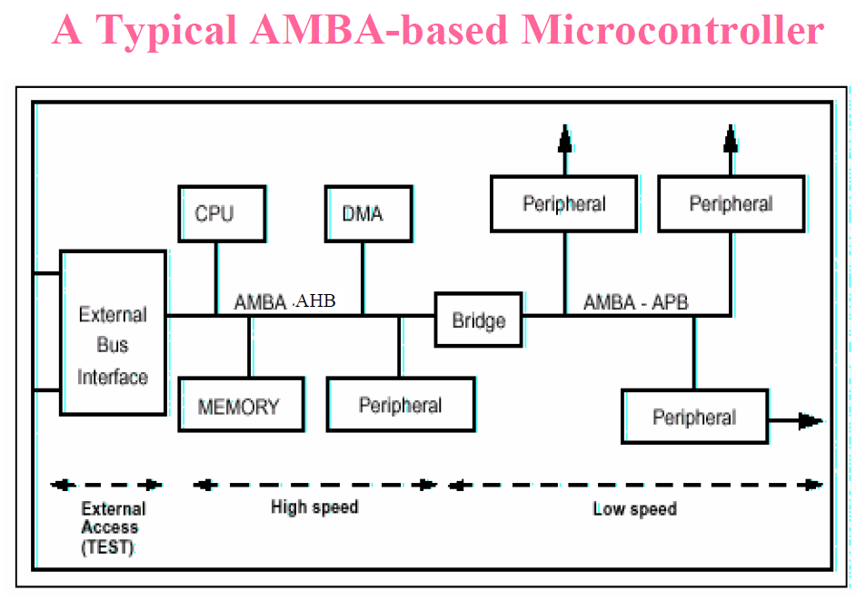

Slide 5
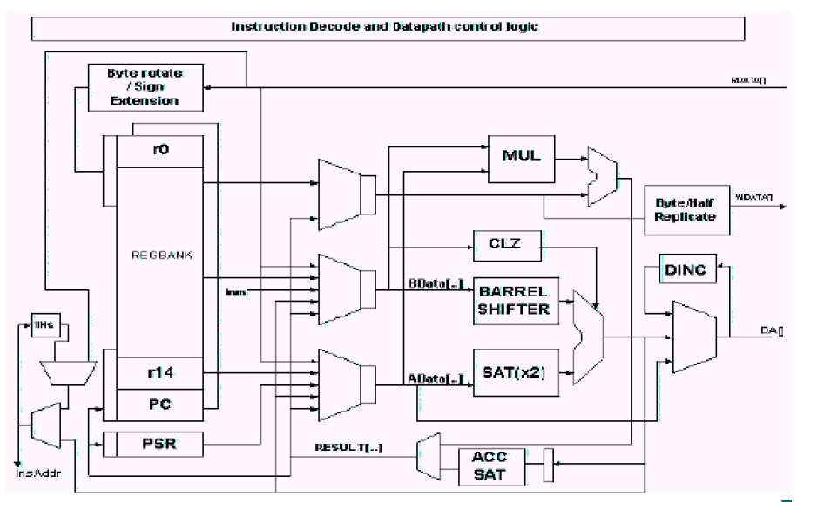

Slide 6
EBBR (Embedded Base Boot Requirements)
Be a agnostic about ACPI and DeviceTree
Focus on the UEFI interface, not a specific codebase.
Design to be implementable and useful today.
Design to be OS independent
Support multiple architectures
Design for common embedded hardware
Plat to evolve over time

Slide 7
Firmware Storage
Boot firmware images and data
Independent of the storage used for OS partitions and the EFI System Partition (ESP).
This could be physically separate device (e.g. SPI flash)
Or a dedicated logical unit (LU) within a device (e.g. eMMC boot partition or UFS boot LU).

Slide 8
Fixed Shared Storage
Fixed storage is storage that is permantely attached to the platfor, and cannot be moved between systems.
eMMC and Universal Flash Storage (UFS) device are often used as shared fixed storage for both firmware and the OS.
Operating system must not use the dedicated firmware partition for installing EFI applications including, but not limited to, the OS loader and OS specific files. Instead, a normal ESP should be created. OS partitioning tools must take care not to modify or delete dedicated firmware partitions

Slide 9
Removable Shared Storage
Ignore..

