Slide 1
E-NER— An Annotated Named Entity Recognition Corpus of Legal Text
UCL Computer Science
Ting Wai Terence Au​
Ingemar J. Cox​
Vasileios Lampos
NLLP Workshop 2022 (paper 43)
8th December 2022

Slide 2
UCL Computer Science
Named Entity Recognition (NER)
Named entities (NE) are names of specific object in the world, for example
names of location, organizations, people
Identifying NE in documents can help many other legal NLP tasks such as
record linkage (Dozier et al. 2010), contract analysis (Chalkidis et al., 2017)

Slide 3
UCL Computer Science
Named Entity Recognition (NER)
Named entities (NE) are names of specific object in the world, for example
names of location, organizations, people
Identifying NE in documents can help many other legal NLP tasks such as
record linkage (Dozier et al. 2010), contract analysis (Chalkidis et al., 2017)
Examples of NER datasets
CoNLL-2003 (Sang and De Meulder, 2003)
Ontonotes 5.0 (Weischedel et al., 2012)
CONTRACTS-NER (Chalkidis et al., 2017)
Fin-3, Fin-5 (Alvarado et al., 2015)
Word | NE tag
plaintiff | O
A. | I-PER
Schwartz | I-PER
filed | O
a | O
lawsuit | O
in | O
California | I-COURT
Superior | I-COURT
Court | I-COURT

Slide 4
UCL Computer Science
EDGAR-NER (E-NER)
Financial entities (such as companies, individuals and funds) registered with the US Securities and Exchange Commission (US SEC) are required to submit filings to the Electronic Data Gathering, Analysis and Retrieval (EDGAR) database
We arbitrarily chose the year 2010 and downloaded 52 filings. We avoided filings that contain almost no text (such as tables for the filer to fill in)

Slide 5
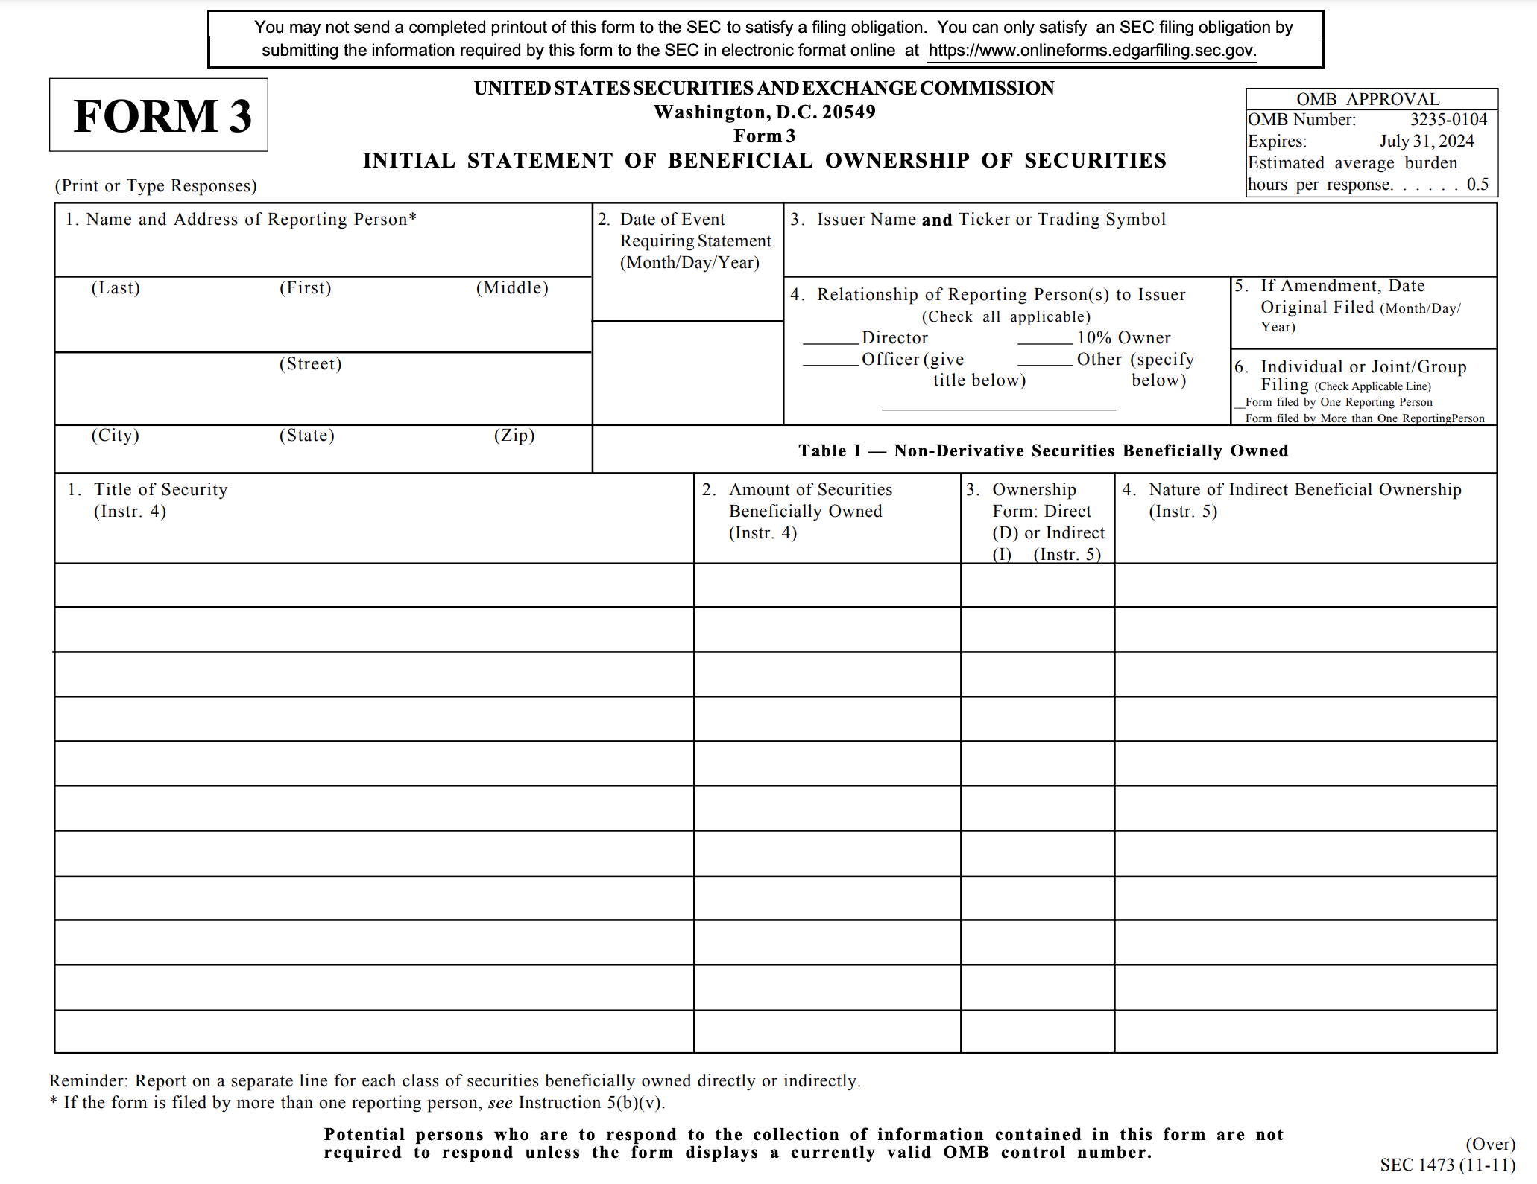
UCL Computer Science
EDGAR-NER (E-NER)

Slide 6
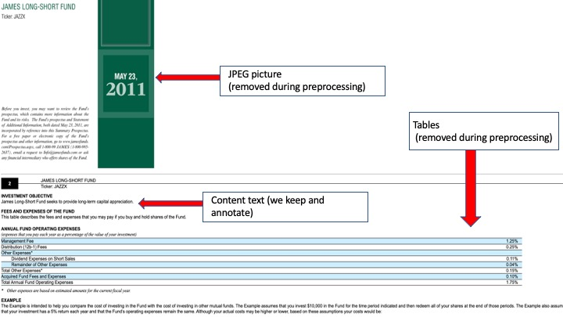
UCL Computer Science
EDGAR-NER (E-NER)
After downloading the filings from EDGAR, we preprocess the raw HTML text file by removing:
SEC filing header section
Graphical elements
Tables that contain no sentences
Page numbers
Figures and plots
XBRL instances

Slide 7
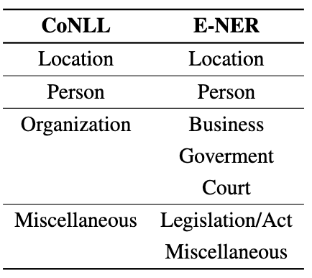
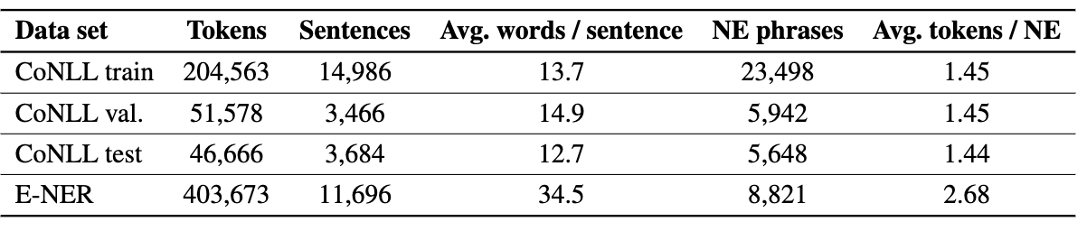
UCL Computer Science
EDGAR-NER (E-NER)

Slide 8
UCL Computer Science
EDGAR-NER (E-NER)

Slide 9
UCL Computer Science
Experiments
We applied 4 NER models:
CoNLL-2003 Baseline
Hidden Markov Model
Conditional Random Field
BERT
Train and test datasets:
Train and test on CoNLL-2003 dataset (G to G)
Train on CoNLL-2003 dataset, test on E-NER dataset (G to L)
Train and test on E-NER dataset (5-fold cross validation) (L to L)
For BERT, we “finetune” the model

Slide 10
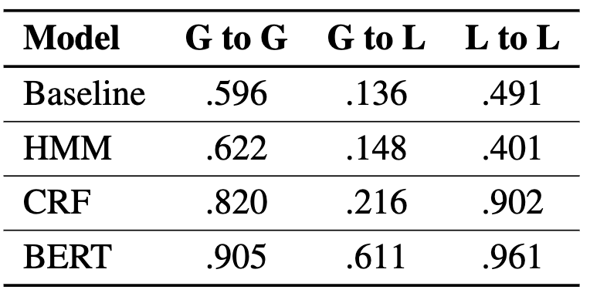
UCL Computer Science
Experiments
We applied 4 NER models:
CoNLL-2003 Baseline
Hidden Markov Model
Conditional Random Field
BERT
Train and test datasets:
Train and test on CoNLL-2003 dataset (G to G)
Train on CoNLL-2003 dataset, test on E-NER dataset (G to L)
Train and test on E-NER dataset (5-fold cross validation) (L to L)
F-1 score
Notes:
(f1 is micro)

Slide 11
UCL Computer Science
Github
https://github.com/terenceau2/E-NER-Dataset

