Slide 1
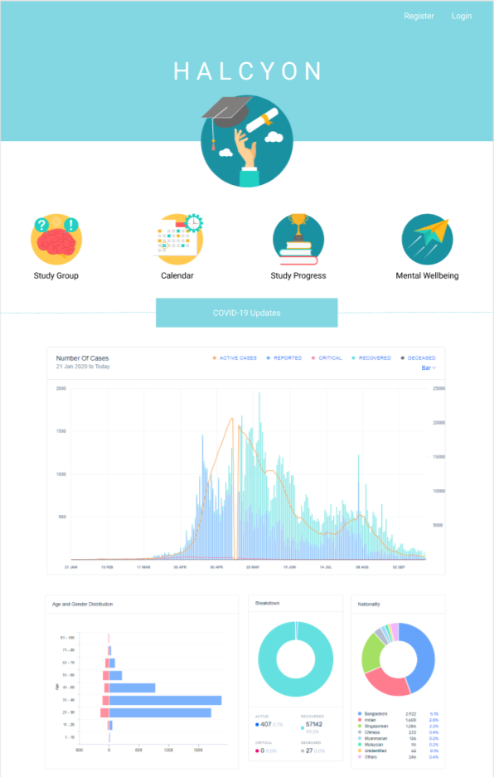
Halcyon
All in one academic application
Notes:
Introducing our application, Halcyon. which describes a time of peace and happiness,

Slide 2
Table of Contents
01
02
03
04
Problem and Users
Functional Requirements
Our target audience
Features and Functions
Non-Functional Requirements
Benefits
System/Quality attributes
What we hope our application achieves

Slide 3
01
Problem and Users

Slide 4
Problem and Context
Amidst the Covid’19 Pandemic, most faculties have decided to shift most, if not all classes online. The curriculum powered by E-learning primarily has led to students becoming jaded due to them studying alone at home.

Slide 5

Users
NUS Students
Specially designed for NUS Students in all zones and faculties, targeted at those who are being affected by the Covid-19 pandemic

Slide 6
02
Functional Requirements

Slide 7
Halcyon’s Features
Front Page
Home Page
Calendar
Students can preview the application interface and log-in with their NUS Email Credentials
Consists of the different tabs and functions
Generated based on the modules that the User is taking

Slide 8
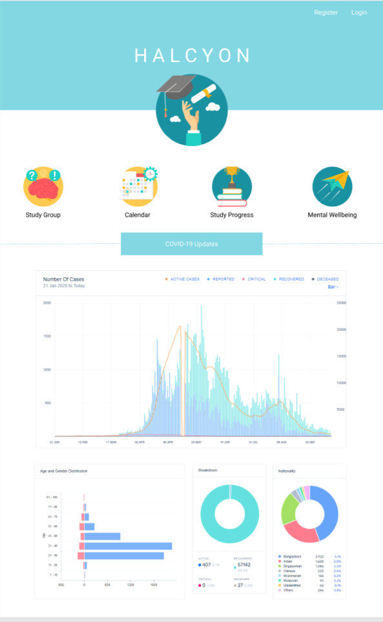
Welcome Page
Upon entering the application, Users will first view the various functions of the application, namely: Calendar, Study Group, Study Progress, and Mental Wellbeing. In addition, there would be covid’19 numbers updated daily. Users can then login to their accounts which would require registration based on their NUS email.

Slide 9
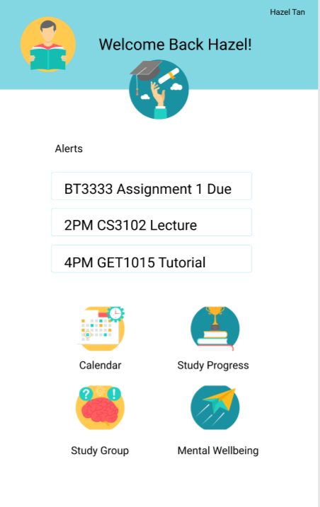
Home Page
In addition to the function tabs, Halcyon provides updated alerts of the student’s assignments that are in due, according to the date. Students can key in their assignments and due dates to track them in the alerts section. Push-Notifications are present for users to remind themselves without opening the application

Slide 10
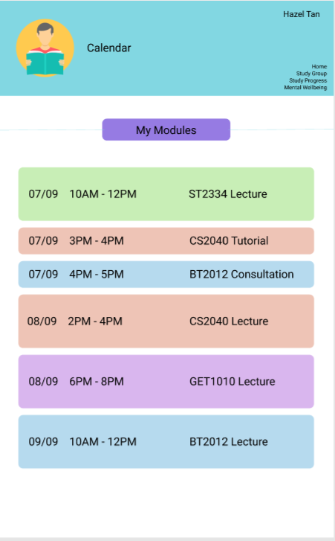
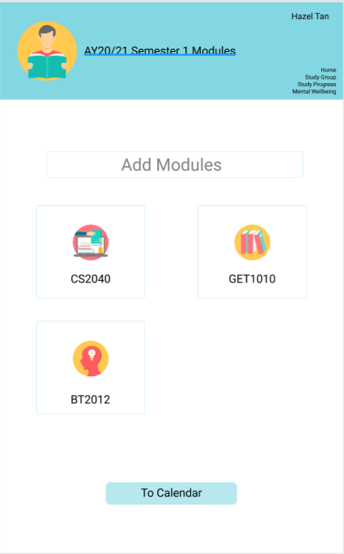
Calendar
Halcyon holds a Calendar page where students are able to view their upcoming classes, including lectures, sectionals and tutorials.
Students can navigate to the ‘My Modules’ page to add their modules which will then show up on their calendar

Slide 11
Halcyon’s Features
Study Group
Study Progress
Mental Wellbeing
Free to join study groups available based on modules
Monitors the amount of time used for studying daily
Provides weekly updated memes and suggests activities to destress

Slide 12
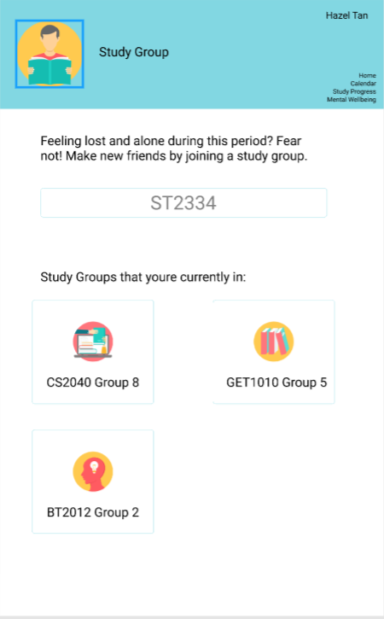
Study Group
Halcyon allows users to search for study groups in different modules and join them. For each module, a user can join one study group.

Slide 13
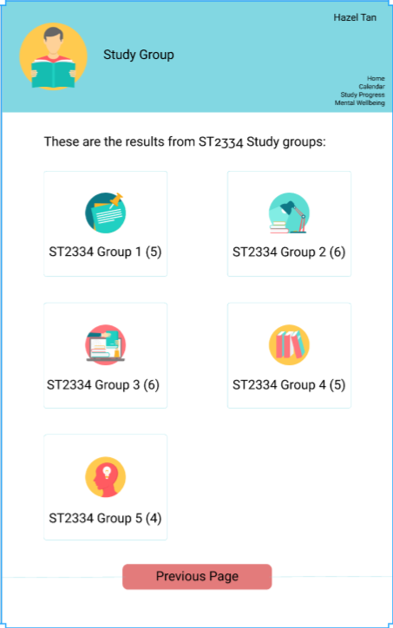
Study Group
After searching for study groups based on the module code, users are able to view the different study groups and the number of participants in each group, before deciding which group they wish to join.

Slide 14
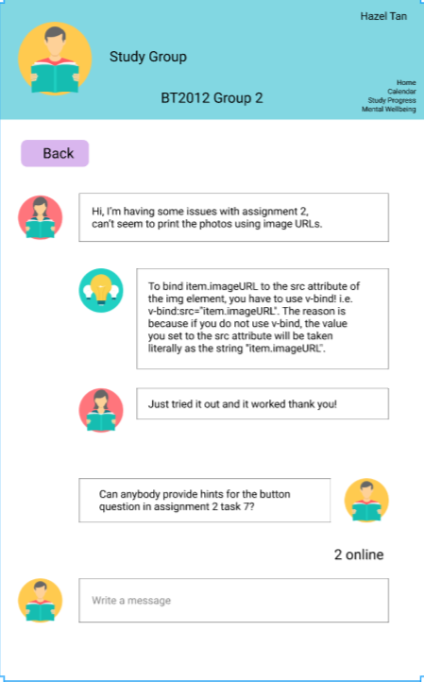
Study Group
Upon joining a group, Halcyon provides an in app messaging tool to allow the group members to communicate and share queries and information.

Slide 15
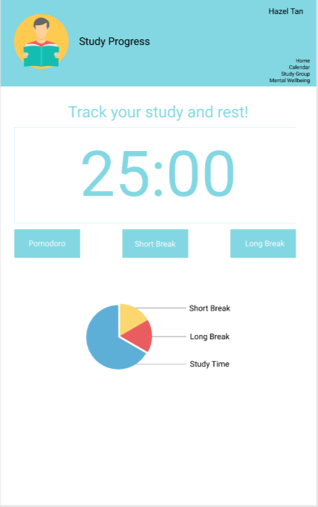
Study Progress
Study Progress allows users to monitor their study time and break times, splitting into short and long breaks. These data will then be consolidated on a weekly and monthly basis and users can view the trends and changes across weeks and months.

Slide 16
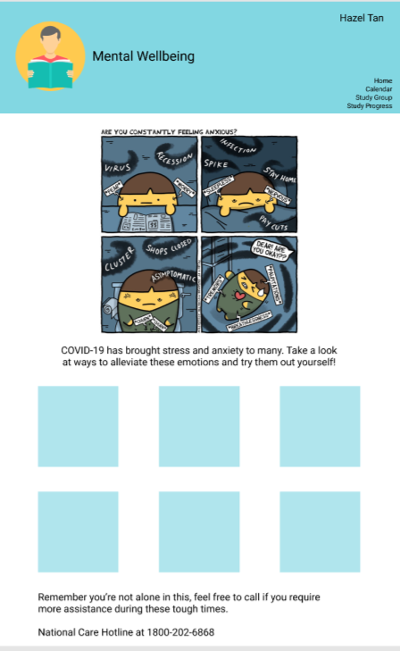
Mental Wellbeing
We understand that covid’19 has resulted in various ways of stress, as so for students who have immense workload and a one-dimensional learning curriculum. Halcyon hopes to provide users some tips and advice on how to cope with these stress. Also, users can view some recommended activities to destress, which will be updated on a weekly basis.

Slide 17
03
Non-Functional Requirements

Slide 18
Non-Functional Requirements
Simplicity
Halcyon pursues minimalism, meaningful results
Usability
Halcyon provides well sized buttons and diverse colours for greater interactivity
Performance
Halcyon aims to be time efficient, providing users with a seamless experience
Security
Halcyon will provide a secure database and network for the users details and messages in the application

Slide 19
Benefits of using Halcyon
All in one concept
Improved time management
Allows for calendar/timetable input along with study groups and study progress monitoring
Study Progress allows users to better manage their time and balance their work and rest
Weekly recommendations
Forging friendships
Constant new suggestions to destress and maintain mental wellness
Allow students to meet new people in a safe environment

Slide 20
Thank You

