Slide 1
ASEAN Olympic
Performance Intelligence System
Historical analysis of ASEAN participation and medal performance, 1924–2016
Terence Quek
SCTP Associate Data Analyst Capstone Project
October 2026
Notes:
Introduce the project as an analytics system for examining ASEAN Olympic participation and medal performance. The analysis covers records from 1924 to 2016 and combines Python-based preparation and exploratory analysis with an interactive Power BI dashboard.

Slide 2
Business challenge and research objectives
A regional view is needed to turn historical Olympic records into comparable evidence
Decision challenge
Approved research objectives
ASEAN performance data spans many countries, sports and Olympic editions. Without a consistent medal measure and common view, decision-makers cannot easily compare results or identify where deeper investigation is needed.
01
Participation and medal trends
05
Athlete profiles
02
Country benchmarking
06
Emerging or declining areas
03
Medal-producing sports
07
Medal opportunities
Analytical boundary
04
Gender differences
•
Historical patterns describe performance but do not establish why medals were won.
•
Recommendations identify where to investigate or focus resources, subject to available data.
ASEAN Olympic Performance Intelligence System
02
Notes:
Frame the work as a decision-support problem. The seven objectives come from the EDA notebook. The dataset does not include funding, coaching quality or training investment, so the analysis can identify patterns and opportunity signals but cannot prove their causes. Source: 02_EDA_ASEAN_Olympics.ipynb.

Slide 3
Data preparation and measurement
The cleaning process preserved traceability and prevented duplicate participation or team-medal counts
271,116
1,385
3,233
90
10
raw athlete-event rows
exact duplicates removed
ASEAN athlete-event records
deduplicated official medals
ASEAN countries represented
Key cleaning decisions
Missing demographic values
•
Merged country names using NOC codes and resolved unmatched codes, including SGP.
5.3%
17.4%
17.5%
•
Filtered the global dataset to the ten ASEAN countries in scope.
Age
Height
Weight
•
Created Won_Medal, Medal_Status, Gender and missing-value indicators.
Values were retained and flagged rather than imputed, avoiding artificial athlete measurements.
•
Deduplicated team medals by Games, NOC, Event and Medal
ASEAN Olympic Performance Intelligence System
03
Notes:
Explain that the global source contained 271,116 rows. Removing 1,385 exact duplicates left 269,731 global rows, after which the ASEAN filter produced 3,233 records. Age, height and weight were retained as missing and flagged rather than imputed. Team medals were deduplicated to 90 country medal records. Sources: 01_Data_Cleaning.ipynb and ASEAN_Olympics_Cleaning_Log.md.

Slide 4
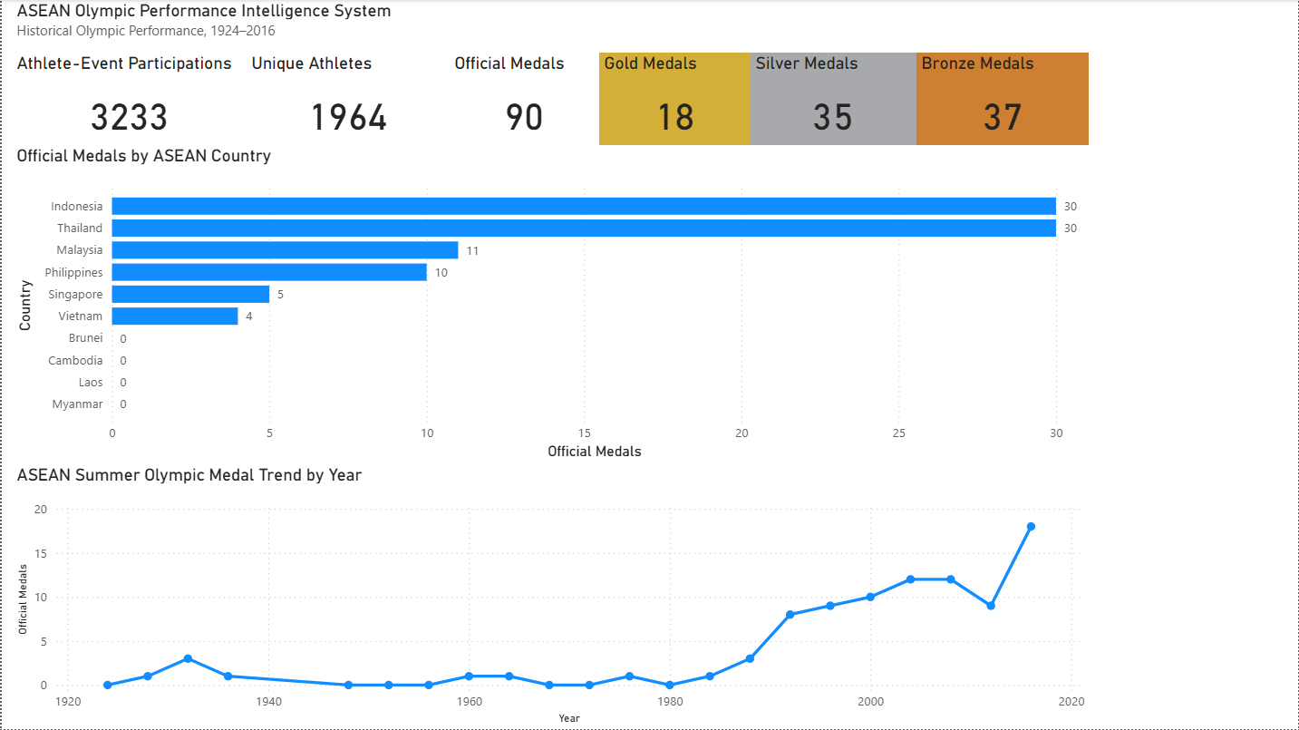
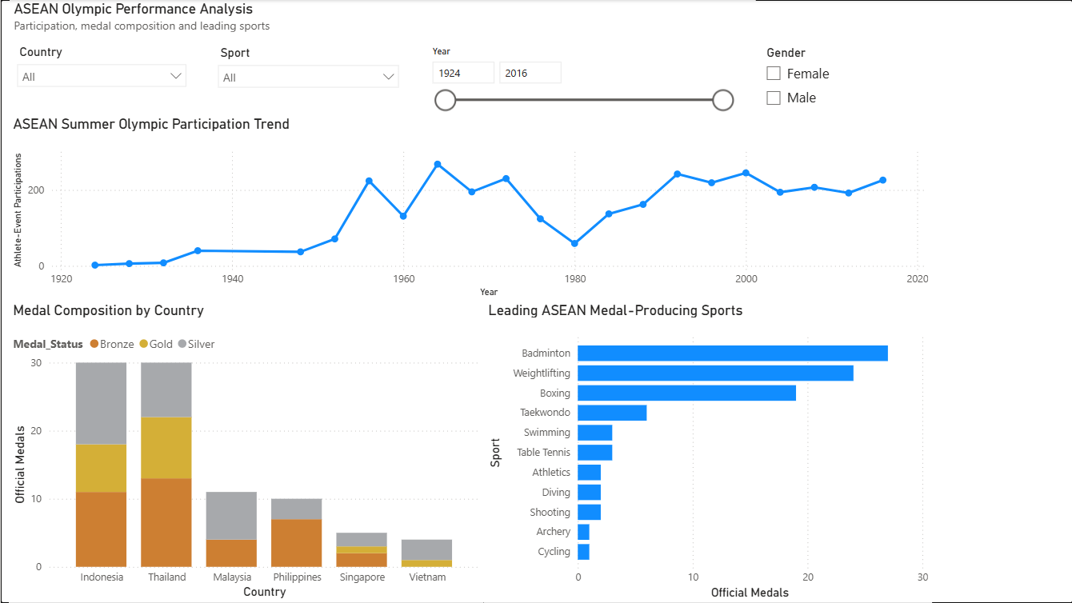
Analytics system delivered
Power BI supports interactive exploration while Python provides auditable preparation and deeper analysis
Executive overview
Performance analysis
Management view
Analytical view
Headline KPIs, country ranking and the medal trend provide a consistent regional baseline.
Country, sport, year and gender slicers allow focused comparisons. A Singapore swimming check correctly returned Joseph Schooling’s 2016 gold medal.
ASEAN Olympic Performance Intelligence System
04
Notes:
Describe the system as two connected layers. Python prepares and validates the data. Power BI provides an executive page and a performance analysis page. The Joseph Schooling filter test checked Singapore, swimming, gold and years after 2000, returning one record from 2016. Sources: supplied Power BI screenshots, 01_Data_Cleaning.ipynb and 02_EDA_ASEAN_Olympics.ipynb.

Slide 5
Participation broadened as medal performance strengthened
Female participation approached parity by 2016, while official medals reached a dataset peak
49.6%
18
female share of 2016 ASEAN Summer participations
official medals in 2016, the highest edition total in the dataset
Trend charts show Summer editions. The overall KPI includes 14 Winter athlete-event records.
ASEAN Olympic Performance Intelligence System
05
Notes:
Participation expanded substantially over the historical period. Female participation began later and reached 49.6% of ASEAN Summer athlete-event participations in 2016. Official medal performance increased from the 1990s and reached 18 medals in 2016. The chart supports a long-term pattern but does not identify its causes. Source: calculations from 02_EDA_ASEAN_Olympics.ipynb and athlete_events.csv after the documented cleaning steps.

Slide 6
Indonesia and Thailand account for two-thirds of ASEAN medals
Country outcomes vary widely despite broad regional participation
66.7%
of ASEAN official medals came from Indonesia and Thailand
Country totals
Indonesia 30
Thailand 30
Malaysia 11
Philippines 10
Singapore 5
Vietnam 4
Four ASEAN countries recorded no official medals during the dataset period.
ASEAN Olympic Performance Intelligence System
06
Notes:
Indonesia and Thailand each recorded 30 official medals. Together they contributed 60 of 90 medals, or 66.7%. Malaysia recorded 11, the Philippines 10, Singapore 5 and Vietnam 4. Brunei, Cambodia, Laos and Myanmar recorded none in this dataset. This comparison describes outcomes and does not explain differences in resources or sporting systems. Source: 02_EDA_ASEAN_Olympics.ipynb.

Slide 7
Three sports generated most medals, while weightlifting gained ground
Equal four-edition periods show both established strengths and changing sources of success
Badminton, weightlifting and boxing contributed 70 of 90 medals, or 77.8%.
Weightlifting rose from 4 to 19 medals. Badminton and boxing remained major contributors despite lower totals in the later period.
ASEAN Olympic Performance Intelligence System
07
Notes:
Badminton, weightlifting and boxing generated 70 of 90 medals, or 77.8%. To examine change fairly, compare two periods containing four Summer editions each: 1988 to 2000 and 2004 to 2016. Weightlifting increased from 4 to 19 medals. Taekwondo increased from 1 to 5 and table tennis from 0 to 3. Badminton decreased from 15 to 12 and boxing from 9 to 6, but both remained major contributors. These figures describe historical change and should not be treated as forecasts. Source: calculations from the cleaned athlete-events data.

Slide 8
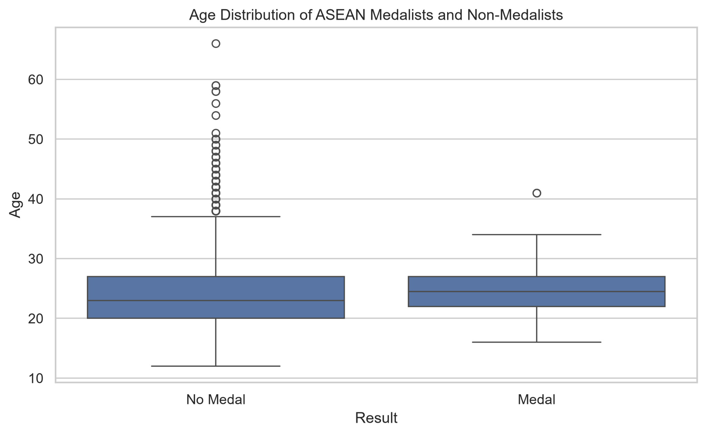
Age alone does not distinguish medal success
Medal yield offers a separate benchmark for identifying where deeper sport-level analysis may add value
Indonesia leads this descriptive ratio. Countries with high participation and lower medal yield warrant sport-level investigation before decisions are made.
Median age
23.0 years without a medal | 24.5 years with a medal
The distributions overlap substantially. Age provides context but has limited value as a standalone indicator.
The ratio is not adjusted for event mix or team size.
ASEAN Olympic Performance Intelligence System
08
Notes:
The age analysis excludes 171 records with missing ages. Medal records have a median age of 24.5 years and an interquartile range of 22 to 27. Non-medal records have a median age of 23 and an interquartile range of 20 to 27. The overlap is substantial. The medal-yield chart divides official medals by athlete-event participations. It is a directional benchmark only because sport mix, event structure and team size differ across countries. Sources: ASEAN_Age_Medal_Boxplot.png, 01_Data_Cleaning.ipynb and calculations from the cleaned dataset.

Slide 9
Recommendations and limitations
Historical evidence supports focused action, followed by validation with current programme data
01
Protect proven medal pathways
Limitations
Maintain targeted development in badminton, weightlifting and boxing, which produced 77.8% of the region’s medals.
•
Historical records end in 2016.
02
Tailor strategy by country
•
The data lacks funding, coaching and training variables.
Use each country’s sport profile and medal yield to prioritise detailed reviews instead of applying one regional programme.
•
Athlete-event records can repeat the same athlete.
03
Track performance by Olympic edition
•
Age is missing for 5.3% of ASEAN records; height and weight are missing for about 17.5%.
Monitor participation, gender representation, official medals and medals per 100 participations using the same definitions.
•
The medal-yield ratio is descriptive and does not establish causation.
Next analytical step
Add current athlete-development, investment and competition data to test which factors are associated with medal outcomes.
ASEAN Olympic Performance Intelligence System
09
Notes:
Close with practical recommendations that follow directly from the evidence. Proven sports deserve continued attention, but strategy should remain country-specific. Consistent edition-level monitoring will make future comparisons stronger. Emphasise that the analysis covers historical associations only and should be supplemented with current programme, funding, coaching and competition data before investment decisions.

