Slide 1
Big Mountain Resort: Executive Summary
Guided Capstone | Price Optimization Strategy
By Terence Michel

Slide 2
Problem Identification
Big Mountain Resort may be undervaluing its adult weekend tickets.
This project compares ticket prices and features across North American ski resorts to identify a data-driven pricing strategy.

Slide 3
Data Wrangling & Feature Engineering
Cleaned and merged datasets with missing value imputation
Standardized resort names, states, and regions
Derived features like resort density and terrain attributes

Slide 4
Recommendation & Key Findings
Raise ticket price from ~$70 to $78–$80.
Justification:
Ridge model shows 13% undervaluation
Peer resorts with similar features charge more
Infrastructure improvements can support future increases

Slide 5
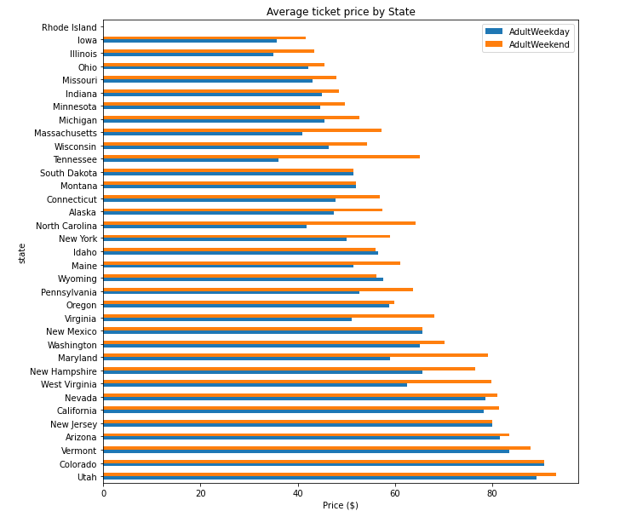
Modeling Performance: R² ≈ 0.82, MAE ≈ $9

Slide 6
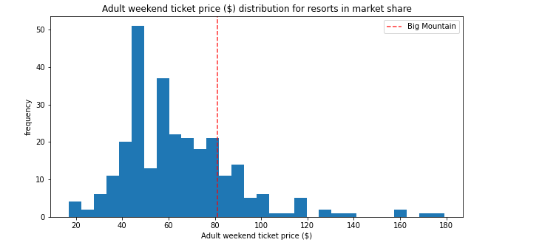
SelectKBest Features and Model Outputs

Slide 7
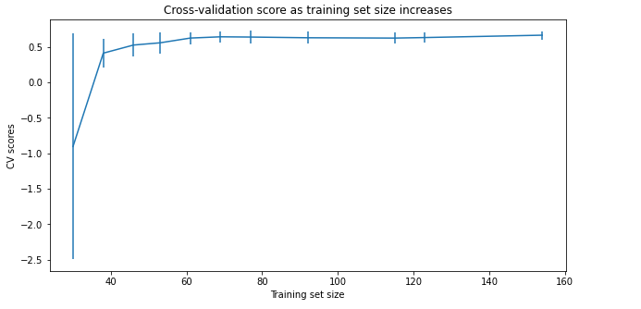
Scenario Analysis: Price Sensitivity to Upgrades

Slide 8
Conclusion & Future Scope
Big Mountain is undervalued and missing revenue
Incremental facility upgrades support higher pricing
Future enhancements:
Seasonal and dynamic pricing models
Cluster-based recommendations
Consumer behavior integration

