Slide 1

COVID-19 Tweet
Sentiment Classification
A Machine Learning Approach Using TF-IDF and Linear Classifiers
Corona NLP Dataset
TF-IDF Features
Springboard Data Science Career Track | Capstone Three

Slide 2






Data Science Methodology
01
02
03
Problem
Data Cleaning
EDA
Define the challenge & value
Normalize & deduplicate tweets
Explore distributions & patterns
04
05
06
Pre-Processing
Modeling
Conclusion
TF-IDF feature engineering
Train & tune 3 classifiers
Results, limits & next steps

Slide 3
The Problem
Statement
"Can machine learning models accurately classify the sentiment of COVID-19 tweets into Positive, Neutral, or Negative categories using only tweet text?"
Dataset Snapshot
3,798
Labeled Tweets
Public Health
Policy
Messaging
Monitor mood in real time
Detect misinformation-driven panic
Tailor communication strategies

Slide 4
Stage 1: Data Acquisition
Dataset: Corona NLP
Label Consolidation
Source:
Publicly available COVID-19 tweet collection
Extremely Positive
Positive
Positive
Size:
3,798 labeled tweets (test split)
→
Neutral
Neutral
Original Labels:
5 categories (Extremely Positive → Extremely Negative)
Negative
Negative
Consolidated:
3 classes: Positive, Neutral, Negative
Extremely Negative
Rationale:
Consolidation improves model reliability & reduces label noise
5 labels → 3 labels

Slide 5
Stage 2: Data Cleaning & Preprocessing
Sentiment Consolidation
Text Normalization
5 original labels → 3 classes (Positive, Neutral, Negative)
All text lowercased for uniform processing
URL Removal
Mention & Hashtag Removal
HTTP/HTTPS links stripped — carry no sentiment value
@mentions and #hashtags removed as Twitter-specific tokens
Special Character Filtering
Whitespace Normalization
Non-alphabetic characters removed; only letters and spaces retained
Consecutive spaces collapsed to single spaces
⚠ 2 tweets with missing text identified → handled with empty-string imputation to prevent data loss.

Slide 6
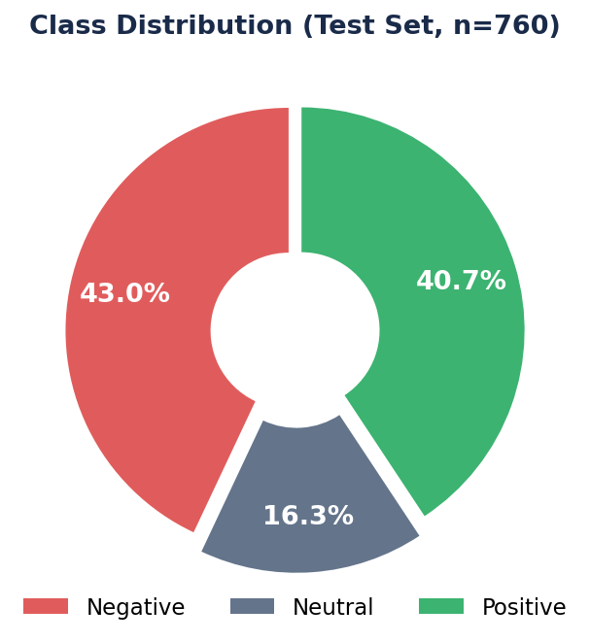
EDA: Class Distribution
Key Insights
43.0%
Negative
Largest class — reflects pandemic anxiety & frustration
40.7%
Positive
Nearly balanced with Negative; hopeful messages & gratitude
16.3%
Neutral
Minority class — informational/factual tweets
Negative & Positive are nearly balanced;
Neutral is the minority class → harder to classify.

Slide 7
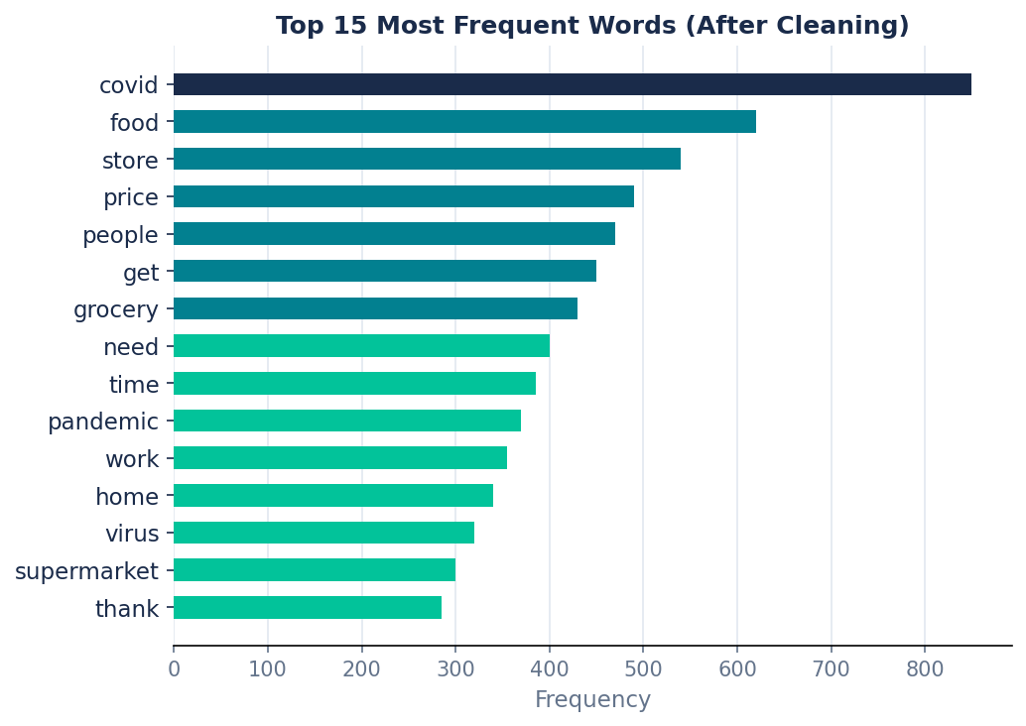
EDA: Top 15 Most Frequent Words
Food Security
"food", "store", "grocery", "supermarket" dominate — economic anxiety was a key driver.
Pandemic Focus
"covid" and "virus" anchor the discourse to the core topic.
Social Signals
"people", "thank", "home", "work" reveal social & behavioral themes.

Slide 8
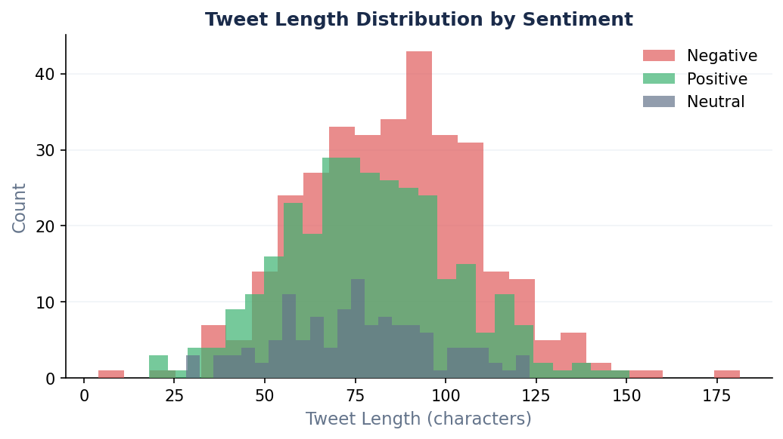
EDA: Tweet Length by Sentiment
Distribution Takeaways
Negative — ~85 chars avg
Slightly longer — anger and frustration often expressed with more words.
Positive — ~80 chars avg
Similar length to negative; emotional expression is verbose.
Neutral — ~75 chars avg
All classes show similar length ranges — tweet length alone is a weak predictor of sentiment.
Slightly shorter — informational statements tend to be concise.

Slide 9
Stage 3: Feature Engineering — TF-IDF
TF-IDF = TF(t,d) × log[ N / df(t) ]
Max Features:
5,000
N-gram Range:
Unigrams + Bigrams (1,2)
Stop Words:
English removed
Training Samples:
3,038 tweets
Test Samples:
760 tweets
Feature Vector:
5,000 dimensions (sparse)
💡 Bigrams capture multi-word sentiment signals like "not good", "very worried", or "thank you" — unigrams alone would miss the full meaning.

Slide 10
Stage 4: Modeling Approach
Logistic Regression
LinearSVC
Multinomial Naive Bayes
✓ Best
2nd
Baseline
67.8%
67.1%
59.9%
Accuracy
Accuracy
Accuracy
Probabilistic linear classifier — well-suited to high-dimensional sparse text data. Outputs class probabilities.
Margin-maximizing linear classifier. Highly effective for text classification with large feature spaces.
Generative probabilistic model based on word frequency. Feature independence assumption breaks down in NLP.
Best params: C=10, solver=liblinear
Best params: C=1
Best params: alpha=1.0
All models tuned with 5-fold GridSearchCV

Slide 11
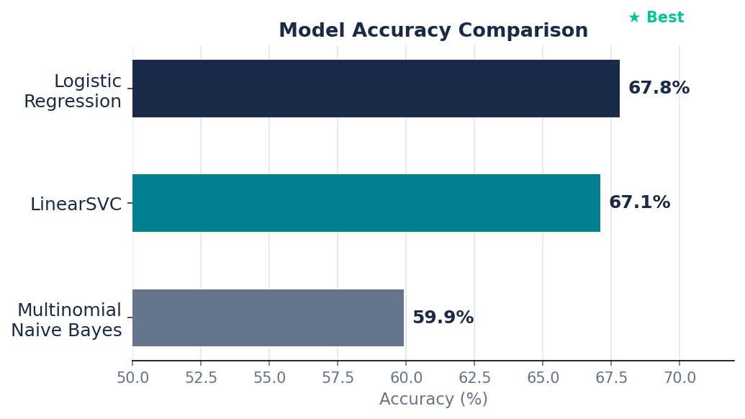
Results: Model Accuracy Comparison
Summary Table
Model | Accuracy | Macro F1
Logistic Reg. ★ | 67.8% | 0.62
LinearSVC | 67.1% | 0.62
Naive Bayes | 59.9% | 0.44
Why Linear Models Won
TF-IDF produces a high-dimensional sparse space ideal for linear classifiers. Naive Bayes' feature independence assumption breaks down in natural language, explaining the ~8 point accuracy gap.

Slide 12
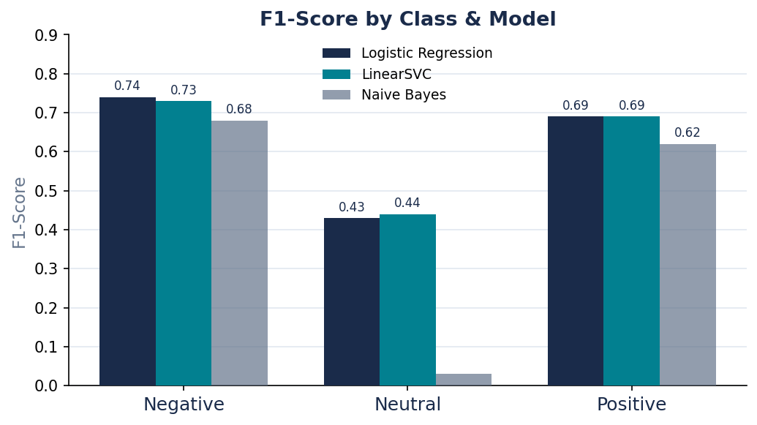
Results: F1-Score by Sentiment Class
Negative
F1: 0.74
P: 0.70 R: 0.78
Best performer — polarized language is easiest to detect.
Positive
F1: 0.69
P: 0.68 R: 0.71
Strong performance — positive keywords are distinct.
Neutral
F1: 0.43
P: 0.57 R: 0.35
Weakest class — neutral language overlaps with both poles.

Slide 13
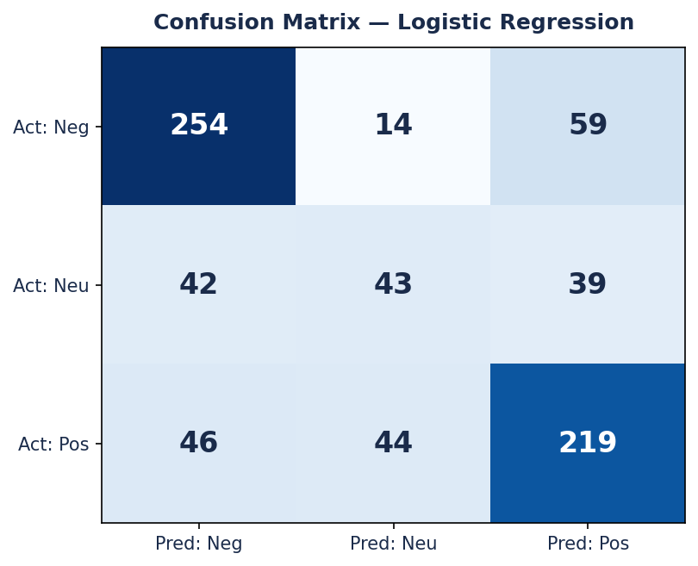
Results: Confusion Matrix — Logistic Regression
Confusion Matrix Insights
78%
Negative Recall
254 of 327 correctly classified
71%
Positive Recall
219 of 309 correctly classified
35%
Neutral Recall
Only 43 of 124 correctly classified
⚠ Most common error: Neutral predicted as Positive or Negative

Slide 14
Recommendations
01
Deploy Logistic Regression for Real-Time Monitoring
The tuned LR classifier (C=10, TF-IDF bigrams) is lightweight, fast, and achieves 67.8% accuracy — ideal for streaming inference on high-volume COVID-19 tweet feeds.
02
Treat Neutral as a Separate Research Problem
Apply a two-stage approach: first classify Positive vs. Not-Positive, then separate Negative from Neutral. Low-confidence predictions should be flagged as Neutral.
03
Invest in Transformer-Based Models for Production
Fine-tuning BERTweet (BERT pretrained on Twitter) is the highest-ROI next step. Contextual embeddings will significantly outperform bag-of-words TF-IDF features.

Slide 15
Ideas for Future Research
Temporal Analysis
Geographic Mapping
Explore how sentiment shifted over time as the pandemic evolved using tweet date metadata.
Leverage location metadata to map sentiment by region, revealing geographic hotspots of distress.
Ensemble Methods
Class Imbalance Handling
Combine Logistic Regression and LinearSVC predictions via soft voting for marginal accuracy gains.
Experiment with SMOTE oversampling or class_weight='balanced' to improve Neutral class recall.

Slide 16
Conclusion
TF-IDF + Logistic Regression provides a strong, efficient baseline for COVID-19 tweet sentiment classification, achieving 67.8% accuracy on a 3-class problem and providing actionable signal for public health monitoring.
67.8%
0.74
0.43
Best Accuracy
(Logistic Reg.)
Negative F1
(Best Class)
Neutral F1
(Hardest Class)
The model is immediately deployable for monitoring public sentiment. The clearest path to improvement is adopting transformer-based language models fine-tuned on Twitter-specific data.
Springboard Data Science Career Track | Capstone Three | COVID-19 Tweet Sentiment Classification

