Slide 1
[onshow.title]
[onshow.subTitle]
AskNicely

Slide 2
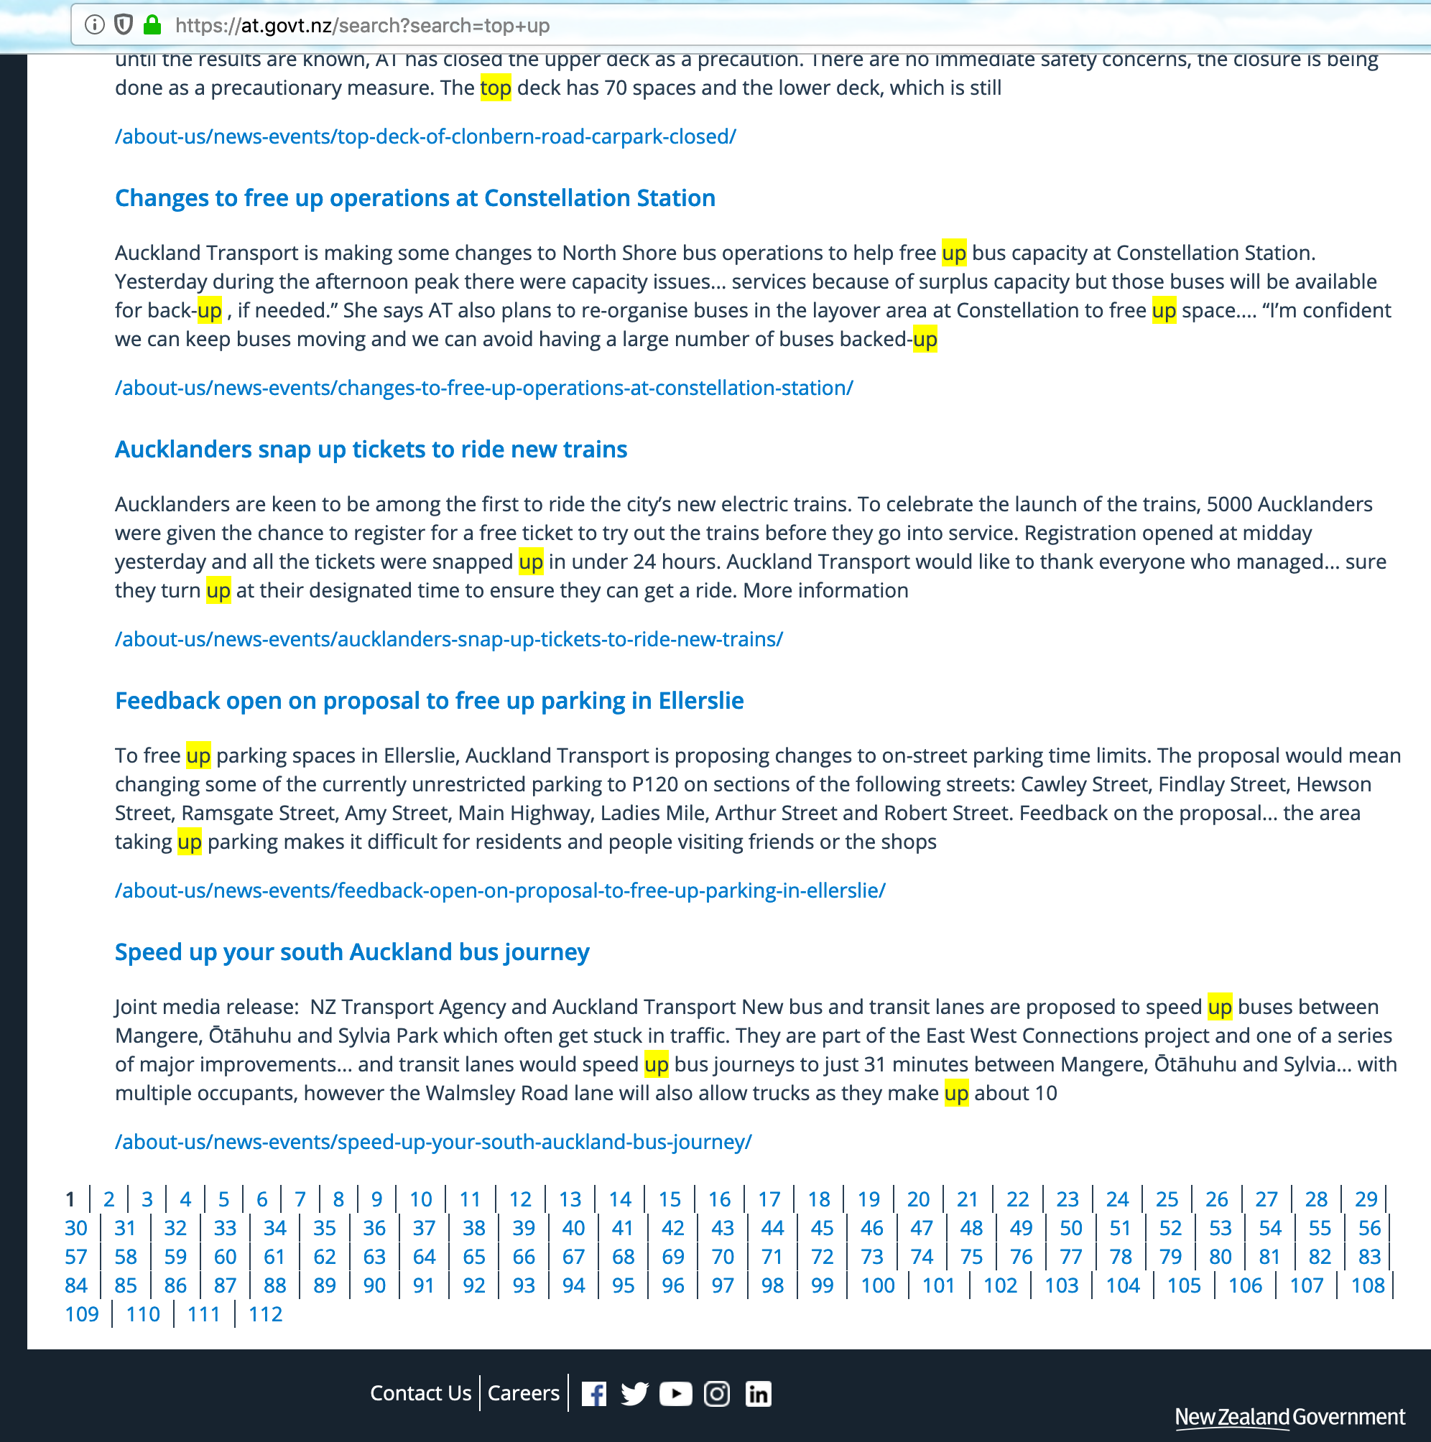
Testing
NPS Trend graph
[onshow.npsTrend;ope=changepic;adjust=sameheight]

