Slide 1
[onshow.title]
[onshow.subTitle]

Slide 2
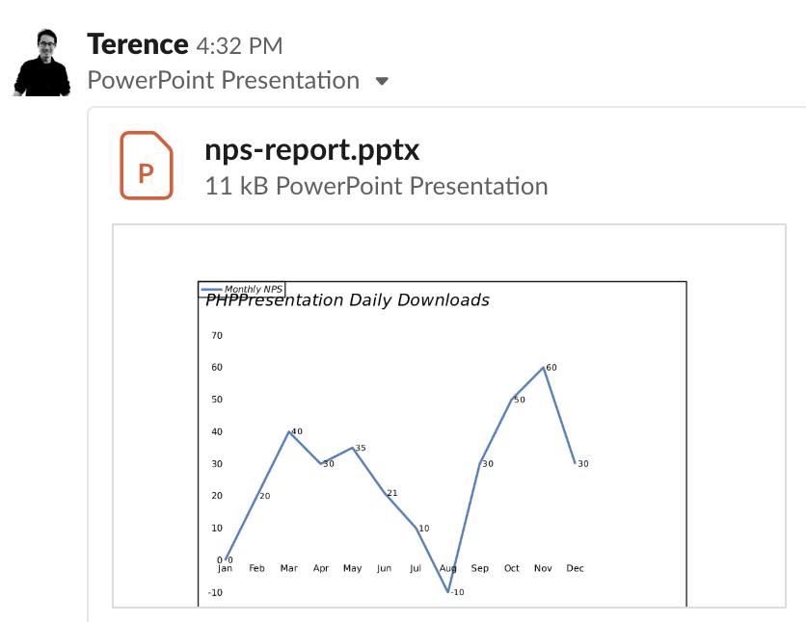
Image

