Slide 1
Indoor Street View Gouri Joshi & Terence Zhao
Business Opportunity
As more of the world becomes digital, even physical spaces can now be explored online. Technology today provides widespread accessibility and convenience for customers who want to preview our stores. The Indoor Street View(ISV) project takes advantage of Google Maps APIs and combines them with our own SKIN (Sears Kmart Indoor Navigation) technology to create an entirely new kind of shopping experience. Customers can virtually navigate stores, explore departments and browse products as if they were really there. In-store initiatives can be translated to online and mobile to draw in more customers and revenue. There is also the opportunity to patent the process of virtualizing stores and offer it as a service to other businesses. The Indoor Street View project is a new dimension in the digital shopping environment that strengthens our role as a leader in integrated retail and paves the way for the store of the future.
Competitive Advantage
Be the first in the industry to offer complete customizable package with the integration of indoor street view and relevant deals as a service to other businesses like airports, malls, etc. Unlike with Google’s services, our solution can be maintained on a private server and customized as per users requirements.
Project Overview
Leverages Google Maps Street View technology to provide customers with an immersive virtual shopping experience
Panoramic images are linked together so that users can navigate departments and aisles and view products as they are in the store
Includes SKIN technology to provide store maps that help the user navigate the store and locate relevant deals based on their location
Project Objective
Enhance online shopping experience with virtual store
Enable customers to “visit” stores from anywhere at anytime
Attract the attention of the technology savvy generation
Add an element of interaction to improve customer engagement.
Success Metrics
Increased online sales revenue due to enhanced shopping experience
Improved perception of Sears as a high tech retail market competitor
Further strengthen Sears role as an integrated retail market leader
Integration with Deals Engine and deployment on mobile devices
Your role and accomplishments
Designed an efficient and scalable process to build Indoor Street View
Deals database integration that updates offers based on customer location
Created a working model for the entire Sears store at Woodfield
Panoramas that support high level of detail including tags and prices
Developed application to work on browser and mobile
Next steps
Automate processes using robotics and store builder interface
Expand the coverage to multiple stores
Productize the feature
Provide routing between points of interest
Future Roadmap
Evolve to Virtual Online Shopping
Integrate with Planogram to identify location of each product and add product specific deals
Provide detailed zoom level that displays 3D models of shelves and items
Integrate with augmented reality project to allow users to shop virtually
Allow users to scan any view in the store with mobile device and receive information, deals, directions, etc. by matching image data against panoramas.

Slide 2
Indoor Street View demo for Sears at Woodfield
Scale of the project
  2 floors
  Xxxx locations
  Xxxx photos – yy GB

Slide 3
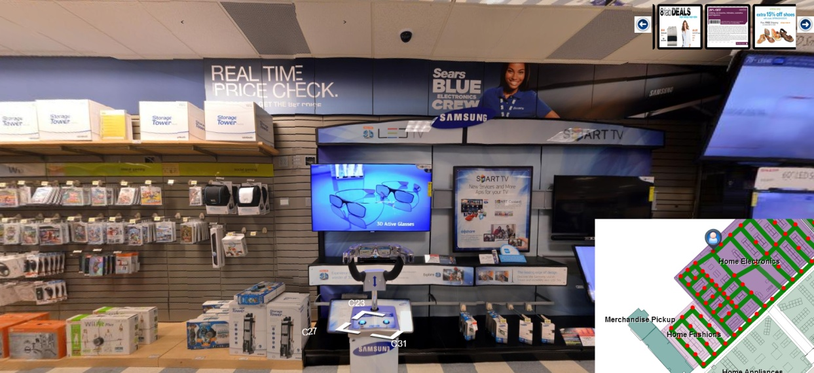





Overview
Indoor Street View
Panoramas
Database of locations, panoramas
Google Map Street
View API’s
Sears Kmart Indoor Navigation APIs
Deals Engine

Slide 4
Integrating Deals
Deals can be presented in 2 ways –
  Department level deals
  Individual product deals
Department level deals
  The Process –
    Identify users current location
    Identify the department
    Get relevant deals for the department
  Deals can be fetched from any deals engine like Shop Local
  Refreshing deals
    User clicks on links or loads new panoramas
Individual product deals
  Define clickable regions on the panorama
  Associate deal with a specific position on the streetview
  Future scope - Integrate with a planogram and locate each product position in the store

