Slide 1
SimplySecure
A Simple Security System Powered by Electric IMP
by Terence Zhao

Slide 2


Slide 3
Objectives
Detect motion and display a reminder to lock the door upon exiting
Trigger an alarm when an unauthorized person enters the premises
Send an email alert when motion is detected after device is armed
Remotely disarm the system by entering the correct key code
Web/Mobile application to handle user interaction

Slide 4
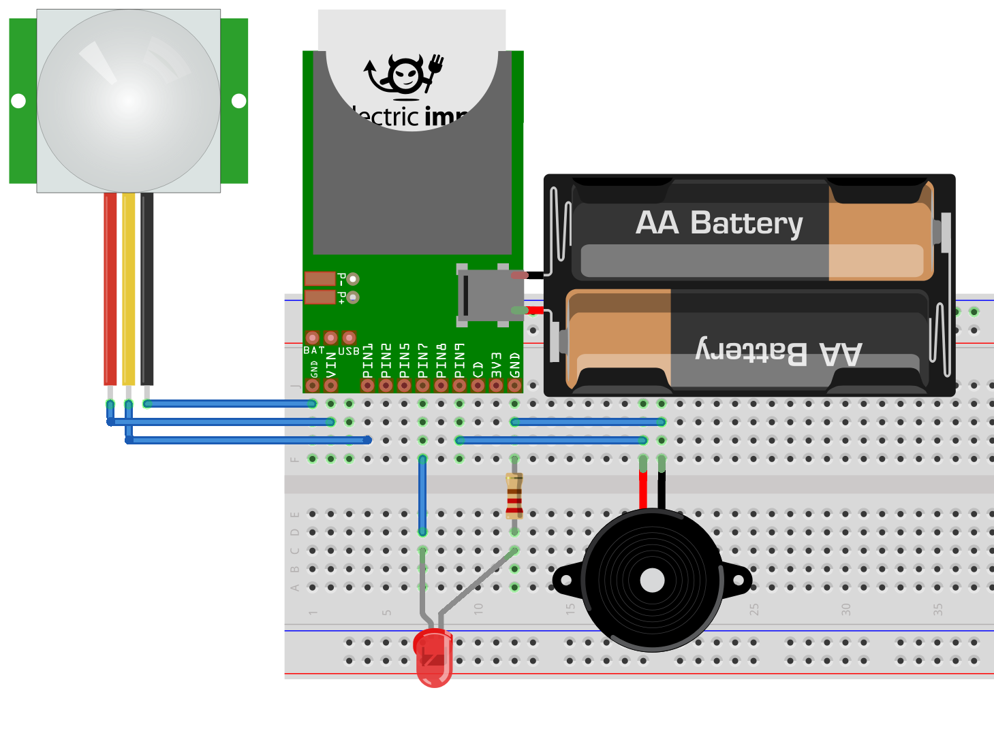
Hardware
Electric IMP
April Board
USB Battery
PIR Sensor
LED
Resistor
5V Buzzer

Slide 5
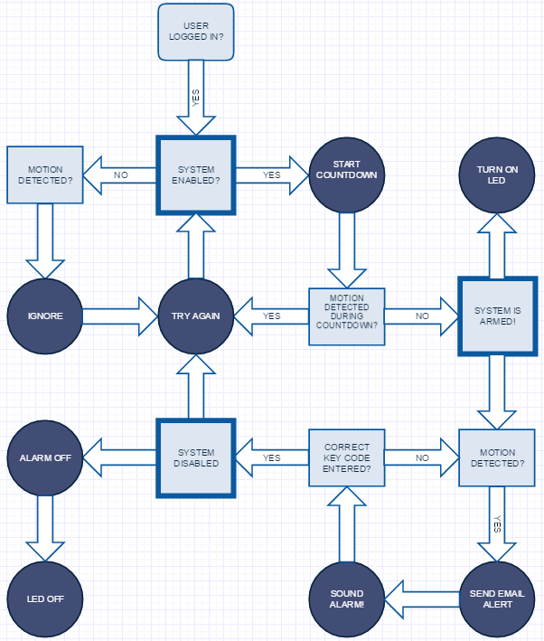
Software
IMP DEVICE
pir_sensor <- hardware.pin1;
led <- hardware.pin7;
buzzer <- hardware.pin9;
imp.wakeup for countdown timer
agent.on to enable/disable system
IMP AGENT
Handle http requests
device.on to trigger alarm
WEB APPLICATION
HTML/Javascript
jQuery Mobile 1.4.5

Slide 6
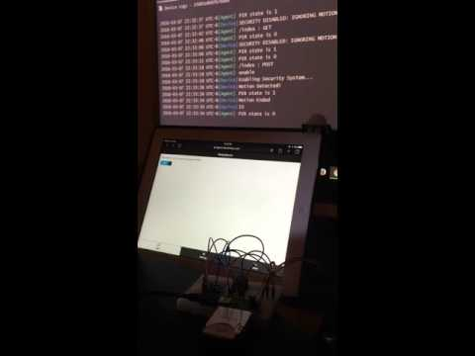
Demo Video

Slide 7
Learnings
The Electric Imp is a great tool for rapid prototyping IoT devices and applications. It provides an abstraction layer that seamlessly integrates hardware, software, and security, reducing costs and increasing productivity.
Building a website for the Agent within the Imp IDE is cumbersome. No local resources or directory structure (All HTML and javascript are combined into single massive string so no syntax highlighting).
The IFTTT maker chanel is very powerful way to interact with popular web services and existing IoT devices through IMP. For example, can replace PIR sensor with Nest Cam for advanced motion detection (filter out false positives, video capture capability, facial recognition).

Slide 8
THANK YOU
Questions?

