Slide 1
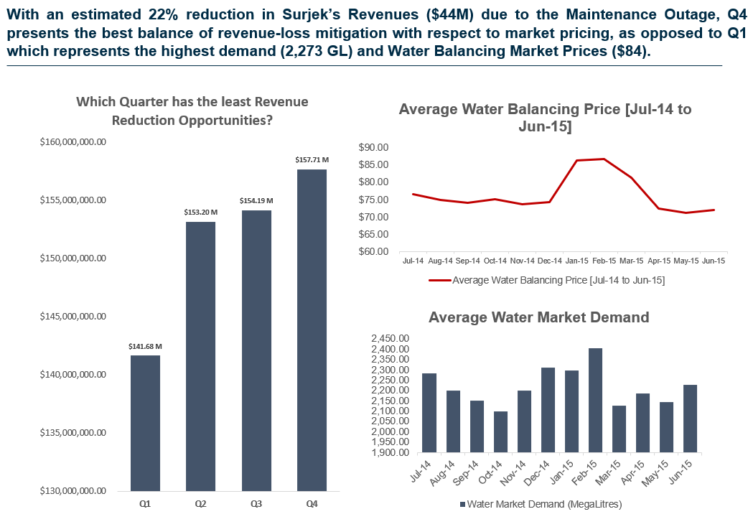
READ ME SLIDE – DO NOT INCLUDE THIS IN YOUR SUBMISSION
In the next few slides, you’ll be filling out this presentation template which summarizes the key insights you’ve unpacked across your economic analysis.
Previously, we’ve filled out the headlines for you. This time you’ll need to fill in the gaps we have deliberately included, using numbers you’ve pulled together in your analysis.
We’ve included an example of what the first slide will look like to help you get started!

Slide 2
With an estimated XX% reduction in Surjek’s Revenues ($XX M) due to the Maintenance Outage, Quarter X presents the best balance of revenue-loss mitigation with respect to market pricing, as opposed to Quarter Y which represents the highest demand (_____ GL) and Water Balancing Market Prices (__).
On this slide, we would like you to show the following: 1) Using a column-chart, please show the quarterly revenue (Q1,Q2,Q3,Q4).
2) Using a combo-chart, create a chart that shows the 12-Monthly Water Market Demand and Average Water Balancing Price(s) using the data from the Water Data Repository Table.
Hint: Use the Charts you’ve created in Q8 and Q10 in the What-If Analysis Tab.

Slide 3
Of the three Desalination Plants, all three remain profitable at current market prices by a favorable margin; Clearly _____ is the most cost-effective $25/ML) followed by ____ ($35.80/ML) and lastly _____ ($54.23/ML) which is consistent across the July-2013 to June-2014 period.
On this slide, we would like you to show the following: 1) Using a column-chart, please show the Overall Cost to Produce for Kootha, Surjek and Jutik compared against the Overall Desalination Cost to Produce ($/ML). This is the macro view.
2) Using a line-chart, trend the monthly Cost to Produce for:
Kootha
Sujrek
Jutik
Kootha + Surjek + Jutik
Hint: Please use the charts you’ve created for the Economic Cost Analysis Tab, Q5 and Q7.

Slide 4
Contrasting the Cost to Produce against the Volume of Water Produced highlights clear <what economic principles indicate costs declining with volume?> with costs rapidly dwindling across all plants as volume surges, with this being particularly noticeable across the Kootha and Surjek Plants with costs dropping as much as 50%.
The third slide we want to show is our overall conclusion regarding the economic relationship between price and quantities for each of the three plants.
On this slide, we would like you to show the following: 1) Create three scatter plots showing the Cost to Produce vs. the Quantity of Water Produced for each Desalination plant
Remember, we are comparing each point using a scatter-plot graphic.
Hint: Reference the scatter plots you created in the Economic Cost Analysis Tab, Q6.

Slide 5
Drilling down further from a product perspective reveals two different patterns of elasticity where <Soft or Hard Water> tends to be relatively price inelastic with an average EoD of ___, while <Soft or Hard Water> is more representative of an elastic relationship with an average EoD of ___.
The fourth slide we want to show is our overall conclusion regarding the economic principles of elasticity for our individual water products at a macro level.
On this slide, we would like you to show the following:
A) Create three scatter plots that show the Water Balancing Market Price vs. the Volume of Water Demanded (I.e. Soft Water, Hard Water, Soft + Hard Water)
Hint: Use the scatterplots you’ve created for the Economic Market Analysis, Q2.

