Slide 1



EFFECTS OF MOBILE GAMES ON THE ACADEMIC PERFORMANCE OF THE STUDENTS IN APEC
Terrence Dale Morales
Johanne Louis Centino
Kevin Danial Clyne
Charlie Ricafranca
Rosen Carl Reyes

Slide 2

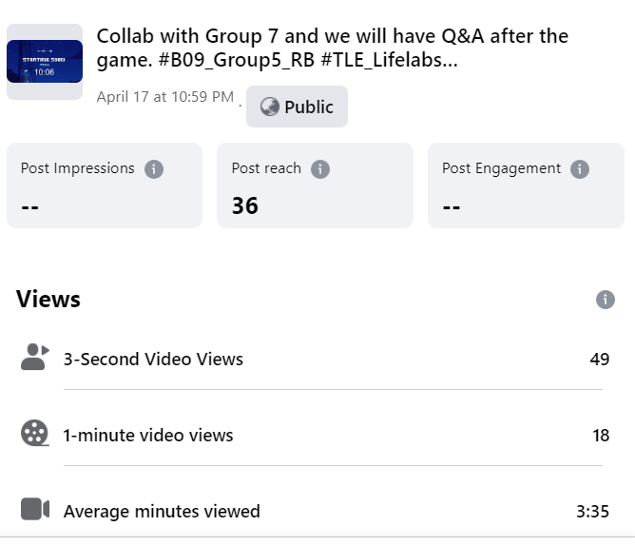
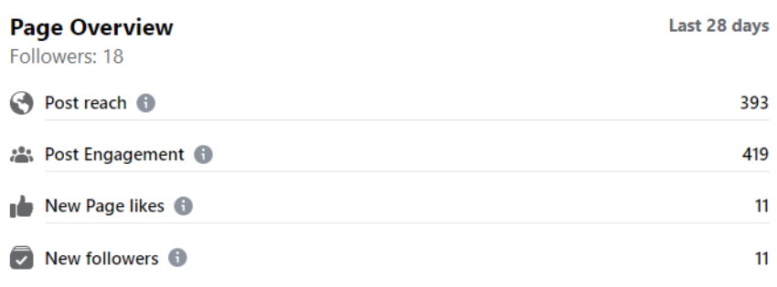
Reach and Engagement of the streaming session

Slide 3
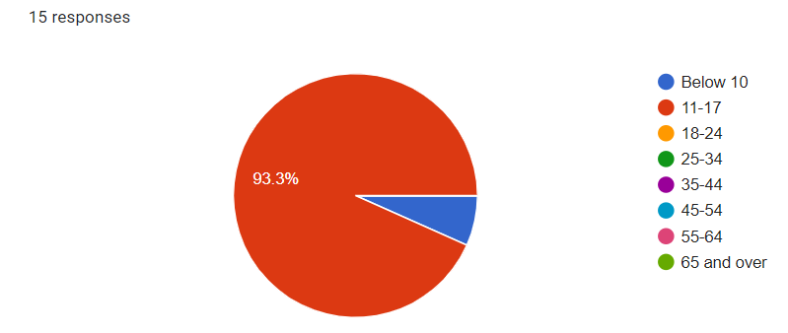
Age groups of respondents

Slide 4
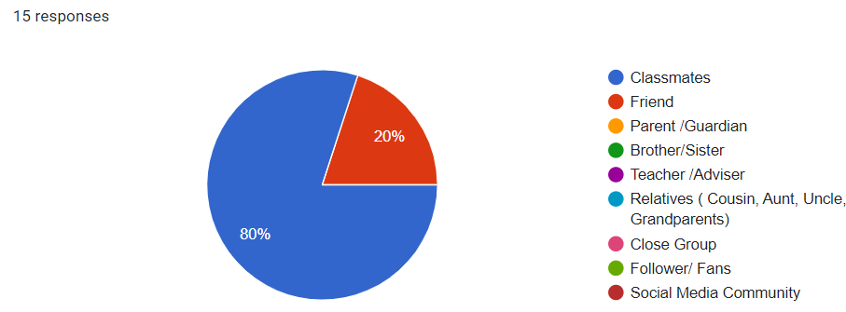
Relationship to the streamer

Slide 5
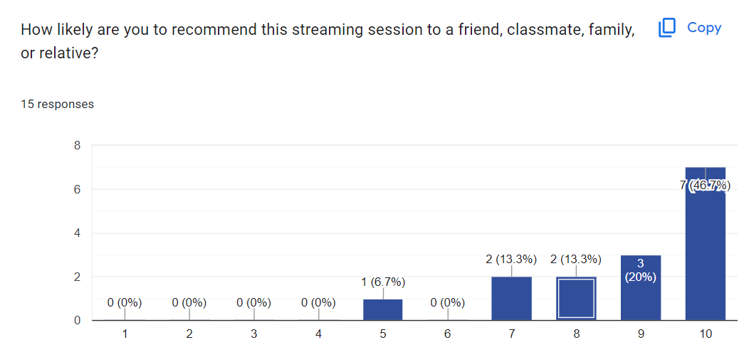
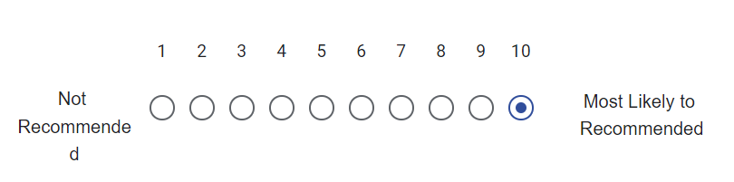
Respondent’ likelihood of recommendation to others

Slide 6
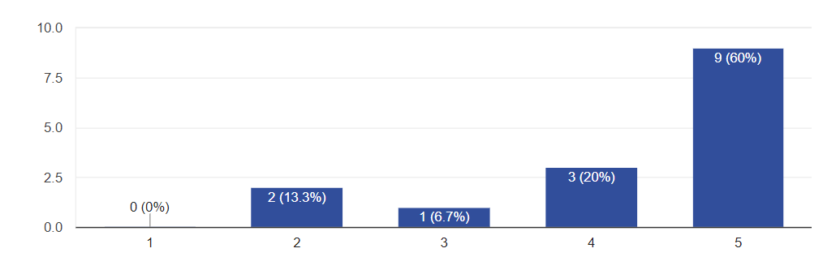
What percentage of the information was new to you?

Slide 7
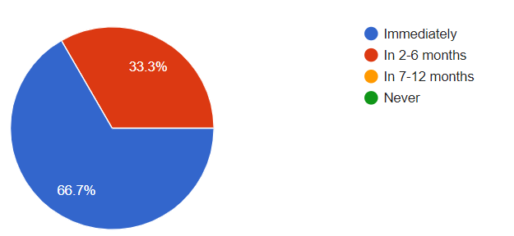
I can use this streaming information:
15 responses

Slide 8
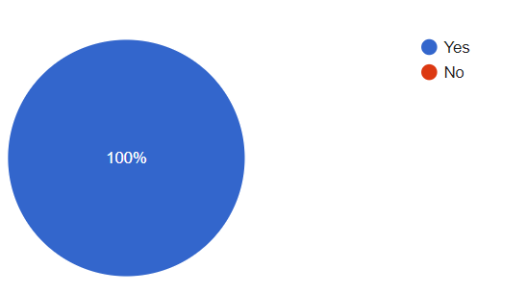
Would you like to learn more about this streaming topic?
15 responses

Slide 9
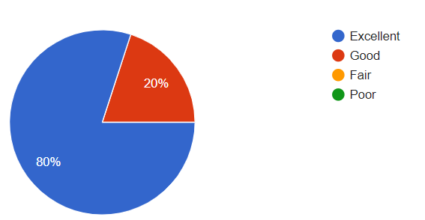
Please rate the streamers’ knowledge about the topic:
15 responses

Slide 10
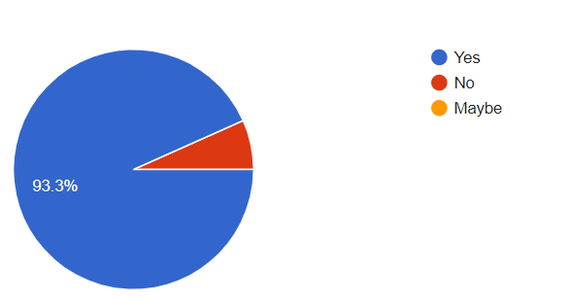
Do you find this streaming content relevant to address solutions, issues, or challenges in our lives?
15 responses

Slide 11
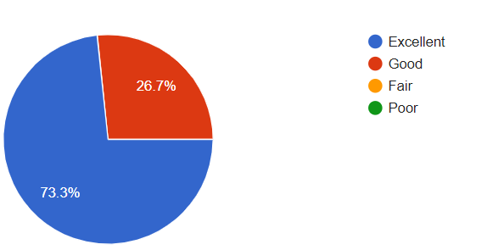
Please rate the streamer's ability to engage you in their content
15 responses

Slide 12
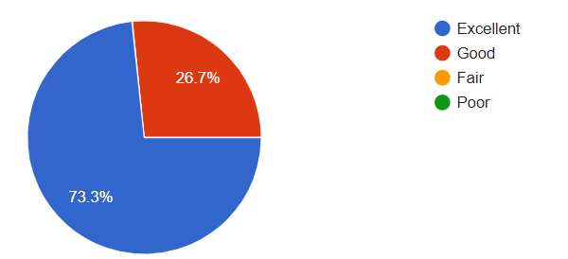
Please rate the design content of our stream:
15 responses

Slide 13
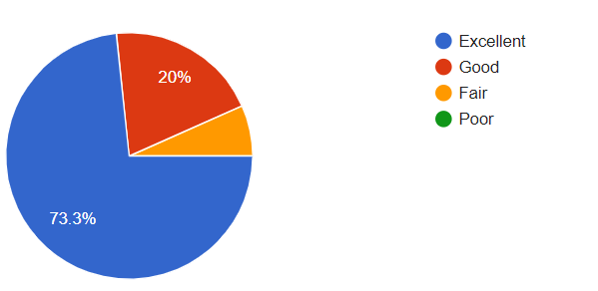
Please rate the time length/duration of our stream:
15 responses

Slide 14
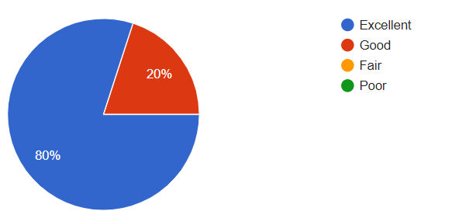
Please rate the platform venue of our stream:
15 responses

Slide 15
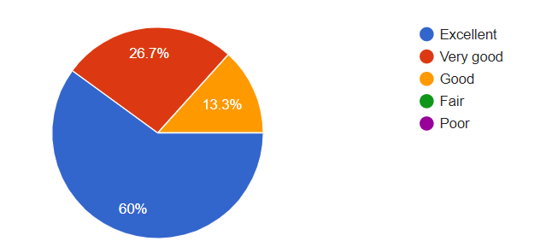
How accurate was the streaming session outline?
15 responses

Slide 16
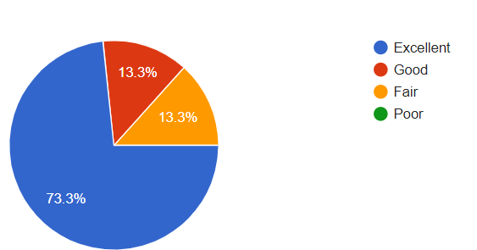
How did the streaming session compare to your expectations?
15 responses

Slide 17
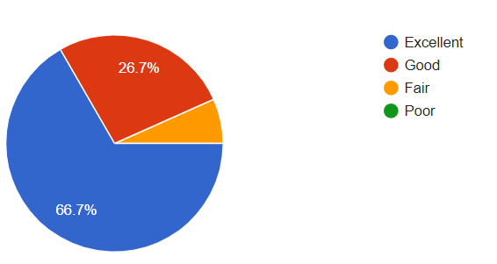
Overall streaming session evaluation:
15 responses

Slide 18
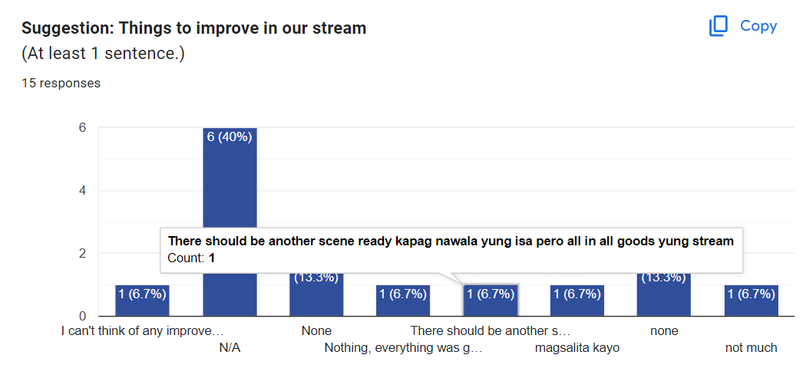
Things that we need to improve in our stream

Slide 19

END
EFFECTS OF MOBILE GAMES ON THE ACADEMIC PERFORMANCE OF THE STUDENTS IN APEC

Slide 20

THANKYOU
GROUP 5
GROUP 5
Terrence Dale Morales
Johanne Louis Centino
Kevin Danial Clyne
Charlie Ricafranca
Rosen Carl Reyes

