Slide 1

DAB303 – Marketing Analytics Final Project Customer Satisfaction in US Airline
Group #33
- Meghaben - W0749147
- Vipin - W0755900
- Yasmin - W0754285
- Urmi - W0756341
- Trang Bui - W0753523

Slide 2
Agenda
Introduction
Dataset
Data Understanding
Data Cleaning
Data Analysis (Descriptive Analytics)
Data Pre-processing for Model Building
ML Algorithms
Comparison Models & Conclusion
References
Q&A

Slide 3

Introduction
Customer satisfaction is always the top of mind in all businesses, especially in airline industry
The more satisfied the customers are, the more loyal they will be. The high-grade customer satisfaction is a key to run the business.
Therefore, the companies always attempt to understand the customer’s needs and feeling so that they can improve their products or service better.
For US Airline, they analyze the survey data to identify the customers’ satisfaction level based on their rating about experience of the flights.

Slide 4
Dataset
Introduction
Dataset
Data Understanding
Data Cleaning
Data Analysis
Data Pre-processing
ML Algorithms
Comparison Models
Conclusion
References
Q&A
The dataset and its detail description can be found under the following URL: https://www.kaggle.com/johndddddd/customer-satisfaction?select=satisfaction.xlsx
The raw dataset contains 129,880 rows and 24 attributes

Slide 5
Data Understanding
Introduction
Dataset
Data Understanding
Data Cleaning
Data Analysis
Data Pre-processing
ML Algorithms
Comparison Models
Conclusion
References
Q&A
Data is collected from US Airline passenger satisfaction survey
Data content include
Customer categories information
Age: The actual age of the passengers
Gender: Gender of the passengers (Female, Male)
Type of Travel: Purpose of the flight of the passengers (Personal Travel, Business Travel)
Class: Travel class in the plane of the passengers (Business, Eco, Eco Plus)
Customer Type: The customer type (Loyal customer, disloyal customer)
Flight distance: The flight distance of this journey
Service satisfaction level rated from passenger about their flights. The level is rated from 1 to 5 corresponding to the level of dissatisfaction to extreme satisfaction. Services include Seat comfort, Departure/Arrival time convenient, Food and drink, Gate location, Inflight wi-fi service, Inflight entertainment, Online support, Ease of Online booking, On-board service, Leg room service, Baggage handling, Check-in service, Cleanliness, Online boarding
Column “satisfaction” include two values “satisfied or “neutral or dissatisfied” that is the final evaluation about their experience of the flight.

Slide 6
Data Cleaning
Introduction
Dataset
Data Understanding
Data Cleaning
Data Analysis
Data Pre-processing
ML Algorithms
Comparison Models
Conclusion
References
Q&A
For string and object datatype: convert to lower cases, and convert non-meaningful data (weird letter) to NULL value
Drop rows contain all NULL value
Drop columns contain more than 50% NULL value
Drop duplicated data rows
Drop unique columns
Handle for missing numeric data
Handle for missing category data

Slide 7
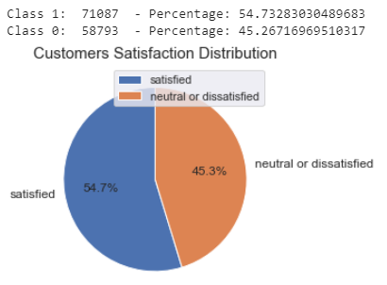
Data analysis
Introduction
Dataset
Data Understanding
Data Cleaning
Data Analysis
Data Pre-processing
ML Algorithms
Comparison Models
Conclusion
References
Q&A
Create group for category columns such as
“Age”: [0-10], [11-20], [21-30]….
“Flight Distance”: [0-1000], [1001-2000] ….
“Departure Delay in Minutes”: [0-120], [121-240]…
“Arrival Delay in Minutes”: [0-120], [121-240],…
1. At the first glance, regards to “Customers Satisfaction Distribution” pie chart, Satisfied customers account 54.8% out of total customers that is a bit higher than dissatisfied customers which is 45.2%

Slide 8
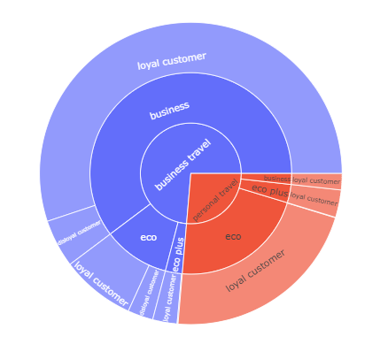
Data analysis (cont.)
For customers who are satisfied:
In overall, 2/3 of them travel for business and 1/3 are personal travel.
For business travel customer, most of them go with business class. And almost of them are determined as loyal customer
For personal travel, they usually fly with eco class, a few of them experience eco plus and business class
Almost customers who is satisfied their flight are absolutely loyal customers.
Therefore, there is no big risk on satisfied customers. There are just a few of them that are disloyal.
We will investigate to see what these customers are satisfied.

Slide 9
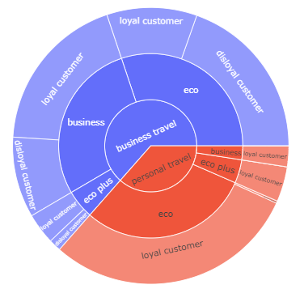
Data analysis (cont.)
For customers who are dis-satisfied:
In overall, the number of business travel is higher than personal travel.
For business travel customer, the customers are separated nearly equal for business and eco class. Around ½ customers of both two these class are disloyal.
For personal travel type, they usually fly with eco class, a few of them experience eco plus and business class. Almost customers travel with personal purpose are loyal customer. This mean that they are still loyal customer even they are dis-satisfied with their flight
We will drill through data in next analysis to see who are dis-satisfied customers.

Slide 10
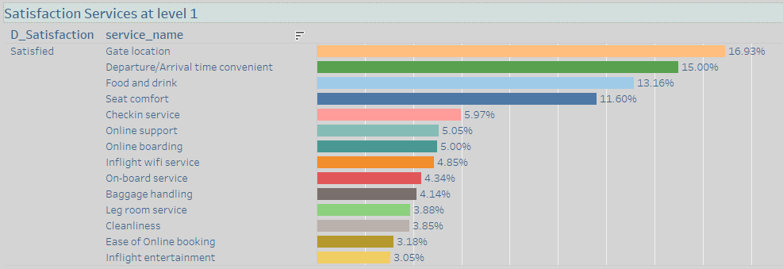
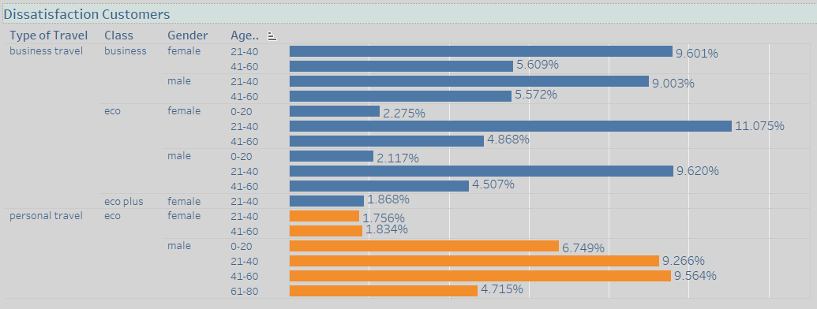
Data analysis (cont.)
Drill through data to see the satisfaction level 1
Gate location is the main reason. The highest number of customers rated level 1 for this service
Departure/Arrival time convenient is also a big problem.
Food and Drink service as well as Seat Comfort are the third and the fourth problems
Drill down to find out who are the dissatisfied customers
Two biggest number of dissatisfied customers are two group of females and group of males in the range of age [21-40]. They usually travel for business with eco class.
Two other biggest number of customer that usually fly with eco class for personal purpose are males in the group of age [41-60], and [21-40]

Slide 11
Data Pre-processing
Introduction
Dataset
Data Understanding
Data Cleaning
Data Analysis
Data Pre-processing
ML Algorithms
Models Comparison
Conclusion
References
Q&A
Data standardization
encode labels to numeric values
data shape is (129880 , 23) with all numeric values and no missing data that is ready for applying ML algorithms
Data splitting
Train set: 75% ( 97,410 rows)
Test set: 25% (32,470 rows)
Input and target variables:
Input: 22 category columns except column “satisfaction”
Target: binary column “satisfaction”
Data scaling
Input variables are scaled in the range of [0,1]

Slide 12
Machine Learning Algorithms
Introduction
Dataset
Data Understanding
Data Cleaning
Data Analysis
Data Pre-processing
ML Algorithms
Models Comparison
Conclusion
References
Q&A
This is the binary classifier problem, some classifier ML algorithms are applied
Decision Tree Classifier
Forest Random Classifier
Logistic Regression
Tuning Models
Hyper-parameters Findings
GridsearchCV is used to look for the best hyper-parameters for each of model
Decision Tree {max_depth:10, min_sample_split:10}
Random Forest {bootstrap:True, max_features:auto, min_sample_split:20, n_estimator:50}
Logistic Regression {C=109, PCA(n_components=22), penalaty=12}

Slide 13
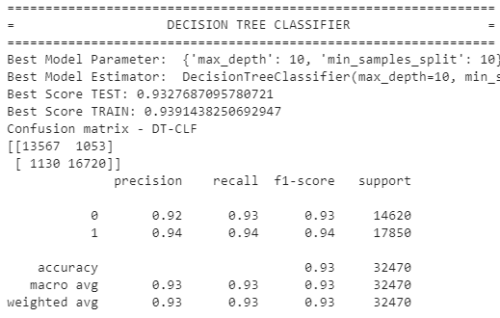
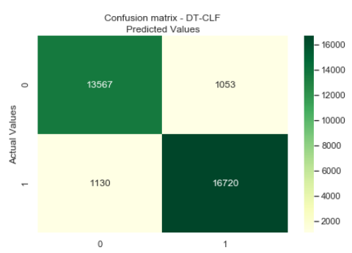
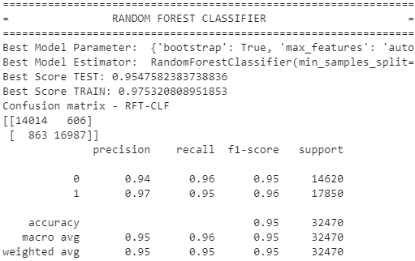
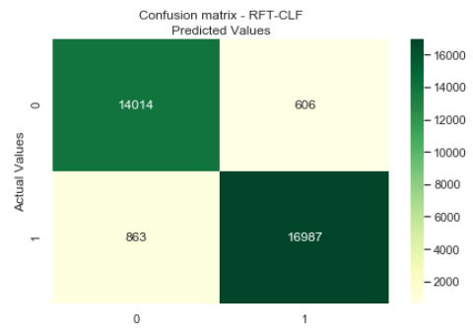
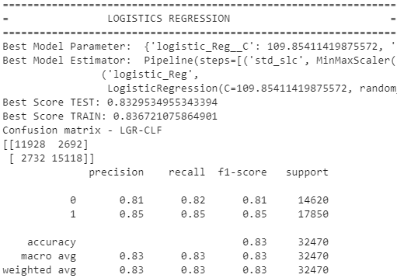
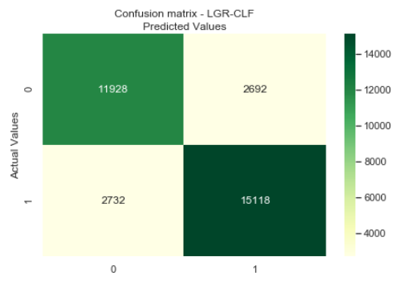
Models Comparison
It is easy to realize that Random Forest Classifier model gave the highest scores
Accuracy: 0.95
F1-score – class 1: 0.96
F1-score – class 0: 0.95
Decision Tree model is the second best one
Accuracy: 0.93
F1-score – class 1: 0.94
F1-score – class 0: 0.93
Logistics Regression scores are too much lower than two other models.

Slide 14
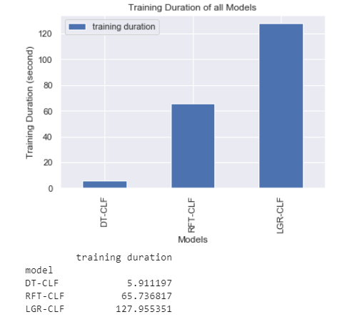
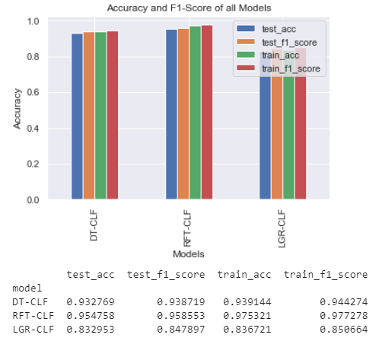
Models Comparison (cont.)
Looking into training duration regarding to the same train set
Logistics Regression took more than 120 seconds for training phases. Regarding to performance score and training duration, we can conclude that Logistics Regression Classifier model is not good for this dataset.
Random Forest Classifier took more than 60 seconds while Decision Tree took 6 seconds only. Training for Random Forest model took 10 times more than Decision Tree with the same train set while its accuracy is higher than 3% only.
Regarding to performance scores and training time, we conclude that Decision Tree is the best model between three of them for US Airline’s customers satisfaction dataset.
CONCLUSION:
With Decision Tree Model, performance scores in training phase are a bit higher than test phases. It is more confident to confirm that this is the good model because it’s a good fit model.

Slide 15
References
https://www.mygreatlearning.com/blog/gridsearchcv/
https://scikit-learn.org/stable/modules/generated/sklearn.model_selection.GridSearchCV.html
5 projects worked in lab in the courses

Slide 16

Q&A

