Slide 1
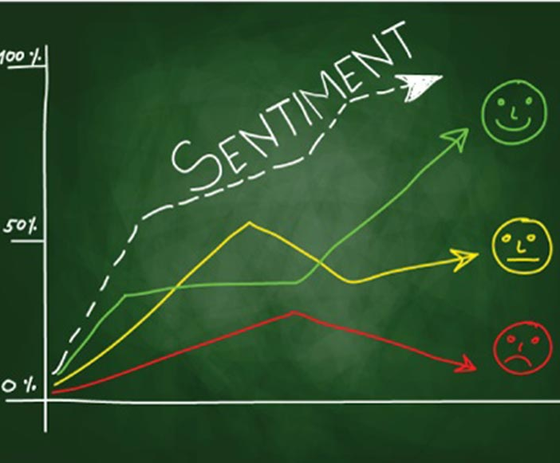
DAB402 Capstone Project Topic SENTIMENT ANALYSIS IN SHORT-TERM RENTAL INDUSTRY
Student Name – Student ID
Trang Bui – 0753523

Slide 2
Agenda
Introduction
1.1 Natural Language Processing
1.2 Natural Language Toolkit Library
1.3 Feature Engineering
1.4 Some pre-trained sentiment classification Models
Case study: Sentiment Analysis in short-term rental industry
Goals & Scope of project
Steps of sentiment analysis problem
Evaluation & Conclusion
Challenging
Q&A
Video: https://www.youtube.com/watch?v=ygUNvQU3yDc

Slide 3
1.1- Natural Language Processing (NLP)
Natural Language Processing (NLP) is a subset of Artificial Intelligence (AI) and is one of the hardest parts of AI because it involves human natural language understanding and processing.
NLP focuses on human language applications such as
Writing recognition
Speech recognition
Automatic translation
Text classification
Document Summarization
Data mining
Sentiment Analysis
In this study, we research about “Sentiment Analysis” using NLP techniques to extract human emotional information from a sentence or a text to evaluate human emotions that is positive or negative or neutral.

Slide 4
1.2 - NLTK library
NLTK is a library written in Python that supports natural language processing. By providing common language processing techniques, it makes natural language processing easier and faster.
NLTK provides processes like tokenization, stemming, tagging, parsing, semantic reasoning, etc..
Some popular functions in NLTK library
Tokenize text: a way to separate text into smaller units (words, characters, phrases,..)
Count Word Frequency: count the number of frequency of word in sentences / documents
Get synonyms from WordNet
Remove Stop Words: stop words are no added meaning for the sentence, so they are usually removed in NLP
Word stemming & lemmatizing are used to convert words to original form.
Etc.

Slide 5
1.3 - Feature Engineering Strategies
Word embedding is a special techniques in natural language processing that map a word or phrase in a lexicon to a real number vector. Word vectors are represented by the embedded word method expressing the semantics of words, from which we can realize the relationship between words.
Count based method (lexicon method): this approach determines scores for positive words, or negative words, then aggregate these scores against a defined metric to decide what emotional text
Bag of Words
TF-IDF (Term Frequency – Inverse Document Frequency)
Predictive method: word2vec embedding is a result of Recurrent Neural Network model. The purpose of RNN model is to represent a natural word into vector space. In this space, the more similar words are, the greater cosine distance value (close to 1), the less similar words with each other, the smaller the cosine distance will be (close to 0)
Continuous Bag of Words (CBOW)
N-Skip-Gram

Slide 6
1.4 - Sentiment Classification Pre-trained Models
Vader (Valence Aware Dictionary and Sentiment Reasoner)
This is a sentiment analysis tool that uses a list of words (lexicon) labeled as positive or negative according to their semantics to compute textual feeling. It is specifically suitable for classifying sentiments expressed in social media.
TextBlob
Textblob is a python library for processing textual data. It provide a consistent API for common natural language processing tasks such as part-of-speech tagging, noun phrase extraction, sentiment analysis, etc. For sentiment analysis, Textblob consider words / phrases to assign polarity and averages to get the final score.
Flair
Flair is also a powerful NLP library that provides many NLP models such as NER (named entity recognization), PoS, a text embedding library, sentiment analysis, etc. In this project, we use Flair as a pre-trained sentiment analysis.

Slide 7
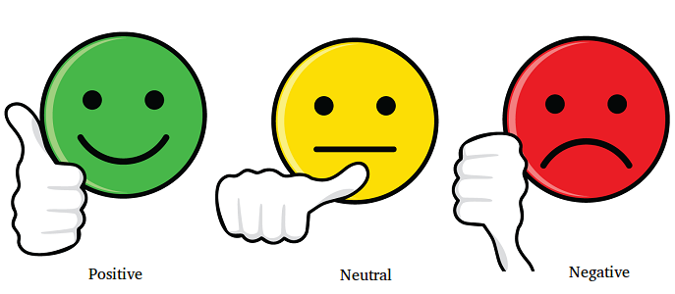
2. Case study: Sentiment Analysis in short-term rental industry
Sentiment analysis in short-term rental industry, especially Airbnb, is specific study case for this research.
We use NLP to analyze the customers’ reviews or feedbacks to determine the customer attitude towards the rental services after staying to answer the business questions:
How do they feel after staying?
[Answer] – Positive / Negative / Neutral
For further research:
What details of their feedbacks?
What are the good and bad rental features group by neighborhood?
What topics are mostly mentioned in the customer reviews.
etc

Slide 8
3. Goals and Scope of project
Goals
Research Natural Language Processing
Build a sentiment classification model to predict emotion of the customers’ reviews / feedbacks in rental industry.
Scope
English language processing only

Slide 9
4. Steps of sentiment analysis problem
Labelled Raw Data
Clean Text / Corpus
Vectorized extracted Features
Confusion Matrix
Feature Extraction
Text Processing
Labelling
Models Building
Model Evaluation
TF-IDF
Bag Of Word
Word2vec
Classification supervised ML
normalize text, remove missing, stop words, stemming, pos & lemmatization
Reviews / feedbacks in human natural language form
Conclusion
Raw Data

Slide 10
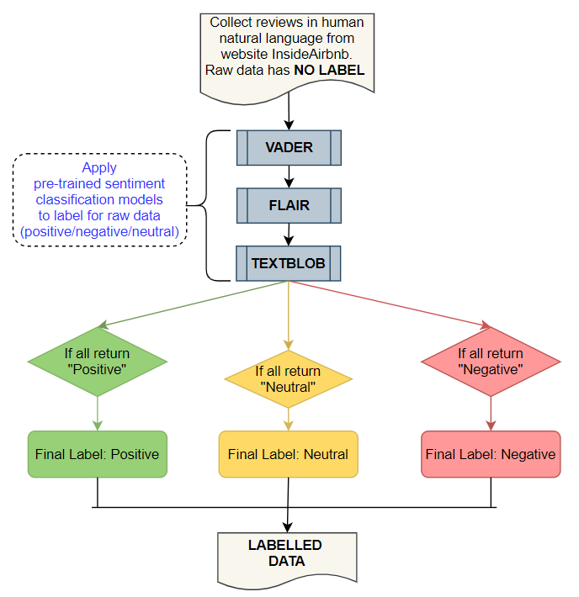
4.1 – Labelling raw data
Instead of labelling manually to prepare train data for model training, we decided to apply some pre-trained classification models such as Vader, TextBlob, Flair. The rule of labelling using pre-trained models:
Final label is kept if three above pretrained models make the same prediction values

Slide 11
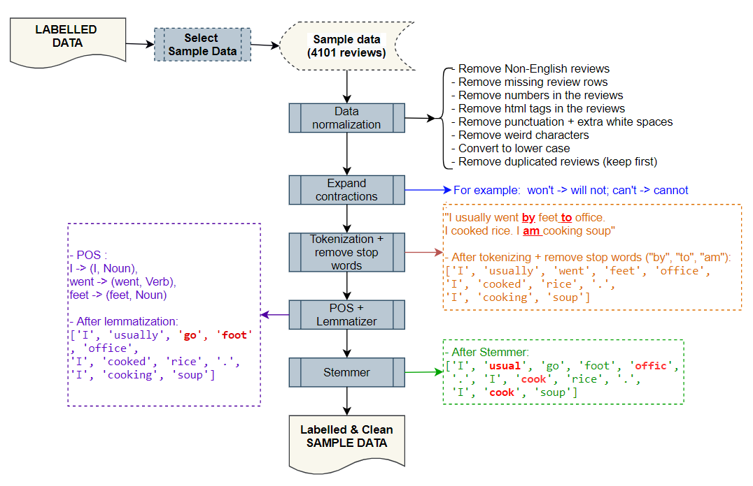
4.2 – Text Processing
Tokenization: a way to separate text into smaller units (words, characters, phrases,..)
Stop words are no added meaning for the sentence, so they are usually removed in NLP. We use Stopwords in NLTK library.
PoS (Part of Speech) technique is used to label a word with grammatical description such as Noun, Adjective, Verb, etc.
Lemmatization & Stemming are used to convert words to original form.

Slide 12
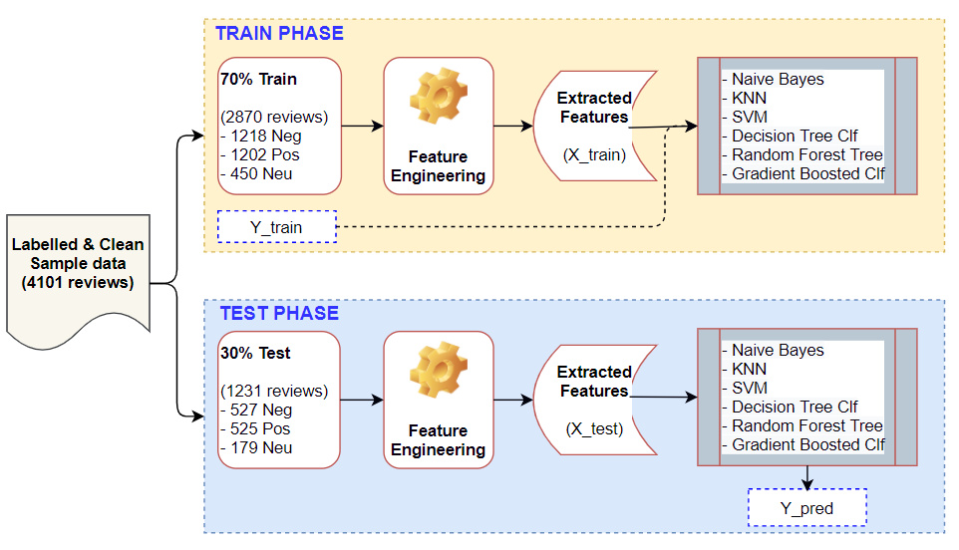
4.3 – Feature Engineering & Predictive Models
In this study, we use some feature extraction below:
Count based Methods
Bag of Words (BoW)
TF-IDF
Word2Vec
Use pretrained word2vec model Gensim to create word embedding.
Create a word embedding from Airbnb data using Keras model
Using Grid-Search to find hyperparameters that is suitable for data and models

Slide 13
5. Evaluation & Conclusion
Confusion matrix for multiple classification are used for evaluation in this study.
However, this part will be provided in report paper because the final evaluation has not been finished yet.

Slide 14
6. Challenging
Raw dataset has no label. We decide to use pre-trained models including Vader, Textblob, and Flair to do tagging
Text processing is an important process in natural language processing because it directly impact to vectorization and model training. The cleaner and exact output data from text processing is, the better models can learn and get high accuracy. Cleaning unstructured and text data is extremely difficult. (correct spelling, remove weird characters, white spaces processing, remove specific names, etc.)
It took a lot of time to for creating corpus as well as model training with approximate 30,000 reviews. The train data set is reduced to 4101 reviews. Therefore, less data can impact to model fitting.

Slide 15

7. Q&A

