Slide 1
Sales Forecast using Time-Series Models
Group #3
Student Name – Student ID
Trang Bui – 0753523
Sowjanya Chilluveru: 0755566
Sriram bonasu: 0756345
Arwinder Kaur: 0746789
Gurpreet Kaur: 0756462

Slide 2
Agenda
Sales Forecast - Problem Statement
Time-Series data
2.1 Introduction
2.2 Dataset
Time-Series models
3.1 Moving Average
3.2 Exponential Smoothing (SES, DES, TES)
3.3 Regression ML models
3.4 ARIMA
3.5 LSTM
Evaluation & Results
Conclusion
Contribution
Q&A

Slide 3
1. Sales Forecast - Problem Statement
What?
Why?
Determine production volumes in terms of the availability of establishments such as: equipment, capital, manpower, storage, etc.
It helps business in production planning and sales control. For example: plan for sale expansion, plan for transition to the new products, etc.)
Getting the opinion of the executive board
Synthesized method from selling forces
Based on customer expectations / demands
Time-series analysis
Other statistics approaches
The estimation is based on the actual sale data of the past few quarters/years
Sales forecast is estimation of how much a business can sale (in money or products) over a certain period of time.
Sales forecast can help business in the marketing decision support system:
How?
Some sales forecast methods:

Slide 4
2.1 Time-series data introduction
What is time-series data?
A series of data points taken from the same source and measured and ordered over a period of time.
Time-series data can be classified into two types:
regular time intervals (metrics)
irregular time intervals (events)
Time-series data components?
Trend: movement along the term
Seasonality: seasonal changes
Cyclicity: change repeat over a certain time
Residual: irregular variations
Time-series is usually used for some analysis applications
Stock price
Exchange Rate, interest rate
Retail Sales
Power Consumptions / Demand
Etc.

Slide 5
2.2 Dataset
We use time-series data from the file “DataCoSupplyChainDataset.csv” in the website:
https://data.mendeley.com/datasets/8gx2fvg2k6/5
Data is gathered and provided by the company DataCo Global. The dataset file is introduced under a Creative Common Attribution 4.0 International license.
Data file contains information of sales, customer, order, product, shipping that related to supply chain business.
In this study, we extracted sales time-series data in 3-years period from Jan-2015 to Jan-2018 for sales forecasting analysis purpose. The sale data is processed by month including 37 data rows of monthly sales amount.

Slide 6
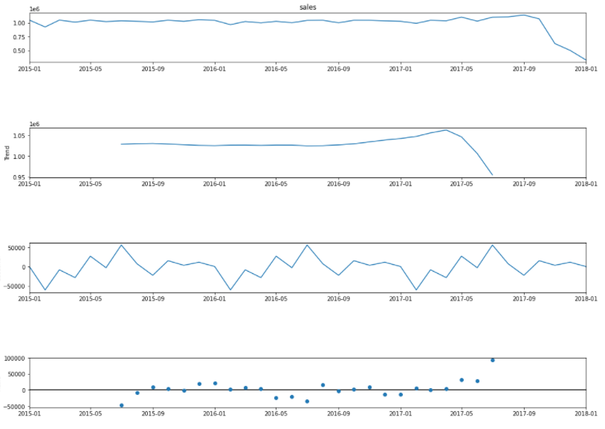
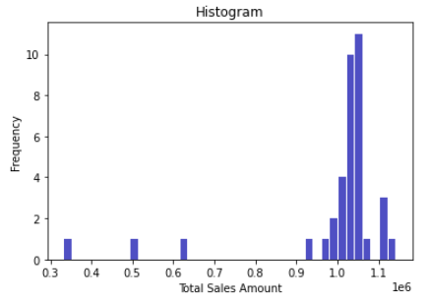
2.3 Dataset - decomposition
The sale amount fluctuated in the range from 900,000 to 1,100,000.
The trend of sales are stable but tended to go down rapidly from Nov-2017.
The seasonal cycle of 12 months.
Residual error is between [-50000, 50000].

Slide 7
3. Time-series data analysis techniques
Moving Average
Exponential Smoothing
Linear Regression ML models
ARIMA
LSTM

Slide 8
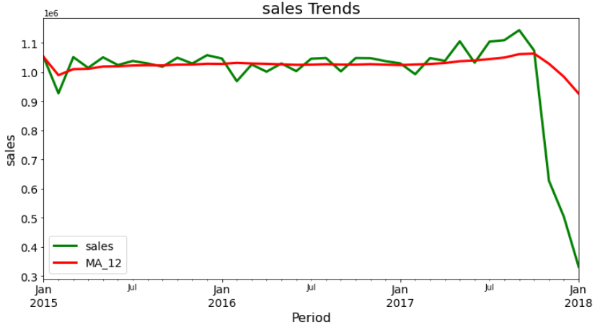
3.1. Moving Average
The simplest time-series forecasting model known as “rolling mean” and be calculated by average data of the time series in a certain time period.
In this project, the sale forecast is the average of the demand during the last 12-months period.
The value obtained for MAE (Mean absolute error) is 62513.0 and MSE (Mean squared error) is 21124506200.28, respectively. The value obtained for RMSE (Root mean squared error) is 145342.72.

Slide 9
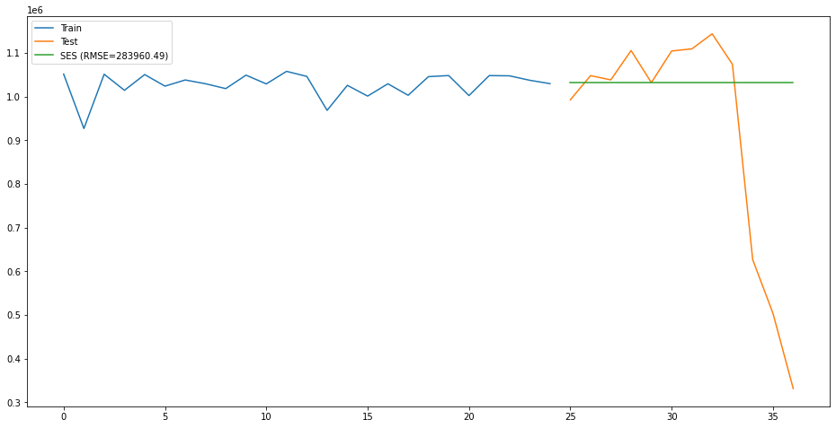
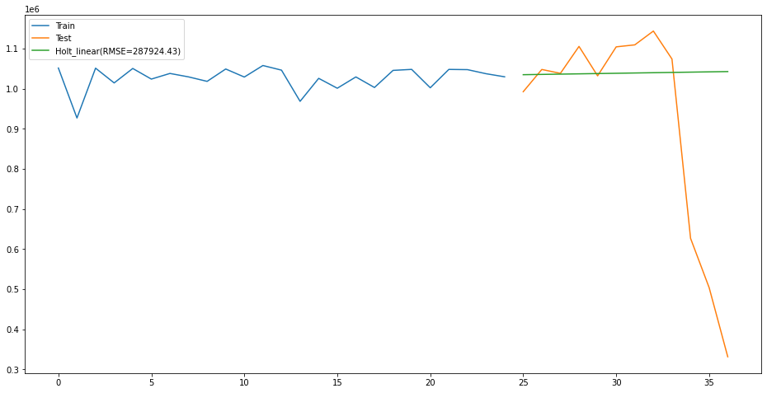
3.2. Exponential Smoothing
Simple Exponential Smoothing (SES)
SES does not consider trend and seasonality, require parameter Alpha called smoothing factor
This model learn bit from most recent demand and last forecast.
That’s the reason we get a straight line as prediction which is not that much useful.
Double Exponential Smoothing (DES)
DES is extension of SES, and is reliable for handling the univariate time series that shows trend but ignores the seasonality.
In the figure, we see a straight line with little upward trend, which is also not a good predictor.

Slide 10
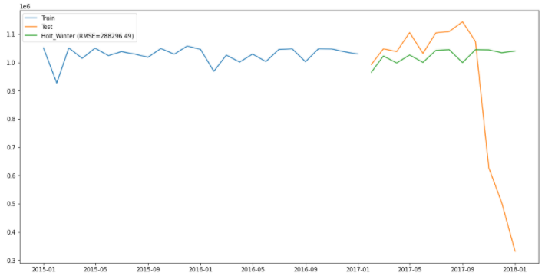
3.2. Exponential Smoothing (cont.)
Triple Exponential Smoothing (TES)
TES is an extension of DES because it is reliable for supporting time series with seasonality and provide much better result.
In line graph, we see fluctuations which proves to be best predictor.
Outcomes:
We observe that
SES gives a straight line and DES gives straight line with little upward trend, Thus both are not that much helpful for forecasting expected results.
Triple exponential smoothing model is providing fluctuating line for forcasting which is little similar to test data and is considering trend and seasonality thus, proved to be best among three.

Slide 11
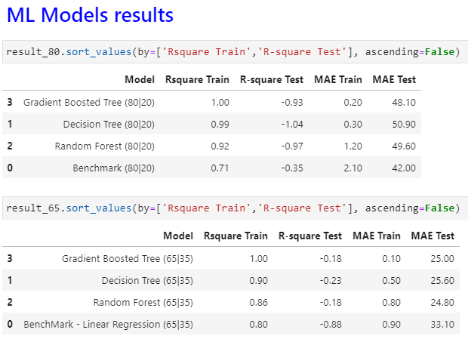
3.3. Linear Regression ML Models
We have used four models in this project i.e, Linear regression model, decision tree model, random forest model and gradient boosted tree model.
To retrieve the best accuracy, we have divided the dataset into two ratios i.e, 80:20 and 65:35.
The 65% training dataset create a better benchmark linear -regression Tree model than the 80% train set.
We tried many combination of parameters using GridSearch to get the best parameters for model.

Slide 12
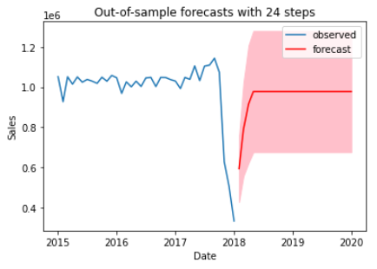
3.4. ARIMA Models (Autoregression Integrated Moving Average)
ARIMA model is an Integration (I) of the AR (auto-regression) and MA (moving average) models
ARIMA model can be used only if the time-series data is stationary
Use Dickey-Fuller test to check stationary.
If data is non-stationary, transform data into stationary form using .diff() method before applying ARIMA model
The process to find the value p, d, q for a fitting ARIMA model
Use ACF / PACF graph (auto-correlation and partial auto-correlation)
Grid-search
Auto-arima
Select the best ARIMA model using
AIC – Akaike information criterion (for prediction)
BIC – Bayesian information criterion (for exploration)
In this project, the SARIMA model can well forecast with in sample data. But it hardly forecasts the fluctuation of sales in next 12 period with out of sample data. However, the confidence interval range of sales amount (pink band) are forecasted between the range [675,000 - 127,900].
Notes:
AR model uses the dependent relationship between an observation and some number of lagged observations
MA model used the dependency between an observation and a residual error (white noise) from moving average model applied to lagged observations
Integrated is the use of difference of the raw observations to make time-series data stationary.
p stands for the number of lag variables included in the ARIMA model, also called the lag order. (AR(p))
d stands for the number of times that the raw values in a time series dataset are differenced, also called the degree of differencing.
q denotes the magnitude of the moving average window, also called the order of moving average. (MA(q))

Slide 13
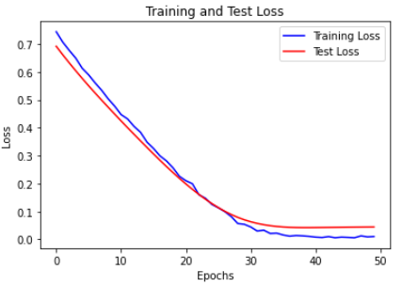
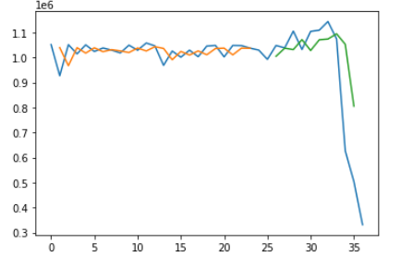
3.5. LSTM Models (Long-short term Memory)
Long-short term memory model is a form of RNN that includes input layer, hidden layers, and output layer
In this work, we create a simple Sequential model includes 1 layer LSTM and 1 layer Dense.
Time step is 1 to predict 1 value
Model is tried with combination of optimizers (‘adam’,’rmsprop’,’sgd’), activations (‘relu’,’sigmoid’,’tanh’), loss functions (‘mse’,’binary_crossentropy’). The fit model is found with ‘adam’ optimizer, ‘relu’ activation and ‘mse’ function, and trained with 50 epochs and batch_size = 3.

Slide 14
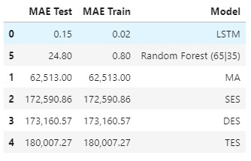
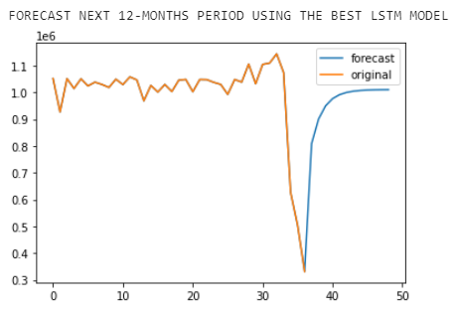
4. Evaluation & Results
Evaluation method
In this project, we use the MAE “mean absolute error ” as an estimator for model performance.
This method is to measure the average of error over the test sample of the absolute differences between prediction and actual observation. The error can be understood as the difference between the estimated values and the actual values. Therefore, the lowest error is, the better model is.
Results
MAE of LSTM model is the smallest that are 0.02 for training phase and 0.15 for test phase within sample. However, the forecast for next 12-months period shows the line without fluctuation and trend.
MA and Exponential Smoothing Models are not well fit due to very large MAE.
.

Slide 15
5. Conclusion
In this project, we practiced again all learnt time-series methods for sales forecast that is a small part of supply chain analytics. The best model is good for train and test phases within sample data. However, we cannot evaluate for out-of-sample case. Therefore, more training data is expected so that the model can learn more the trend and seasonal feature in time-series data and do forecasting better.

Slide 16
6. Contribution
Trang Bui: Looking for Dataset + Data Pre-processing & Exploration, ARIMA, LSTM models + coding combination and do conclusion.
Gurpreet: MA model
Arwinder: Exponential Smoothing (SES, DES, TES) model
Sowjanja: ML models
Sriram: ML models

Slide 17

7. Q&A

