Slide 1

Identifying the Most Influential Drivers of Diabetes Risk

Slide 2
Contents
Key Research Question
Rationale for choosing this research
Diabetes Health Indicators dataset
Dashboards of key findings
Conclusions
Recommendations
Appendix:
Diabetes Dataset explored: features, questions and codes
Trello Board for Project Management

Slide 3

Key Research Question:
Which health, behavioural and socioeconomic factors are the most influential predictors of diabetes risk in the US population?
This analysis identifies the most influential predictors of diabetes risk using a large, cleaned health survey dataset containing one target variable (Diabetes_012) and a further 21 variables spanning:
Clinical/Psychological
Demographic
Functional Health
Lifestyle
Socioeconomic

Slide 4
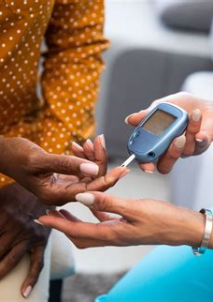
Rationale for Choosing This Research
Diabetes is one of the most prevalent chronic diseases in the United States, affecting millions and placing a substantial burden on the healthcare system
In 2021:
38.4 million Americans had diabetes
97.6 million adults had prediabetes
1.2 million had a new diagnosis of diabetes
Although diabetes has no cure, early detection improves outcomes
Predictive modelling can support clinicians and public‑health planning by identifying high-risk groups earlier to facilitate intervention

Slide 5


Diabetes Health Indicators Dataset
A large secondary health dataset (n = 253,680) was analysed using descriptive and comparative methods to examine patterns associated with diabetes status (Diabetes_012). There were 3 outcomes:
No diabetes: 213,703 individuals (84.24%)
Prediabetes: 4,631 individuals (1.82%)
Diabetes: 35,346 individuals (13.93%
Visual and statistical techniques were used to explore relationships between diabetes outcomes and health, behavioural, and socioeconomic factors, with results interpreted at a population level.
The dataset can be downloaded here: [Diabetes Health Indicators Dataset][dataset]

Slide 6

Dashboards of Key Findings
These dashboards summarise the key findings from this research

Slide 7
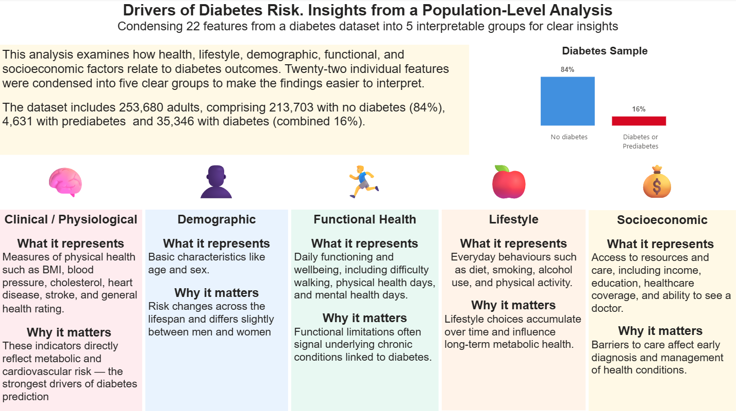

Slide 8
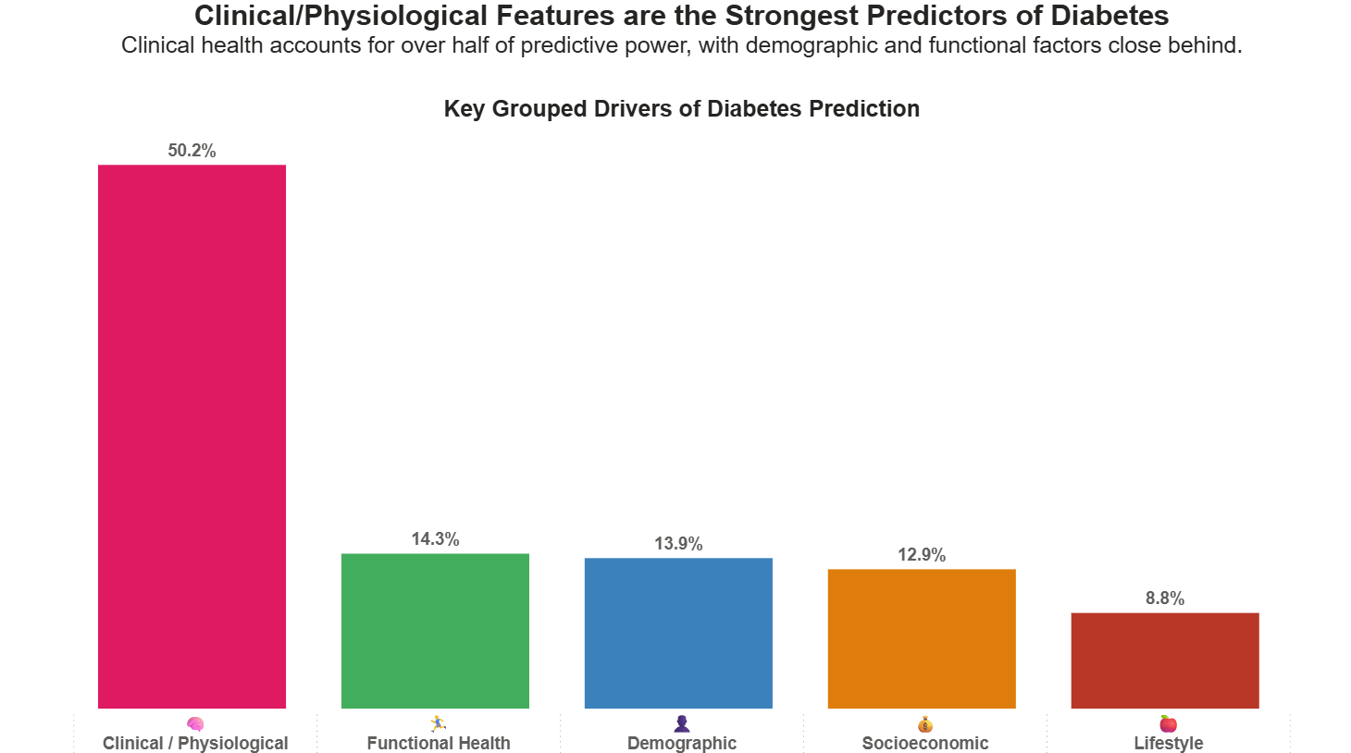

Slide 9
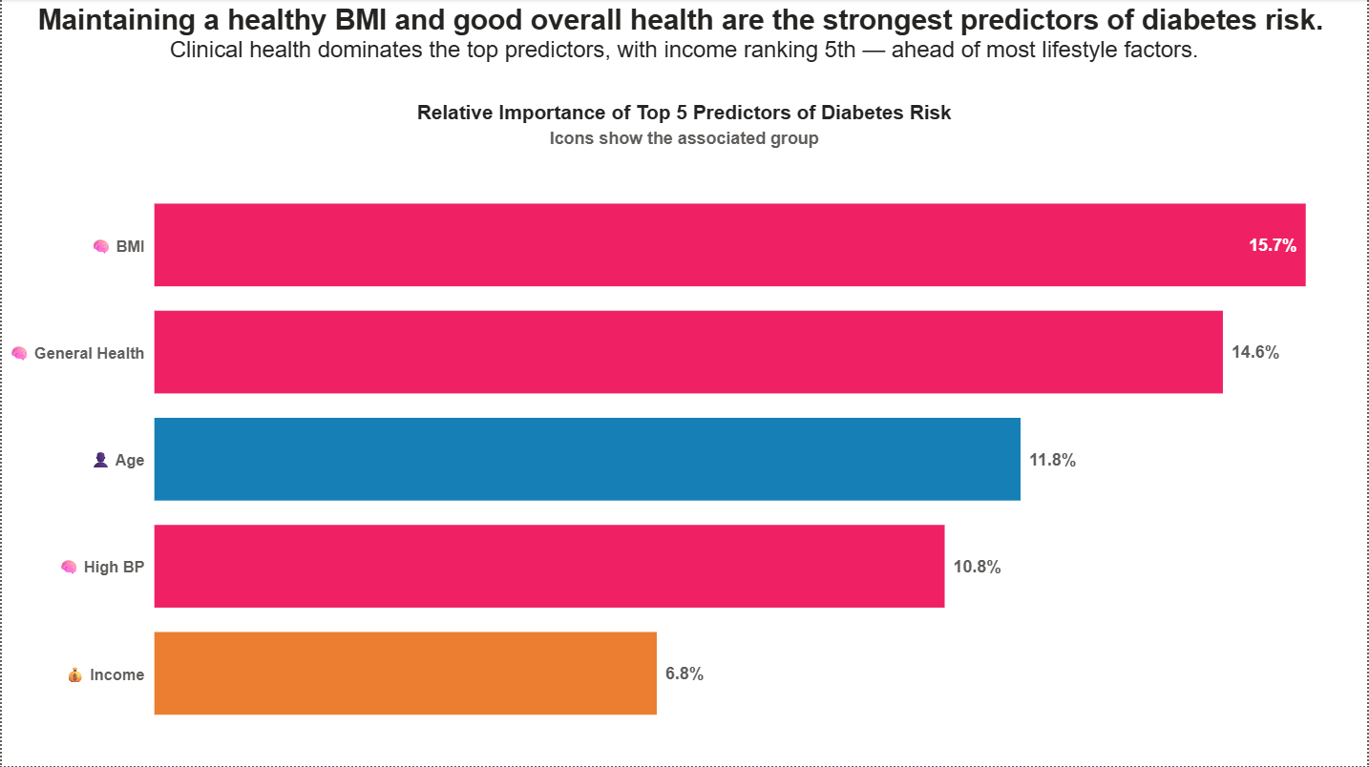

Slide 10
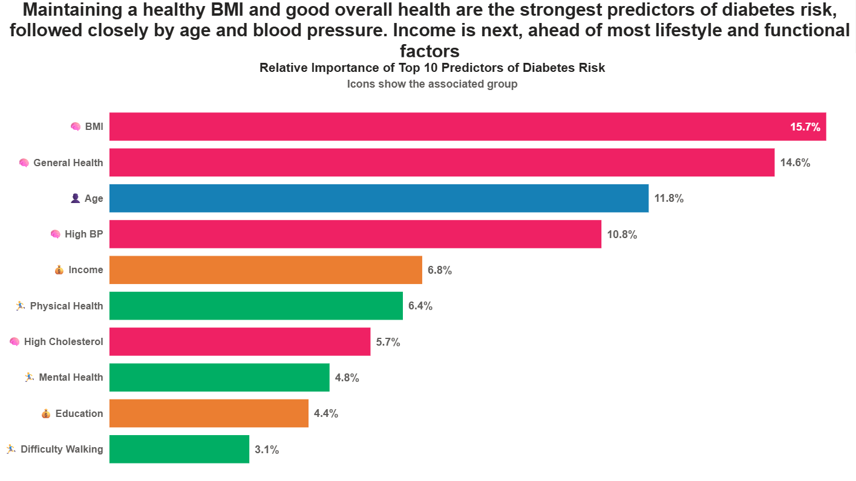

Slide 11
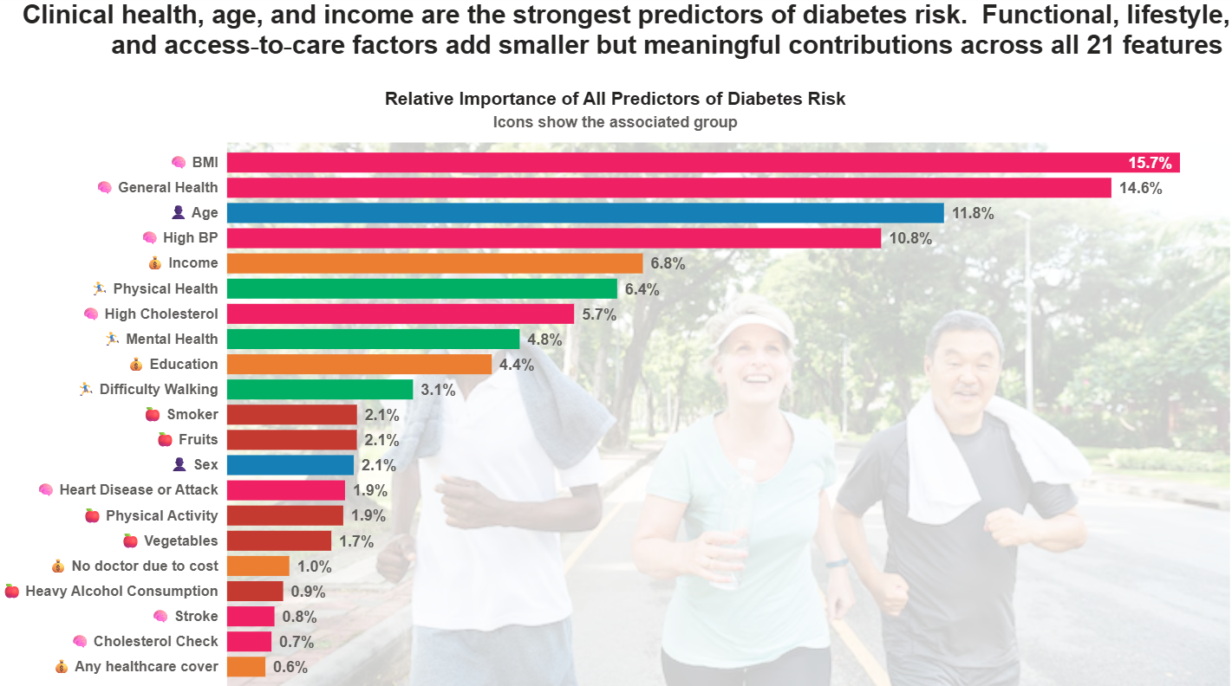

Slide 12
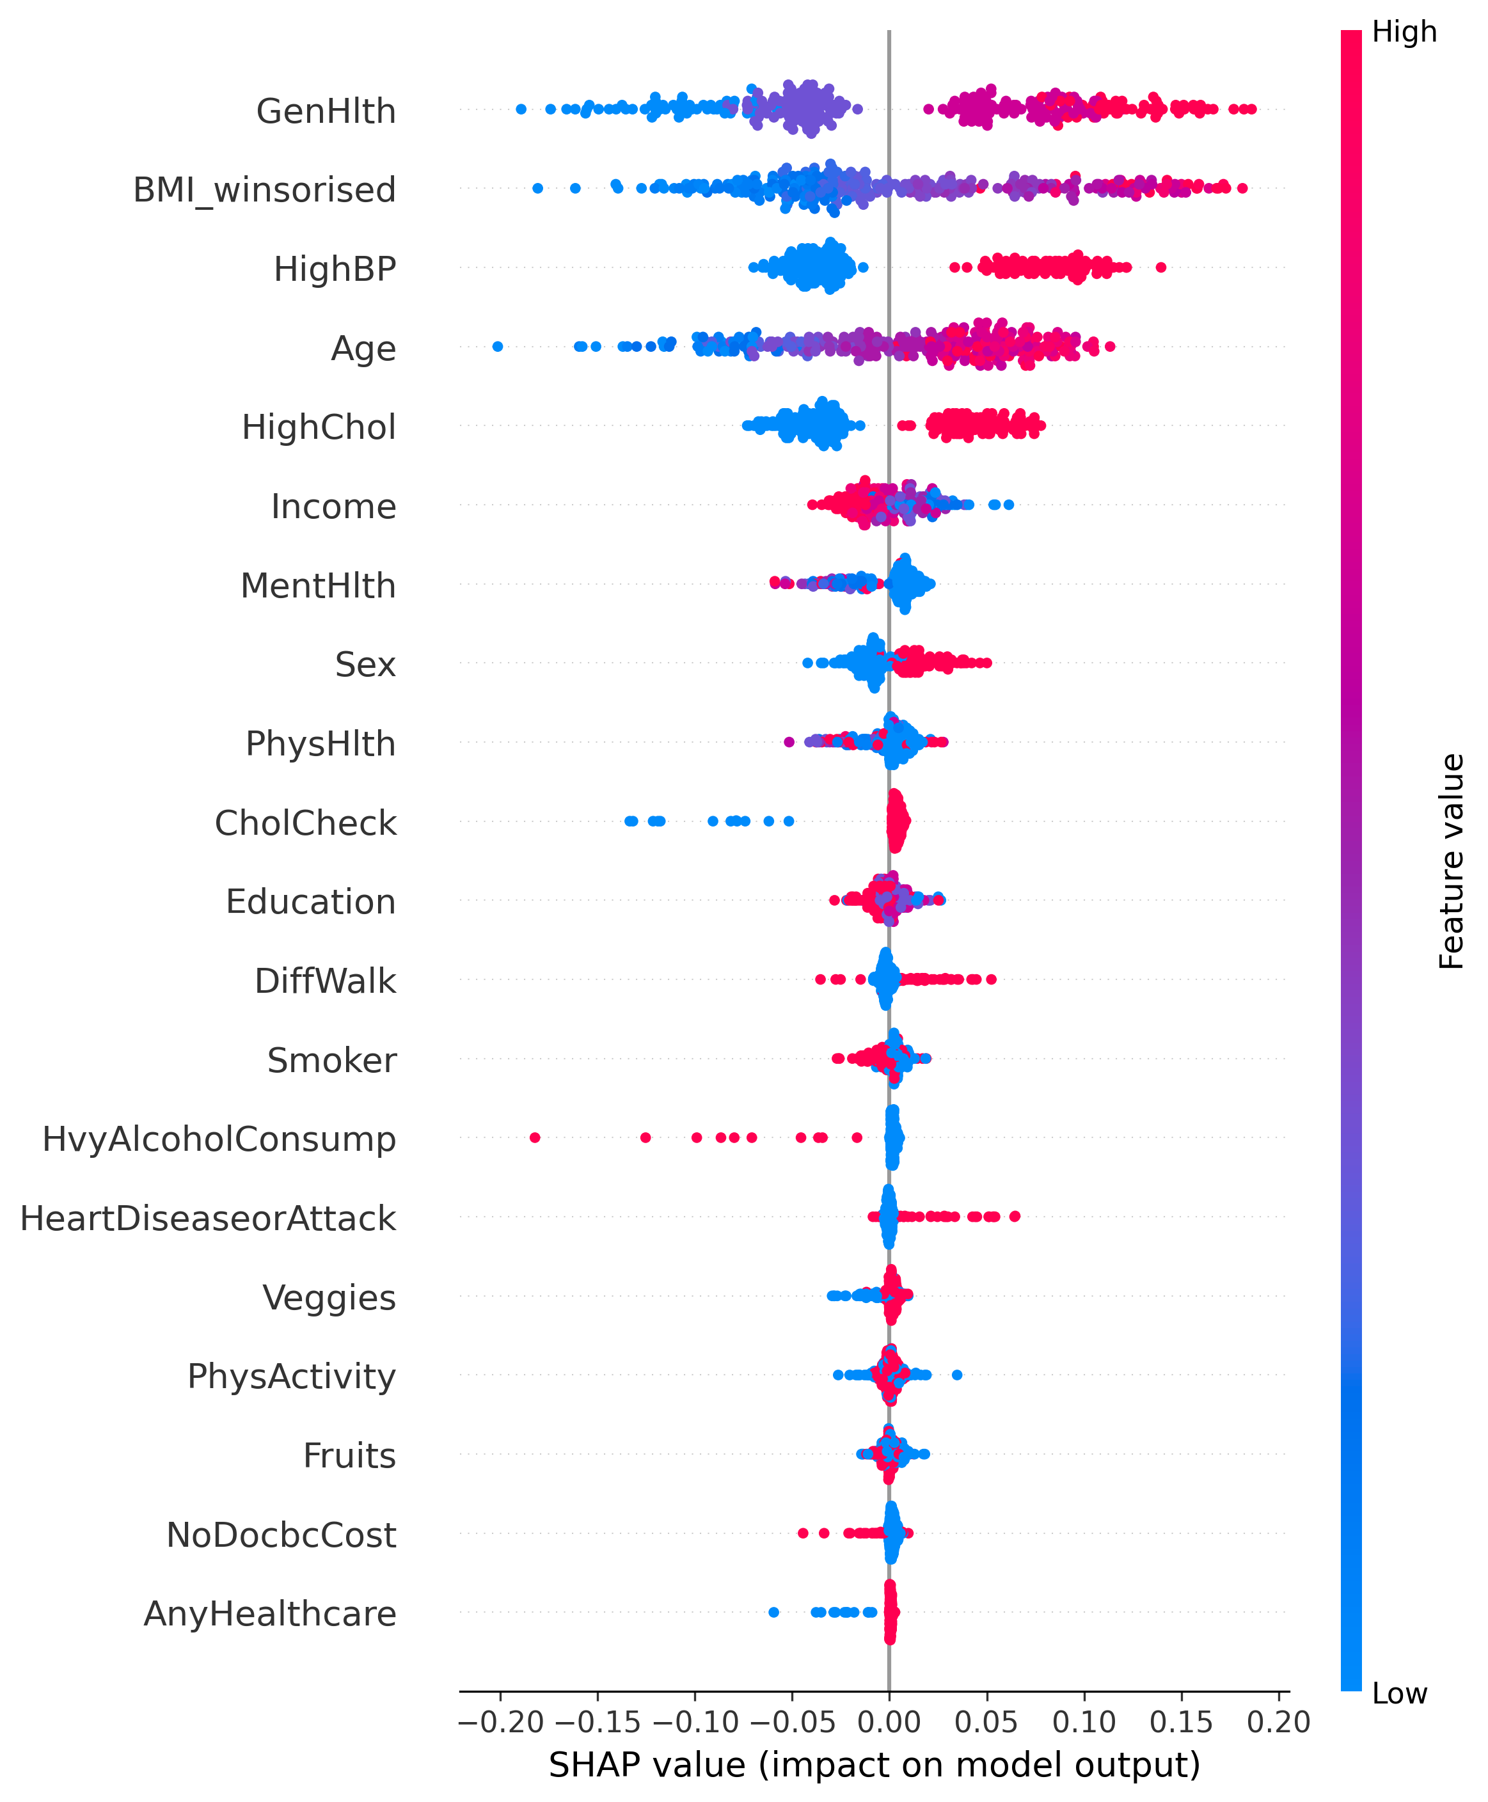
SHAP Analysis
This SHAP plot shows that clinical and physiological indicators (general health, BMI, blood pressure, cholesterol) were the strongest drivers of the model’s predictions, followed by demographic factors such as age and income. Functional limitations (poor physical health days, mobility issues, mental health burden) also contributed meaningfully to higher predicted risk. Lifestyle behaviours like smoking, heavy alcohol use, and inactivity had an effect but were noticeably less influential than clinical and socioeconomic variables.

Slide 13

Conclusions
1. Clinical / Physiological factors lead
Poor general health, high BMI, high blood pressure, and high cholesterol had the strongest and most consistent impact on increasing predicted risk.
2. Demographics matter
Older age and lower income levels reliably pushed risk scores higher, making them key secondary predictors.
3. Functional limitations signalled risk
More unhealthy days, mobility challenges, and mental health strain consistently indicated elevated vulnerability.
4. Lifestyle factors contributed but were less dominant
Smoking, heavy drinking, and inactivity influenced predictions but played a smaller role compared with clinical and socioeconomic drivers.

Slide 14
Recommendations
Prioritise clinical risk screening with routine checks for BMI, blood pressure and cholesterol in primary care settings
Target high-risk demographic groups by expanding preventative outreach for adults in their 40s and beyond, and for lower-income populations where risk increases
Strengthen support for functional and mental health needs
Reinforce lifestyle interventions with structural support by promoting smoking cessation, physical activity and reduced alcohol use

Slide 15
Appendix
Diabetes Dataset explored: features, questions and codes
Trello Board for Project Management

Slide 16
The dataset contains 22 features, including Diabetes_012 (Target)
Group | Feature | Question | Codes
Target | Diabetes_012 | Have you ever been told by a doctor that you have diabetes? | 0=no diabetes; 1=prediabetes; 2=diabetes
Clinical / Physiological | GenHlth | Would you say that in general your health is… | 1= excellent; 2=Very good; 3=Good; 4=Fair; 5= poor
 | BMI | Calculated from weight and height | <18.5: Underweight; 18.5-24.8: Normal weight; 25-29.9: Overweight; >=30:Obese
 | HighChol | Have you ever been told by a doctor, nurse, or other health professional that your blood cholesterol is high? | 0=no high cholesterol; 1=high cholesterol
 | CholCheck | Have you had your cholesterol checked within the past five years? | 0=no; 1=yes
 | HeartDiseaseorAttack | Have you ever been told by a doctor, nurse, or other health professional that you had coronary heart disease or a heart attack? | 0=no; 1=yes
 | HighBP | Have you ever been told by a doctor, nurse, or other health professional that you have high blood pressure? | 0=no high BP;1=High BP
 | Stroke | (Ever told) you had a stroke? | 0=no; 1=yes

Slide 17
Dataset (continued)
Group | Feature | Question | Codes
Demographic | Age | What is your age? | 1=18–24 years; 2=25–29 years; 3=30-34 years; 4=35-39 years; 5=40-44 years; 6=45-49 years; 7=50-54 years; 8=55-59 years; 9=60-64 years; 10=65-69 years; 11=70-74 years; 12=75-79 years; 13 = 80+
 | Sex | Are you male or female? | 0=female; 1=male
Functional Health | DiffWalk | Do you have serious difficulty walking or climbing stairs? | 0=no 1=yes
 | PhysHlth | Thinking about your physical health, which includes physical illness and injury, for how many days during the past 30 days was your physical health not good? | 0-30 days
 | MentHlth | Now thinking about your mental health, which includes stress, depression, and problems with emotions, for how many days during the past 30 days was your mental health not good? | 0-30 days

Slide 18
Dataset (continued)
Group | Feature | Question | Codes
Socioeconomic | NoDocbcCost | Was there a time in the past 12 months when you needed to see a doctor but could not because of cost? | 0=no; 1=yes
 | AnyHealthcare | Do you have any kind of health care coverage, including health insurance, prepaid plans such as HMOs, or government plans such as Medicare or Medicaid? | 0=no; 1=yes
 | Education | What is the highest grade or year of school you completed? | 1= never attended school or only kindergarten; 2=Grades 1-8 (elementary); 3=Grades 9-11(some high school); 4=Grade 12 or GED(high school graduate); 5=College 1–3 years (some college or technical school); 6=College 4+ years (college graduate)
 | Income | Is your annual household income from all sources… | 1=< $10k; 2=$10k-$14.99k; 3=$15k-£19.99k; 4=$20k-$24.99k; 5=$25k=$34.99k; 6=$35k-$49.99k; 7=$50k-£74.99k; 8=≥ $75k

Slide 19
Dataset (continued)
Group | Feature | Question | Codes
Lifestyle | Smoker | Have you smoked at least 10 cigarettes in your entire life? (Note 5 packs=1—cigarettes) | 0=no; 1=yes
 | HvyAlcholConsump | During the past 30 days, how many drinks of alcohol did you have on average per week? Heavy drinkers (adult men having more than 14 drinks per week and adult women having more than 7 drinks per week) | 0=no; 1=yes
 | Fruits | Do you eat fruit at least once per day? | 0=no; 1=yes
 | Veggies | Do you eat vegetables at least once per day? | 0 =no; 1=yes
 | PhysActivity | During the past month, other than your regular job, did you participate in any physical activities or exercises such as running, calisthenics, golf, gardening, or walking for exercise? | 0=no; 1=yes

Slide 20
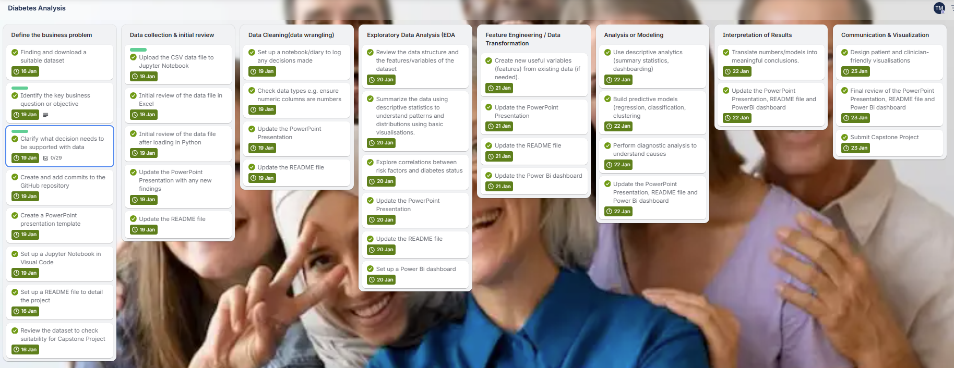
Trello Board

