Slide 1

Marketing A/B Test Performance Analysis
Project Vanguard — A/B Test
From experimental groups to actionable advertising insights
AD GROUP
PSA GROUP
OBSERVED UPLIFT
2.55%
1.79%
≈43%
Observed conversion rate
Observed conversion rate
Relative improvement
Author: Teresa Mendes Coelho Ironhack bootcamp Data Analytics 2026

Slide 2
1. Business Question
What does the A/B test tell us about advertising performance?
The project compares the AD and PSA experimental groups to understand conversion performance and identify useful patterns by day and hour.
GROUP A
GROUP B
AD
PSA
Advertising group
Public service announcement
Analytical goals
Compare conversion
Quantify improvement
Measure the conversion-rate gap between groups.
Translate the gap into relative uplift.
Understand timing
Support decisions
Explore performance by hour and day.
Turn patterns into hypotheses for the next test.
Author: Teresa Mendes Coelho Ironhack bootcamp Data Analytics 2026

Slide 3
2. Data & Analytical Approach
Cleaned marketing A/B test dataset explored with Python and Tableau
DATA
EXPERIMENT
TOOLS
marketing_AB_clean.csv
AD vs PSA
Python + Tableau
Cleaned dataset used for the project.
Experimental groups compared throughout the analysis.
Notebook analysis, calculated fields and dashboards.
Core metrics
Conversion Rate
Observed conversion performance.
Conversion Rate Difference
Gap between group conversion rates.
Relative Improvement
Relative uplift of AD compared with PSA.
Total Ads
Advertising volume by group and hour.
Author: Teresa Mendes Coelho Ironhack bootcamp Data Analytics 2026

Slide 4
3. Executive Summary
The AD group shows stronger observed conversion performance
AD CONVERSION
PSA CONVERSION
ABSOLUTE GAP
RELATIVE UPLIFT
2.55%
1.79%
0.77 pp
≈43%
Observed rate
Observed rate
Percentage-point difference
Observed relative improvement
Main takeaways
• AD has the higher observed conversion rate than PSA.
• The conversion-rate gap is positive in the hourly comparisons shown.
• Ad volume peaks around midday, while conversion efficiency peaks later.
• Volume and efficiency should therefore be evaluated separately.
Author: Teresa Mendes Coelho Ironhack bootcamp Data Analytics 2026

Slide 5
4. A/B Test Results by Experimental Group
Conversion performance and advertising volume
Conversion Rate
Total Ads
AD
2.55%
AD
≈14.0M
PSA
1.79%
PSA
≈0.5M
The volume distribution is highly uneven. This is important when interpreting aggregated results and when considering experimental exposure.
OBSERVED DIFFERENCE
≈ +0.77 pp
≈ +43% relative improvement
Author: Teresa Mendes Coelho Ironhack bootcamp Data Analytics 2026

Slide 6
5. Conversion Rate by Most Ads Day
Daily pattern visible in the dashboard
Monday
3.3%
HIGHEST DAY
Tuesday
3.0%
Monday
Wednesday
2.5%
≈3.3% conversion rate
Thursday
2.1%
LOWER DAYS
Friday
2.2%
Thursday / Saturday
≈2.1% conversion rate
Saturday
2.1%
Sunday
2.5%
Day-of-week is a useful segmentation variable for a future test.
Author: Teresa Mendes Coelho Ironhack bootcamp Data Analytics 2026

Slide 7
6. Advertising Volume by Hour
When is advertising activity highest?
PEAK AD VOLUME
PATTERN
IMPLICATION
12–13h
Midday
Volume ≠ efficiency
Highest exposure
Volume rises sharply from morning
High exposure is not automatically best
0
2
4
6
8
10
12
14
16
18
20
22
Author: Teresa Mendes Coelho Ironhack bootcamp Data Analytics 2026

Slide 8
7. Conversion Rate by Hour
Conversion efficiency follows a different pattern from ad volume
PEAK
SECOND PEAK
LOWEST
16h ≈ 3.1%
20h ≈ 3.0%
2h ≈ 0.7%
Highest observed hourly rate
Another strong evening point
Lowest observed hourly rate
0
2
4
6
8
10
12
14
16
18
20
22
Author: Teresa Mendes Coelho Ironhack bootcamp Data Analytics 2026

Slide 9
8. Where Does AD Outperform PSA Most?
Hourly conversion-rate difference and relative improvement
LARGEST GAP
LARGEST RELATIVE UPLIFT
OTHER STRONG WINDOWS
6h
7h
0h / 5h / 14h / 20h
≈ +2.32 percentage points
≈ +119% relative improvement
Positive gaps visible
Interpretation
The strongest relative improvements occur in lower-volume periods. These peaks are useful hypotheses, but they should be validated with statistical testing and sufficient sample sizes before changing campaign strategy.
Author: Teresa Mendes Coelho Ironhack bootcamp Data Analytics 2026

Slide 10
9. Recommendations
Turning the analysis into the next experiment
1
Keep AD as the leading hypothesis
The observed conversion rate is higher for AD than PSA.
2
Test time-of-day targeting
Explore afternoon/evening windows where conversion efficiency is strongest.
3
Validate before scaling
Use significance tests, confidence intervals and sample-size checks.
4
Segment by day
Test whether the stronger Monday/Tuesday pattern persists.
Author: Teresa Mendes Coelho Ironhack bootcamp Data Analytics 2026

Slide 11
10. Tableau Deliverables
Three dashboards designed for different analytical questions
Marketing A/B Test Performance
Advertising Performance by Hour
A/B Test Group Performance
Executive view
Timing view
Experiment view
KPIs + group comparison + day pattern
Ad volume + conversion + difference + improvement
Conversion + difference + relative improvement + total ads
Together: executive summary → timing analysis → experiment-level comparison.
Author: Teresa Mendes Coelho Ironhack bootcamp Data Analytics 2026

Slide 12
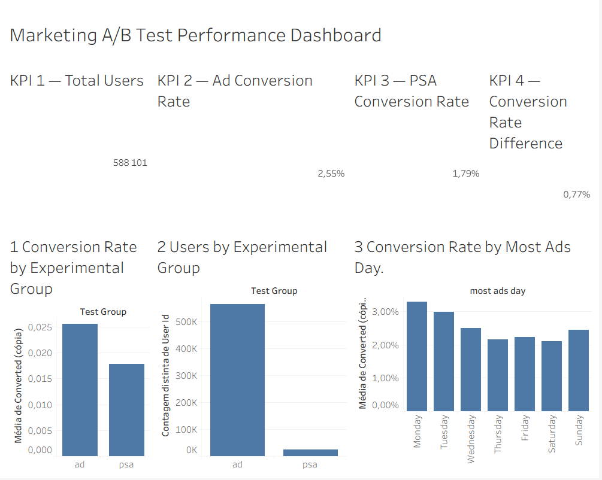
Tableau Dashboard 1 — Marketing A/B Test Performance
Key Insights:
588,101 users were included in the A/B test.
The Ad group achieved a 2.55% conversion rate, compared with 1.79% for PSA.
This represents a 0.77 percentage-point conversion rate difference in favour of the Ad group.
Monday recorded the highest conversion rate, while Saturday had the lowest.
The results show a clear advantage for the Ad campaign over PSA, with a higher conversion rate and a positive lift in performance.
Author: Teresa Mendes Coelho Ironhack bootcamp Data Analytics 2026

Slide 13
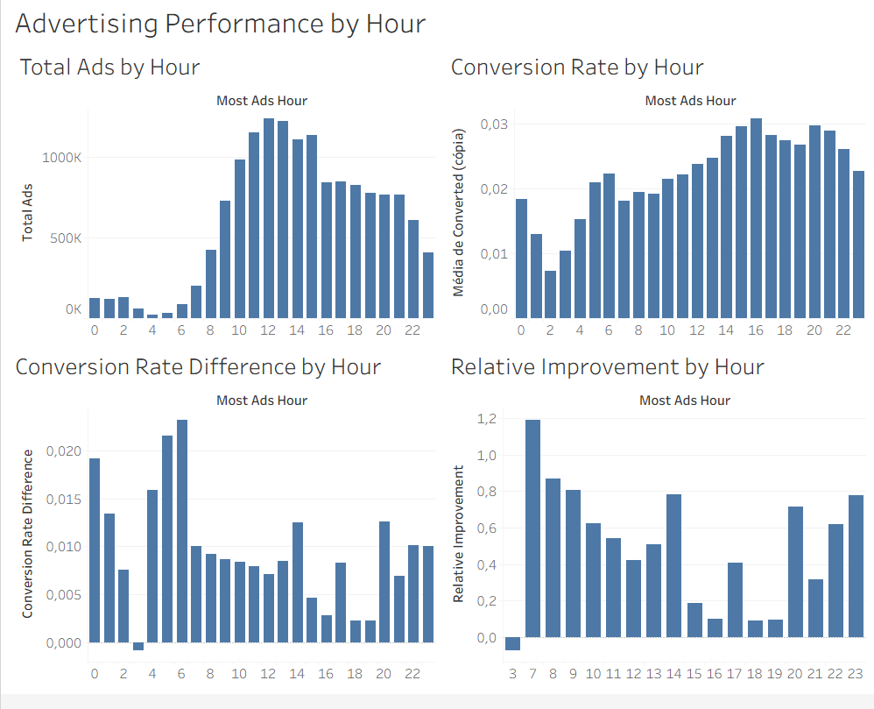
Tableau Dashboard 2 — Advertising Performance by Hour
Key Insights:
Advertising volume increases significantly during the late morning and afternoon.
The highest advertising volume occurs around 12:00–13:00.
Conversion rates peak around 16:00, reaching approximately 3.1%.
The strongest relative improvement is observed around 07:00, suggesting that some lower-volume hours can still generate strong performance.
The analysis shows that advertising volume and conversion efficiency do not necessarily peak at the same time. This suggests an opportunity to optimize ad scheduling rather than simply increasing spend during the busiest hours.
Author: Teresa Mendes Coelho Ironhack bootcamp Data Analytics 2026

Slide 14
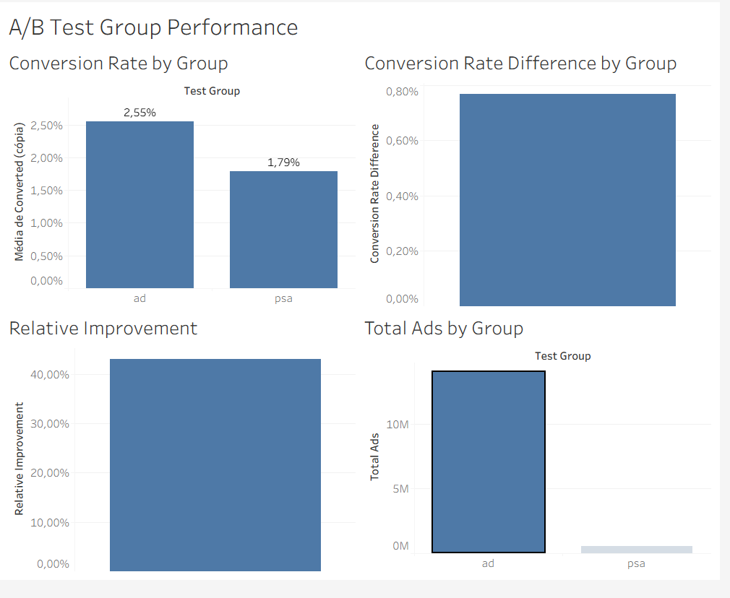
Tableau Dashboard 3 — A/B Test Group Performance
Key Insights:
The Ad group generated a substantially higher conversion rate than PSA.
The conversion rate difference is approximately 0.77 percentage points.
Relative improvement is approximately 43%, indicating a meaningful performance advantage for the Ad campaign.
Total advertising exposure was much higher for the Ad group, so the conversion-rate comparison should remain the primary performance metric.
Overall, the Ad campaign outperformed PSA, both in conversion rate and relative improvement, supporting the hypothesis that the advertising treatment was more effective.
Author: Teresa Mendes Coelho Ironhack bootcamp Data Analytics 2026

Slide 15
11. Conclusion
The experiment points to a promising performance advantage for AD
AD has a higher observed conversion rate than PSA, with an observed uplift of approximately 43%. Hourly analysis also shows that the best conversion periods are not necessarily the periods with the highest advertising volume.
GROUP RESULT
OBSERVED UPLIFT
BEST HOURLY RATE
2.55% vs 1.79%
≈43%
≈3.1% at 16h
Observed dashboard result
Relative improvement
Observed hourly peak
Next step: validate statistical significance and sample-size robustness, then use the findings to design the next A/B test.
Author: Teresa Mendes Coelho Ironhack bootcamp Data Analytics 2026

