Slide 1

Restaurants
Teresa Truong, Tori Paxton, Rebekah Higley

Slide 2
Project Overview
Looking at Food Trends in the United States, we created:
An interactive map of all the restaurants across the U.S.
Graphical representations of:
Most common types of restaurants in the United States
States with the most restaurants
Number of restaurants per franchise

Slide 3
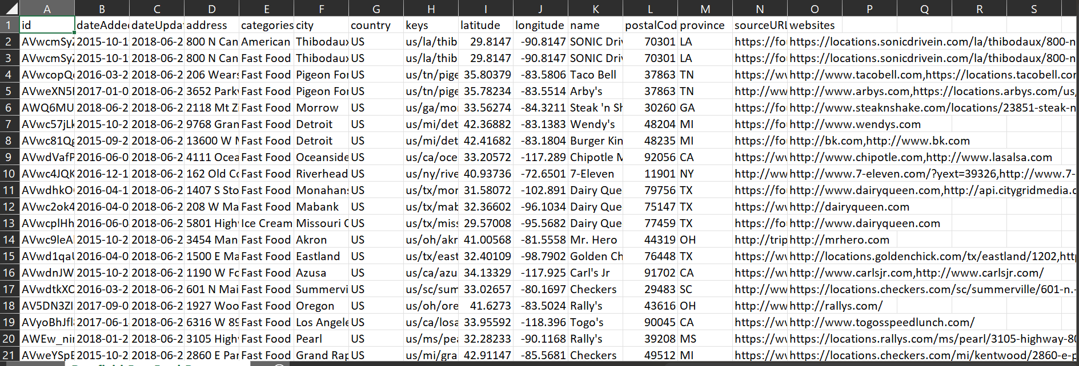
Data Cleaning
We found the data on Kaggle
It included several csvs that had very similar data
Each data set had a lot of columns that we didn’t need, and a lot of them had the same information

Slide 4
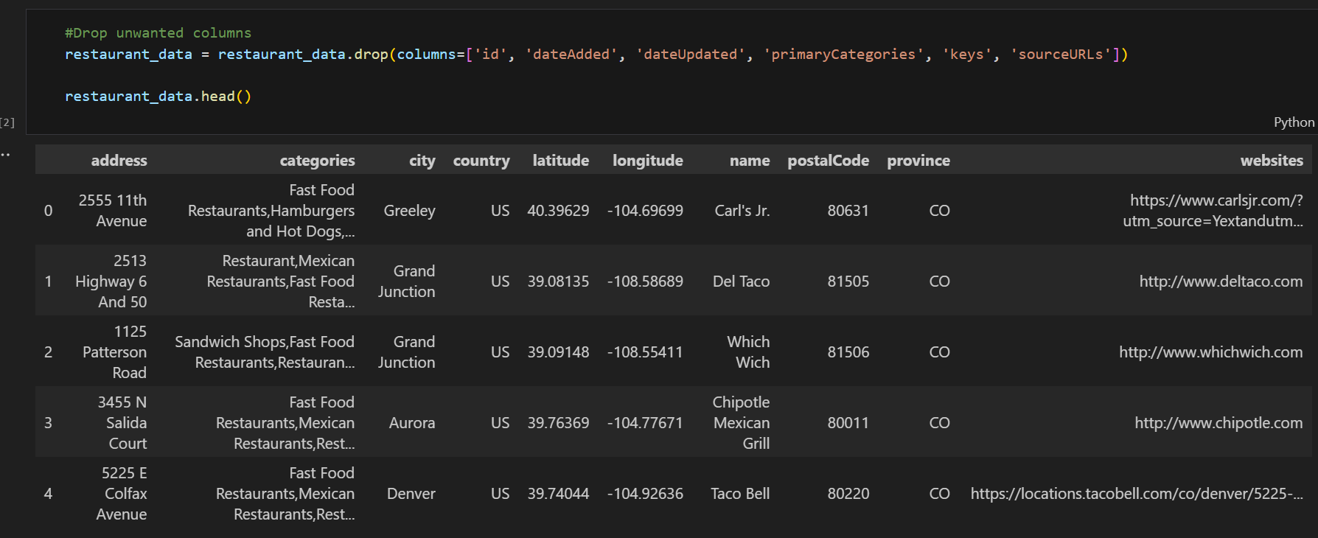
We used a Jupyter Notebook to clean up the data
We dropped the columns and information we didn’t need
This left use with a data that was easier to use

Slide 5
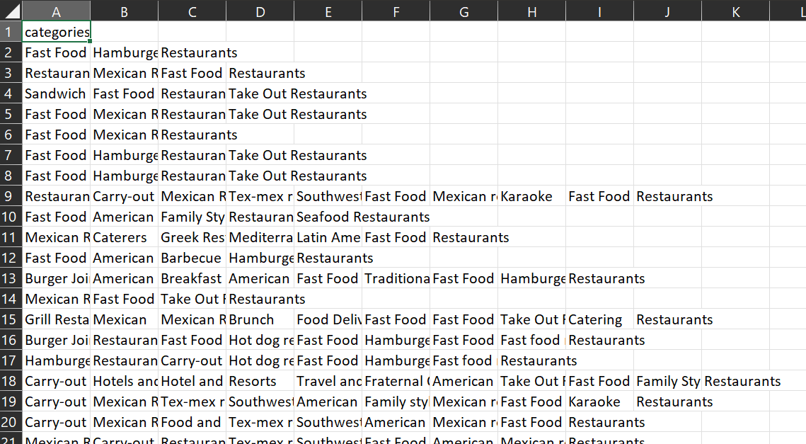
In addition to dropping the columns we didn’t need we fixed the restaurant type column so we could search for a certain word from the column
Previously the column had multiple words describing the restaurant that were clumped together

Slide 6
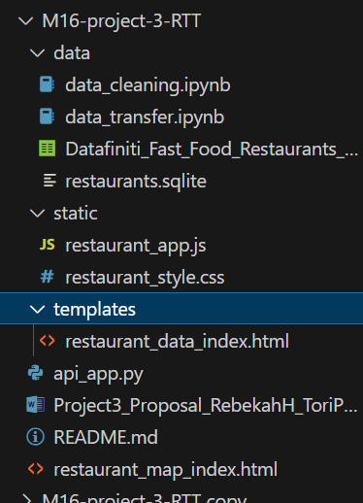
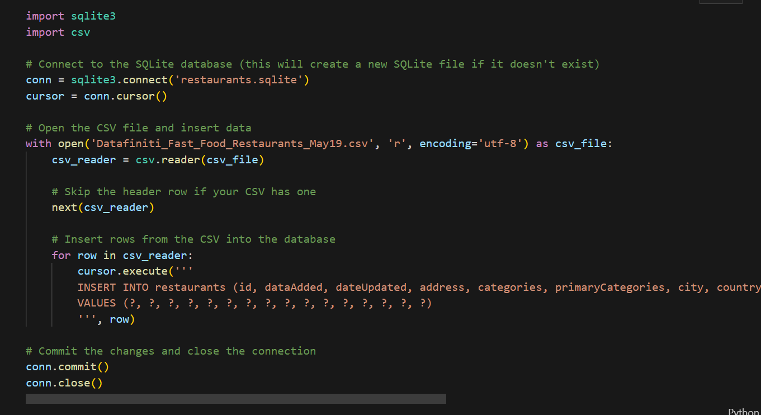
Collection of files
Multiple files were needed
In addition to the Jupyter Notebook to clean the data, we had another Jupyter Notebook to transfer the data

Slide 7
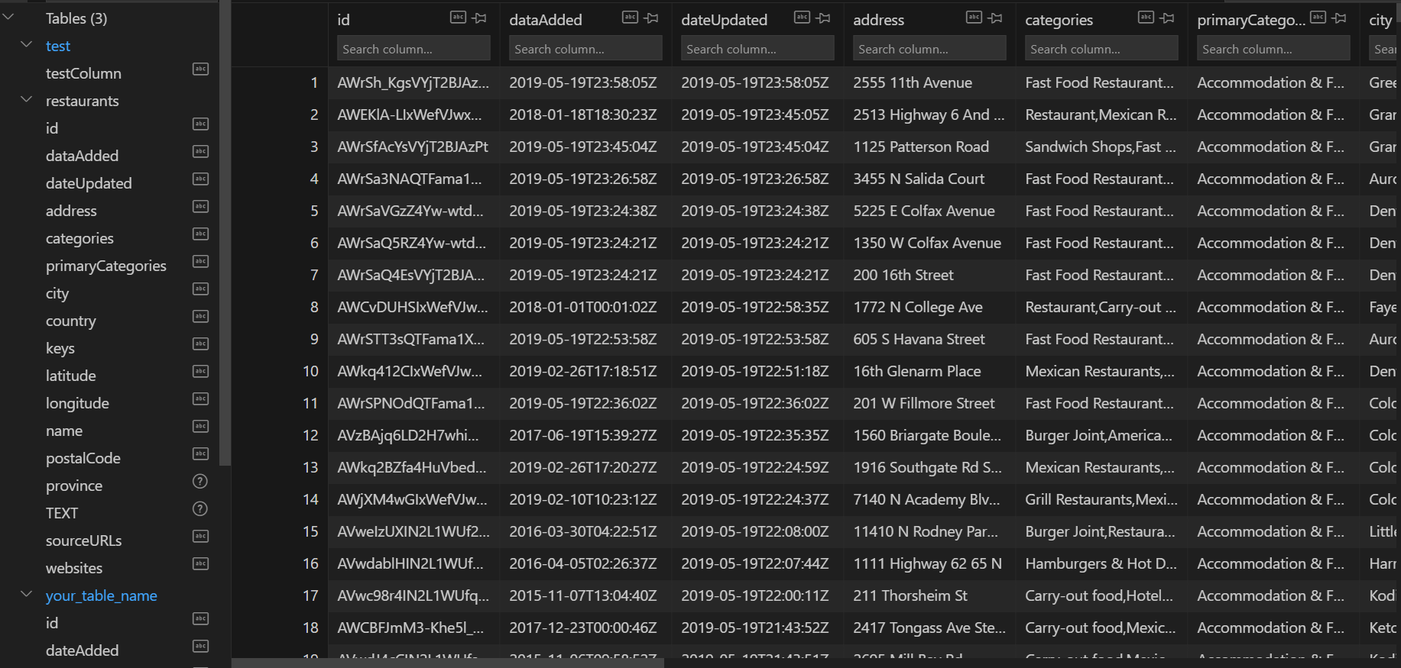
Creation of Database

Slide 8
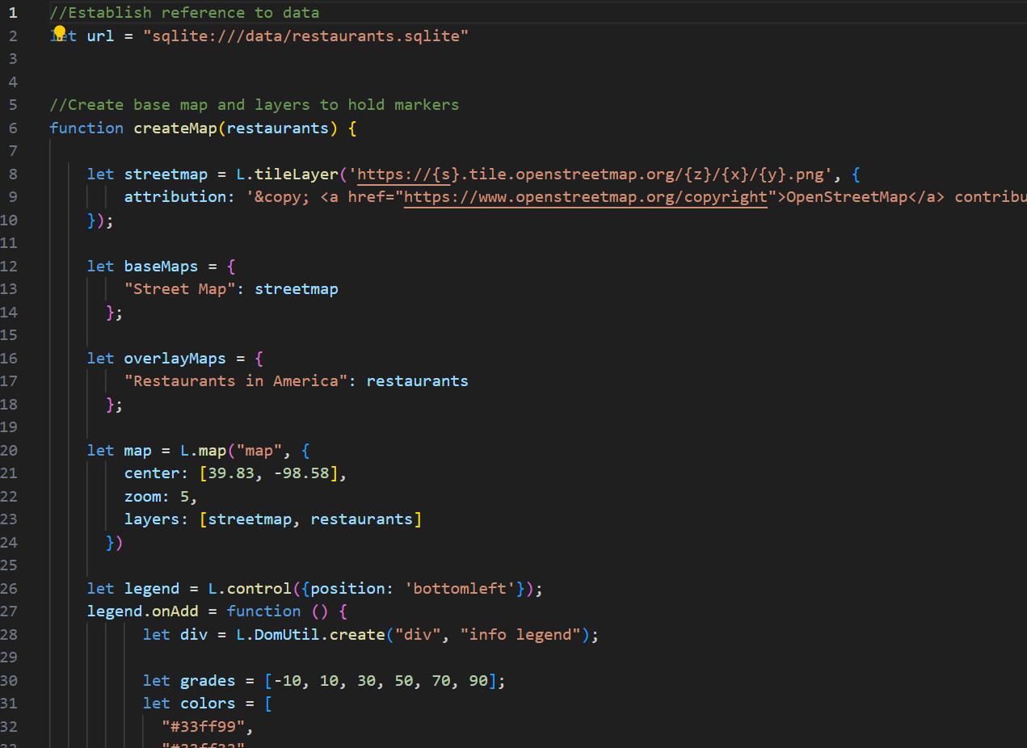
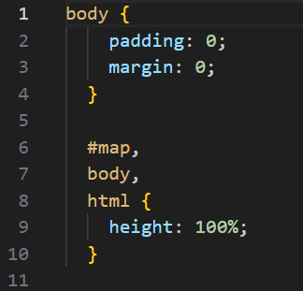
JS File
CSS File

Slide 9
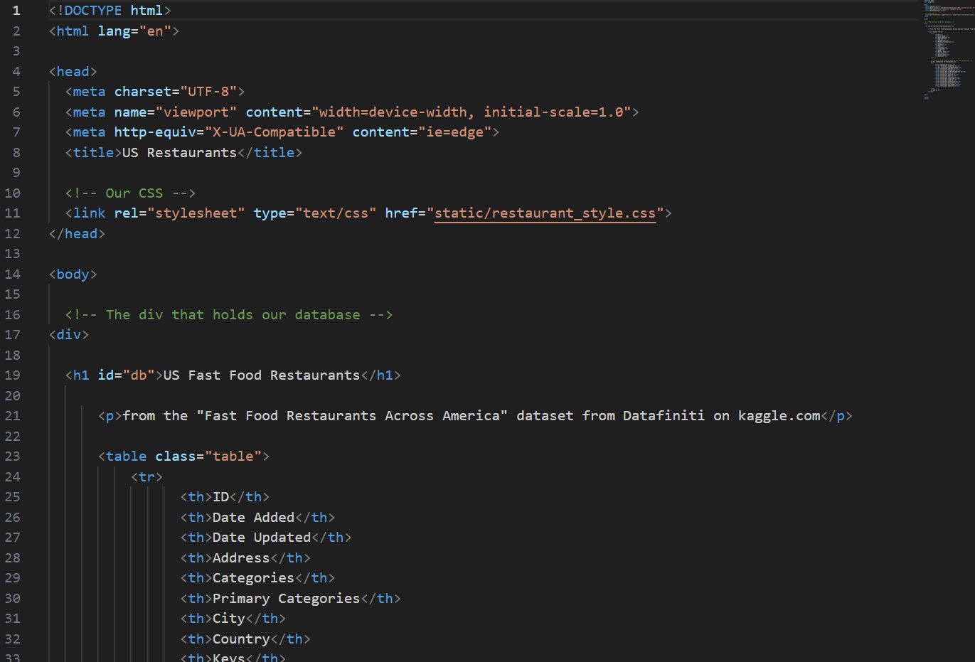
HTML File

Slide 10
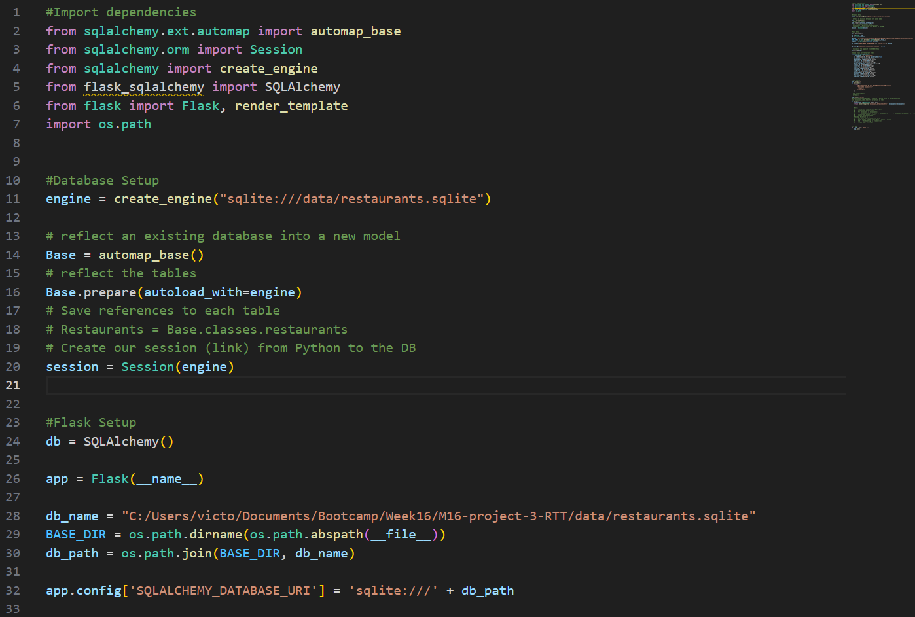
Python File

Slide 11
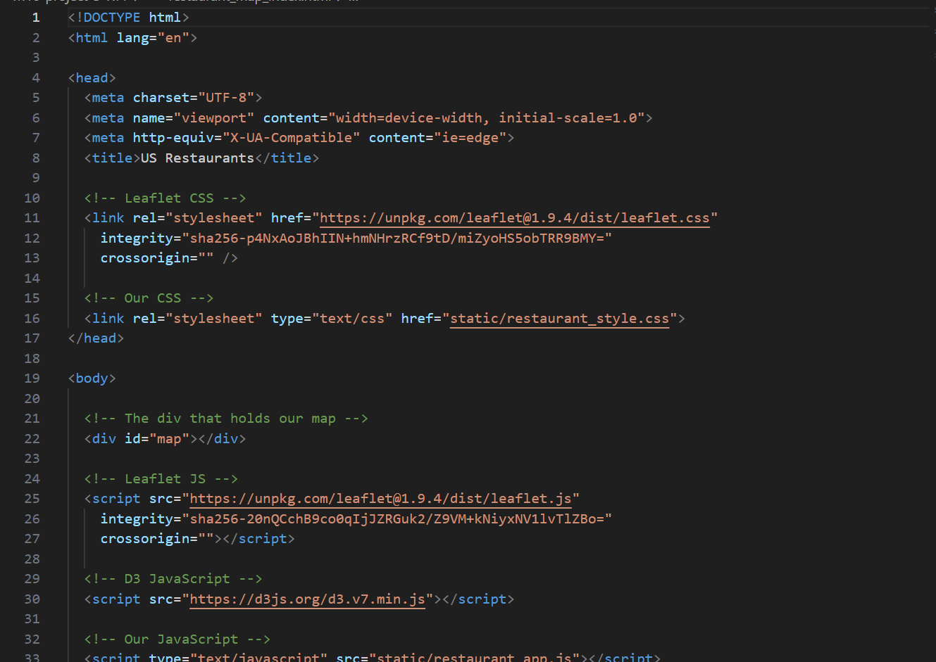
Another HTML File

Slide 12
Research Areas

Slide 13
Findings/Analysis

Slide 14
Credit

Slide 15
Any Questions?

