Slide 1
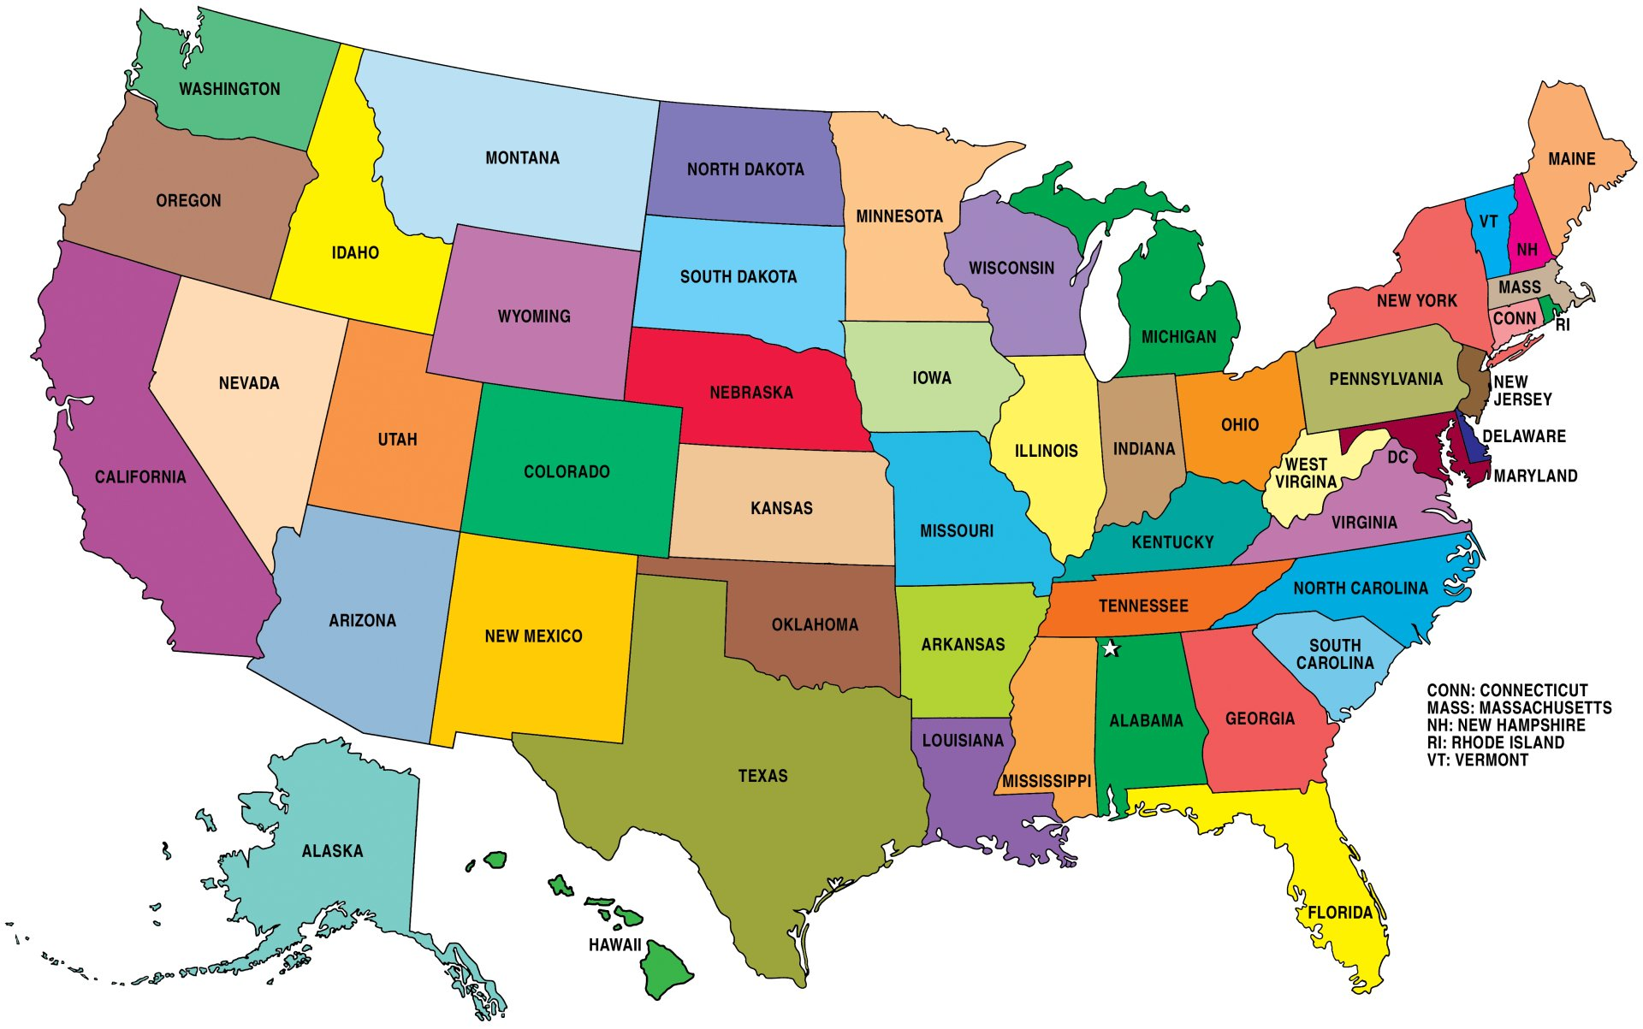
Restaurants in the United States
By: Tori Paxton, Teresa Truong, and Rebekah Higley

Slide 2
Project Overview
Looking at food trends in the United States, we have created:
An interactive map of all the restaurants across the U.S.
Graphical representations of:
Most common types of restaurants in the United States
States with the most restaurants
Number of restaurants per franchise

Slide 3
Data Cleaning

Slide 4
Database Creation

Slide 5
Creation of HTML File

Slide 6
Creation of CSS File

Slide 7
Creation of Javascript File

Slide 8
Research Areas

Slide 9
Findings/Analysis

Slide 10
Credit

