Slide 1
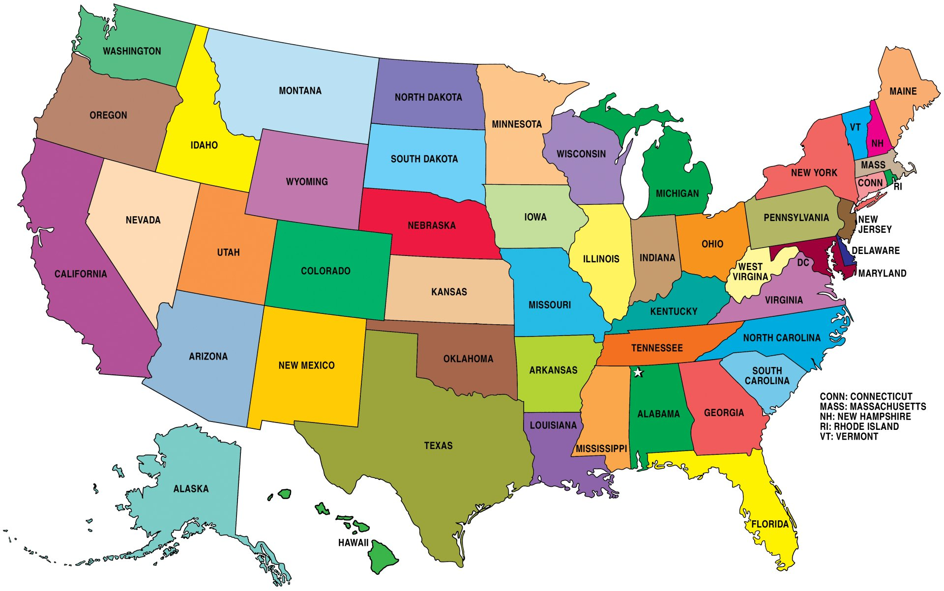
Fast Food Restaurants in the United States
By: Tori Paxton, Teresa Truong, and Rebekah Higley

Slide 2
Project Overview
Looking at food trends in the United States, we have created:
An interactive map of all the restaurants across the U.S.
Graphical representations of:
States with the most restaurants
Number of restaurants per franchise
Fast food restaurants with only 1 location compared with those with multiple locations

Slide 3
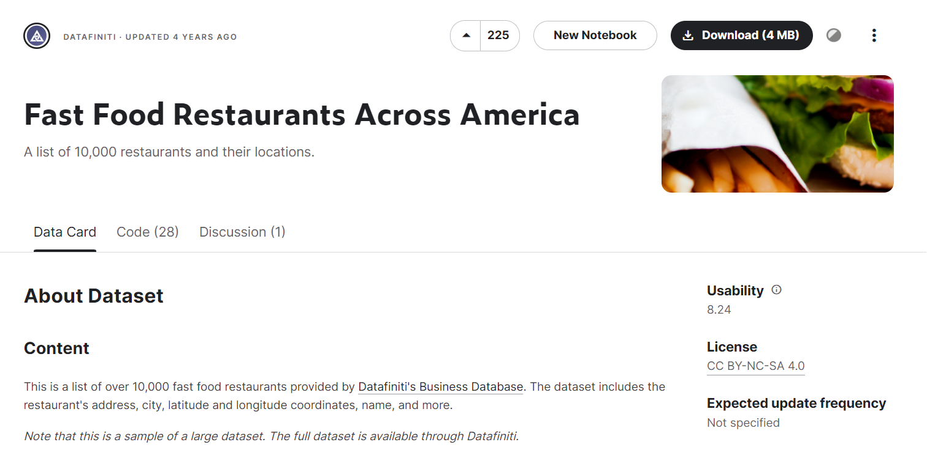
Dataset
Columns:
id
dateAdded
dateUpdated
address categories
primaryCategories
city
country
keys
latitude
longitude
name
postalCode
province
sourceURLs
websites

Slide 4
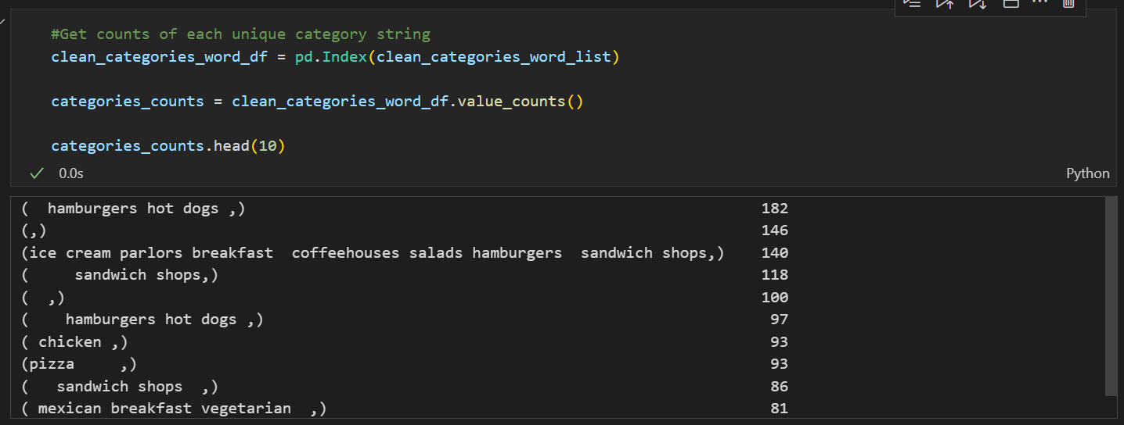
Data Cleaning
Many common category keywords were identified:
Hamburgers
Hot dogs
Ice cream
Sandwich
Breakfast
Chicken
Pizza
Chicken

Slide 5
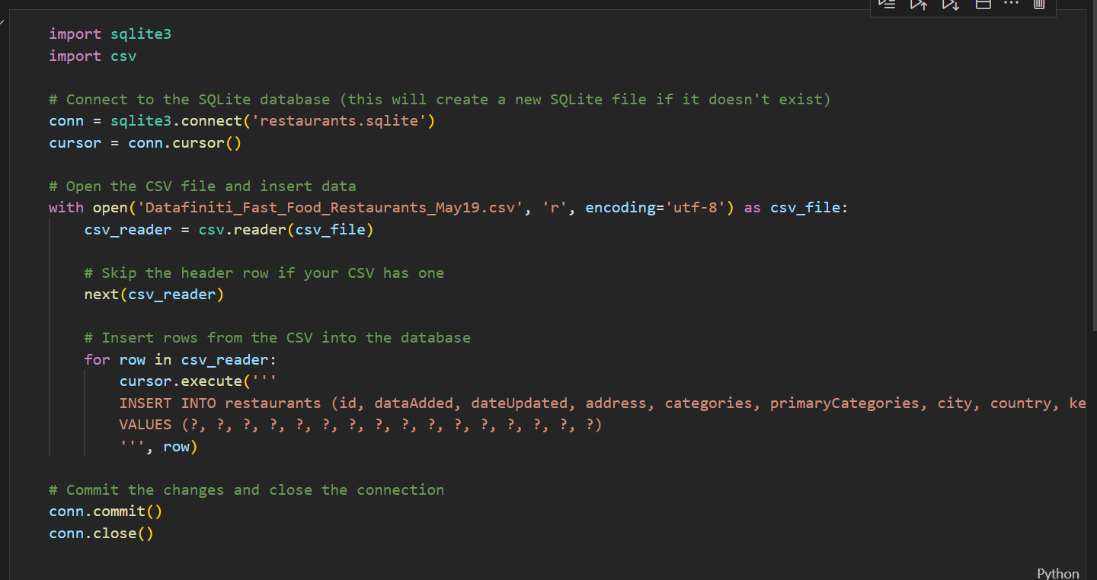
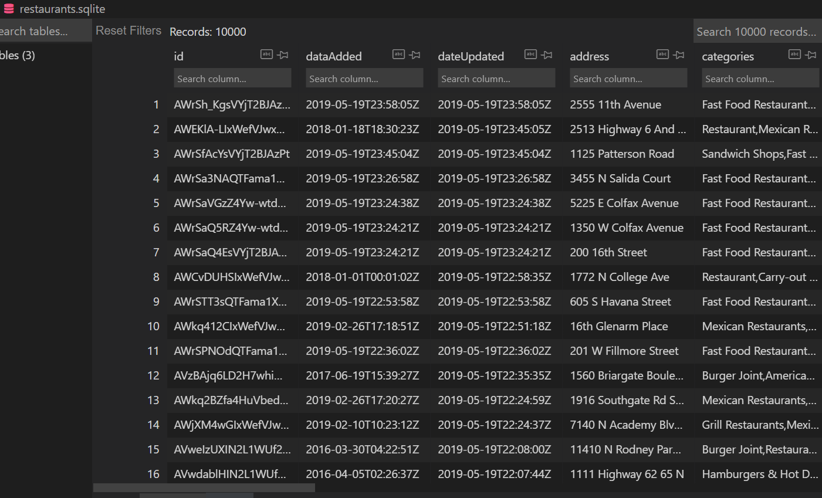
Database Creation

Slide 6

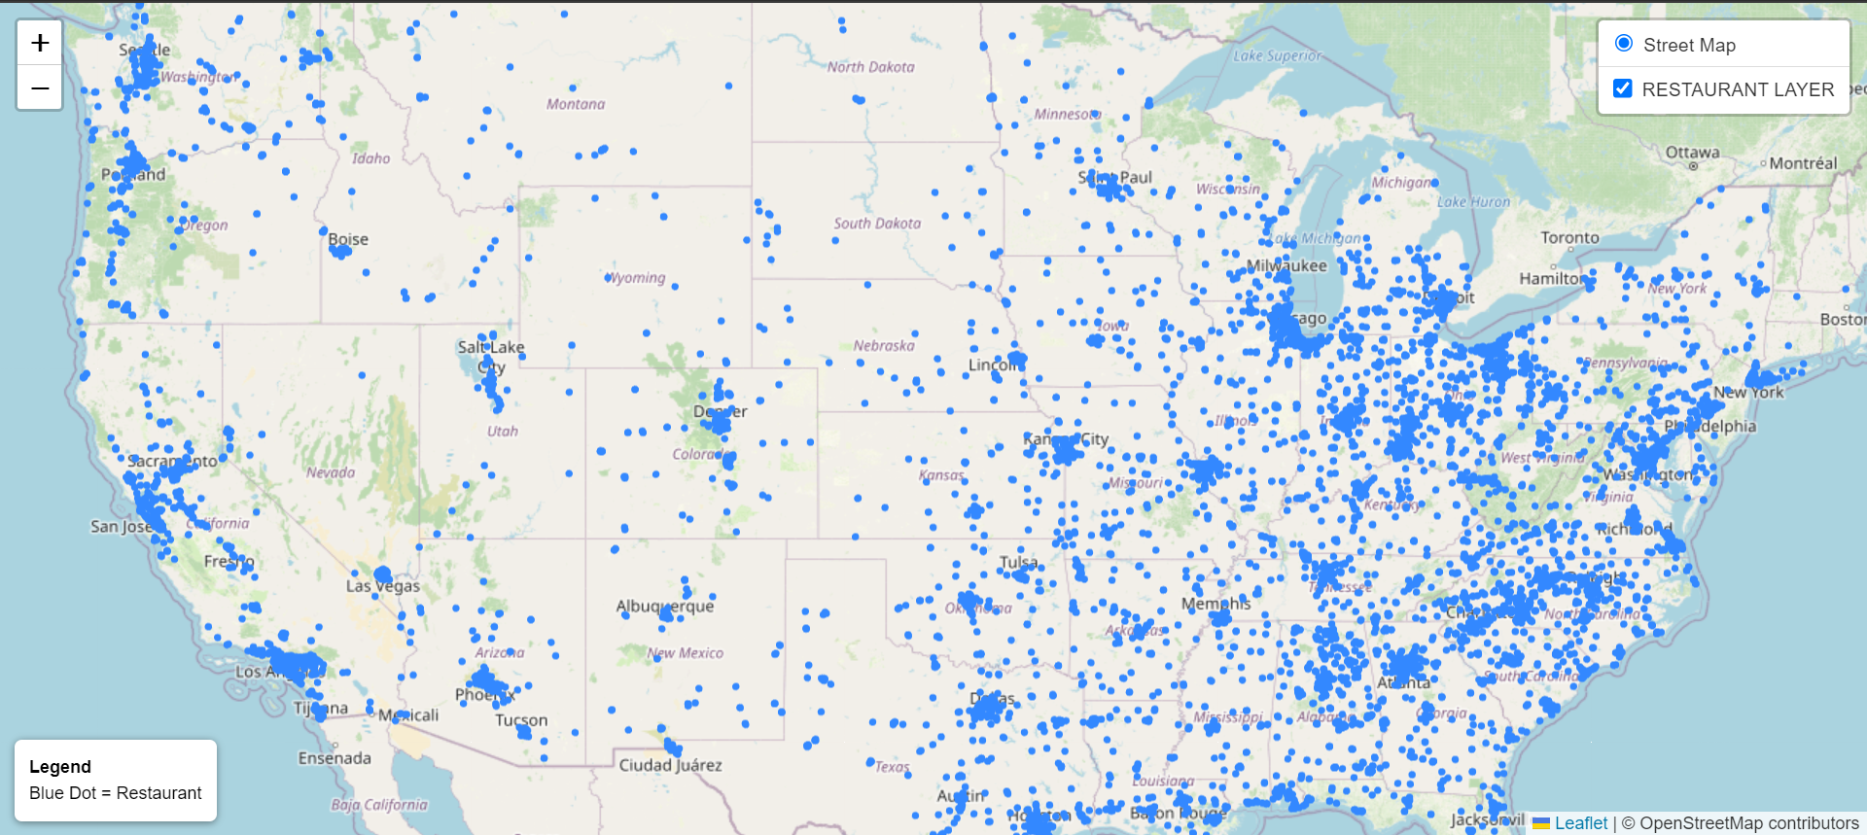
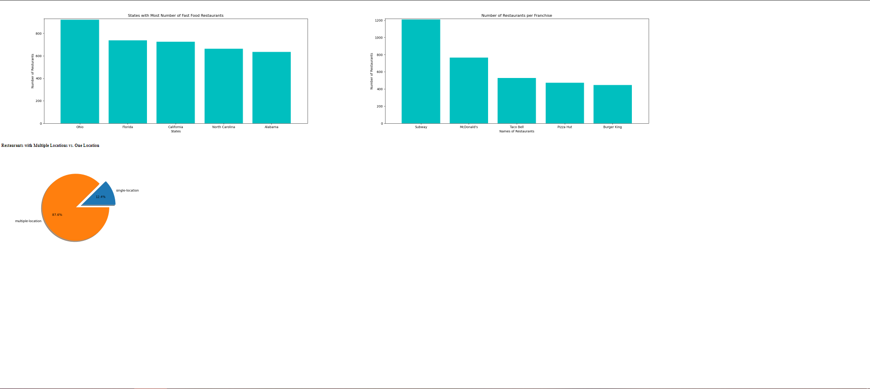
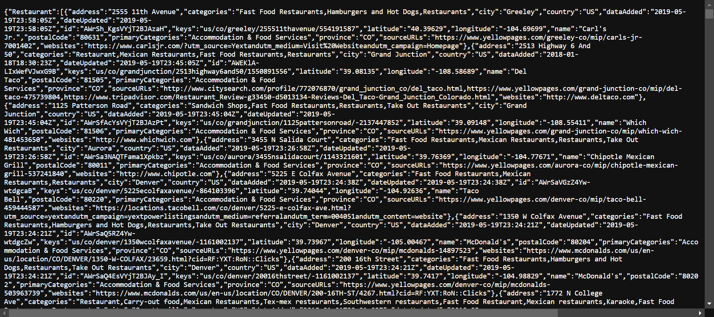
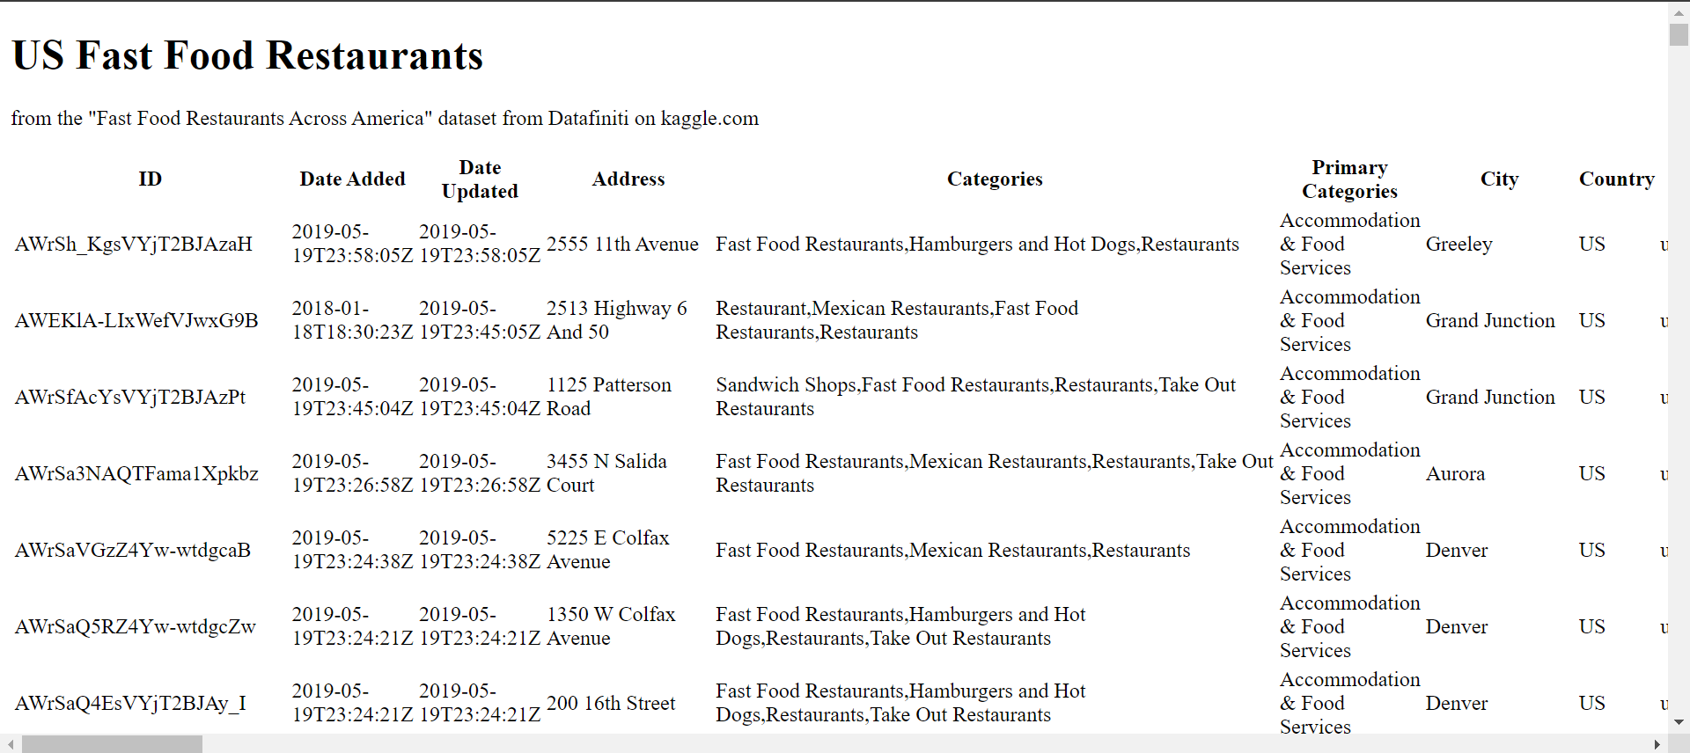
Creation of HTML, JavaScript, and CSS Files and the API
The API includes routes to a map with points for each restaurant in the dataset, graphs from our analysis, a json file of the dataset, and a table of the data.

Slide 7
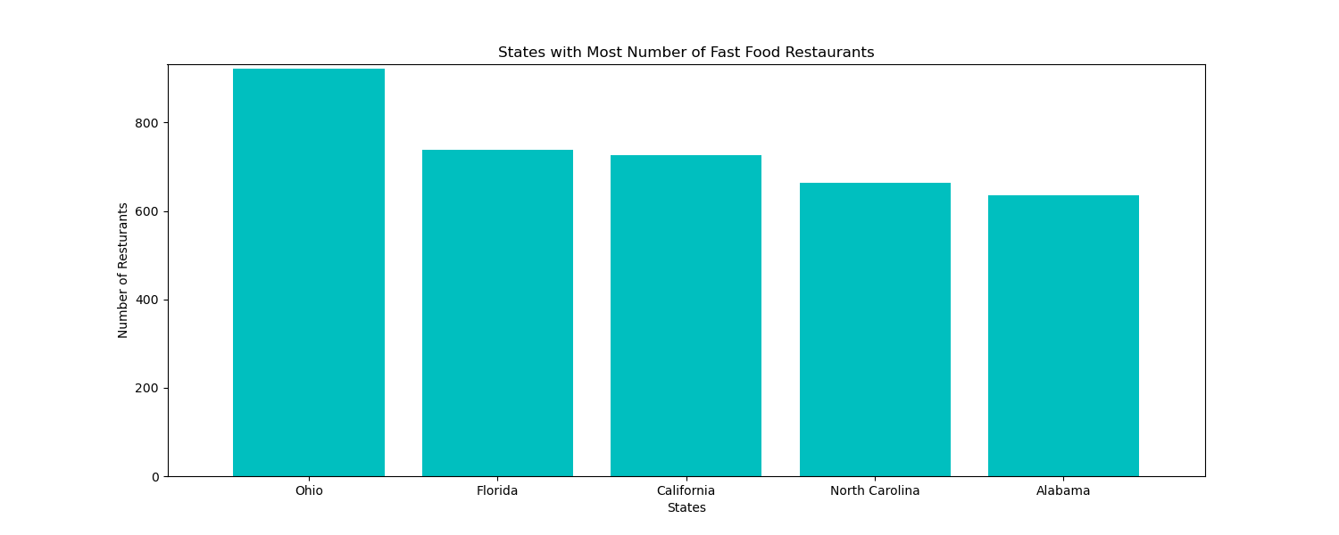
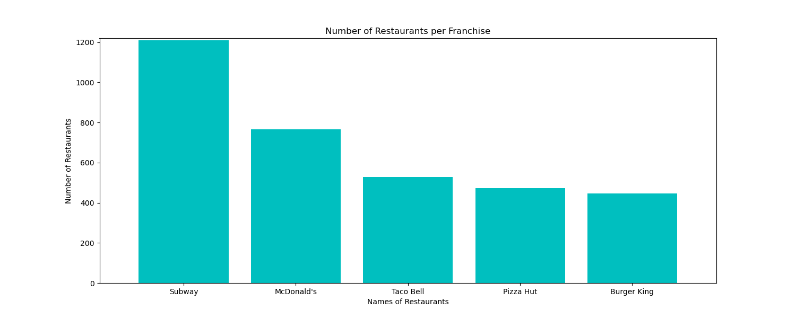
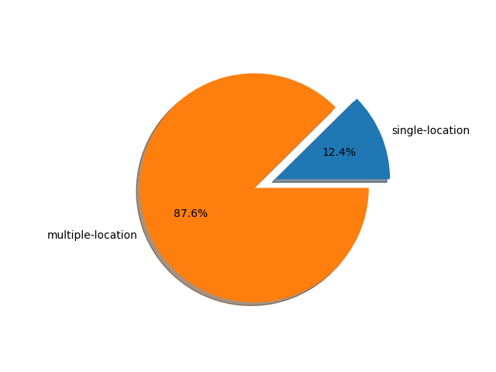
Analysis and Findings
The top fast food franchises’ types match up well with the most common category keywords from the data cleaning process.

Slide 8



Application
Prospective business owners
Everyday people looking for a place to eat
Food writers and researchers

