Slide 1
Predicting real estate sales in Connecticut
Tori Paxton
John Weissmann
Teresa Truong​

Slide 2
AGENDA
Introduction​
Data Pre-Processing
​Creating the Model
Optimizing the Model
​Evaluating the Model
Summary Visuals
Conclusion

Slide 3
introduction
The goal of this project is to create, train, optimize, and evaluate a supervised machine learning model that predicts the sale price of a real estate property in Connecticut based on location and property type with at least 75% accuracy.

Slide 4
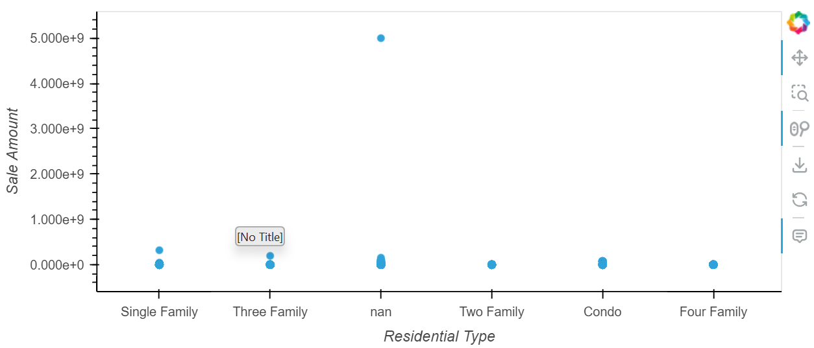
Data pre-processing
Created a scatter plot with the data provided to display the sales information. This scatter plot shows the difference in cost between the different types of homes. Distribution of sales is then calculated by using this information and added to the main data frame.

Slide 5
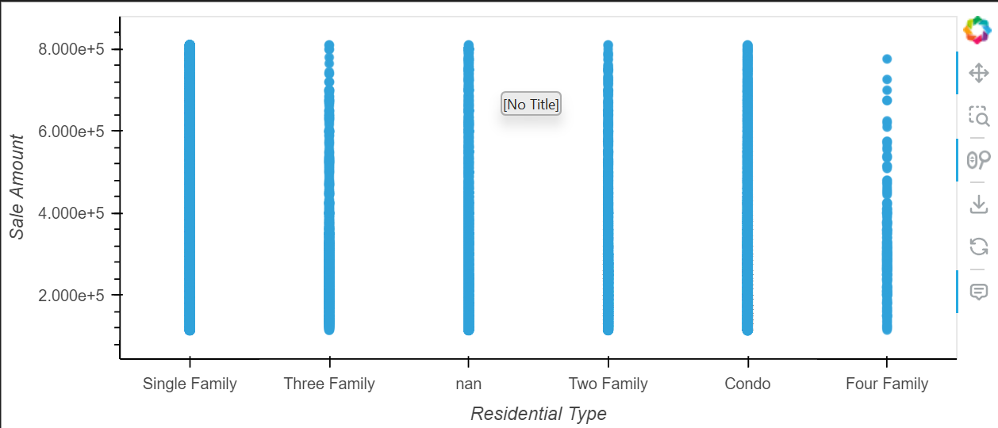
Data pre-processing
In this plot, it shows the correlation between the salary of each family style home.

Slide 6
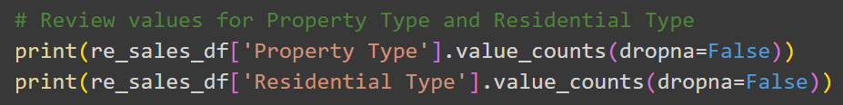
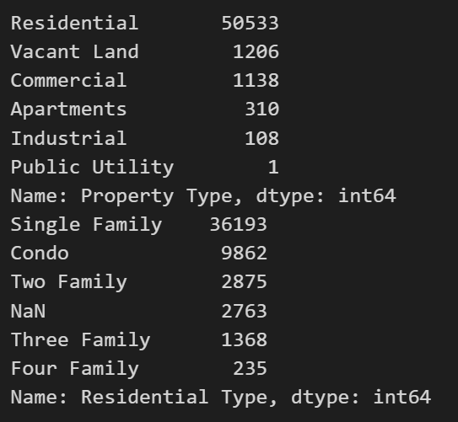
Data pre-processing

Slide 7
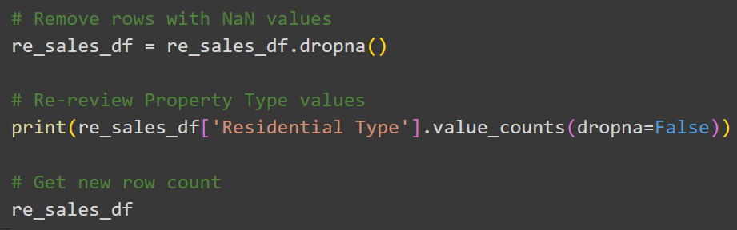
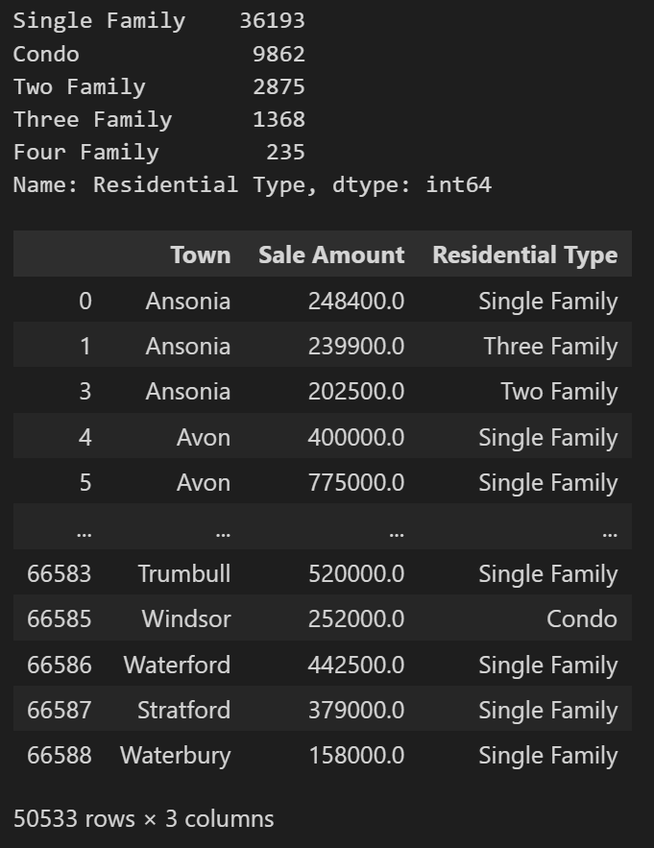
Data pre-processing

Slide 8
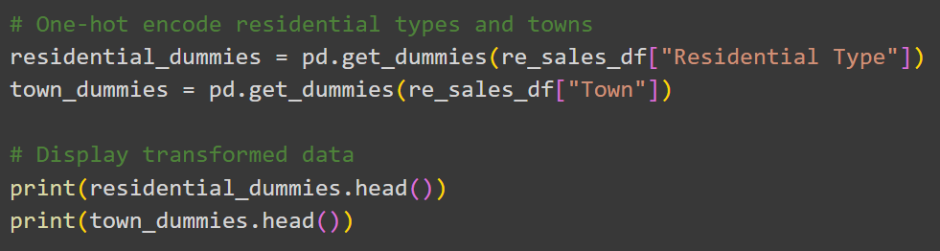
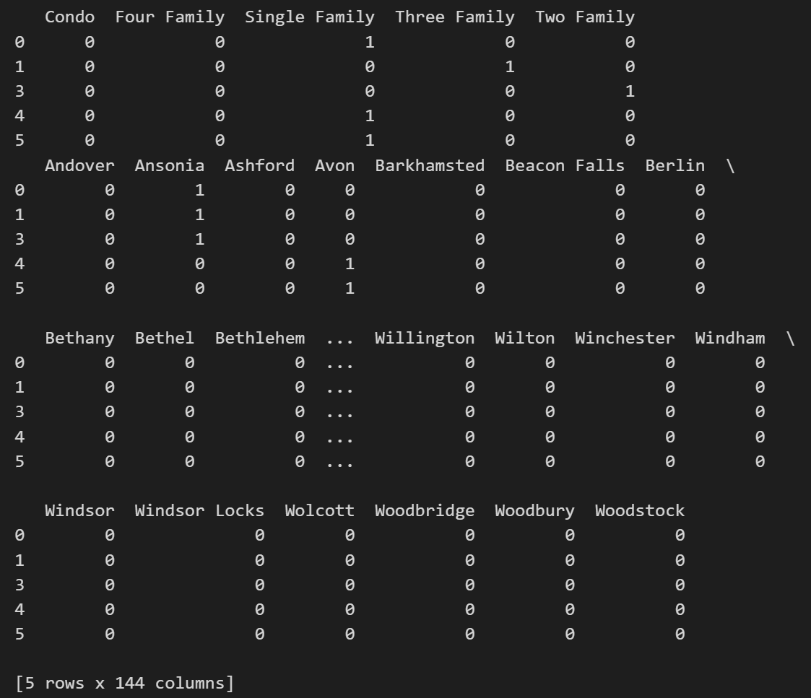
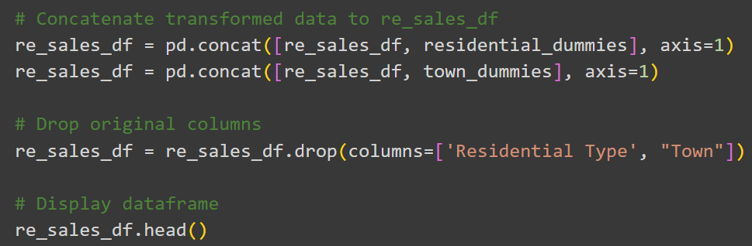
Data pre-processing

Slide 9
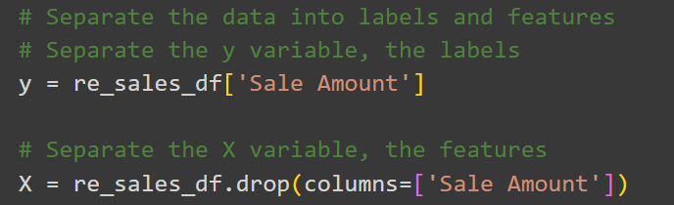

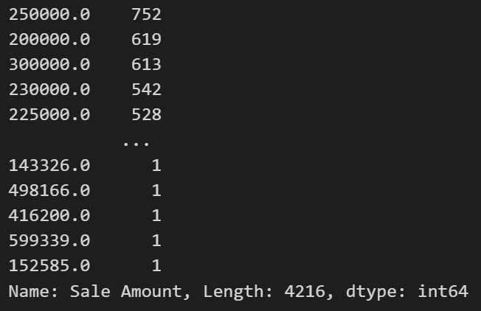
Creating the model

Slide 10
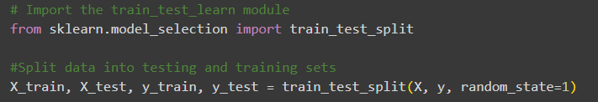
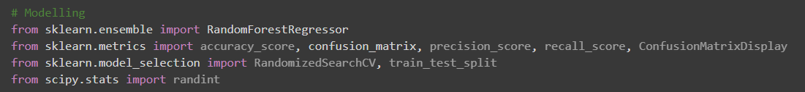
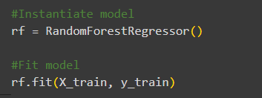

Creating the model

Slide 11
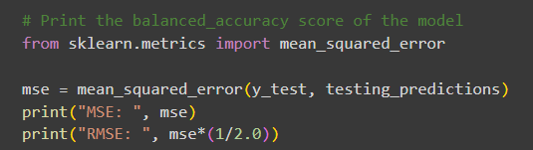

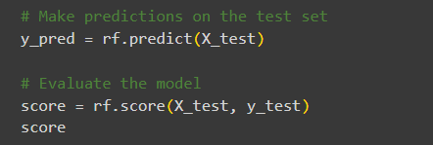

evaluating the model

Slide 12
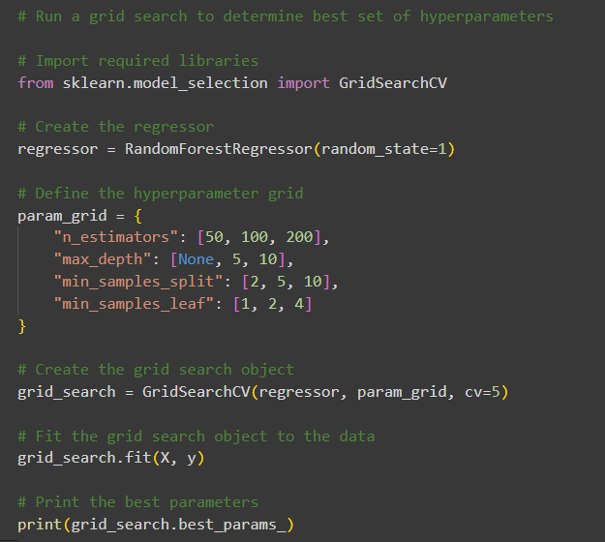
Optimizing the model

Slide 13

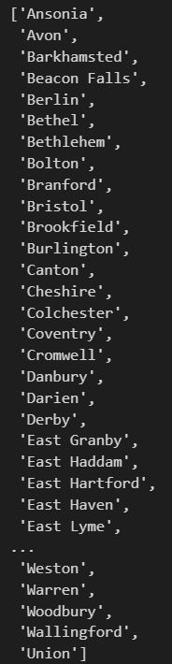
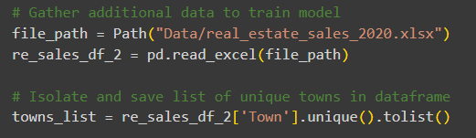
Optimizing the model

Slide 14
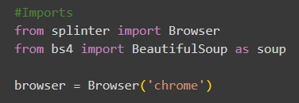

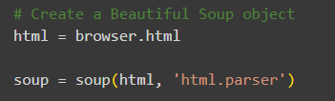

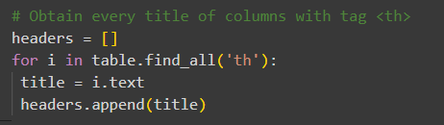
Optimizing the model

Slide 15


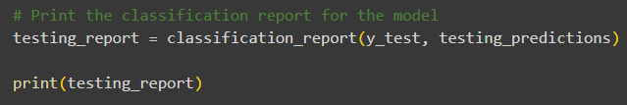
evaluating the model

Slide 16
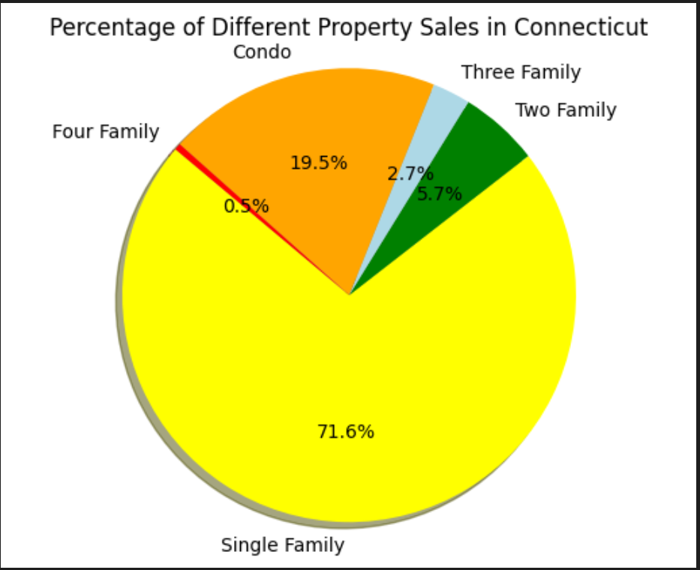
Summary visuals
According to the dataset, this pie chart shows the percentages of the 5 different types of homes sold in Connecticut.
Most of the homes sold are single family homes
The least type of home sold are four family homes

Slide 17
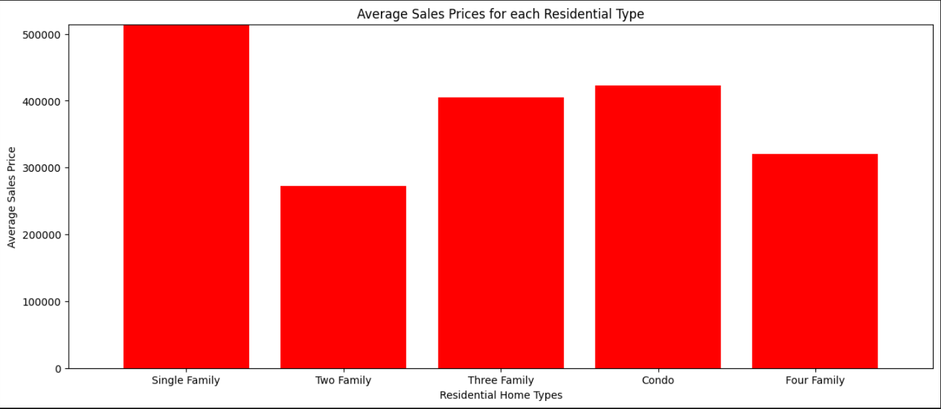
Summary visuals
According to the dataset, this bar chart shows the average selling price for each type of residential home.
Single family style homes had the highest average sales
Two family style homes had the lowest average sales

Slide 18
conclusion
Using this machine learning model can be beneficial in many ways including:
Property Valuation:
Helps determine the estimated values of properties based on location, property size, features, and recent market trends
Predictive Analytics:
Analyze historical property data to predict future property values, helping real estate professionals and buyers make informed investment decisions
Market Analysis
Identify emerging real estate trends and hot markets. Agents and buyers can use this information to target areas with high potential for appreciation or identify neighborhoods that match their preferences.

