Slide 1
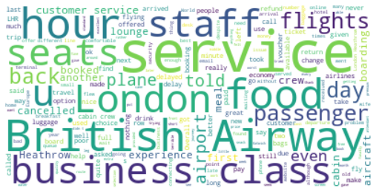
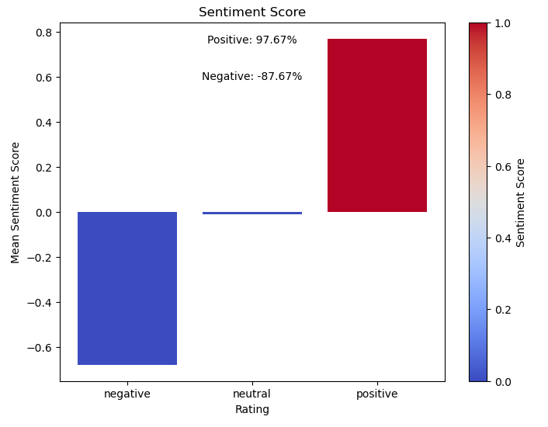
The word cloud shows that the key topics within the reviews include “hour”, “class”, “seat” and “business class”, showing that people are actively talking about their experience and the airline.
The sentiment bar chart above shows that there is an almost equal amount of both positive and negative tone of reviews in the dataset. This means that out of the 1000 reviews the majority were polarized as being either positive or negative

