Slide 1
APPLICATION MANAGEMENT SYSTEM BY BIDII

Slide 2
Team
Teresia Nduati – Full-stack Web Developer

Slide 3
What is the Project About
This application allows clients to book appointments with service providers like massage therapists.

Slide 4
Core Components of the Project
Role-based access:
Client interface – booking
Admin interface – View client bookings
Booking and scheduling
Allow clients to select specific services and book appointments.
Payment Integration
Stripe to handle secure payments (Test mode)

Slide 5
Technical Overview
Front-end
React: Component-based architecture
Back-end:
Nodejs and Express: Consistency and reduce context switching between languages
Database
Firestore: Real-time data synchronization

Slide 6
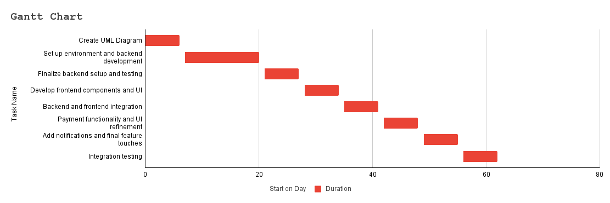
Timeline

Slide 7
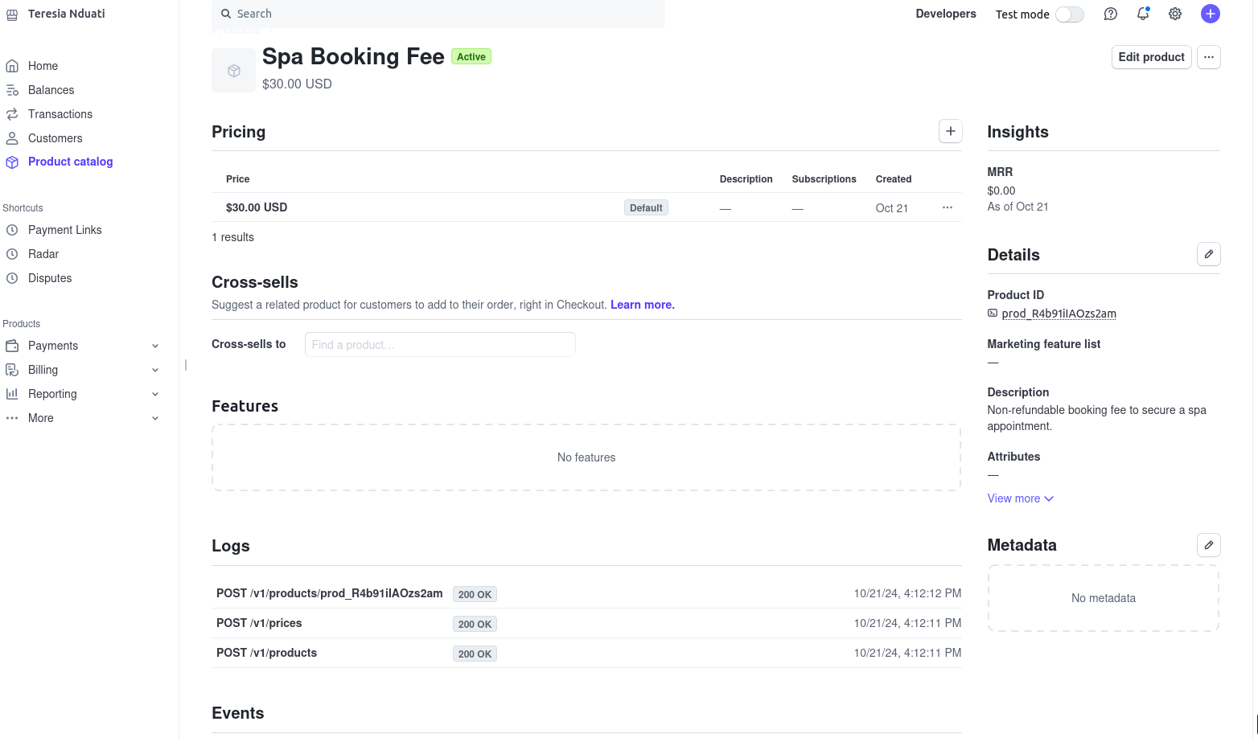
Progress: Stripe’s Payment Link

Slide 8
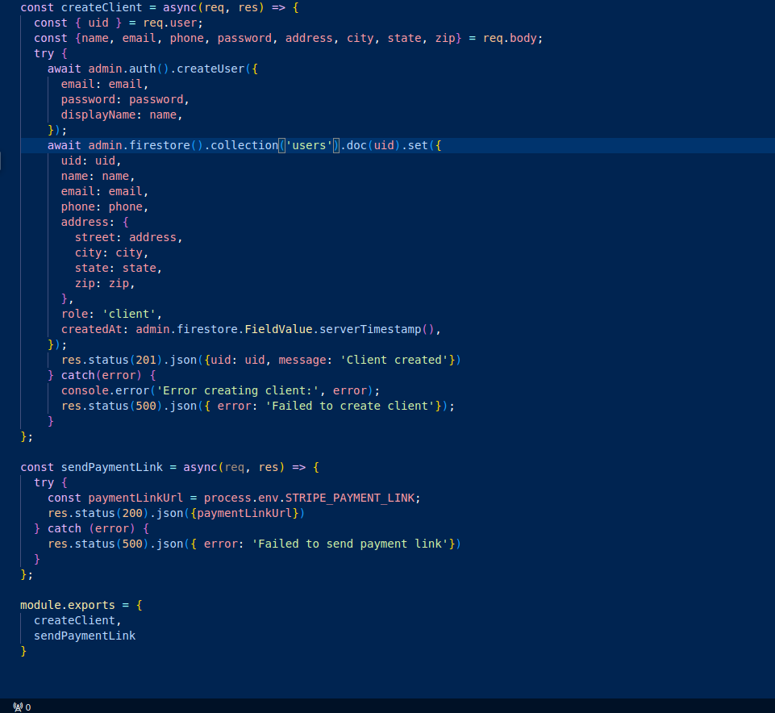
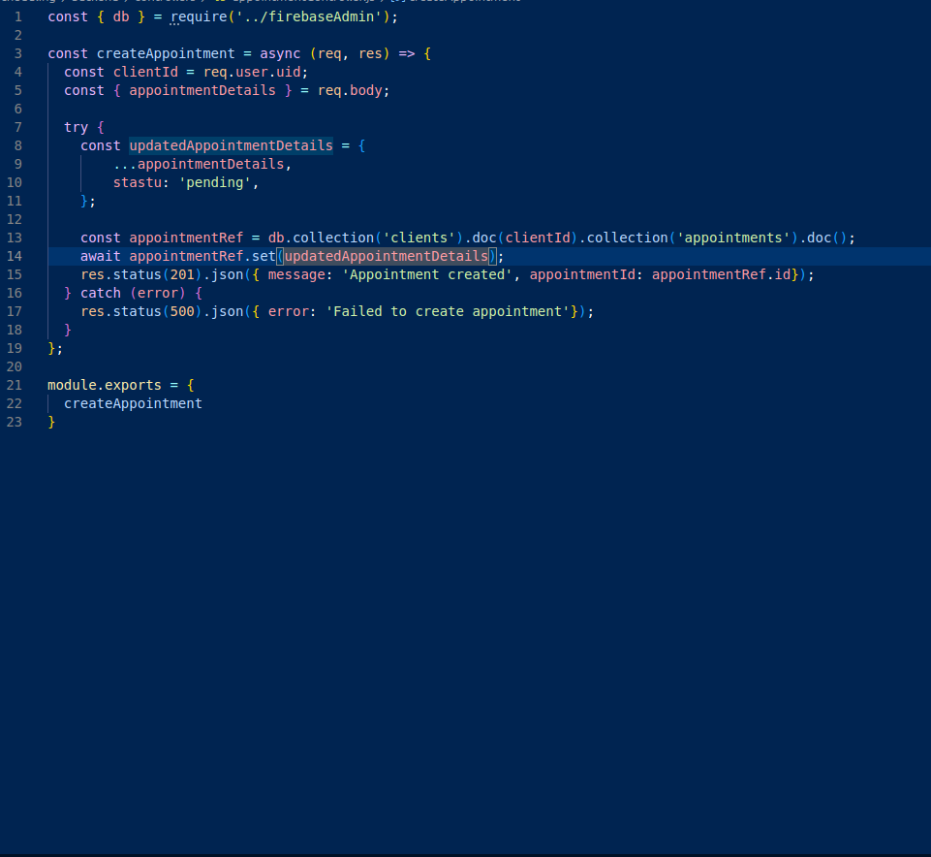
Code Snippets

Slide 9
Thank you

