Slide 1
Feature Selection for media classification
Silvana Podaras & Florian Schober

Slide 2




Motivation
Notes:
Various type of media and their features given – we want to make classifications

Slide 3
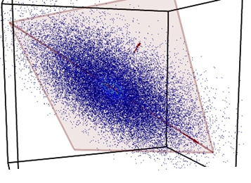
Motivation

Slide 4
Motivation
Select relevant features!

Slide 5
Motivation
Remove redundancy
Expressive representation of data
More accurate classification
Speed up computation time

Slide 6
Feature selection
NO new features!
Select relevant subset
Discriminating features
Notes:
Relevant = depends on application, but in genereal: Discriminating feature = when looking at the feature, clear classification can be done
No redundancy = two features should not lead to same information

Slide 7
Feature Types
Flat Features
Independent
Structured
Certain structure induced

Slide 8
Flat Features
No information about structure needed
No relation to each other
Outperformed by structured feature methods

Slide 9

Methods for flat features
Filter
Wrapper
Embedded

Slide 10
Filter methods
Filter out relevant features
Independent of classification algorithm
Computationally efficient
No optimal performance guaranteed
Notes:
„Filter out least interesting variables“
No optimal performance when doing the classification, eventually bias/properties of the classfier influence the result in a neg way

Slide 11
Filter methods
Rank features with certain metric
Univariate
Multivariate
Chose features with highest rankings, use for classification task
Notes:
Univariate = each feature independent eg. Eucledean disstance
Multivariate = correlation between features, can remove redundant features (univariate → filter methods tend to have redundant features)

Slide 12
Example: RELIEF
Algorithm for Binary classification
Represent features by weights in a vector
Pick one instance randomly, calculate relevance of features
Update weights
Choose features with highest weights
Notes:
Relevance: Eucledian distance between near hit and near miss (closesst instances in the neighborhood of X from the same and the other class) – if value for same class is high, the weight gets a positive value, else a negative value. Update weights: bigger weights if relevant feature
We see → no classifier used

Slide 13
Filter methods
Fisher Score
Information Gain
Min. Redundancy - Max. Relevance
…
Notes:
Relevance: Eucledian distance between near hit and near miss (closesst instances in the neighborhood of X from the same and the other class) – if value for same class is high, the weight gets a positive value, else a negative value. Update weights: bigger weights if relevant feature
We see → no classifier used

Slide 14
Wrapper methods
Consider classification algortihm
Select features that fit classifier best
Computationally expensive!
Not flexible (cannot change classifier afterwards)
Notes:
Fit classifier best = consider biases and heuristics of a classifier optimally

Slide 15
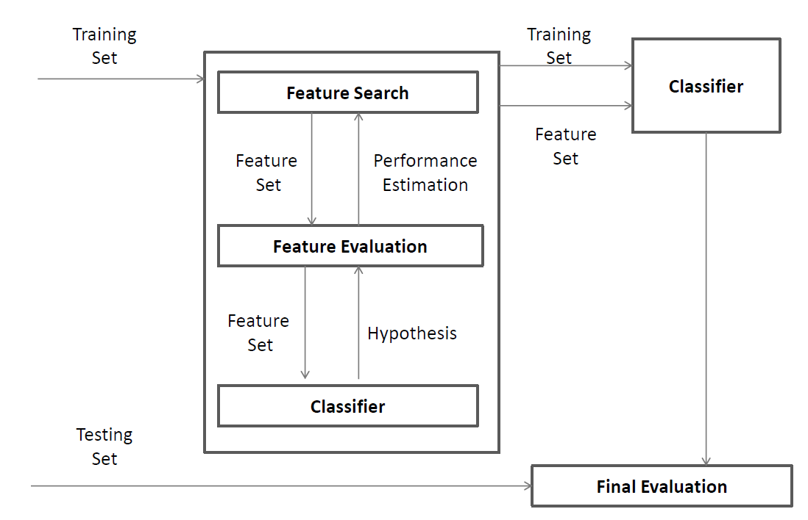
Wrapper methods
Notes:
Search for a subset : different algorithms possible:
hill-climbing, best-first, branch-and-bound, and genetic algorithms.
Either start from full set and reduce features, or start from empty set and add features.

Slide 16
Wrapper methods
Notes:
Evaluation/Estimation:
´
Train classsifier with the subset, evaluate e.g with, cross validation – uses the classifier!

Slide 17
Wrapper methods
Notes:
Iterate, expand old subset and add features, (or decimate and remove) , and repeat

Slide 18
Itarative process
Adapt feature subset
Forward selection
Backward elimination
Train classifier
Evaluate (f.ex.with crossvalidation)
Repeatand choose best feature subset

Slide 19
Wrapper methods
Notes:
Finally:
Use subset with best performance to train classifier, and use it for actual classification task (normally after testing with testset independent from training set)

Slide 20
Wrapper methods
Notes:
Search: different algorithms possible
Evaluation/Estimation: Test set, cross validation – uses the classifier
Finally: Use subset with best performance to train classifier, and use it for actual classification task (normally after testing with testset independent from training set)

Slide 21
Wrapper methods
Search routine:
Greedy search, Branch and Bound, Genetic Algorithms …
Classifier:
SVM, KNN,….

Slide 22
Embedded methods
Hybrid:
Combine benefits of filters and wrappers
Computationally efficient
Higher quality for classification
Notes:
They try to unite the benefits of the other two

Slide 23
Embedded methods
Hard to seperate feature selection and learning
Hard to characterize
Examples: SVM, linear regression, C4.5 algorithm, …
Notes:
NO characterisation apart from that possible

Slide 24
Structured features
Certain assumption about structure
Outperform flat feature methods
(Bsp tree-structure - evtl sogar was konkretes, f.ex. alter/jahre/monate ?!)

Slide 25
Methods for structured features
Group
Tree
Graph
(evtl 1-2 bsp pro art, fortführendes zeug?)

Slide 26
Applications
Classification/ pattern recognition
Data representation
Prediction

Slide 27
Questions?

