Slide 1
Feature Selection for media classification
Silvana Podaras & Florian Schober

Slide 2




Motivation
quantify

Slide 3
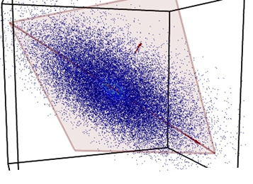
Motivation

Slide 4
Motivation
Select relevant ones!

Slide 5
Motivation
Remove redundancy
Expressive representation of data
More accurate classification
Speed up computation time

Slide 6
Feature selection
NO new features!
Select relevant subset
Discriminating features

Slide 7
Feature Types
Flat Features
→ Independent
Structured
→ of certain structure

Slide 8
Flat Features
No information about structure needed
No relation to each other
Outperformed by structured feature methods

Slide 9

Methods for flat features
Filter
Wrapper
Embedded

Slide 10
Filter methods
Filter out relevant features
Independent of classification algorithm
Computationally efficient
No optimal performance guaranteed

Slide 11
Wrapper methods
Consider classification algortihm
Select features that fit classifier best
Iteartively Search and Evaluate
Computationally expensive!

Slide 12
Embedded methods
Hybrid method
Computationally
Higher quality for classification

Slide 13
Structured features
Certain assumption about structure
Outperform flat feature methods
(Bsp tree-structure - evtl sogar was konkretes, f.ex. alter/jahre/monate ?!)

Slide 14
Methods for structured features
Group
Tree
Graph
(evtl 1-2 bsp pro art, fortführendes zeug?)

Slide 15
Applications
Classification/ pattern recognition
Data representation
Prediction

Slide 16
Questions?

Slide 17
Literature

