Slide 1
Feature Selection for media classification
Silvana Podaras & Florian Schober

Slide 2





Classification Pipeline Feature Extraction
Features
Notes:
Since classification of media grows more and more important, it is necessary to have a look at how this is done and how we can improve it.
Various

Slide 3
Classification Pipeline Feature (Subset) Selection
Many Features
Less Features
Notes:
Since classification of media grows more and more important, it is necessary to have a look at how this is done and how we can improve it.
Various

Slide 4
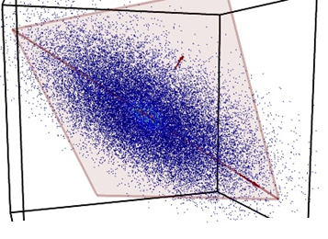
Classification Pipeline Training of a classifier
SVM
Neural Net
Bayes
...
Notes:
Since classification of media grows more and more important, it is necessary to have a look at how this is done and how we can improve it.
Various

Slide 5
Classification Pipeline Classification of data
Labeled data
SVM
Neural Net
Bayes
...
Notes:
Since classification of media grows more and more important, it is necessary to have a look at how this is done and how we can improve it.
Various

Slide 6
Classification Pipeline
Feature Extraction
Feature Selection
Training of a classifier
Classification of data

Slide 7
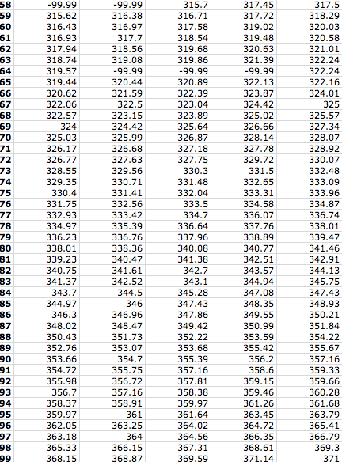
Motivation – High Dimensionality
Many Samples
Many Features

Slide 8
Motivation – High Dimensionality
Many Samples
Many Features

Slide 9
Motivation
Remove redundancy
Expressive representation of data
More accurate classification
Speed up computation time

Slide 10
Feature selection
NO new features!
Select relevant subset
Discriminating features
Notes:
Relevant = depends on application, but in genereal: Discriminating feature = when looking at the feature, clear classification can be done
No redundancy = two features should not lead to same information

Slide 11
Feature Types
Flat
Independency assumed
Structured
Certain structure assumed
Notes:
Nicht fix definierbar, kommt auf annahmen/ zugrundeliegende modellierung des problems an - VIEEELE möglichkeiten.

Slide 12
Flat Features
Possible structure is ignored
No relation to each other
Outperformed by structured feature methods

Slide 13

Methods for flat features
Filter
Wrapper
Embedded

Slide 14
Filter methods
Filter out relevant features
Independent of classification algorithm
Computationally efficient
No optimal performance guaranteed
Notes:
„Filter out least interesting variables“
No optimal performance when doing the classification, eventually bias/properties of the classfier influence the result in a neg way

Slide 15
Filter methods
Rank features with certain metric
e.g. assign weights to features
Chose features with highest rankings, use for classification task
e.g. eliminate weights near zero
Notes:
Univariate = each feature independent eg. Eucledean disstance
Multivariate = correlation between features, can remove redundant features (univariate → filter methods tend to have redundant features)

Slide 16
Example: RELIEF
Algorithm for Binary classification
Chose random sample X
Find nearest neighbor in same and in other class
Compute weight according to distances
Notes:
Relevance: Eucledian distance between near hit and near miss (closesst instances in the neighborhood of X from the same and the other class) – if value for same class is high, the weight gets a positive value, else a negative value. Update weights: bigger weights if relevant feature
We see → no classifier used

Slide 17
Wrapper methods
Consider classification algortihm
Select features that fit classifier best
Computationally expensive!
Not flexible (cannot change classifier afterwards)
Notes:
Fit classifier best = consider biases and heuristics of a classifier optimally
Better results achieved

Slide 18
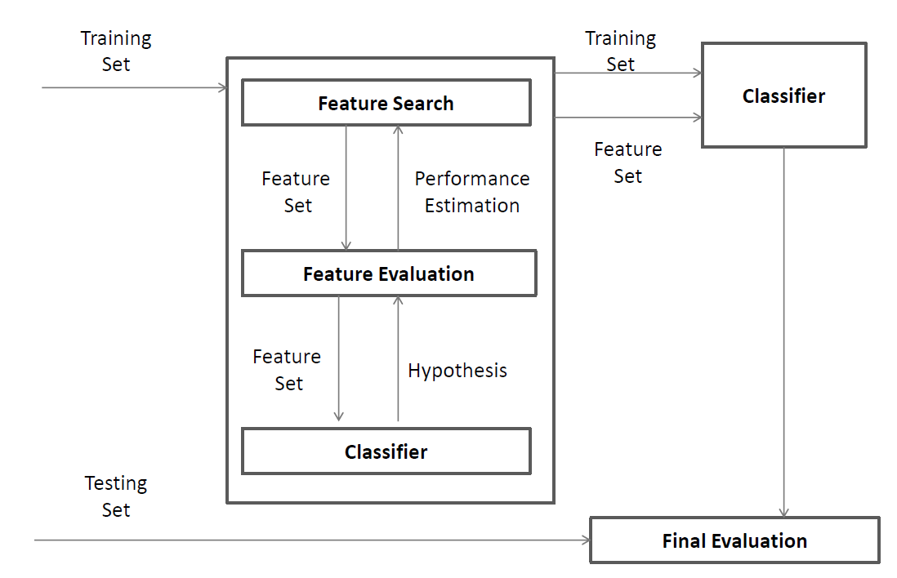
Wrapper methods
Notes:
Search for a subset : different algorithms possible:
hill-climbing, best-first, branch-and-bound, and genetic algorithms.
Either start from full set and reduce features, or start from empty set and add features.

Slide 19
Wrapper methods
Notes:
Evaluation/Estimation:
´
Train classsifier with the subset, evaluate e.g with, cross validation – uses the classifier!

Slide 20
Wrapper methods
Notes:
Iterate, expand old subset and add features, (or decimate and remove) , and repeat
--je nach methode kommts drauf an, wie viele subsets getestet werden (greedy vs genetic)

Slide 21
Itarative process
Adapt feature subset
Forward selection
Backward elimination
Train classifier
Evaluate (f.ex.with crossvalidation)
Repeatand choose best feature subset

Slide 22
Wrapper methods
Notes:
Finally:
Use subset with best performance to train classifier, and use it for actual classification task (normally after testing with testset independent from training set)

Slide 23
Wrapper methods
Notes:
Search: different algorithms possible
Evaluation/Estimation: Test set, cross validation – uses the classifier
Finally: Use subset with best performance to train classifier, and use it for actual classification task (normally after testing with testset independent from training set)

Slide 24
Wrapper methods
Search routine:
Greedy search, Branch and Bound, Genetic Algorithms …
Classifier:
SVM, KNN,….

Slide 25
Embedded methods
Hybrid:
Combine benefits of filters and wrappers
Computationally efficient
Higher quality for classification
Notes:
They try to unite the benefits of the other two

Slide 26
Embedded methods
Hard to seperate feature selection and learning
Hard to characterize
Examples: C4.5 Feature elimination using SVM
Notes:
NO characterisation apart from that possible

Slide 27
Structured features
Certain assumption about structure
Select/discard related features
Usually outperforms flat feature methods
Extend the
Least Absolute Shrinkage and Selection Operator

Slide 28
LASSO
Predecessor of Elastic Nets
Minimizes Energy-Term
Usually consists of Error-Function (e.g. Least Squares)
Energy-Term can be extended
To consider relationships
To ignore relationships

Slide 29



Methods for structured features
Group
Tree
Graph

Slide 30
Structured features: Group
Cluster features into groups
Groups more likely to be selected completely
Challenges:
Group- or feature-selection?
Overlapping groups
e.g. Sparse Group Lasso

Slide 31
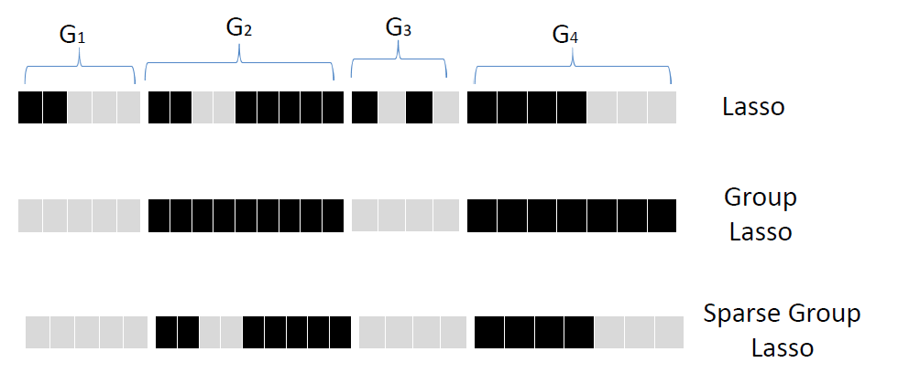
Structured features: Group Example: (Sparse) Group Lasso

Slide 32
Structured features: Tree
Allows hierarchical groups
Features are leafs
Subtrees more likely to be discarded/accepted at once
e.g. Tree structured group Lasso

Slide 33
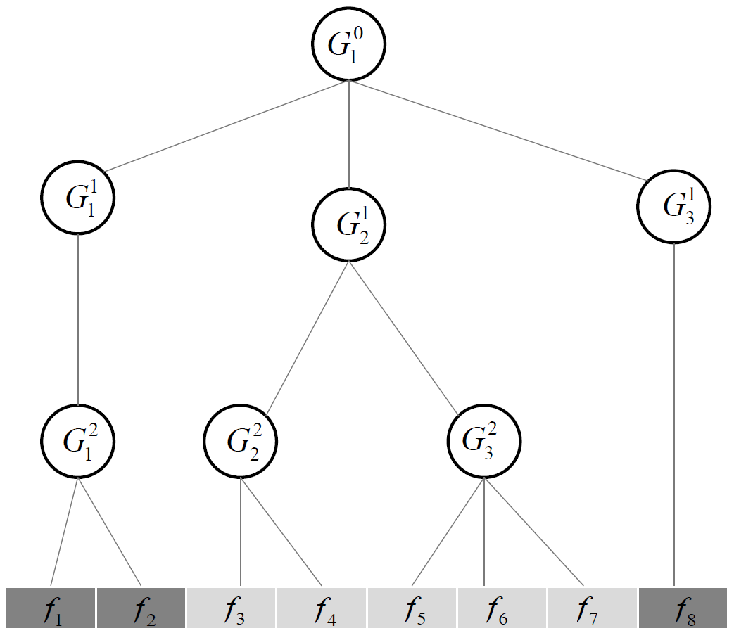
Structured features: Tree Example: Tree structured group Lasso

Slide 34
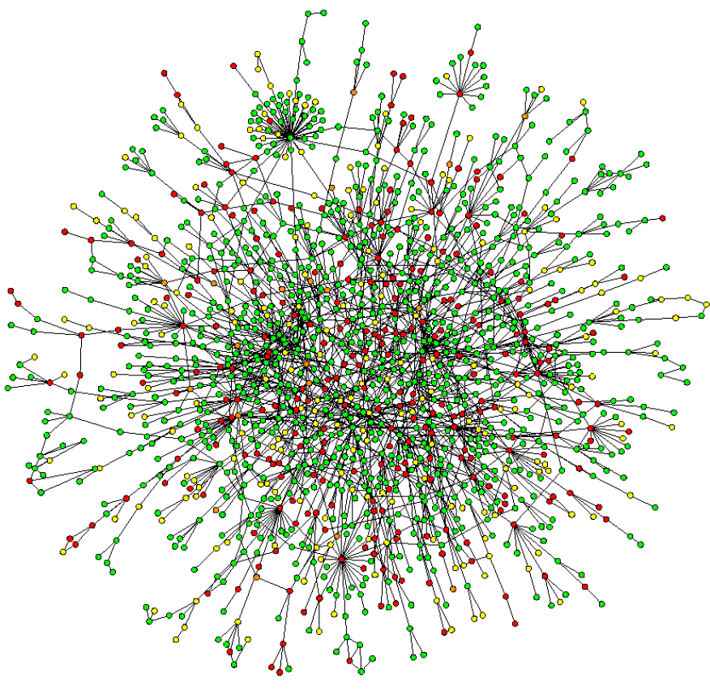
Structured features: Graph
Related features form
a graph
Likely to accept/
discard connected-
components at once
e.g. Graph Lasso

Slide 35
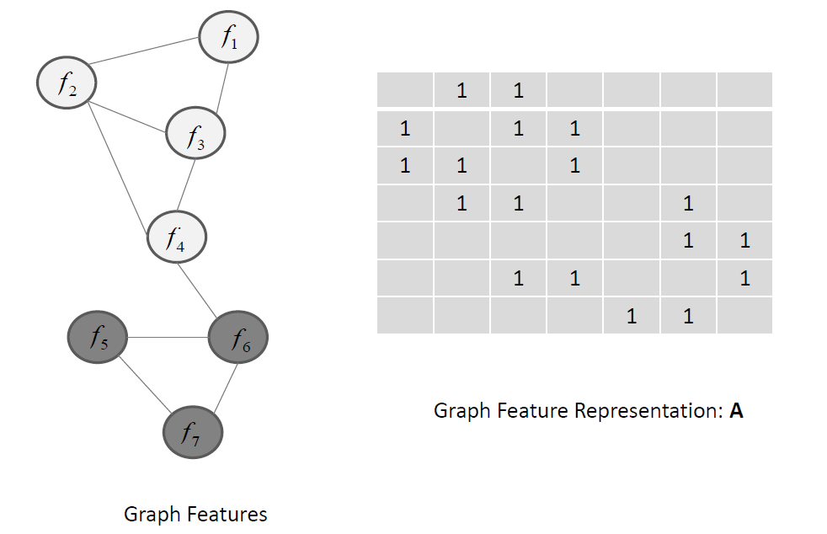
Structured features: Tree Example: Graph Lasso

Slide 36
Structured features: Graph
Related features form
a graph
Likely to accept/
discard connected-
components at once
e.g. Graph Lasso

Slide 37
Streaming features
Handle dynamically changing amount of features
Social Media

Slide 38
Streaming feature methods
“Generate” new feature
Check if feature is worth adding
Check whether to remove other features

Slide 39
Applications
Techniques
Classification / pattern recognition
Data representation
Fields
DNA microarray data
Text
Pictures
Videos
…

Slide 40
Literature
B RANK , J., G ROBELNIK , M., M ILIC -F RAYLING , N., AND M LADENIC , D. 2002. Feature selection using linear support vector machines.
E PPSTEIN , M., AND H AAKE , P. 2008. Very large scale relieff for genome-wide association analysis. In Computational Intelligence in Bioinformatics and Computational Biology, 2008.
F ROHLICH , H., C HAPELLE , O., AND S CHOLKOPF , B. 2003. Feature selection for support vector machines by means of genetic algorithm. In Tools with Artificial Intelligence, 2003.
H OLLAND , J. H. 1992. Adaptation in Natural and Artificial Systems: An Introductory Analysis with Applications to Biology, Control and Artificial Intelligence. MIT Press, Cambridge, MA, USA.
H UANG , J., H OROWITZ , J. L., AND M A , S. 2008. Asymptotic properties of bridge estimators in sparse high-dimensional regression models. The Annals of Statistics, 587–613.
J ACOB , L., O BOZINSKI , G., AND V ERT , J.-P. 2009. Group lasso with overlap and graph lasso. In Proceedings of the 26th annual international conference on machine learning, ACM, 433–440.
J ENATTON , R., M AIRAL , J., B ACH , F. R., AND O BOZINSKI , G. R. 2010. Proximal methods for sparse hierarchical dictionary learning. In Proceedings of the 27th International Conference on Machine Learning (ICML-10), 487–494.
J IN , X., L I , R., S HEN , X., AND B IE , R. 2007. Automatic web pages categorization with relieff and hidden naive bayes. In Proceedings of the 2007 ACM Symposium on Applied Computing, ACM, New York, NY, USA, SAC ’07, 617–621.
K IM , S., AND X ING , E. P. 2010. Tree-guided group lasso for multi-task regression with structured sparsity.
K IRA , K., AND R ENDELL , L. A. 1992. The feature selection problem: Traditional methods and a new algorithm. In Proceedings of the Tenth National Conference on Artificial Intelligence, AAAI Press, AAAI’92, 129–134.
K NIGHT , K., AND F U , W. 2000. Asymptotics for lasso-type estimators. Annals of statistics, 1356–1378.

Slide 41
Literature
K OHAVI , R., AND J OHN , G. H. 1997. Wrappers for feature subset selection. ARTIFICIAL INTELLIGENCE 97, 1, 273–324.
K ONONENKO , I., S IMEC , E., AND R OBNIK - ˇ S IKONJA , M. 1997. Overcoming the myopia of inductive learning algorithms with relieff. Applied Intelligence 7, 1 (Jan.), 39–55.
K UDO , M., AND S KLANSKY , J. 2000. Comparison of algorithms that select features for pattern classifiers. Pattern Recognition 33, 1, 25 – 41.
L EE , L IU , L. W. 2015. Very large scale relieff algorithm on gpu for genome-wide association study. 78 – 84.
L IU , J., AND Y E , J. 2010. Moreau-yosida regularization for grouped tree structure learning. In Advances in Neural Information Processing Systems, 1459–1467.
M AO , K. 2004. Orthogonal forward selection and backward elimination algorithms for feature subset selection. Systems, Man, and Cybernetics, Part B: Cybernetics, IEEE Transactions on 34, 1 (Feb), 629–634.
M OORE , J. H., AND W HITE , B. C. 2007. Tuning relieff for genome-wide genetic analysis. In Proceedings of the 5th European Conference on Evolutionary Computation, Machine Learning and Data Mining in Bioinformatics, Springer-Verlag, Berlin, Heidelberg, EvoBIO’07, 166–175.
N AKARIYAKUL , S., AND C ASASENT , D. P. 2007. Adaptive branch and bound algorithm for selecting optimal features. Pattern Recognition Letters 28, 12, 1415 – 1427.
N AKARIYAKUL , S., AND C ASASENT , D. P. 2008. Improved forward floating selection algorithm for feature subset selection. In Wavelet Analysis and Pattern Recognition, 2008. ICWAPR ’08. International Conference on, vol. 2, 793–798.
N ARENDRA , P. M., AND F UKUNAGA , K. 1977. A branch and bound algorithm for feature subset selection. Computers, IEEE Transactions on C-26, 9 (Sept), 917–922.
O H , I.-S., L EE , J.-S., AND M OON , B.-R. 2004. Hybrid genetic algorithms for feature selection. Pattern Analysis and Machine Intelligence,

Slide 42
Literature
P UDIL , P., N OVOVI ˇ COV ´ A , J., AND K ITTLER , J. 1994. Floating search methods in feature selection. Pattern Recogn. Lett. 15, 11 (Nov.),1119–1125.
Q UINLAN , J. R. 1986. Induction of decision trees. Machine learning 1, 1, 81–106.
R OBNIK -S IKONJA , M., AND K ONONENKO , I. 1997. An adaptation of relief for attribute estimation in regression. In Proceedings of the Fourteenth International Conference on Machine Learning, Morgan Kaufmann Publishers Inc., San Francisco, CA, USA, ICML ’97, 296–304.
S ALZBERG , S. L. 1994. C4. 5: Programs for machine learning by j. ross quinlan. morgan kaufmann publishers, inc., 1993. Machine Learning 16, 3, 235–240.
S OMOL , P., P UDIL , P., AND K ITTLER , J. 2004. Fast branch amp; bound algorithms for optimal feature selection. Pattern Analysis and Machine Intelligence, IEEE Transactions on 26, 7 (July), 900–912.
T ANG , J., A LELYANI , S., AND L IU , H. 2014. Feature selection for classification: A review. Data Classification: Algorithms and Applica- tions, 37.
T ANG , J., A LELYANI , S., AND L IU , H. 2014. Feature selection for classification: A review. Data Classification: Algorithms and Applica- tions, 37.
T IBSHIRANI , R. 1996. Regression shrinkage and selection via the lasso. Journal of the Royal Statistical Society. Series B (Methodological), 267–288.
V ERIKAS , A., AND B ACAUSKIENE , M. 2002. Feature selection with neural networks. Pattern Recogn. Lett. 23, 11 (Sept.), 1323–1335.
Z OU , H., AND H ASTIE , T. 2005. Regularization and variable selection via the elastic net. Journal of the Royal Statistical Society: Series B (Statistical Methodology) 67, 2, 301–320.
Z OU , H. 2006. The adaptive lasso and its oracle properties. Journal of the American statistical association 101, 476, 1418–1429

Slide 43
Questions? Discussion!

