Slide 1
Feature Selection for media classification
Silvana Podaras & Florian Schober

Slide 2




Motivation
quantify

Slide 3
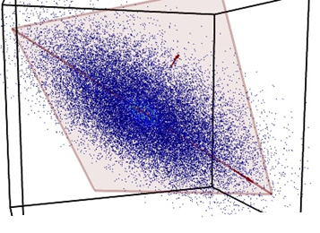
Motivation

Slide 4
Motivation
Select relevant ones!

Slide 5
Motivation
Remove redundancy
Expressive representation of data
More accurate classification
Speed up computation time

Slide 6
Feature selection
NO new features!
Select relevant subset
Discriminating features
Notes:
Relevant = depends on application, but in genereal: Discriminating feature = when looking at the feature, clear classification can be done
No redundancy = two features should not lead to same information

Slide 7
Feature Types
Flat Features
→ Independent
Structured
→ of certain structure

Slide 8
Flat Features
No information about structure needed
No relation to each other
Outperformed by structured feature methods

Slide 9

Methods for flat features
Filter
Wrapper
Embedded

Slide 10
Filter methods
Filter out relevant features
Independent of classification algorithm
Computationally efficient
No optimal performance guaranteed

Slide 11
Filter methods
Rank features
Chose features with highest rankings, induce classification models

Slide 12
Example: RELIEF
Binary classification
Represent features by weights in a vector
Pick one random, calculate near-hot and near miss
Update weights
Choose features with highest weights

Slide 13
Wrapper methods
Consider classification algortihm
Select features that fit classifier best
Computationally expensive!
Not flexible (cannot change classifier afterwards)
Notes:
Fit classifier best = consider biases and heuristics of a classifier optimally

Slide 14
Wrapper methods
Search for potential subset
Estimate performance on classifier
Iterate until desired quality achieved
F.example: Branch and bound, genetic algorithms
Notes:
Search: different algorithms possible
Evaluation/Estimation: Test set, cross validation – uses the classifier
Finally: Use subset with best performance to train classifier, and use it for actual classification task (normally after testing with testset independent from training set)

Slide 15
Example: Genetic algorithms
Search for potential subset
Estimate performance on classifier
Iterate until desired quality achieved
F.example: Branch and bound, genetic algorithms
Notes:
Search: different algorithms possible
Evaluation/Estimation: Test set, cross validation – uses the classifier
Finally: Use subset with best performance to train classifier, and use it for actual classification task (normally after testing with testset independent from training set)

Slide 16
Embedded methods
Hybrid method
Computationally efficient
Higher quality for classification
F.ex. SVM, Logistic regression

Slide 17
Embedded methods
PAPER: “In regularization methods, classifier induction and feature selection are achieved simultaneously by estimating w with properly tuned penalties.”

Slide 18
Structured features
Certain assumption about structure
Outperform flat feature methods
(Bsp tree-structure - evtl sogar was konkretes, f.ex. alter/jahre/monate ?!)

Slide 19
Methods for structured features
Group
Tree
Graph
(evtl 1-2 bsp pro art, fortführendes zeug?)

Slide 20
Applications
Classification/ pattern recognition
Data representation
Prediction

Slide 21
Questions?

Slide 22
Literature

