Slide 1
Feature Selection for media classification
Silvana Podaras & Florian Schober

Slide 2





Motivation
Features

Slide 3
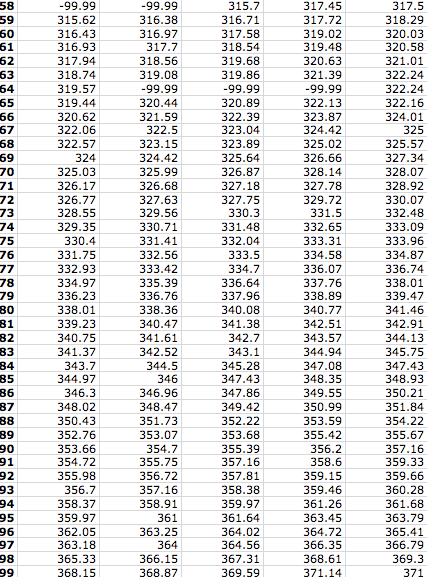
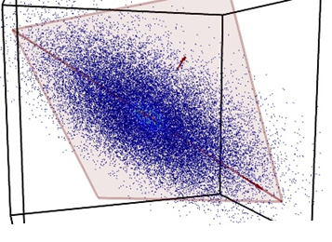
Motivation – High Dimensionality
Many Samples
Many Features

Slide 4
Motivation
Remove redundancy
Expressive representation of data
More accurate classification
Speed up computation time

Slide 5
Structured features
Certain assumption about structure
Select/discard related features
Usually outperforms flat feature methods

Slide 6
Methods for structured features
Group
Tree
Graph

Slide 7
Structured features: Group
Cluster features into groups
Groups more likely to be selected completely
Challenges:
Group- or feature-selection?
Overlapping groups
e.g. Sparse Group Lasso

Slide 8
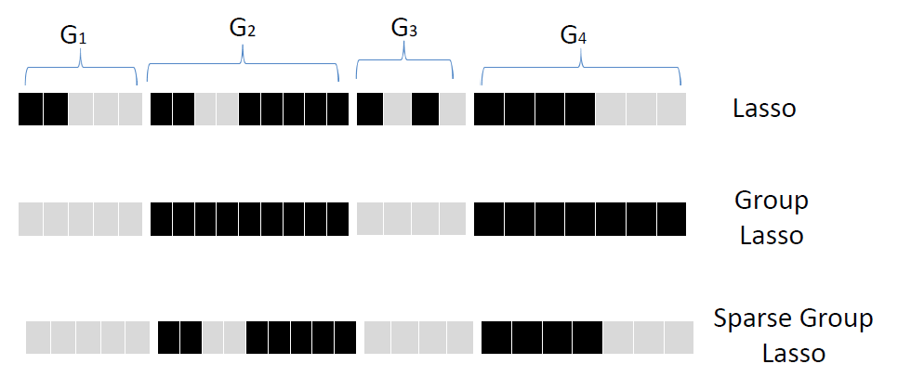
Structured features: Group Example: (Sparse) Group Lasso

Slide 9
Structured features: Tree
Allows hierarchical groups
Features are leafs
Can discard subtrees at once
e.g. Tree structured group Lasso

Slide 10
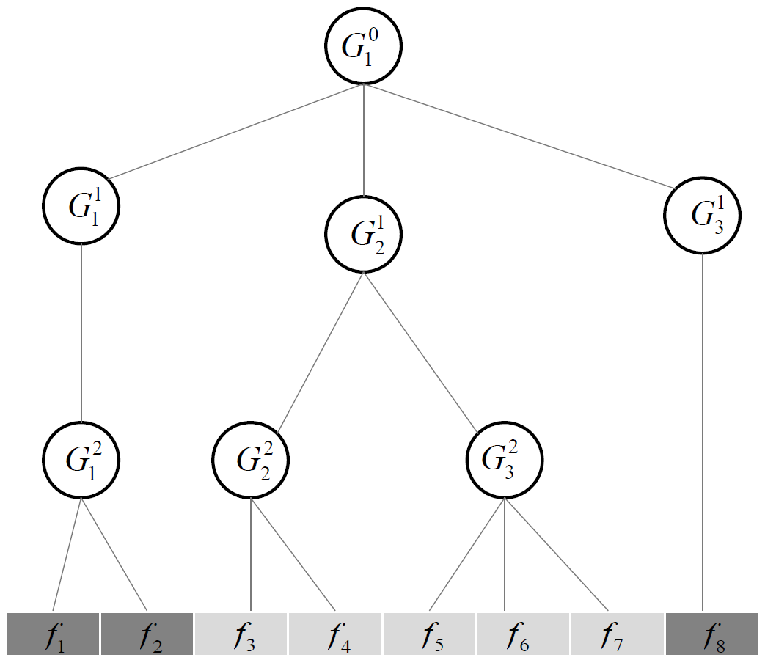
Structured features: Tree Example: Tree structured group Lasso

Slide 11
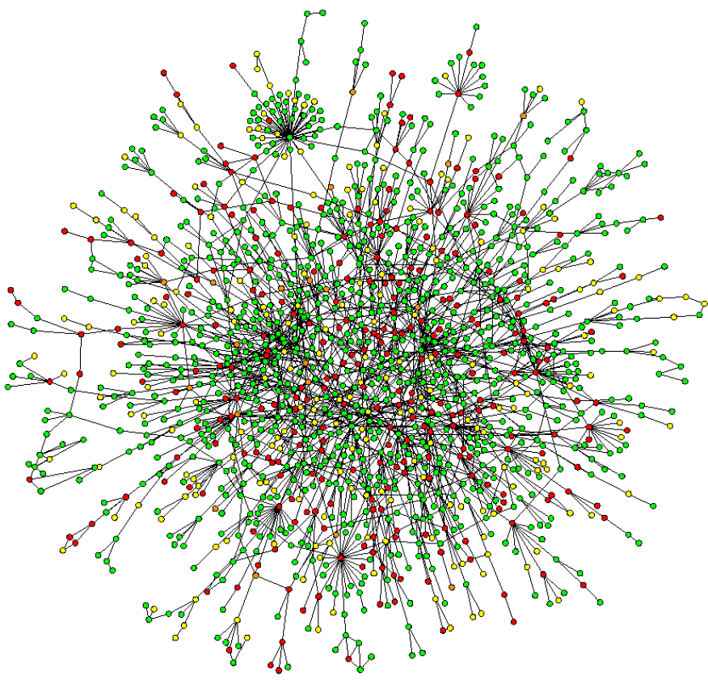
Structured features: Graph
Related features form
a graph
Likely to accept/
discard connected-
components at once
e.g. Graph Lasso

Slide 12
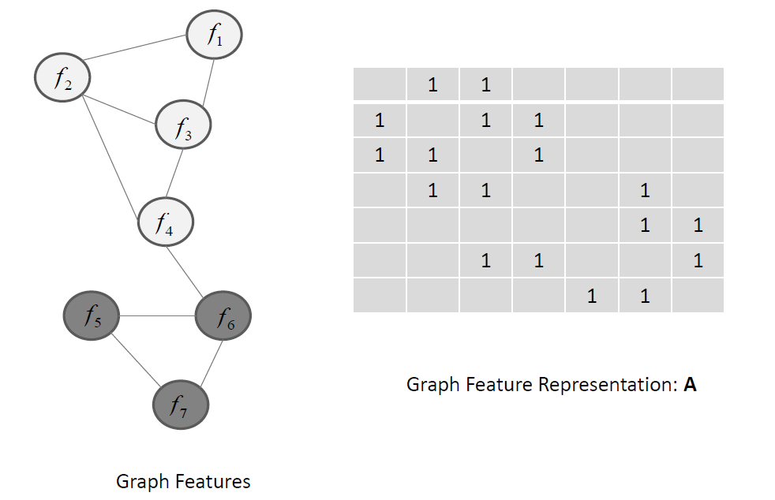
Structured features: Tree Example: Graph Lasso

Slide 13
Applications
Classification / pattern recognition
Data representation
Prediction

Slide 14
Literature
B RANK , J., G ROBELNIK , M., M ILIC -F RAYLING , N., AND M LADENIC , D. 2002. Feature selection using linear support vector machines.
E PPSTEIN , M., AND H AAKE , P. 2008. Very large scale relieff for genome-wide association analysis. In Computational Intelligence in Bioinformatics and Computational Biology, 2008.
F ROHLICH , H., C HAPELLE , O., AND S CHOLKOPF , B. 2003. Feature selection for support vector machines by means of genetic algorithm. In Tools with Artificial Intelligence, 2003.
H OLLAND , J. H. 1992. Adaptation in Natural and Artificial Systems: An Introductory Analysis with Applications to Biology, Control and Artificial Intelligence. MIT Press, Cambridge, MA, USA.
H UANG , J., H OROWITZ , J. L., AND M A , S. 2008. Asymptotic properties of bridge estimators in sparse high-dimensional regression models. The Annals of Statistics, 587–613.
J ACOB , L., O BOZINSKI , G., AND V ERT , J.-P. 2009. Group lasso with overlap and graph lasso. In Proceedings of the 26th annual international conference on machine learning, ACM, 433–440.
J ENATTON , R., M AIRAL , J., B ACH , F. R., AND O BOZINSKI , G. R. 2010. Proximal methods for sparse hierarchical dictionary learning. In Proceedings of the 27th International Conference on Machine Learning (ICML-10), 487–494.
J IN , X., L I , R., S HEN , X., AND B IE , R. 2007. Automatic web pages categorization with relieff and hidden naive bayes. In Proceedings of the 2007 ACM Symposium on Applied Computing, ACM, New York, NY, USA, SAC ’07, 617–621.
K IM , S., AND X ING , E. P. 2010. Tree-guided group lasso for multi-task regression with structured sparsity.
K IRA , K., AND R ENDELL , L. A. 1992. The feature selection problem: Traditional methods and a new algorithm. In Proceedings of the Tenth National Conference on Artificial Intelligence, AAAI Press, AAAI’92, 129–134.
K NIGHT , K., AND F U , W. 2000. Asymptotics for lasso-type estimators. Annals of statistics, 1356–1378.

Slide 15
Literature
K OHAVI , R., AND J OHN , G. H. 1997. Wrappers for feature subset selection. ARTIFICIAL INTELLIGENCE 97, 1, 273–324.
K ONONENKO , I., S IMEC , E., AND R OBNIK - ˇ S IKONJA , M. 1997. Overcoming the myopia of inductive learning algorithms with relieff. Applied Intelligence 7, 1 (Jan.), 39–55.
K UDO , M., AND S KLANSKY , J. 2000. Comparison of algorithms that select features for pattern classifiers. Pattern Recognition 33, 1, 25 – 41.
L EE , L IU , L. W. 2015. Very large scale relieff algorithm on gpu for genome-wide association study. 78 – 84.
L IU , J., AND Y E , J. 2010. Moreau-yosida regularization for grouped tree structure learning. In Advances in Neural Information Processing Systems, 1459–1467.
M AO , K. 2004. Orthogonal forward selection and backward elimination algorithms for feature subset selection. Systems, Man, and Cybernetics, Part B: Cybernetics, IEEE Transactions on 34, 1 (Feb), 629–634.
M OORE , J. H., AND W HITE , B. C. 2007. Tuning relieff for genome-wide genetic analysis. In Proceedings of the 5th European Conference on Evolutionary Computation, Machine Learning and Data Mining in Bioinformatics, Springer-Verlag, Berlin, Heidelberg, EvoBIO’07, 166–175.
N AKARIYAKUL , S., AND C ASASENT , D. P. 2007. Adaptive branch and bound algorithm for selecting optimal features. Pattern Recognition Letters 28, 12, 1415 – 1427.
N AKARIYAKUL , S., AND C ASASENT , D. P. 2008. Improved forward floating selection algorithm for feature subset selection. In Wavelet Analysis and Pattern Recognition, 2008. ICWAPR ’08. International Conference on, vol. 2, 793–798.
N ARENDRA , P. M., AND F UKUNAGA , K. 1977. A branch and bound algorithm for feature subset selection. Computers, IEEE Transactions on C-26, 9 (Sept), 917–922.
O H , I.-S., L EE , J.-S., AND M OON , B.-R. 2004. Hybrid genetic algorithms for feature selection. Pattern Analysis and Machine Intelligence,

Slide 16
Literature
P UDIL , P., N OVOVI ˇ COV ´ A , J., AND K ITTLER , J. 1994. Floating search methods in feature selection. Pattern Recogn. Lett. 15, 11 (Nov.),1119–1125.
Q UINLAN , J. R. 1986. Induction of decision trees. Machine learning 1, 1, 81–106.
R OBNIK -S IKONJA , M., AND K ONONENKO , I. 1997. An adaptation of relief for attribute estimation in regression. In Proceedings of the Fourteenth International Conference on Machine Learning, Morgan Kaufmann Publishers Inc., San Francisco, CA, USA, ICML ’97, 296–304.
S ALZBERG , S. L. 1994. C4. 5: Programs for machine learning by j. ross quinlan. morgan kaufmann publishers, inc., 1993. Machine Learning 16, 3, 235–240.
S OMOL , P., P UDIL , P., AND K ITTLER , J. 2004. Fast branch amp; bound algorithms for optimal feature selection. Pattern Analysis and Machine Intelligence, IEEE Transactions on 26, 7 (July), 900–912.
T ANG , J., A LELYANI , S., AND L IU , H. 2014. Feature selection for classification: A review. Data Classification: Algorithms and Applica- tions, 37.
T ANG , J., A LELYANI , S., AND L IU , H. 2014. Feature selection for classification: A review. Data Classification: Algorithms and Applica- tions, 37.
T IBSHIRANI , R. 1996. Regression shrinkage and selection via the lasso. Journal of the Royal Statistical Society. Series B (Methodological), 267–288.
V ERIKAS , A., AND B ACAUSKIENE , M. 2002. Feature selection with neural networks. Pattern Recogn. Lett. 23, 11 (Sept.), 1323–1335.
Z OU , H., AND H ASTIE , T. 2005. Regularization and variable selection via the elastic net. Journal of the Royal Statistical Society: Series B (Statistical Methodology) 67, 2, 301–320.
Z OU , H. 2006. The adaptive lasso and its oracle properties. Journal of the American statistical association 101, 476, 1418–1429

Slide 17
Questions? Discussion!

