Slide 1

Job Management system
Teo Jia Jun

Slide 2
Overview
Introduction
Project Background, Objectives and Scopes
Methodology
Design
Demo
QnA

Slide 3
Project Background, Objectives and Scopes
A platform to manage all kinds of the jobs.
Find the jobs easily.
Manage the vacancies and internship company list.
Students, Job Providers, Admin

Slide 4
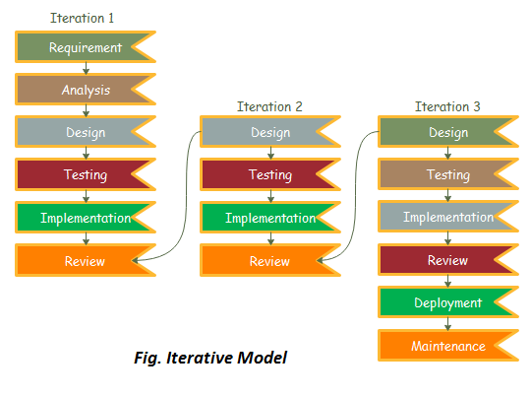
Methodology
Iterative Model
Changes easily
Agile

Slide 5
Design
9 sub functions:
1. Register System
2. Manage Register Request System
3. Login System
4. Find Job System
5. Contact System
6. Feedback System
7. Profile System
8. Provide Job System
9. Apply System

Slide 6
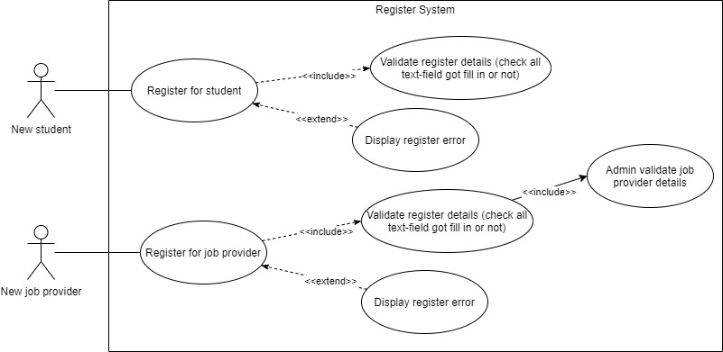
Register System

Slide 7
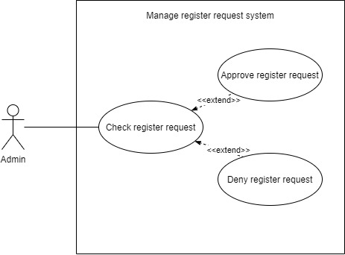
Manage Register Request System

Slide 8
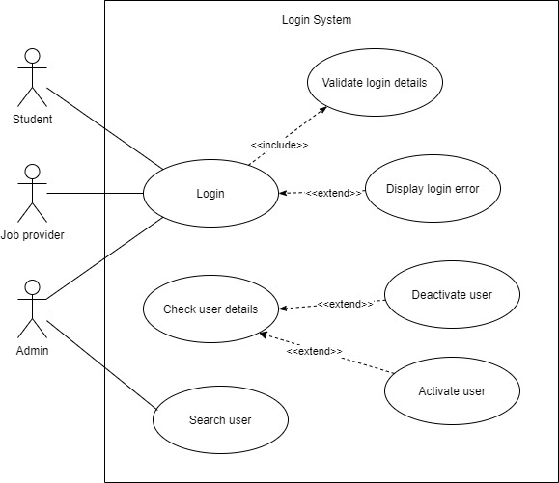
Login System

Slide 9
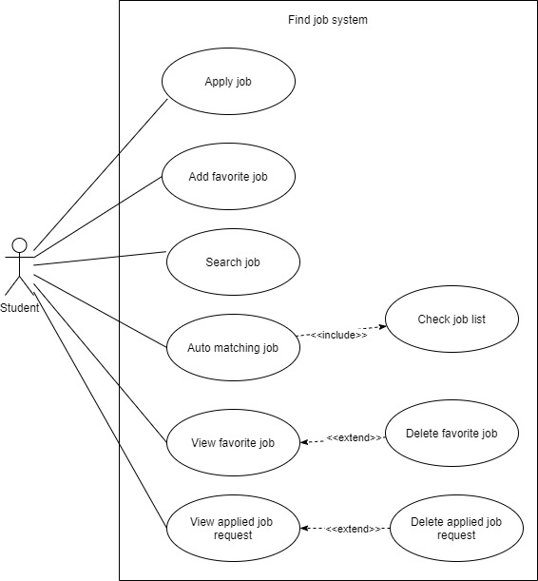
Find Job System

Slide 10
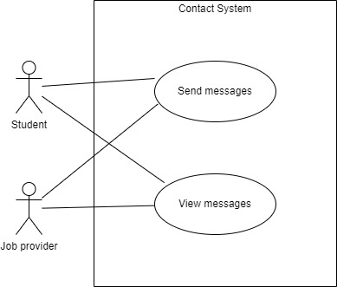
Contact System

Slide 11
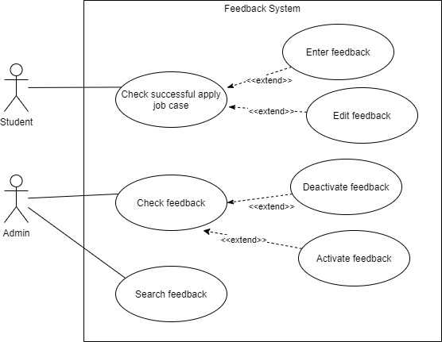
Feedback System

Slide 12
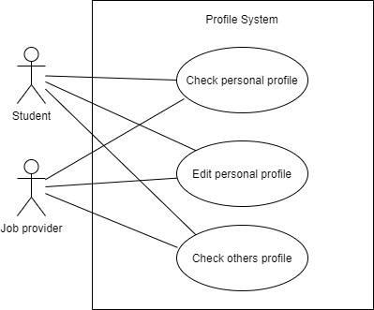
Profile System

Slide 13
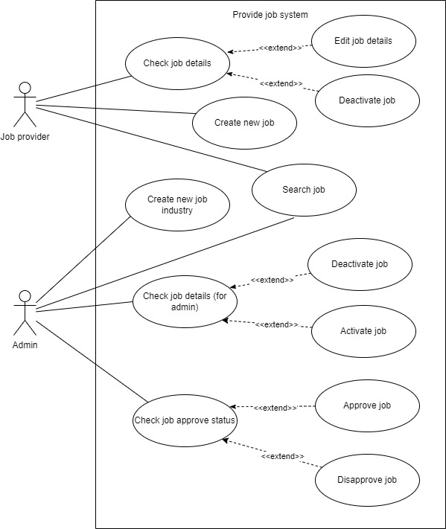
Provide Job System

Slide 14
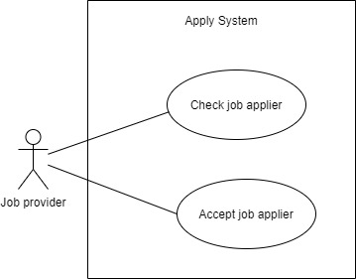
Apply System

Slide 15
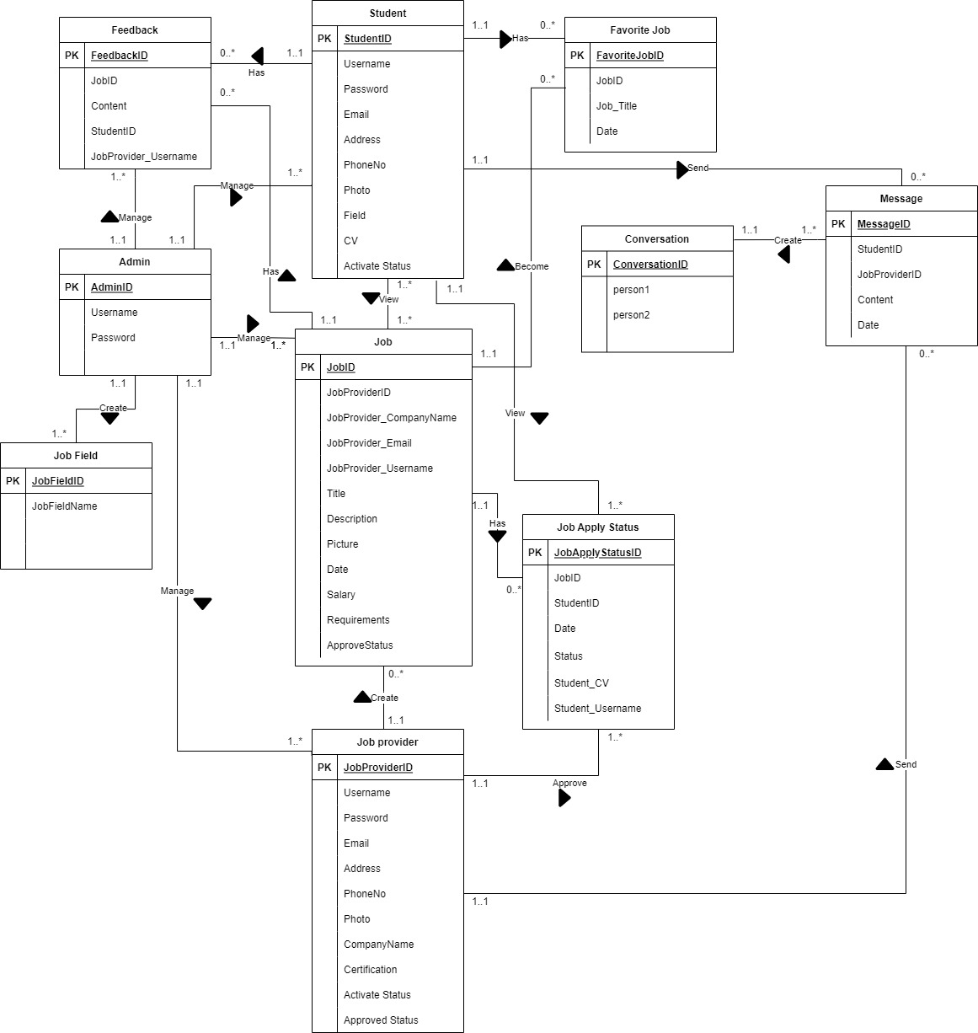
ER Diagram

Slide 16
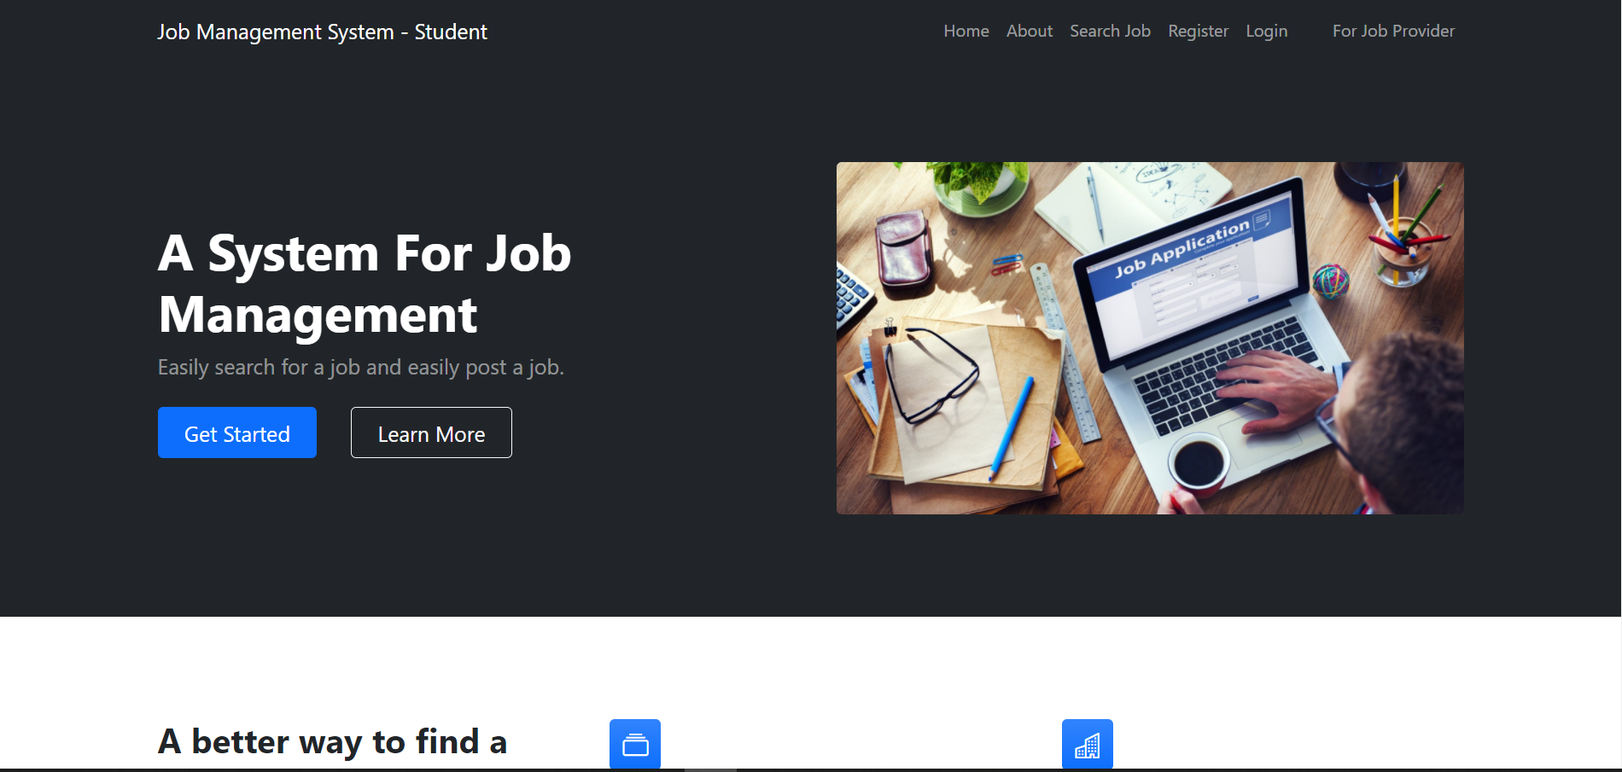
Demo

Slide 17

QnA

Slide 18


