Slide 1
G2 Sarmad Yousif Simon Zeer Sari Yono This site allows students to prepare for one standardized English test in reading and writing online. This site also allows students to practice their test questions and then take the actual test. Type of the standardized test is your decision, which can be chosen from ACT with areas of English and Reading, SAT with areas of Writing and Reading, or STEP test in Reference. To simplify implementation, listening comprehension is not required to support.

Slide 2
What tools we used? ERD design : LucidChart. Mockups: Cacco. IDE: phpStorm. Language: PHP ,HTML,CSS. Database: ANY ( we used an ORM) so any relational database given that it has a driver for PHP. Frameworks: Laravel. Server Platform: Ubuntu with Nginx as web server. Version Control: Git.

Slide 3
Features
Password recovery. Ability to choose practice or test type. Ability to choose Difficulty level. Ability to choose number of questions for practice test. Instant score review. Instant feed back. Easy access to history usage.

Slide 4
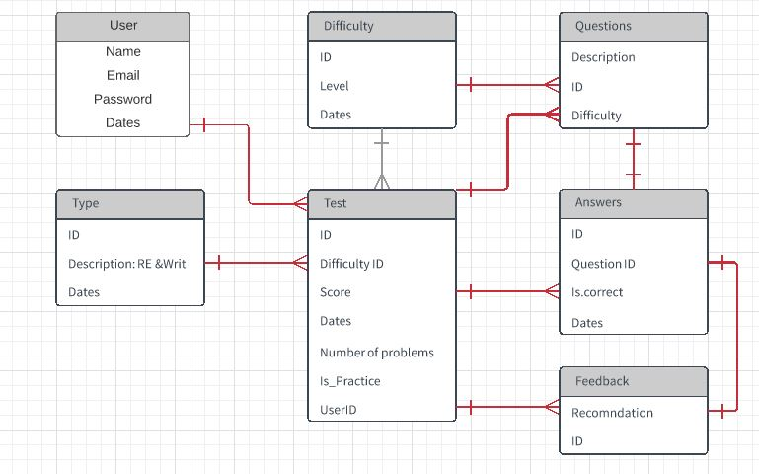

Slide 5
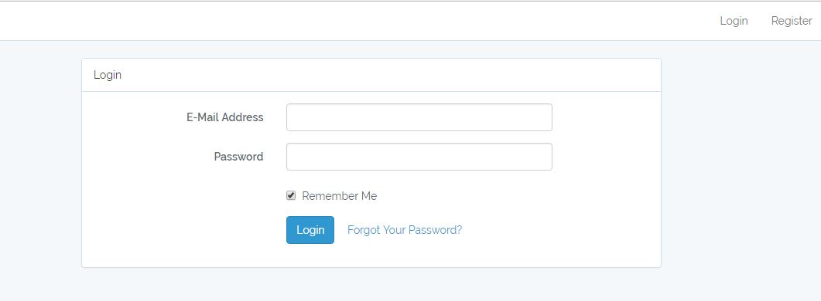
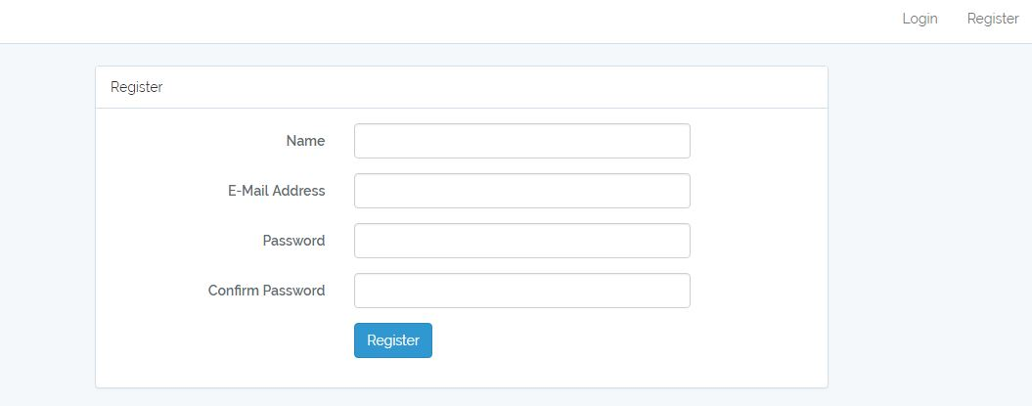

Slide 6
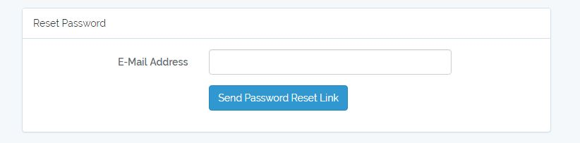
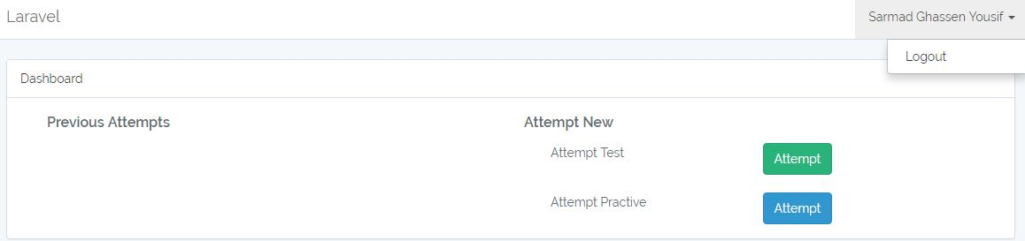
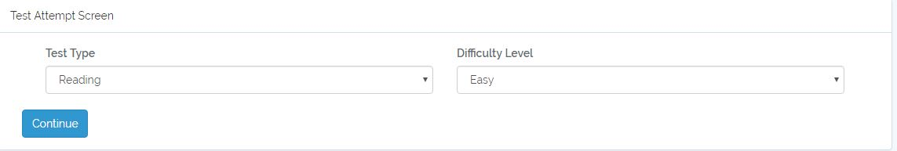


Slide 7
Future Improvements: larger questions database. Better enhanced feedback. Advanced frontend design. Better Security. More test types. Better scalability. Transactional emails.

