Slide 1
SOCIAL MEDIA APP
Containerized Deployment: Architecture & Configuration Deep-Dive
Architecture · every configuration file · load balancing · load test results
Individual project — infrastructure course exemption assignment

Slide 2
What Was Built
Two existing app repositories, wrapped in production-style infrastructure
↔
📈
🔒
Load Balancer
Monitoring
TLS
Nginx reverse proxy, 2 backend replicas, round-robin routing
Netdata, auto-discovers every container, live dashboard
Self-signed certificate terminated at the load balancer
Application layer (unchanged): React/Vite frontend + Express/MongoDB REST API + JWT auth, posts, likes, comments, bookmarks

Slide 3
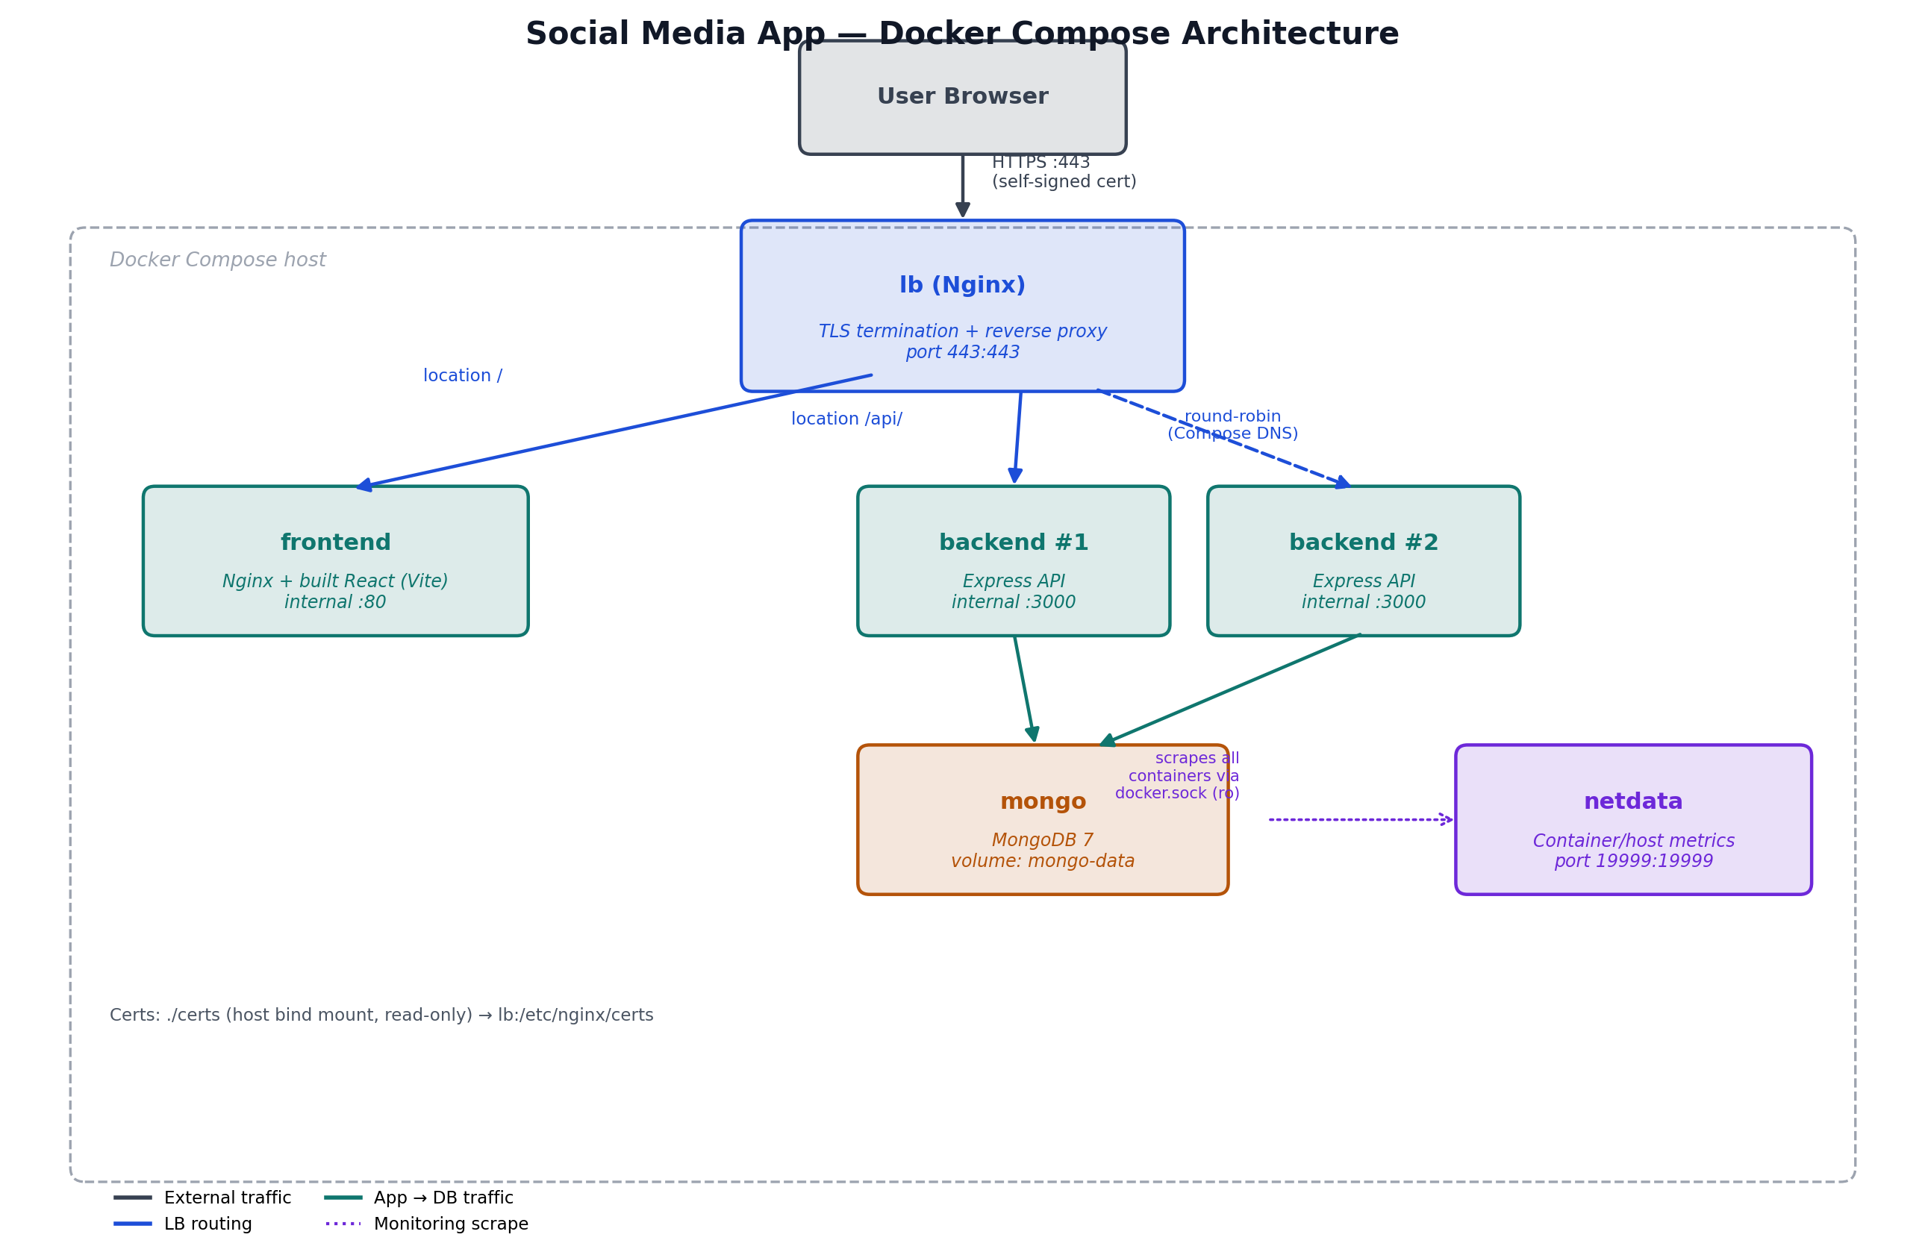
Architecture

Slide 4
SECTION 1 OF 2
Configuration Files
Every file that defines how the stack builds, connects, and runs

Slide 5
docker-compose.yml
Production stack — part 1 of 3: data layer and backend
docker-compose.yml
services:
mongo:
image: mongo:7
volumes:
- mongo-data:/data/db
backend:
build: ./social-media-api
environment:
DB_URI: mongodb://mongo:27017/api-db
SECRET: some-dev-secret
depends_on:
- mongo
deploy:
replicas: 2
expose:
- "3000"

Slide 6
docker-compose.yml
Production stack — part 2 of 3: frontend and load balancer
docker-compose.yml (continued)
frontend:
build:
context: ./planet-link
args:
VITE_BASE_URL: https://localhost/api
depends_on:
- backend
lb:
image: nginx:alpine
ports:
- "443:443"
volumes:
- ./nginx-lb.conf:/etc/nginx/conf.d/default.conf:ro
- ./certs:/etc/nginx/certs:ro
depends_on:
- backend
- frontend

Slide 7
docker-compose.yml
Production stack — part 3 of 3: monitoring and volumes
docker-compose.yml (continued)
netdata:
image: netdata/netdata
ports:
- "19999:19999"
cap_add:
- SYS_PTRACE
security_opt:
- apparmor:unconfined
volumes:
- /proc:/host/proc:ro
- /sys:/host/sys:ro
- /var/run/docker.sock:/var/run/docker.sock:ro
restart: unless-stopped
volumes:
mongo-data:

Slide 8
nginx-lb.conf
TLS termination and routing — the only service exposed to the host
nginx-lb.conf
upstream backend_servers {
server backend:3000;
}
server {
listen 443 ssl;
server_name localhost;
ssl_certificate /etc/nginx/certs/selfsigned.crt;
ssl_certificate_key /etc/nginx/certs/selfsigned.key;
location /api/ {
proxy_pass http://backend_servers/;
proxy_set_header Host $host;
proxy_set_header X-Real-IP $remote_addr;
}
location / {
proxy_pass http://frontend:80;
proxy_set_header Host $host;
}
}
Compose's embedded DNS resolves “backend” to both replicas — round-robin needs no extra config here.

Slide 9
Backend Dockerfiles
social-media-api — production build vs. hot-reload development build
Dockerfile (production)
Dockerfile.dev
FROM node:20-alpine
WORKDIR /app
COPY package*.json ./
RUN npm ci --omit=dev
COPY . .
EXPOSE 3000
CMD ["node", "server.js"]
FROM node:20-alpine
WORKDIR /app
COPY package*.json ./
RUN npm ci
COPY . .
EXPOSE 3000
CMD ["npx", "nodemon", "server.js"]
Dev keeps devDependencies and runs via nodemon for hot reload; prod installs lean and runs node directly.

Slide 10
Frontend Dockerfile
planet-link — multi-stage build: compile with Vite, serve with Nginx
Dockerfile
nginx.conf
FROM node:20-alpine AS build
WORKDIR /app
COPY package*.json ./
RUN npm ci
COPY . .
ARG VITE_BASE_URL
ENV VITE_BASE_URL=$VITE_BASE_URL
RUN npm run build
FROM nginx:alpine
COPY --from=build /app/dist /usr/share/nginx/html
COPY nginx.conf /etc/nginx/conf.d/default.conf
EXPOSE 80
server {
listen 80;
root /usr/share/nginx/html;
index index.html;
location / {
try_files $uri $uri/ /index.html;
}
}
VITE_BASE_URL is a build-time ARG, not a runtime ENV — Vite bakes it into the JS bundle, so changing it always requires a rebuild.

Slide 11
Development Mode
docker-compose.dev.yml — same services, swapped for hot reload
Bind mounts
./social-media-api:/app and ./planet-link:/app — edits on the host appear inside the container immediately.
Anonymous node_modules volume
/app/node_modules on both services — shadows the bind mount so the container's own Linux-built dependencies are never overwritten by the host's.
dockerfile: Dockerfile.dev
Points each build at its hot-reload image (nodemon for the backend, Vite's own dev server for the frontend) instead of the production image.
Ports opened directly
3000, 5173, and 27017 are all published straight to the host — no load balancer, no TLS, for fast local iteration.

Slide 12
Certificate Generation
certs/generate-cert.sh — one-time, self-signed, 365-day RSA 2048 cert
generate-cert.sh
#!/bin/sh
openssl req -x509 -nodes -days 365 -newkey rsa:2048 \
-keyout selfsigned.key \
-out selfsigned.crt \
-subj "/CN=localhost"
Windows Git Bash gotcha: prefix with MSYS_NO_PATHCONV=1 — otherwise the shell rewrites “/CN=localhost” into a Windows filesystem path before openssl ever sees it.

Slide 13
Load Balancing
Making the requirement functionally real, not nominal
The problem with a naive setup:
A reverse proxy in front of a single backend instance provides no actual load balancing — it's a proxy wearing an LB's name.
1
backend runs with deploy.replicas: 2
Two independent Express containers, same image, sharing one MongoDB.
2
Docker Compose's embedded DNS
Resolving the service name “backend” returns both replica IPs and round-robins automatically — no extra config.
3
Nginx (“lb”) proxies /api/ → backend_servers
The upstream block takes advantage of that round-robin on every new connection.

Slide 14
SECTION 2 OF 2
Validation
Proving the load balancer and monitoring actually work under load

Slide 15
Load Test & Monitoring
autocannon -c 100 -d 30 → http://localhost:3000/posts (single-replica baseline)
1,293
76.85
39,000
115
req/sec (avg)
ms avg latency
requests / 30s
ms p99 latency
Netdata confirmed the load was correctly attributed:
• CPU and network usage spiked clearly on the backend container during the test
• mongo and frontend containers remained flat throughout
• Confirms per-container monitoring, not just host-wide aggregate stats

Slide 16
Key Decisions
Choices made deliberately for this project's scope
Docker Compose, not Kubernetes
K8s overhead (ingress, etcd, manifests) is disproportionate for a single-host demo.
Nginx, not Traefik / HAProxy
Explicit, auditable config; the standard expected choice for this assignment.
2 backend replicas, not 1
Makes the load-balancer requirement functionally real.
Netdata, not Zabbix
Zero-config auto-discovery via the Docker socket vs. a server/agent/DB setup.
TLS terminated at the LB only
Centralizes certificate management to a single, auditable place.

Slide 17
Known Limitations
Documented scope decisions, not oversights
Second database
Redis considered (session/list caching) but omitted — no clear functional need without adding complexity for its own sake.
Keepalived / Corosync+Pacemaker
OS- and LB-level HA clustering judged disproportionate risk/effort for a single-host Compose deployment.
MongoDB single point of failure
No replica set configured; acceptable at demo scale, flagged explicitly rather than hidden.
Self-signed cert browser warning
Expected, correct behavior for any self-signed certificate — exactly what the assignment specifies.

Slide 18
Running the Project
Production stack
Development stack (hot reload)
cd certs && sh generate-cert.sh && cd ..
docker compose up -d --build
→ https://localhost
docker compose -f docker-compose.dev.yml \
up --build
Frontend → localhost:5173
Backend → localhost:3000
MongoDB → localhost:27017
Monitoring
http://localhost:19999

Slide 19
Live Demo
https://localhost — register, post, like, comment, bookmark

