Slide 1
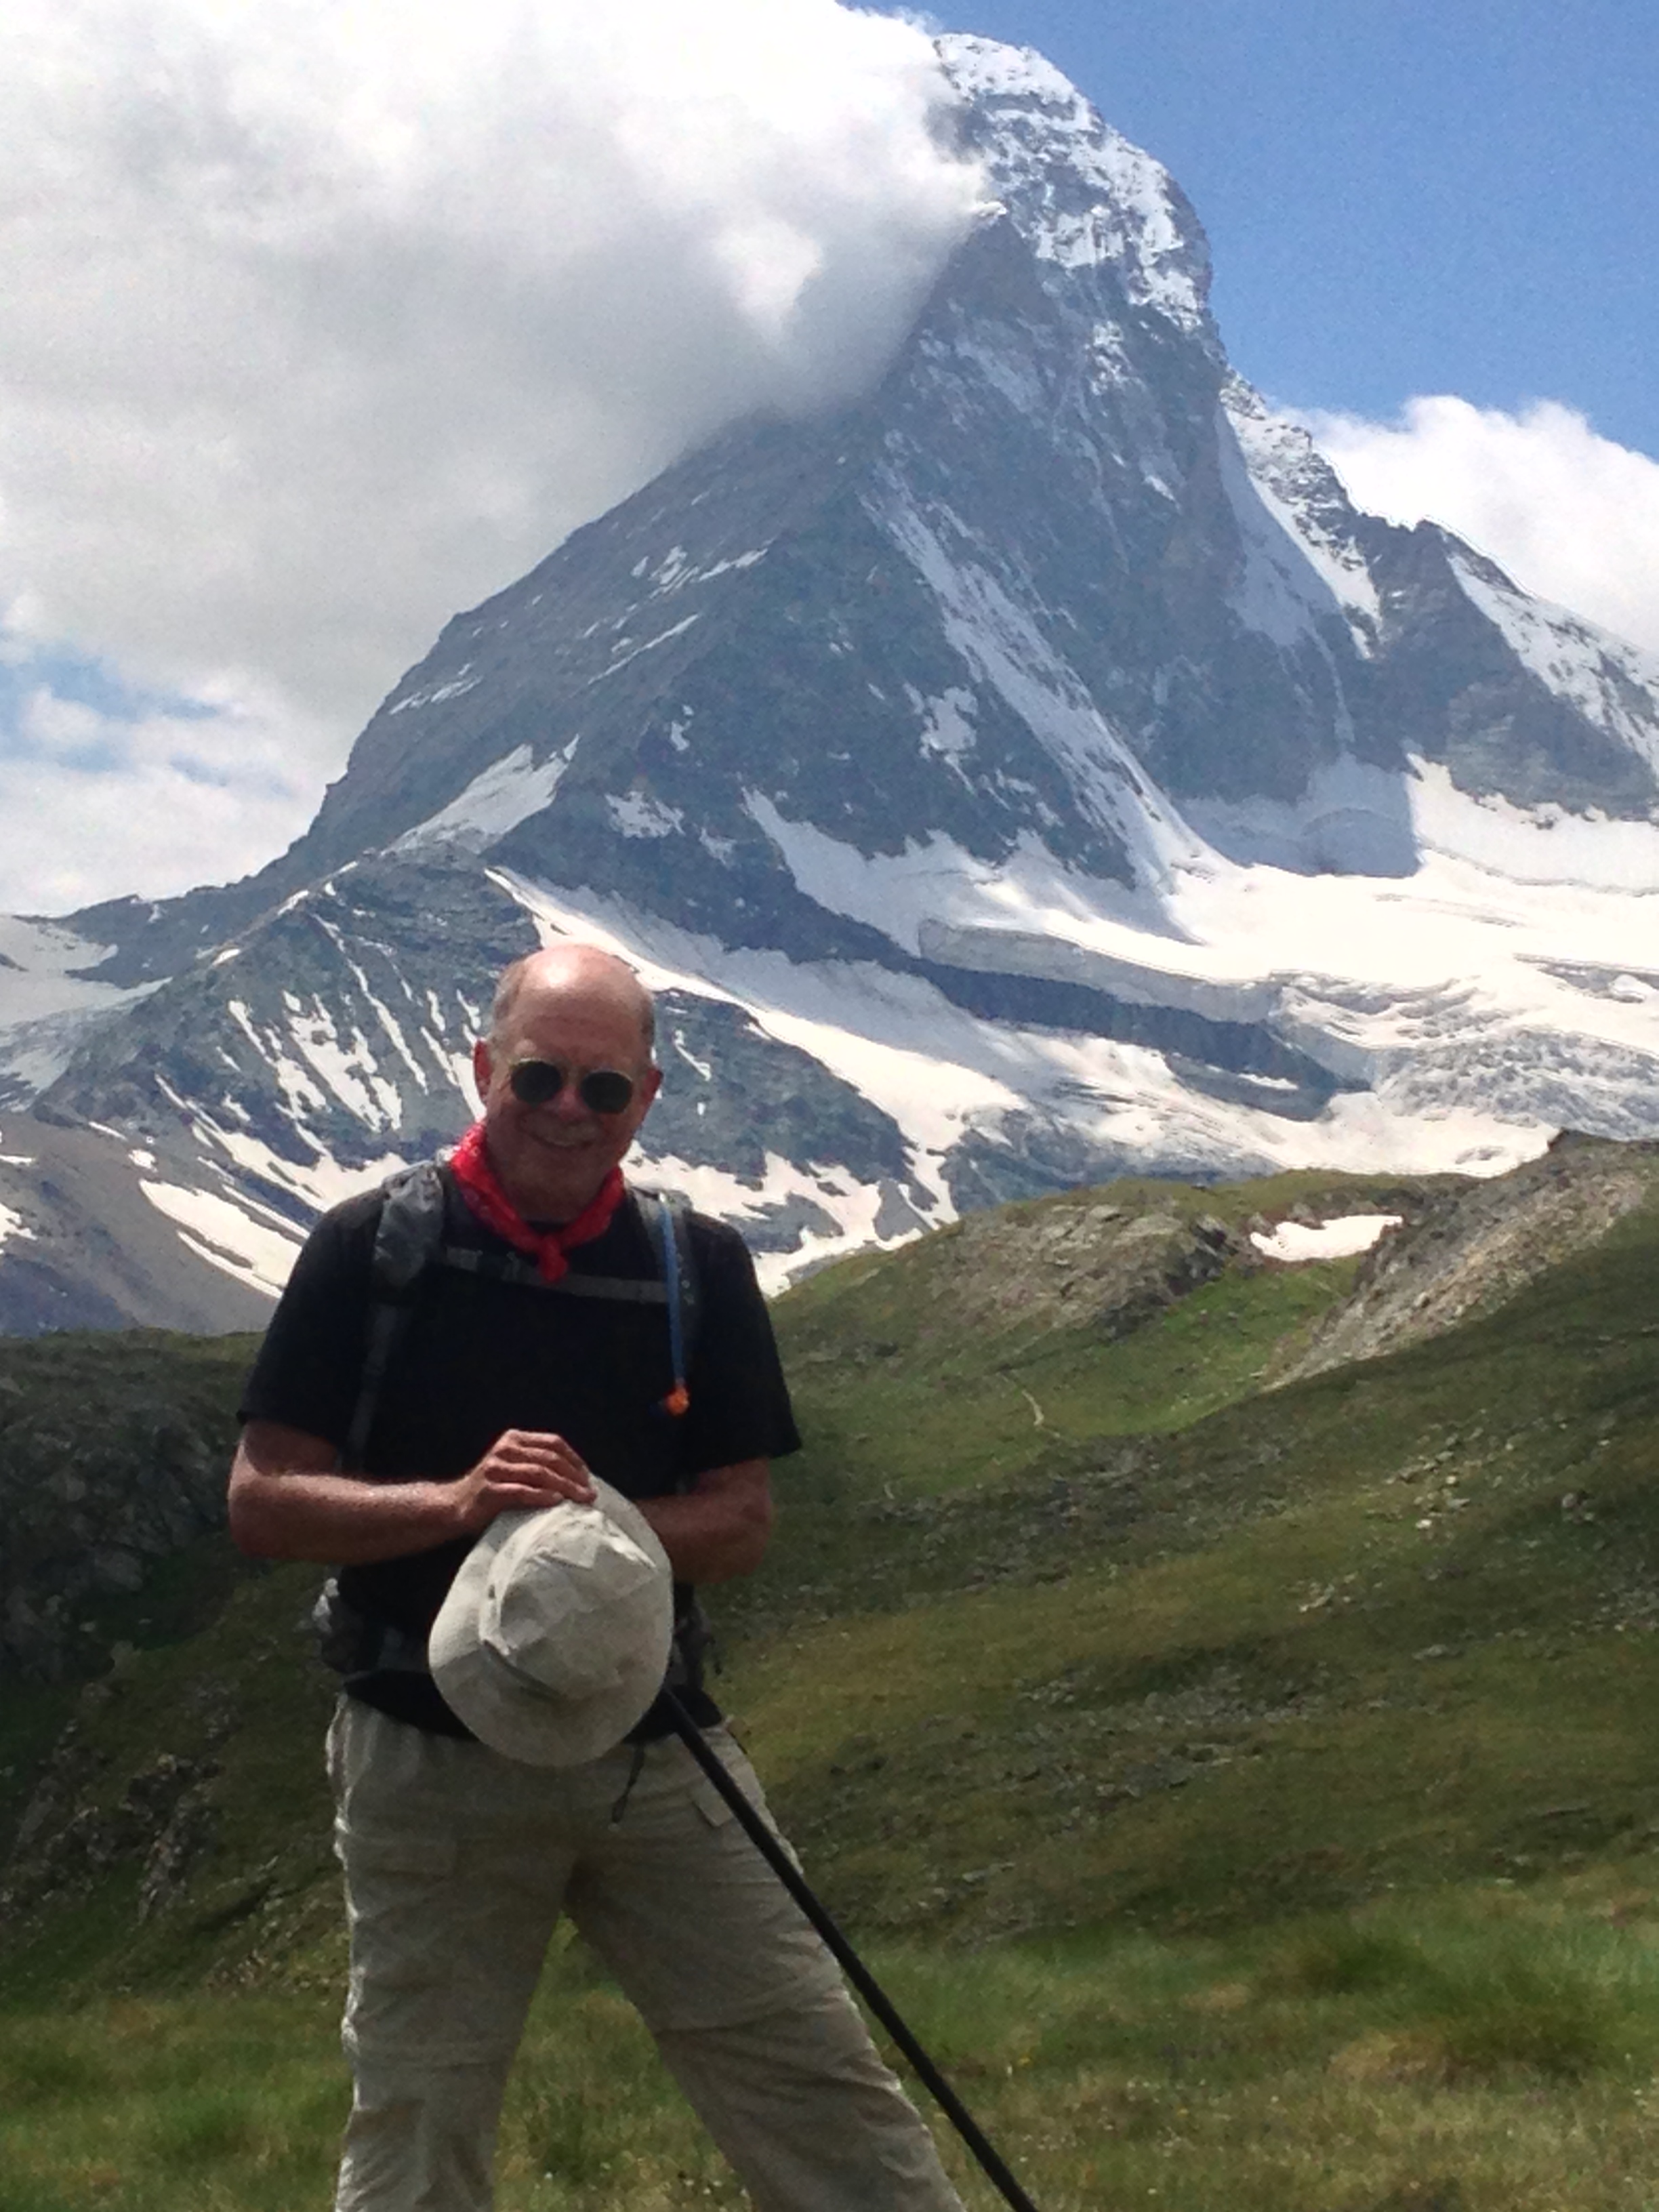
Out and About
Sights that caught my eye while walking around…

