Slide 1

Intelligent Automation for a Software-defined World

Slide 2





Who am I?
Erik Johnson
terminalmage
terminalmage
terminalmage
terminalmage
Notes:
In case you freeze and don’t remember:
Senior Core Engineer
Employed by SaltStack for a little over 5 years
Involved with the community for 6.5 years

Slide 3

What is SaltStack?
Notes:
Quick move to next slide

Slide 4
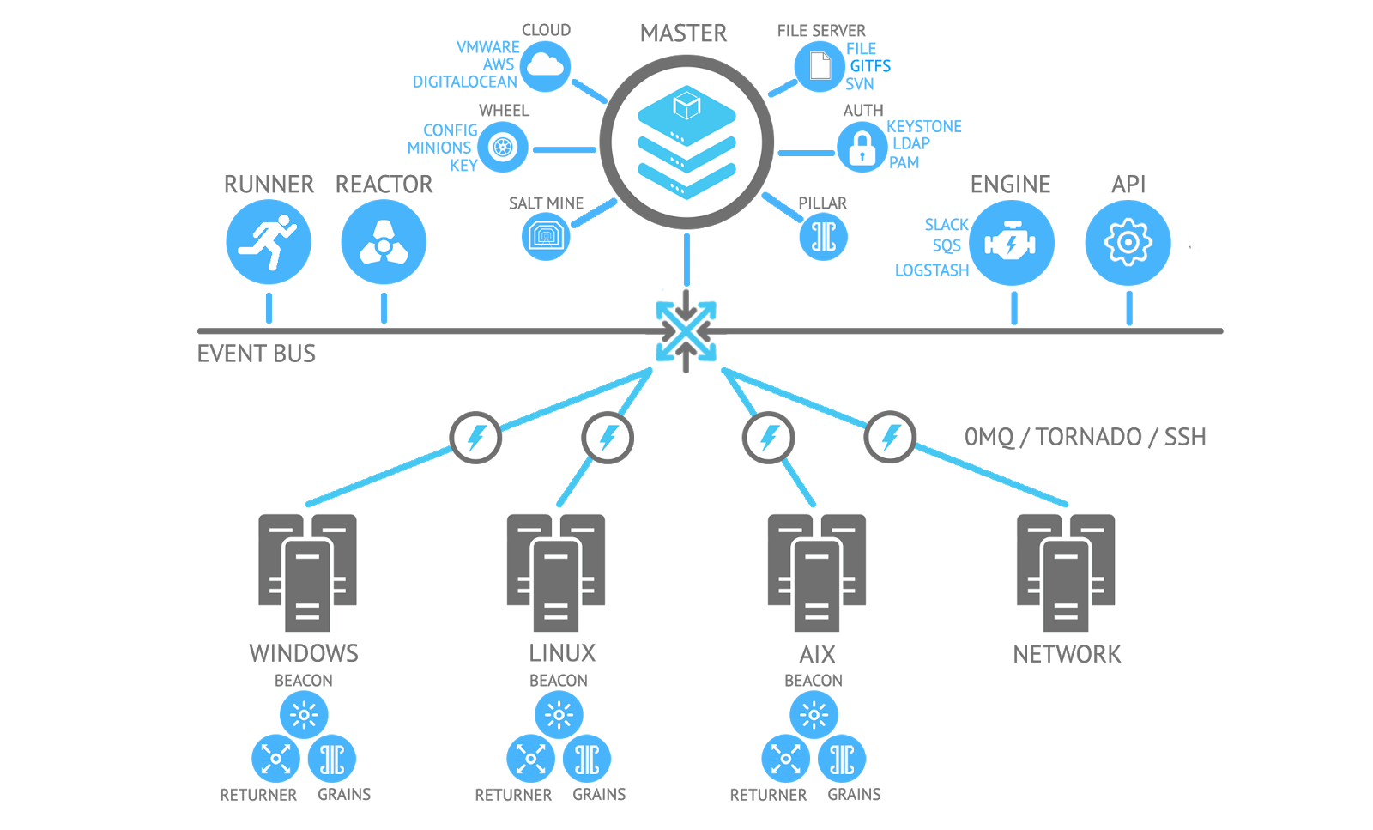
Notes:
“Well, Salt does a lot, so this is not always easy to answer. But nearly all of what it does is built upon a single concept.” (switch slide)

Slide 5

Remote Execution
Notes:
Salt was initially developed to very quickly run Python code and shell commands on a large number of machines in parallel. Back in my sysadmin days we would use tools like clusterssh to login to a dozen or so boxes at a time and run the same Cfengine command, but that doesn’t scale very well. (change slide)

Slide 6
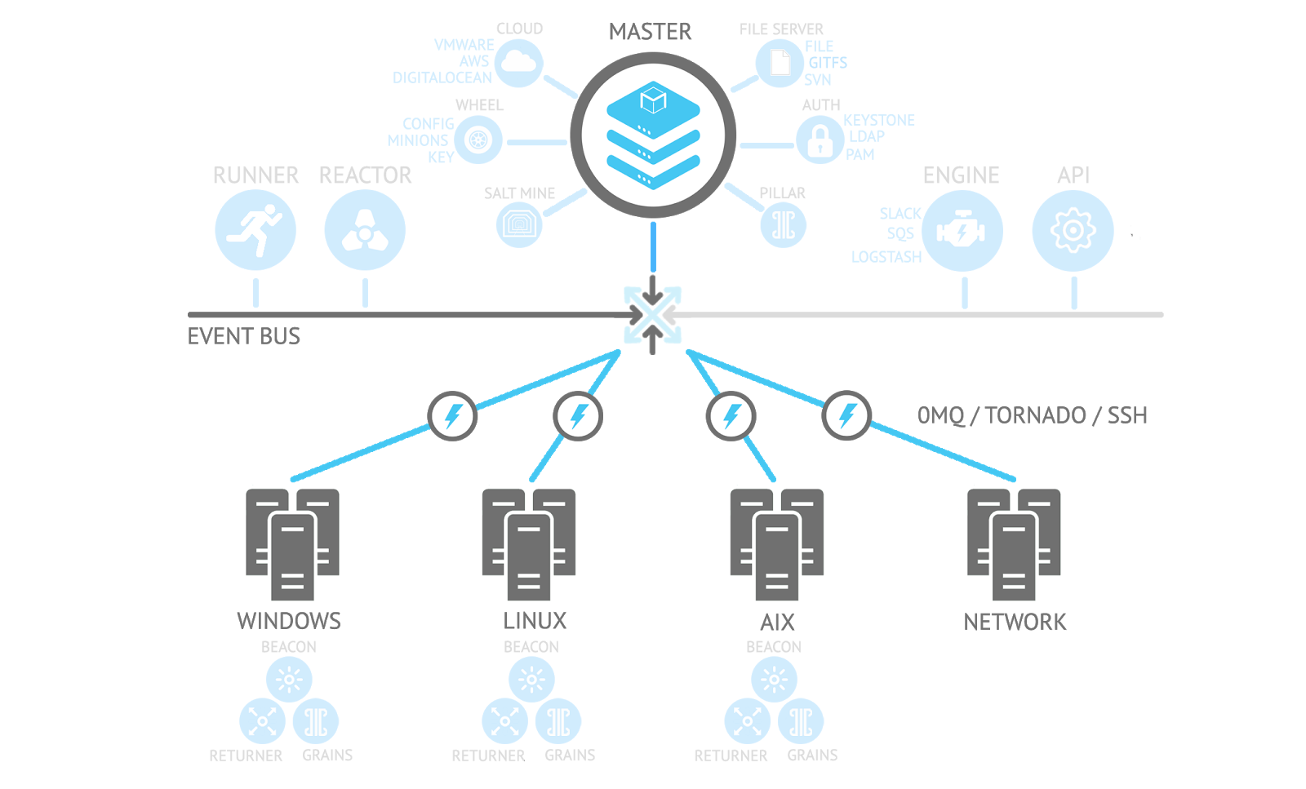
Notes:
So when you take another look at this diagram, the core functionality is what you see here (click for animation)
A master with a number of subscribers, and an event bus for communicating results back up to the master.

Slide 7
Communication
A Minion connects to the master on 2 TCP ports
  4505 (Publish interface)
    Jobs are received over this connection
  4506 (Return port)
    Results are sent back to master over this connection
    Also used by Minions to ask the master to do things (fileclient requests, etc.)
ZeroMQ is the default transport
Notes:
No need to open firewall ports on each Minion, they just need to be able to reach these two ports on the master.

Slide 8
Getting Started
Visit https://repo.saltstack.com/ for instructions on adding the SaltStack repo to your machines
Install the salt-master package on the Master, and the salt-minion package on the machine(s) you want to manage (a.k.a. Minions)
  A master can also run a salt-minion daemon
In /etc/salt/minion, use the master config parameter to tell the Minion how to find the master (e.g. master: host_or_ip_address)
Start the salt-master and salt-minion daemons, and use the salt-key command on the Master to accept key exchange requests from Minions.
Notes:
Switch to terminal to demo salt-key, and mention that we are using docker containers for this demo. Also, before accepting the key, start up the state.event runner to display the events as they are being received by the master.
Before switching slides, make sure to demo a few commands (test.ping, pkg.install, etc.)

Slide 9
Lifecycle of a Remote Execution Job
Target is resolved
Job is published to matching Minions
Master receives results
Results are stored in the job cache (and when using the Salt CLI, written to the console)
Notes:
“So that’s how the core functionality of Salt works” (switch slide)

Slide 10
Functionality Built upon Remote Execution
Configuration management
Orchestration
Pluggable fileserver (serves from Master’s local filesystem, git, s3, etc.)
Event-driven execution
Proxy Minions (leverage web APIs to allow Salt to configure network switches and other hardware)
Cloud drivers to manage VMs on AWS, DigitalOcean, Azure, Linode, etc.
Lots more
Notes:
“By no means an exhaustive list”
Proxy minions allow you to designate a minion that can reach a supported device over the network as the proxy host for that device. The device then appears from the perspective of the master to be its own separate Minion.
I won’t be covering all of these tonight, in particular I’ll be focusing a lot on the event bus and event-driven execution.

Slide 11
Configuration Management
foo:
service.running:
- enabled: True
- watch:
- file: /etc/foo.conf
file.managed:
- name: /etc/foo.conf
- source: salt://foo/files/foo.conf
- mode: 600
- user: foo
- group: foo
- require:
- pkg: base_pkgs
base_pkgs:
pkg.installed:
- pkgs:
- foo
- bar
- baz: 1.2-3.el7
These are called states, because they ensure that something is in a given state; they are organized in files ending in .sls.
States are idempotent; no action is taken when changes are not required
Configuration is done in easy-to-read YAML
Everything renders down to a Python dictionary, so the top-level keys must be unique
Each state has a name argument, and when not specified, the top-level key (also called the “ID declaration”) is passed in its place
Requisites can be used to control order of execution
  require will keep a state from running until (and unless) the required state(s) finish successfully
  watch is like require, but is only implemented for some states, and provides additional functionality (in this example, it would restart the service when the watched file is changed)
Notes:
Demo time! Show first the users and then the users-jinja SLS files.

Slide 12
The Event Bus
Many different kinds of Minion-to-Master communication are performed via events
  Key exchange and Minion authentication
  Minion startup/reconnect
  Returning job results
Master also fires events to the bus (information about published jobs, fileserver updates, etc.)
salt-run state.event pretty=True is the easiest way to visualize the events

Slide 13
The Event Bus
Events from external sources can be added to the event bus using two extendable systems
Beacons – Feed information from Minions to event bus
  Examples: inotify (filesystem changes), wtmp/btmp (logins), etc.
Engines – Can run on either the Master or Minion, creating long-running processes that allow other systems to interact with Salt. Engines can fire events onto the bus, but can also do other things, such as integrating with chat services (Slack, HipChat, IRC).
Notes:
The inotify beacon uses python-inotify and libinotify
The Slack engine (remember to mention the upcoming demo) uses slackclient
Remember to mention the wtmp/btmp beacon and slack engine demos as well
“So, we are generating these events… what can we do with them?”

Slide 14
The Reactor
Watches bus for events with tags matching configured patterns, and takes actions based on them
Combined with events generated by normal operation, as well as beacons, engines, and even ones manually fired, allows Salt to be used for event-driven execution
Notes:
Switch to terminal before leaving this slide, to look at reactor configurations, and then demo the reactions configured there (failed states, logins)
Make sure to mention that the wtmp beacon includes more specific functionality that lets you send events only during certain hours of the day, and can also filter by group instead of user
Also, mention that there is another beacon which can log shell commands, but it requires strace and doesn’t work with the docker setup I’m using for the demo

Slide 15
Salt API
Rest API which allows other systems to interact with the Salt Master
  CherryPy, Tornado, and WSGI netapi modules exist, with the CherryPy module (rest_cherrypy) the most mature/full-featured
  rest_cherrpy will return JSON by default, but this can be changed by setting a different MIME type in an Accept header.
To use, add the appropriate configuration to the Master and start the salt-api service

Slide 16
Salt API (rest_cherrypy)
rest_cherrypy:
port: 8000
ssl_crt: /etc/pki/tls/certs/localhost.crt
ssl_key: /etc/pki/tls/certs/localhost.key
external_auth:
pam:
alice:
- .*
bob:
- 'web*':
- test.*
- network.*
This requires a TLS keypair to be generated. If you don’t have one, you can run the following command on the master (requires PyOpenSSL as well as the salt-minion package to be installed):
  salt-call --local tls.create_self_signed_cert
At least one external_auth system must be configured to send commands to the API
  This example uses PAM on the Master
  Alice has access to run any command on any Minion, while Bob is limited to a subset of functions on Minions beginning with web*
Notes:
Break briefly to show the configuration used on the demo master, and make sure to mention that this demo will use the “auto” eauth plugin which always returns a successful login attempt. This is used merely for testing/demonstration and should obviously not be used in production.

Slide 17
Salt API (rest_cherrypy)
$ curl -sSk https://saltmaster.tld:8000/login \
-H 'Accept: application/x-yaml' \
-d username=alice \
-d password=correcthorsebatterystaple \
-d eauth=pam
return:
- eauth: pam
expire: 1531225168.056414
perms:
- .*
start: 1531181968.056414
token: b0c9fa780f9a0b1f1605ad795101f028c7b8e8e3
user: alice
A successful login will produce a token, which must then be passed in all POSTs which hit one of the other endpoints, via an X-Auth-Token header
Notes:
“Now that we have our token, we can run the Salt commands that our external auth has granted the saltdev user permission to run.” (switch slide)

Slide 18
Salt API (rest_cherrypy)
$ curl -sSk https://saltmaster.tld:8000 \
-H 'X-Auth-Token: b0c9fa780f9a0b1f1605ad795101f028c7b8e8e3' \
-d client=local \
-d tgt='*' \
-d fun=test.ping
{"return": [{"chipy-ubuntu18": true, "chipy-cent7": true, "chipy-arch": true}]}
$ curl -sSk https://saltmaster.tld:8000 \
-H 'X-Auth-Token: b0c9fa780f9a0b1f1605ad795101f028c7b8e8e3' \
-H 'Accept: application/x-yaml' \
-d client=local \
-d tgt='*' \
-d fun=test.ping
return:
- chipy-arch: true
chipy-cent7: true
chipy-ubuntu18: true
To run a Salt command, the data you post must include the client and fun (function) parameters, as well as any other params accepted by that client
The local client is used to run remote execution functions, and requires a target (tgt), and optionally a tgt_type (grain, pcre, etc.)
These two examples show how the Accept header can be used to alter the format of the return data
Positional arguments to the function go in an arg key which contains a list of args, keyword arguments go in a kwarg key which contains a dictionary
  Using curl, this is best done using a Content-type header of application/json

Slide 19
Salt API (rest_cherrypy)
$ curl -sSk https://saltmaster.tld:8000/hook/foo/bar \
-H 'X-Auth-Token: b0c9fa780f9a0b1f1605ad795101f028c7b8e8e3' \
-H 'Content-type: application/json' \
-d '{"hello": "world"}'
{"success": true}
The /hook​ endpoint can be used to fire events onto the event bus
This example would fire an event with a tag of salt/netapi/hook/foo/bar. The data in the event would contain a headers key containing the response headers, and a post key containing the data posted to the API.
A return of {“success”: true} lets us know that the result was a 200 OK.

Slide 20
Outputters
The Salt CLI supports a number of different output formats
The default outputter for most functions is one which recurses into the return data and provides a nicely formatted representation of the data structure
Other outputters include json, yaml, pprint, as well as one which nicely formats the dictionary returned when states are run
Notes:
Make sure to demonstrate several outputters, as well as showing how state return data can be displayed using different outputters

Slide 21
Returners
Returners send a copy of the return data from a job to an alternate destination
This can be used to send them to databases, SMTP, SMS (via Twilio), messaging services, monitoring services such as Nagios and Zabbix, etc.
Specified by using the --returner CLI flag when running Salt
Multiple returners can be used (comma-separated) in a single command
Notes:
Demo the Slack returner here, and this will be the last slide before we wrap up with a SaltConf pitch.

Slide 22

Notes:
Our 5th annual user conference
2nd year in a row at the Salt Palace Convention Center
Early bird pricing available through Aug. 3https://saltconf.com/register
I’ll be doing a talk on my development workflow (debugging, using docker to test as I write code, etc.)

Slide 23
THANK YOU!
Slides and config files at https://github.com/terminalmage/talks
Come say “Hi!” in our community Slack!

