Slide 1

FINAL YEAR PROJECT PRESENTATION
ON
“PREDICTION OF PARKINSON'S DISEASE BASED ON SPIRAL AND WAVE DRAWINGS USING DEEP LEARNING AND EXPLAINABLE ARTIFICIAL INTELLIGENCE (EXAI)”
BY
Mr. Wakhare Narendra Digambar
Mr. Lamkhade Akshay Bhasker
Mr. Khairnar Prasad Vinod
Mr. Gupta Smaksh Dheeraj
Under Guidance of
Prof. S. C. Deshmukh
DEPARTMENT OF INFORMATION TECHNOLOGY
AMRUTVAHINI COLLEGE OF ENGINEERING, SANGAMNER
A/P: GHULEWADI, SANGAMNER, AHMEDNAGAR, PIN - 422608
YEAR 2022-23

Slide 2
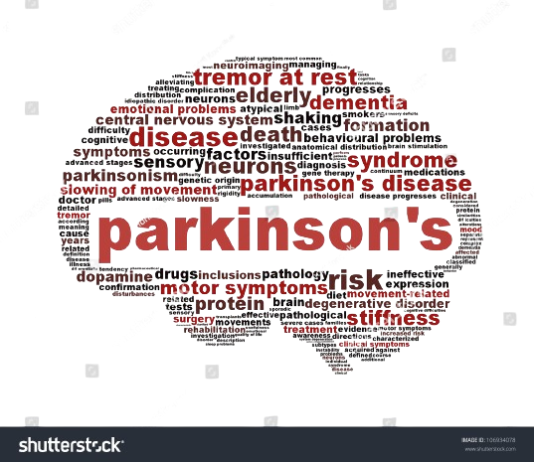
PROBLEM STATMENT
“PREDICTION OF PARKINSON'S DISEASE BASED ON SPIRAL AND WAVE DRAWINGS USING DEEP LEARNING AND EXPLAINABLE ARTIFICIAL INTELLIGENCE (EXAI)”
PREDICTION OF PARKINSON’S DISEASE THROUGH EXAI

Slide 3
INTRODUCTION
Overview of Parkinson’s Disease (PD): - PD is a rapidly growing neurodegenerative disorder primarily affecting the elderly, with no known cure. - Early diagnosis is crucial for improving the quality of life in PD patients.
Challenges in Early Diagnosis: - Early-stage diagnosis of PD is difficult, complicating timely treatment. - Current diagnostic methods lack transparency and interpretability, which are vital in clinical settings.
Importance of Explainable AI (EXAI) in Healthcare: - EXAI enhances transparency in predictive models, allowing clinicians to trust and understand AI-driven decisions. - Critical for improving clinical practices and patient outcomes.
Proposed Solution: Hybrid Deep Learning Model: - Introduction of a novel hybrid deep transfer learning model combining VGG19 Net and Google Net. - Focus on distinguishing PD patients from healthy individuals with high accuracy.
Significant Results and Model Interpretation:- Achieved 98.45% accuracy using the VGG19-INC model, surpassing other pre-trained models. - Explainable AI techniques, such as LIME, are employed to interpret the model’s predictions, ensuring trustworthiness and transparency.
PREDICTION OF PARKINSON’S DISEASE THROUGH EXAI

Slide 4
MOTIVATION
The motivation for this study stems from the urgent need for early diagnosis of Parkinson's Disease (PD).
A rapidly growing neurodegenerative disorder with no cure.
Traditional diagnostic methods are often costly, inconvenient, and lack transparency, especially in underdeveloped regions.
By leveraging advancements in IT and AI, this research aims to enhance diagnostic accuracy through the analysis of digitized drawing tasks using a hybrid deep learning model.
The incorporation of Explainable AI (EXAI) ensures that the model's predictions are transparent and trustworthy, making it a valuable tool for improving clinical practices and patient outcomes.
PREDICTION OF PARKINSON’S DISEASE THROUGH EXAI

Slide 5
PURPOSE
The purpose of this project is to develop and evaluate machine learning models for the early detection and diagnosis of Parkinson's Disease (PD).
Using spiral and wave drawing data. By extracting kinematic and spatio-temporal features from digital drawings collected from both PD patients and healthy individuals.
The project aims to identify significant patterns that can differentiate between the two groups. The study utilizes classical machine learning algorithms such as Logistic Regression, Random Forest, Support Vector Classification, and K-Nearest Neighbors,
As well as deep learning techniques like the VGG19-INC hybrid model, to improve diagnostic accuracy.
The project explores Explainable AI (XAI) methods, particularly LIME, to make the models more transparent and interpretable, thereby enhancing their trustworthiness in medical applications.
PREDICTION OF PARKINSON’S DISEASE THROUGH EXAI

Slide 6
SCOPE
Early PD Diagnosis Enhancement:- Improve the accuracy of early Parkinson’s Disease diagnosis, which is vital for patient quality of life. Utilize deep learning models to distinguish between PD patients and healthy individuals.
Hybrid Deep Learning Models:- Develop a hybrid model combining VGG19 Net and Google Net. Validate performance against other pre-trained models like AlexNet and ResNet-50.
Explainable AI (EXAI) Integration:- Use Explainable AI techniques like LIME to enhance transparency and interpretability of model predictions.
Digitized Drawing Analysis:- Analyze static and dynamic spiral drawings from PD patients using digitized tablets. Extract kinematic variables to accurately classify PD patients.
Clinical Impact:- Highlight the model’s potential for clinical implementation, particularly in resource-limited settings. Demonstrate high classification accuracy and reliable, interpretable outcomes for healthcare practitioners.
PREDICTION OF PARKINSON’S DISEASE THROUGH EXAI

Slide 7
OBJECTIVE
The image presents a comprehensive approach to diagnosing Parkinson's Disease using spiral and wave drawing data from patients and healthy individuals. The process begins with data acquisition and the extraction of kinematic and spatio-temporal features, such as stroke speed and acceleration, to enhance diagnostic capabilities.
The next step involves feature engineering to develop additional features like normalized radial velocity. Classical machine learning models, including Logistic Regression, Random Forest, SVC, and KNN, are implemented and fine-tuned for optimal performance. A hybrid deep learning model, VGG19-INC, is also developed using transfer learning techniques to improve classification accuracy.
The models are evaluated using metrics like accuracy, precision, recall, and F1-score, with a focus on comparing the performance of classical machine learning against the deep learning approach. To ensure transparency, Explainable AI (XAI) techniques, particularly LIME, are applied to interpret the predictions of the deep learning models.
Finally, the approach demonstrates the potential for early diagnosis of Parkinson's Disease, validating the robustness and generalizability of the models across different drawing tests and patient populations.
PREDICTION OF PARKINSON’S DISEASE THROUGH EXAI

Slide 8
PROPOSED WORK
Data Acquisition & Collection:
Dataset Source: Parkinson’s Disease spiral drawing dataset from the UCI Machine Learning Repository.
Participants: 25 Parkinson’s Disease Patients (PDP) and 15 healthy individuals.
Tests Conducted:
Static Spiral Test (SST): Retracing a static Archimedean spiral.
Dynamic Spiral Test (DST): Retracing a blinking spiral, testing memory and pause time.
Stability Test on Certain Point (STCP): Drawing circles without touching the screen to test hand stability.
Feature Engineering:
Kinematic Features:
Duration of static and dynamic spirals.
Stroke count, velocity, acceleration, and jerk.
Radial Velocity and Normalized Radial Velocity (mean and standard deviation).
PREDICTION OF & PARKINSON’S DISEASE THROUGH EXAI

Slide 9
Spatio-temporal Features:
Number of changes in velocity and acceleration.
On-surface and in-air time measurements for SST and DST.
Model Selection & Parameter Tuning:
Classifiers Used:
Logistic Regression with lbfgs solver for handling small datasets with L2 regularization.
Random Forest Classifier for ensemble learning with default parameters.
Support Vector Classification (SVC) with rbf kernel.
K-nearest neighbors (KNN) with k=5.
Deep Learning Approach:
Hybrid Model: Combines VGG19Net and GoogleNet for deep transfer learning.
VGG19 Net: Extracts basic features from spiral drawings.
Inception Modules: Extracts high-dimensional features.
Explainable AI (EXAI): Utilizes LIME to make the deep learning model's predictions interpretable and transparent.
PREDICTION OF PARKINSON’S DISEASE THROUGH EXAI

Slide 10
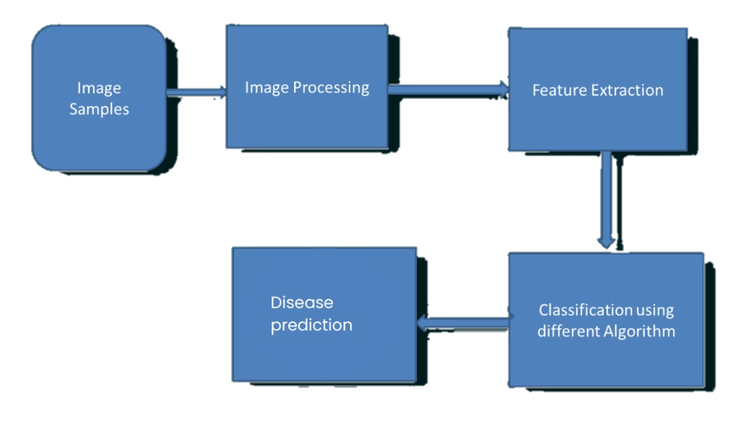
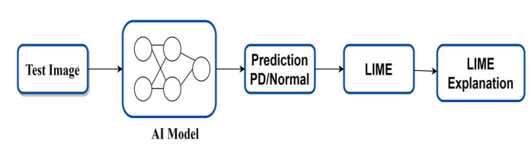
SYSTEM ARCHITECTURE
PREDICTION OF & PARKINSON’S DISEASE THROUGH EXAI

Slide 11
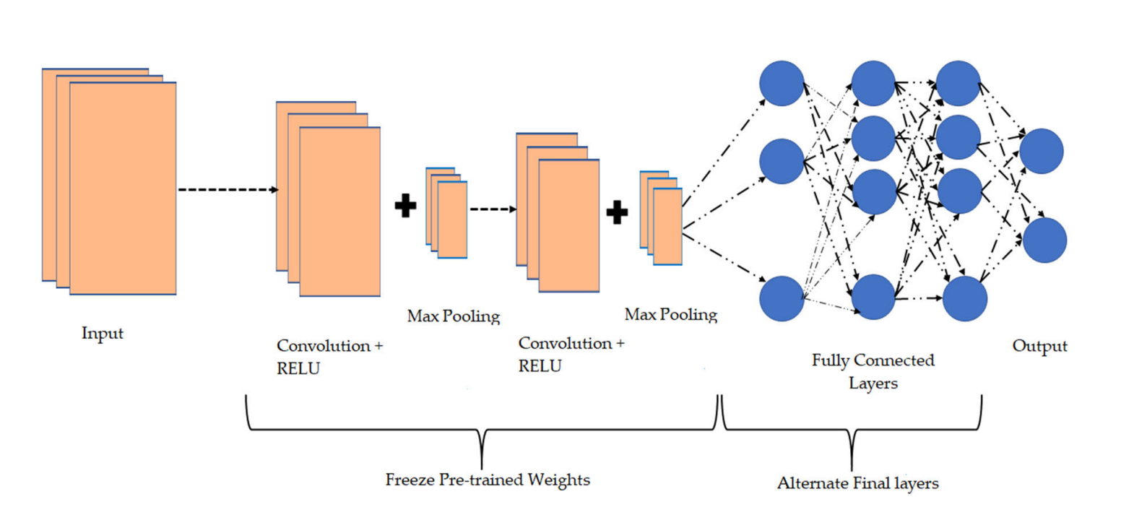
ARCHITECTURE
Block diagram or Algorithm
PREDICTION OF & PARKINSON’S DISEASE THROUGH EXAI

Slide 12
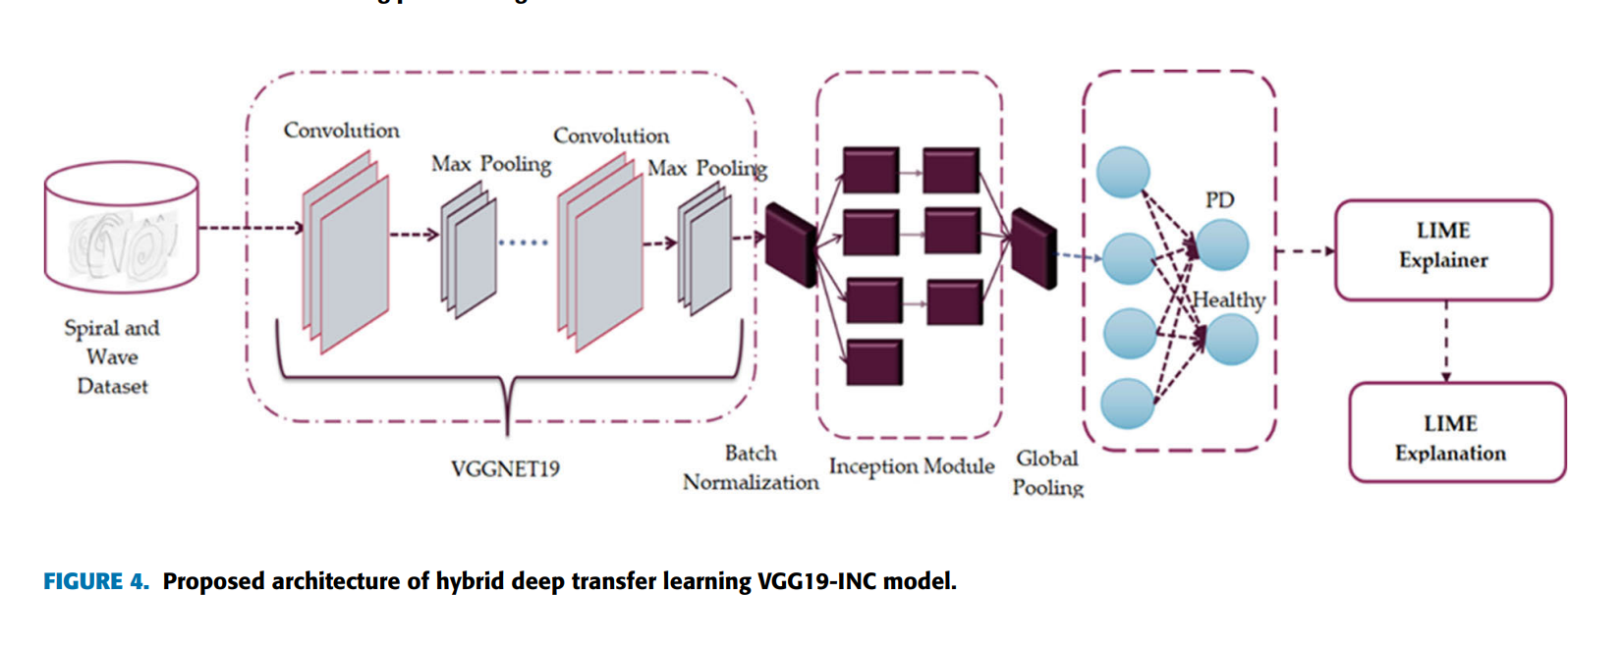
ARCHITECTURE
PREDICTION OF & PARKINSON’S DISEASE THROUGH EXAI

Slide 13
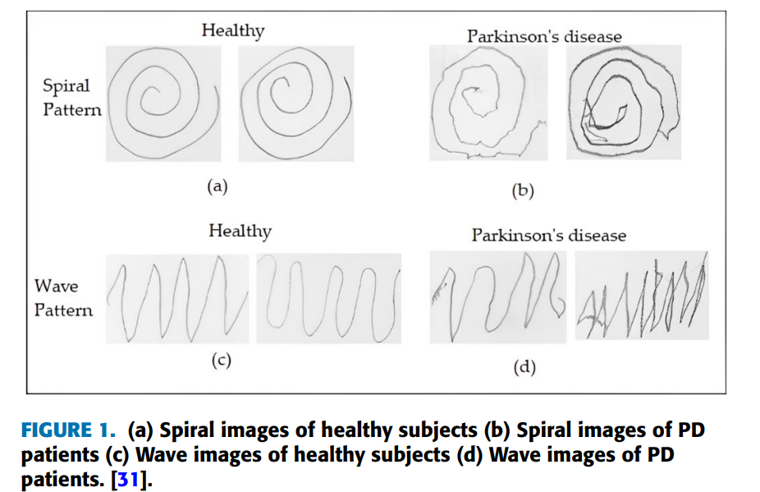
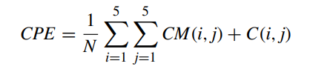
WORKING
PREDICTION OF & PARKINSON’S DISEASE THROUGH EXAI

Slide 14
LITERATURE SURVEY
Sr. No | Name of Author | Paper Name | Description
[1] | S. Saravanan Kannan Ramkumar K. Narasimhan Subramaniyaswamy Vairavasundam Ketan Kotecha Ajith Abraham | Explainable Artificial Intelligence (EXAI) Models for Early Prediction of Parkinson’s Disease Based on Spiral and Wave Drawings | This study enhances early Parkinson's disease diagnosis using a hybrid deep learning model combining VGG19 and Google Net, achieving 98.45% accuracy. To ensure transparency, Explainable AI (EXAI) methods like LIME are used to clarify how the model makes its predictions, improving trust in its clinical application.
[2] | Megha Kamble , Prashant Shrivastava, Megha Jain | Digitized spiral drawing classification for Parkinson’s disease diagnosis | The study uses digitized spiral drawings to differentiate Parkinson’s patients from healthy individuals. By analyzing drawing patterns and applying machine learning, a 91% accuracy was achieved in classification, highlighting its potential for early PD diagnosis.
PREDICTION OF PARKINSON’S DISEASE THROUGH EXAI

Slide 15
LITERATURE SURVEY
Sr. No | Name of Author | Paper Name | Description
[3] | Maya Shelke , Gitanjali Mote , Nihar Madhaw Ranjan | Detection of Parkinson's Disease using Machine Learning Algorithms and Handwriting Analysis | This study proposes a system for early detection of Parkinson's disease using handwriting analysis, specifically spiral and wave drawings. The system utilizes a histogram of oriented gradients for feature extraction and a random forest classifier for diagnosis. The model achieved 86.67% accuracy with spiral drawings and 83.30% with wave drawings.
[4] | Megha Kamble , Prashant Shrivastava, Megha Jain | Digitized spiral drawing classification for Parkinson’s disease diagnosis | The study uses digitized spiral drawings to differentiate Parkinson’s patients from healthy individuals. By analyzing drawing patterns and applying machine learning, a 91% accuracy was achieved in classification, highlighting its potential for early PD diagnosis.
PREDICTION OF PARKINSON’S DISEASE THROUGH EXAI

Slide 16
REFERENCES
[1] R. Brausei,a. Ünlü1, K.Krakow2. "Handwriting Analysis For Diagnosis And Prognosis Of Parkinson's Disease."Preprint Of The Contribution To The Vii. Int. Symp. Biological And Medical Data Analysis Isbmda 2006,
[2] J. Cancela, S. V. Mascato, D. Gatsios, G. Rigas, A. Marcante, G. Gentile, R. Biundo, M. Giglio, M. Chondrogiorgi, R. Vilzmann, S.Konitsiotis, A. Antonini, M. T. Arredondo, D.I. Fotiadis, Senior Member, Ieee On Behalf Of The Pd_manager Consortium."Monitoring Of Motor And Non-motor Symptoms Of Parkinson's "Disease Through A Mhealth Platform.978-1-4577-0220-4/16/$31.00 ©2016 Ieee
[3] I.E. Moudden, M. Ouzir, S. Elbernoussi."Automatic Speech Analysis In Patients With Parkinson's Disease Using Feature Dimension Reduction. "Icmre 2017, February 8-12, 2017, Paris, France.© 2017 Acm. Isbn 978-1-4503-5280- 2/17/02...$15.00
PREDICTION OF & PARKINSON’S DISEASE THROUGH EXAI

Slide 17
Parkinson’s disease (PD) is a rapidly growing neurodegenerative disorder primarily affecting the elderly.
Parkinson's disease is one of the most common type of dementia.
Diagnosing Parkinson's Disease (PD) challenging due to symptom overlap with other conditions
Explainable Artificial Intelligence (EXAI) Models for Early Prediction of Parkinson’s Disease Based on Spiral and Wave Drawings.
Spiral drawing is a skilled and complex coordinated motor activity. Therefore, it is treated as sensitive motor assessment. Motor rating scale and its subscale Unified Parkinson’s disease rating scale (UPDRS-III) is the most widely used and accepted rating scale in Parkinson’s disease.
Spiral And Wave drawing Analysis for Early Detection of Parkinson’s Disease.
PREDICTION OF PARKINSON’S DISEASE THROUGH EXAI

